Slide 1
Test Scores/EOC
Florida User Group 2024-2025
Notes:
This session will cover Test Builder setup affecting state reporting, EOC, and Date Passed setup and troubleshooting steps.

Slide 2
Agenda
Recent Updates
Test Builder Setups
Assessment Details
Troubleshooting Tips
Notes:
EOC Reminders: Course and tests are linked
Grading – EOC method
-options
Mass Change Selected Grade Mark has been updated to include EOC test grade bucket

Slide 3
Recent Updates
PR 5981953 - The Date Passed logic has been updated to find the earliest passing combination when averaging ACT test scores.
PR 3711096 - Add limit access to Assessment Details
PR 6014735 - Updated logic for District Defined Average/Summation to work across two versions of the same test (using the same State Code and same Subject Codes on each test).
Notes:
PR 5981953 - The Date Passed logic has been updated to find the earliest passing combination when averaging ACT test scores. Previously we were only using the highest passing score average instead of the earliest the student passed.
PR 3711096 – Add limit access to Assessment Details. New security line item

Slide 4
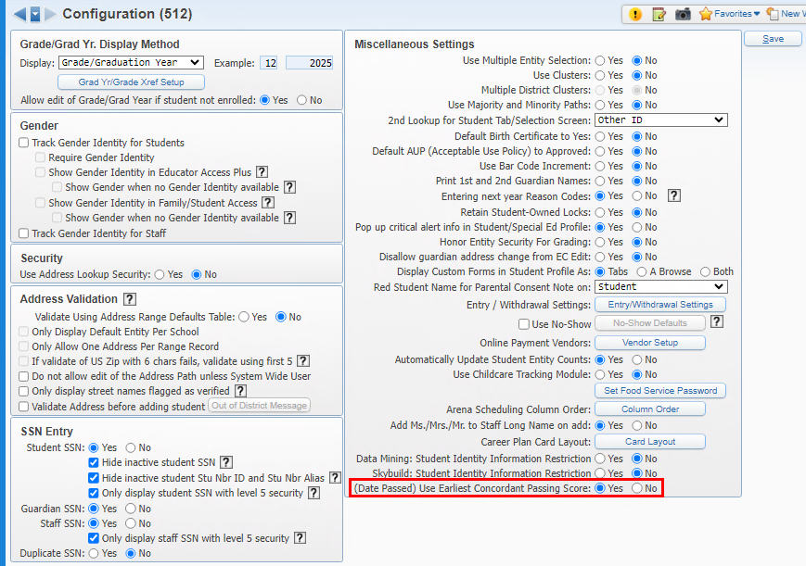
PR 5981953 - The Date Passed logic has been updated to find the earliest passing combination when averaging ACT test scores.
District is using Student Management Configuration option(Date Passed) Use Earliest Concordant Passing Score set to Yes.
Product Setup > Skyward Contact Access > Student Management > Configuration
Notes:
T-Score Setup – this is only used for legacy tests and should not be setup up.
Score Ranges Override - EOC score range overrides have been added to EOC Details in Test Builder to accommodate the provisional scores that affect Algebra 1 and Geometry passing scores. NOTE: This area is no longer needed to specify different score ranges as the state had added new test score subject content codes to identity tests using provisional score ranges.

Slide 5
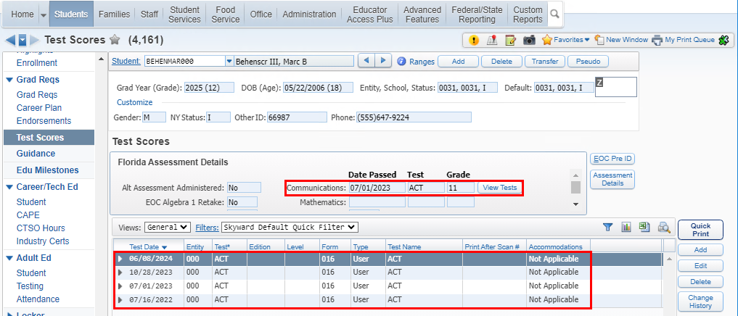
PR 5981953 - The Date Passed logic has been updated to find the earliest passing combination when averaging ACT test scores.
Student took the ACT test 4 times. When the average is coming from more than one test, the View Tests button will display on the screen.
Web Student Management > Students > Student Profile > Test Scores
Notes:
T-Score Setup – this is only used for legacy tests and should not be setup up.
Score Ranges Override - EOC score range overrides have been added to EOC Details in Test Builder to accommodate the provisional scores that affect Algebra 1 and Geometry passing scores. NOTE: This area is no longer needed to specify different score ranges as the state had added new test score subject content codes to identity tests using provisional score ranges.

Slide 6
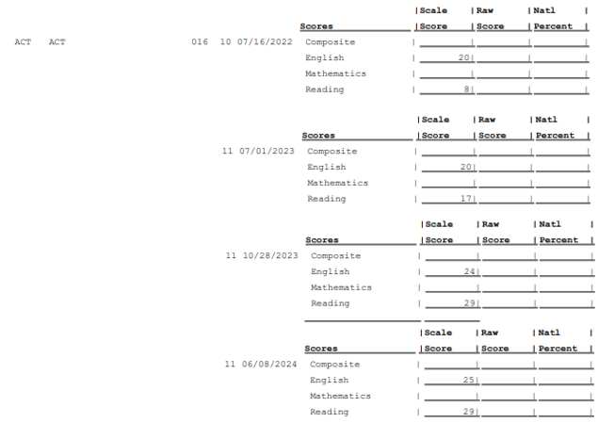
PR 5981953 - The Date Passed logic has been updated to find the earliest passing combination when averaging ACT test scores.
The student’s earliest passing average came from 2 tests.
Web Student Management > Office > Curriculum & Assessment > Test Scores > Test Builder > EOC Details
Notes:
T-Score Setup – this is only used for legacy tests and should not be setup up.
Score Ranges Override - EOC score range overrides have been added to EOC Details in Test Builder to accommodate the provisional scores that affect Algebra 1 and Geometry passing scores. NOTE: This area is no longer needed to specify different score ranges as the state had added new test score subject content codes to identity tests using provisional score ranges.

Slide 7
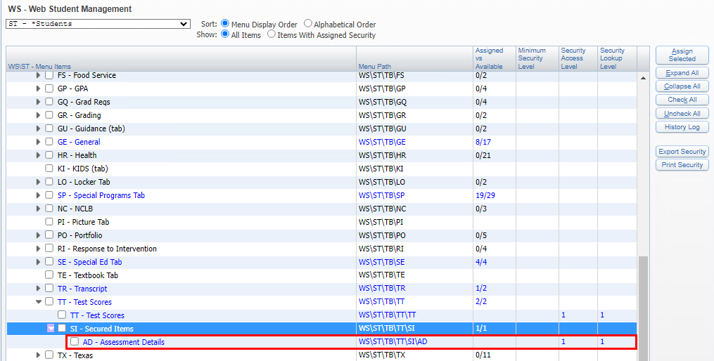
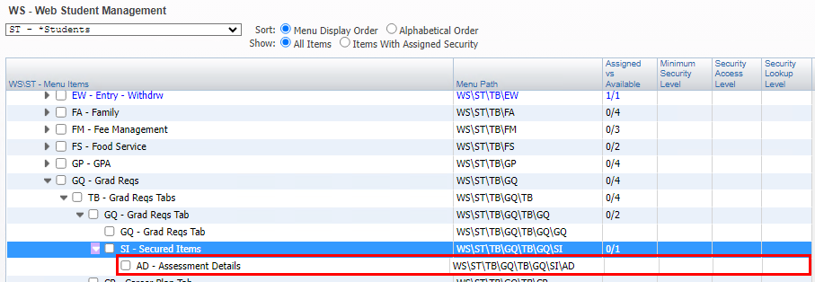
PR 3711096 - Add limit access to Assessment Details
Available in Student Profile:
Test Scores tab
Grad Reqs tab
Product Setup > Skyward Contact Access > Security > Security Groups
Notes:
T-Score Setup – this is only used for legacy tests and should not be setup up.
Score Ranges Override - EOC score range overrides have been added to EOC Details in Test Builder to accommodate the provisional scores that affect Algebra 1 and Geometry passing scores. NOTE: This area is no longer needed to specify different score ranges as the state had added new test score subject content codes to identity tests using provisional score ranges.

Slide 8
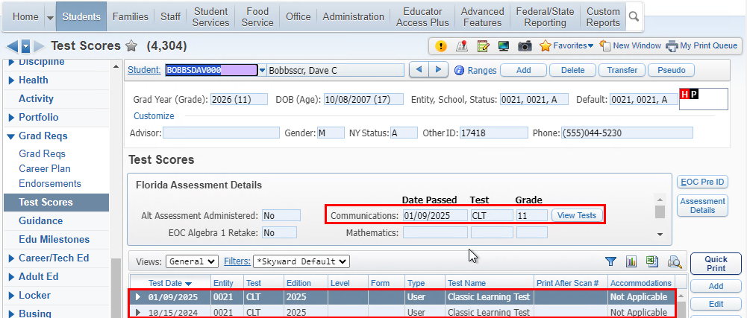
PR 6014735 - Updated logic for District Defined Average/Summation to work across two versions of the same test (using the same State Code and same Subject Codes on each test).
Student took the CLT test 2 times. When the summation of all is using more than one test, the View Tests button will display on the screen.
Web Student Management > Students > Student Profile > Test Scores > Assessment Details
Notes:
T-Score Setup – this is only used for legacy tests and should not be setup up.
Score Ranges Override - EOC score range overrides have been added to EOC Details in Test Builder to accommodate the provisional scores that affect Algebra 1 and Geometry passing scores. NOTE: This area is no longer needed to specify different score ranges as the state had added new test score subject content codes to identity tests using provisional score ranges.

Slide 9
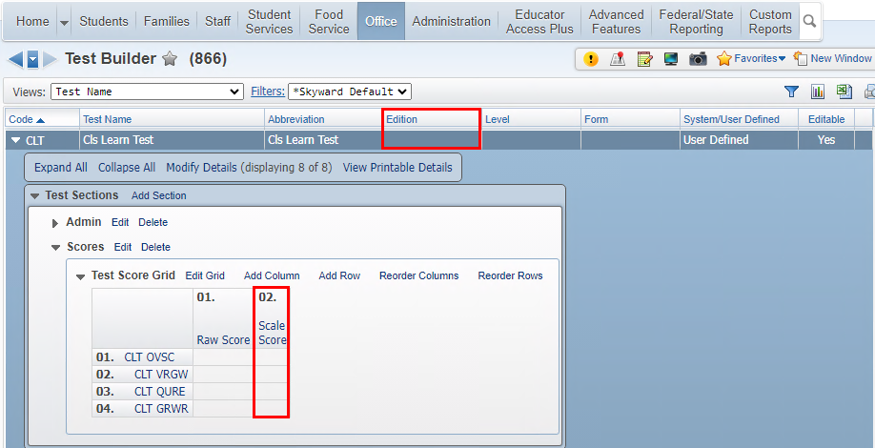
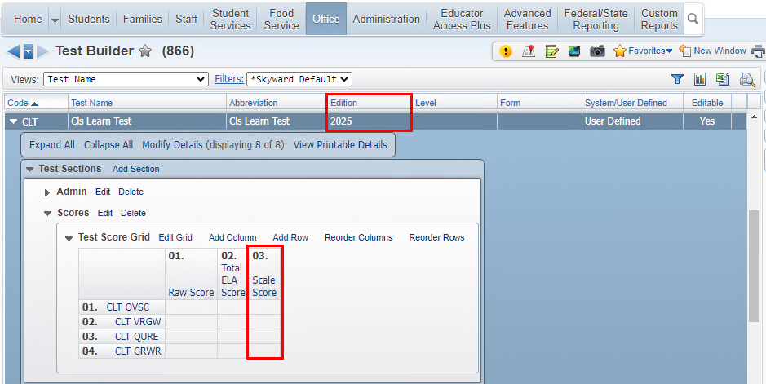
PR 6014735 - Updated logic for District Defined Average/Summation to work across two versions of the same test (using the same State Code and same Subject Codes on each test).
Previously if the scores were coming from different versions of the same test, the system was not averaging across the versions. The different version have the scale score in different locations.
Web Student Management > Office > Curriculum & Assessments > Test Scores > Test Builder
Notes:
T-Score Setup – this is only used for legacy tests and should not be setup up.
Score Ranges Override - EOC score range overrides have been added to EOC Details in Test Builder to accommodate the provisional scores that affect Algebra 1 and Geometry passing scores. NOTE: This area is no longer needed to specify different score ranges as the state had added new test score subject content codes to identity tests using provisional score ranges.

Slide 10
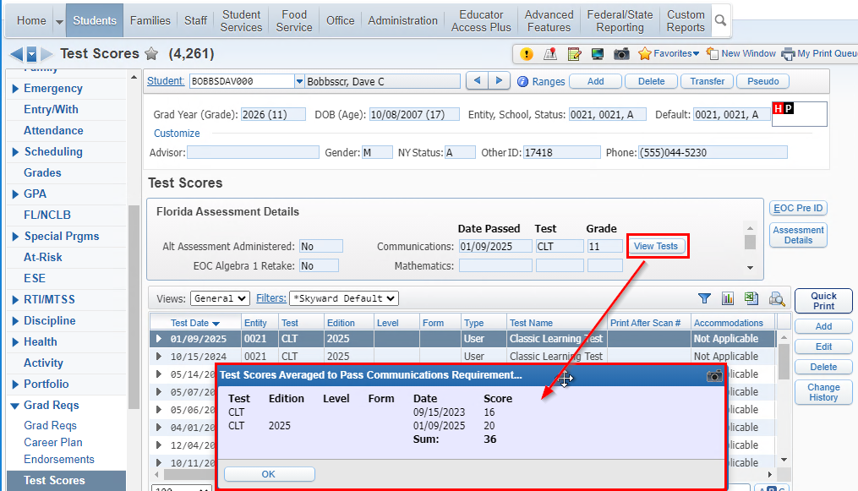
PR 6014735 - Updated logic for District Defined Average/Summation to work across two versions of the same test (using the same State Code and same Subject Codes on each test).
The CLT summation is using scores from both versions of the CLT test.
Web Student Management > Students > Student Profile > Test Scores > Assessment Details
Notes:
T-Score Setup – this is only used for legacy tests and should not be setup up.
Score Ranges Override - EOC score range overrides have been added to EOC Details in Test Builder to accommodate the provisional scores that affect Algebra 1 and Geometry passing scores. NOTE: This area is no longer needed to specify different score ranges as the state had added new test score subject content codes to identity tests using provisional score ranges.

Slide 11
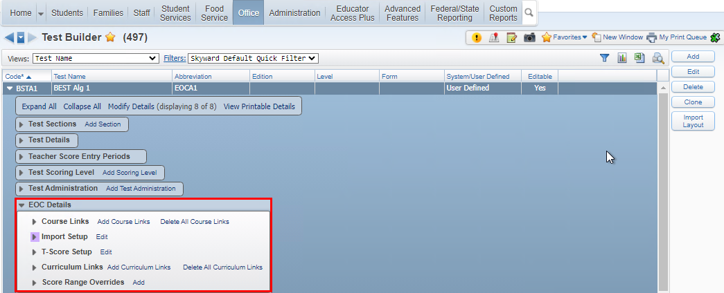
EOC Details
Course Links – be sure to include TR00 courses
Import Setup – used to determine what data us imported, overwritten, what school years for courses to include.
T-Score Setup – this is used only for Legacy tests. Be sure to ask if you are unsure if your district setup needs this.
Curriculum Links – allows you to link courses by using curriculum keys instead of course links.
Score Range Overrides – no longer needed
The following slides will go over the areas under EOC Details.
Web Student Management > Office > Curriculum & Assessment > Test Scores > Test Builder > EOC Details
Notes:
T-Score Setup – this is only used for legacy tests and should not be setup up.
Score Ranges Override - EOC score range overrides have been added to EOC Details in Test Builder to accommodate the provisional scores that affect Algebra 1 and Geometry passing scores. NOTE: This area is no longer needed to specify different score ranges as the state had added new test score subject content codes to identity tests using provisional score ranges.

Slide 12
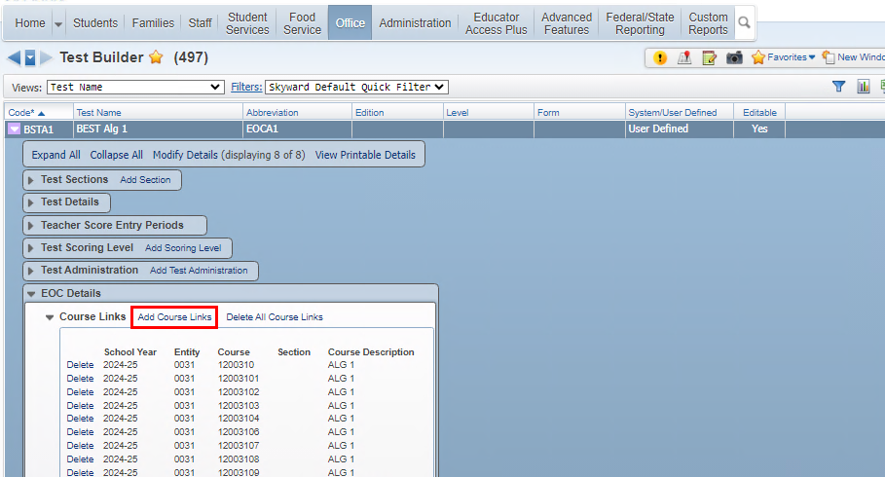
EOC Details
Course Links – be sure to include all possible courses that a student could take or have taken to meet the requirements
If a course is not applying for EOC, make sure the course has been linked to the EOC, this includes courses from TR00, Virtual, and Middle School Courses.
Web Student Management > Office > Curriculum & Assessment > Test Scores > Test Builder > Expand Test > Expand EOC Details
Notes:
T-Score Setup – this is only used for legacy tests and should not be setup up.
Score Ranges Override - EOC score range overrides have been added to EOC Details in Test Builder to accommodate the provisional scores that affect Algebra 1 and Geometry passing scores. NOTE: This area is no longer needed to specify different score ranges as the state had added new test score subject content codes to identity tests using provisional score ranges.

Slide 13
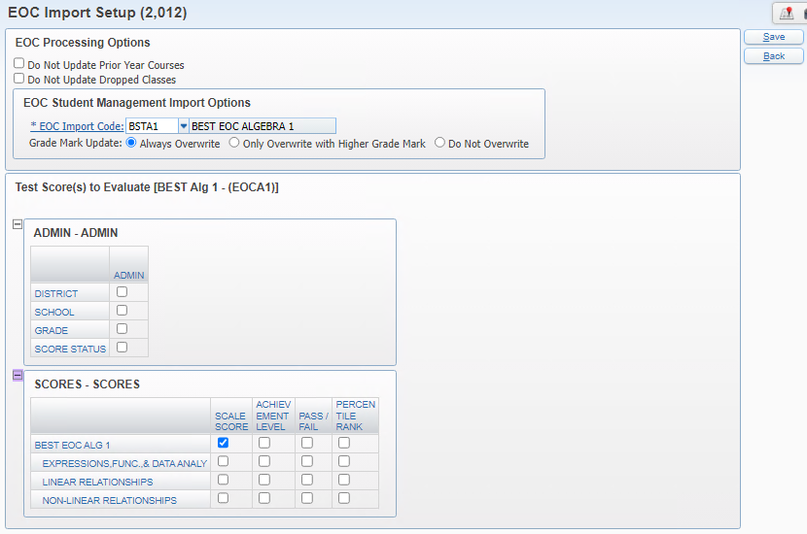
EOC Details
Import Setup – used to determine what data us imported, overwritten, what school years for courses to include.
Import Setup – used when importing test scores to indicate how courses should be processed and where to populate the score.
Web Student Management > Office > Curriculum & Assessment > Test Scores > Test Builder > Expand Test > Expand EOC Details
Notes:
Do not update prior year courses – if set it will only update courses based on year selected in import
Do not update dropped courses – if set it will not update dropped courses
EOC Import Code – this is used to identify the score ranges to grade mark that will be used to populate the EOC Test Grade when the test score is imported.
Grade Mark Update – overwrite options

Slide 14
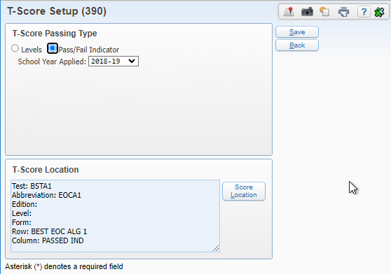
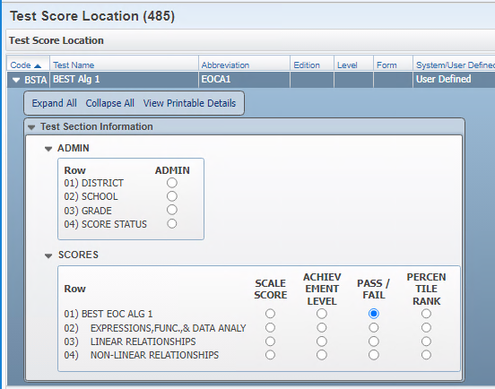
EOC Details
T-Score Setup – this is used only for Legacy tests. Be sure to ask if you are unsure if your district setup needs this.
PR 6011893 – Updates:
1. Allow T-Score Setup to be removed/deleted
2. Add warning message indicating 'This area is for legacy tests and should not be used on new test setup without consulting Skyward'
T-scores should only be used for ‘legacy’ tests. PR 6011893 will be updating this area in a future addendum to add a warning message as well as allow setup to be deleted.
Web Student Management > Office > Curriculum & Assessment > Test Scores > Test Builder > Expand Test > Expand EOC Details
Notes:
PR 2/3/2025 Oct Release Addendum 10 estimated.

Slide 15
EOC Details
Curriculum Links – allows you to link courses by using curriculum keys instead of course links.
Should only be used if ALL courses linked to the curriculum should apply
This area should only be used if ALL courses linked to the selected curriculum keys should apply for this test. If not, then use the Course Links area above.
Web Student Management > Office > Curriculum & Assessment > Test Scores > Test Builder > Expand Test > Expand EOC Details
Notes:
PR 2/3/2025 Oct Release Addendum 10 estimated.

Slide 16
EOC Details
Score Range Overrides – no longer needed
Score Range Overrides were initially added so that different score ranges could be defined for the provisional and cut scores for tests such as Algebra 1. Since the state released separate subject content codes, this area is no longer needed for that setup.
Web Student Management > Office > Curriculum & Assessment > Test Scores > Test Builder > Expand Test > Expand EOC Details
Notes:
PR 2/3/2025 Oct Release Addendum 10 estimated.

Slide 17
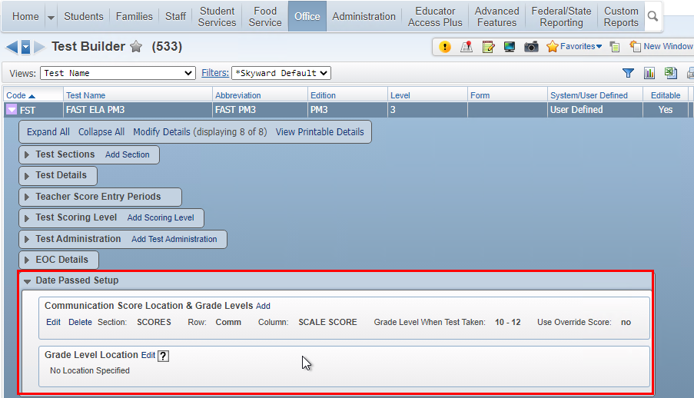
Tests Requiring Date Passed Setup
Select Add to identify score and any override values as needed
If only one score location is selected, the override is tied to that specific score location
Web Student Management > Office > Curriculum & Assessment > Test Scores > Test Builder

Slide 18
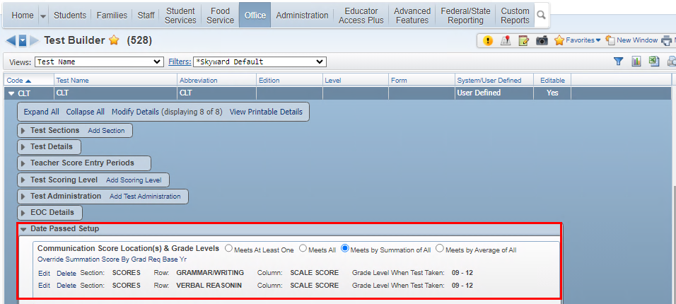
Date Passed Setup options Display based on more than one score location is selected.
When more than one score location is specified, additional options are available
If only one score location is selected, then these options do not display
Web Student Management > Office > Curriculum & Assessment > Test Scores > Test Builder

Slide 19
Date Passed Setup options for Score Location and Grade Levels
Meets At Least One - Student must have a passing score in one of the score locations.
Meets by Summation of All - Student must have scores from each section that combined have a passing score. Example would be the CLT (Classic Learning Test).
Meets by Average of All - Student must have scores from each section that averaged have a passing score. Example would be the ACT test.
Override Summation/Average Score By Grad Req Base Yr - When one of the new options is selected (Summation or Average), a new Override link appears. With new options, it’s the combination of both lines (either by summing or averaging) that is checked against, so overrides are entered here instead of on each individual record.
Web Student Management > Office > Curriculum & Assessment > Test Scores > Test Builder

Slide 20
Date Passed Setup options
Overrides
Use Score Override Value: Use this option to set the override score value if Grad Req Base Yr does not apply. This option will apply the override score to Grad Req Base Yr of 0000 – 9999.
Web Student Management > Office > Curriculum & Assessment > Test Scores > Test Builder

Slide 21
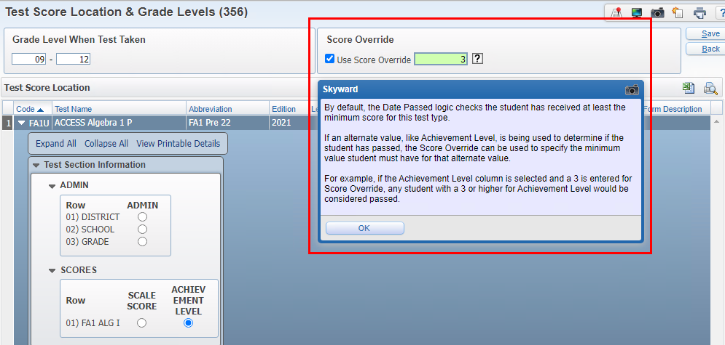
Date Passed setup for FA1 and FA2 must use the Score Override when using the Achievement Level
FA1 & FA2 Date Passed Score Location and Override Setup
Web Student Management > Office > Curriculum & Assessment > Test Scores > Test Builder
Notes:
Example of using the Score Override

Slide 22
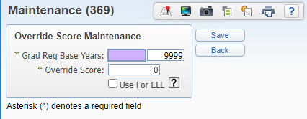
Date Passed Score Location and Override Setup using Grad Req Base Year option
Use Score Override Range: Use this option to set the override score value to only apply to students that fall within Grad Req Base Yr range. This option would be set if the passing override score value could change year to year.
Multiple records may be entered when the grad year ranges do not overlap
For Example: using a local defined test for ELL.
Web Student Management > Office > Curriculum & Assessment > Test Scores > Test Builder

Slide 23
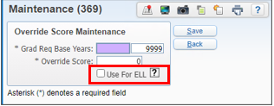
Date Passed Setup options
Overrides – Use for ELL
Use for ELL: When this option is selected, override will only be used for students that have ELL Program record. The override use will be limited to students that have a total time in an ELL Program of less then two years.
Web Student Management > Office > Curriculum & Assessment > Test Scores > Test Builder

Slide 24
Graduation Year Codes for Date Passed ELL Option
The Graduation Year records can be set up at the district level and/or the entity level.
To use the ELL option for the date passed overrides, the student must be in ELL for less that 2 years from their graduation date.
Web Student Management > Office > Grading > Setup > Codes > Graduation Year Codes
Notes:
The logic will look first for an entity level date for the student’s current default entity, and it will use that date if available, otherwise it will use the district level date.
If a record for the student’s graduation year is not available, then this logic will not apply for the student.

Slide 25
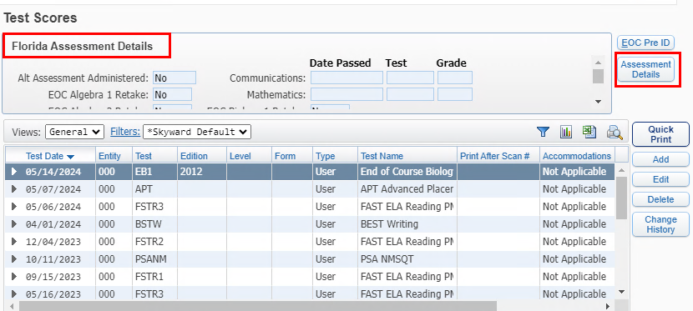
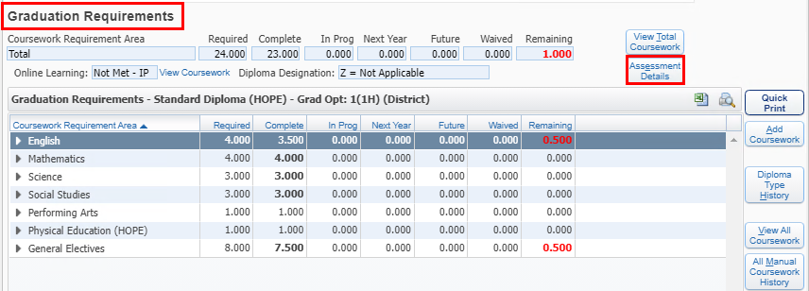
Assessment Details Security Access
Web Student Management > Students > Student Profile > Test Scores – Assessment Details OR Student Profile > Graduation Requirements > Assessment Details
Notes:
The user will see a message on the Assessment Details if there is a test that based on programmed logic would apply but the test is not set up for date passed.

Slide 26
Assessment Details Security Access
New security menu items to Assessment Details
Test Scores tab
Graduation Requirements tab
Requires level 1access to view
Web Student Management > Students > Student Profile > Test Scores – Assessment Details
Notes:
Security Access to the Assessment Details – need at least a level 1 to view only. PR 6015130 fixed the access to the Grad Reqs tab and Test Score tab so a level 1 allows user to view the assessment details button. Came out with Addendum 08.

Slide 27
Assessment Details Information
Messages alert user to setup needed
Web Student Management > Students > Student Profile > Test Scores – Assessment Details
Notes:
The user will see a message on the Assessment Details if there is a test that based on programmed logic would apply but the test is not set up for date passed.

Slide 28
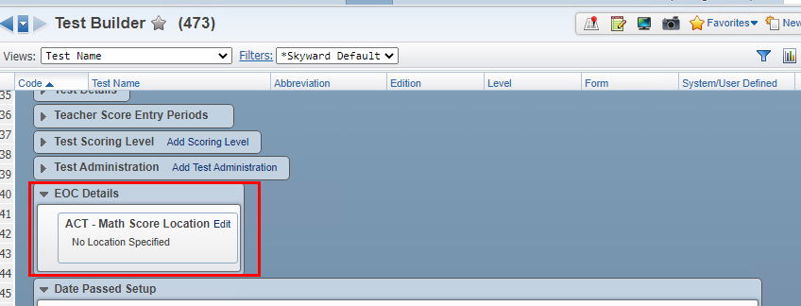
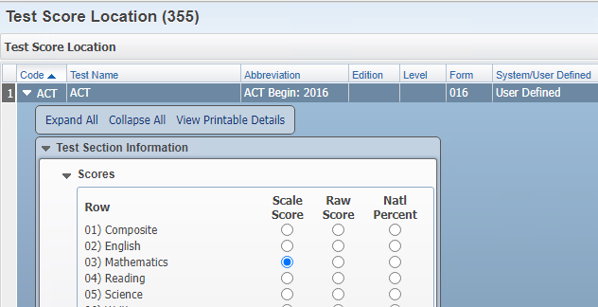
ACT/SAT/PSAT
Web Student Management > Office > Curriculum & Assessment > Test Scores > Test Builder

Slide 29
ACT test is now calculating as a passing test
Warning message is no longer populating
ACT/SAT/PSAT
Web Student Management > Students > Student Profile > Test Scores – Assessment Details

Slide 30
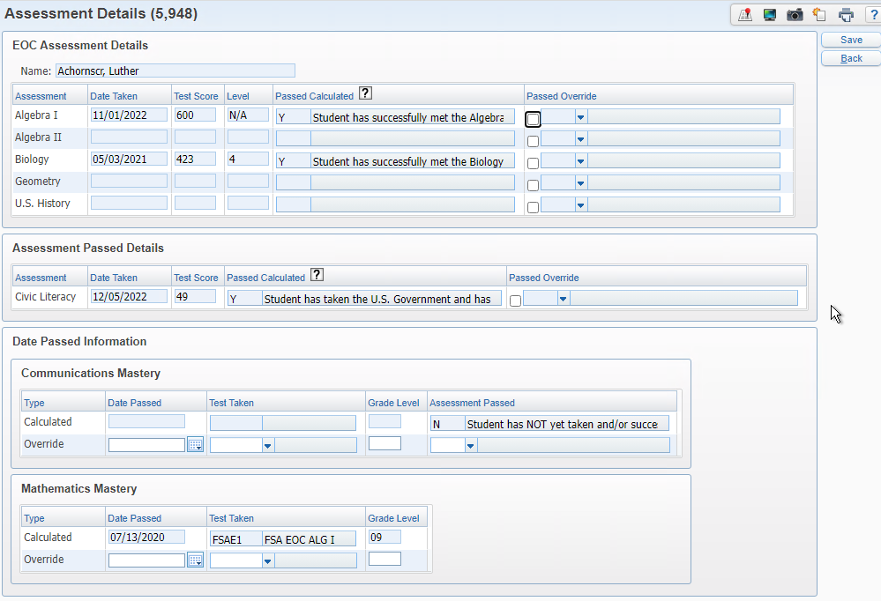
EOC Assessment Details will always populate the highest score, regardless of the test.
Date Passed will always populate the FSA test first and then comparative/concordant scores.
Configuration option to determine how scores populate for the concordant: (Date Passed) Use Earliest Concordant Passing Score
Location: Product Setup > Skyward Contact Access > Student Management > Configuration
EOC Assessment
& Date Passed Logic
Web Student Management > Students > Student Profile > Test Scores – Assessment Details

Slide 31
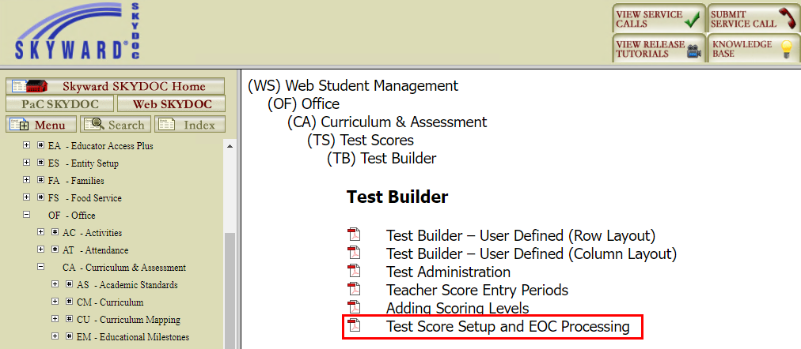
Documentation for Date Passed is included in Test Score Setup and EOC Processing available from Test Builder
Within Skyward > Question Mark > SkyDoc – Skyward Documentation
Notes:
For best search results, go to that area of the software you want documentation for and then select the question mark.

Slide 32
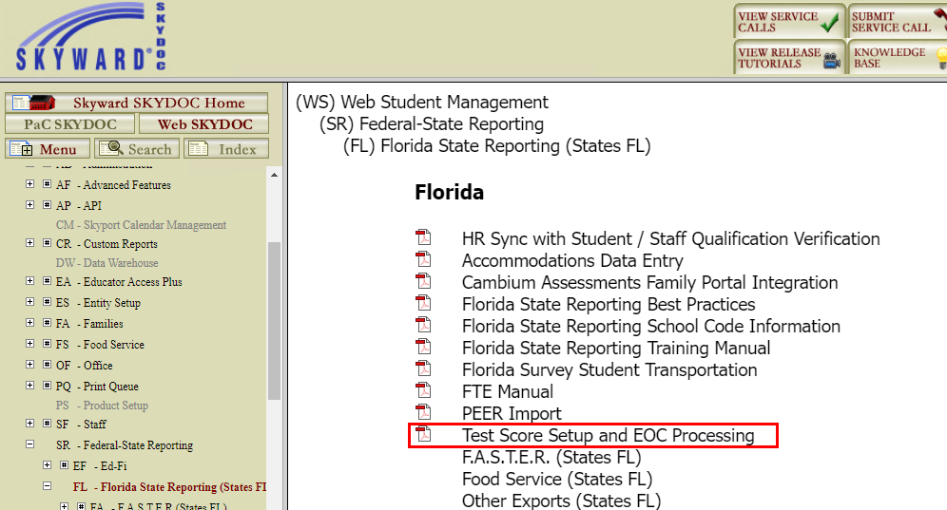
Documentation for Date Passed is included in Test Score Setup and EOC Processing available from Florida State Reporting
Within Skyward > Question Mark > SkyDoc – Skyward Documentation
Notes:
For best search results, go to that area of the software you want documentation for and then select the question mark.

Slide 33
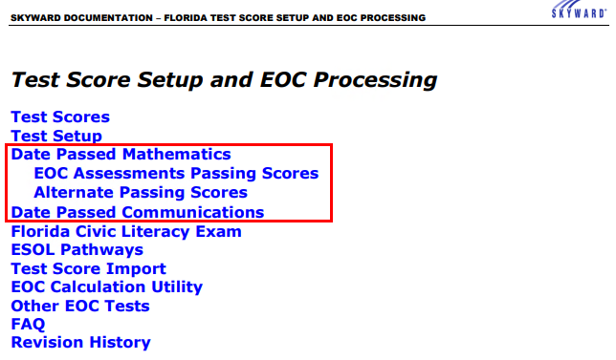
Test Score Setup and EOC Processing includes Date Passed Setup and logic.
Within Skyward > Question Mark > SkyDoc – Skyward Documentation
Notes:
This document is updated as state changes are made and our logic/setup updated.
You can see changes in the Revision History area.

Slide 34
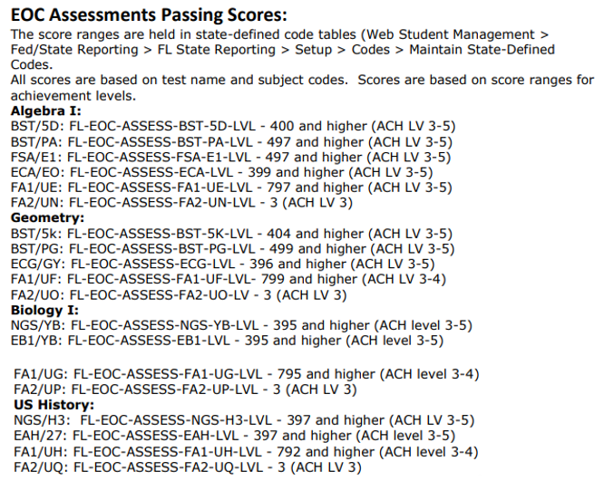
Test Score Setup and EOC Processing document also includes the EOC Passing Score Ranges
Within Skyward > Question Mark > SkyDoc – Skyward Documentation
Notes:
This document is updated as state changes are made and our logic/setup updated.
You can see changes in the Revision History area.
We added the passing scores for the EOC assessments based on state test/subject codes

Slide 35
Added information regarding Alternate Passing Scores
Within Skyward > Question Mark > SkyDoc – Skyward Documentation
Notes:
This document is updated as state changes are made and our logic/setup updated.
You can see changes in the Revision History area.
We added the passing scores for the EOC assessments based on state test/subject codes

Slide 36
EOC Reminders
No new EOC tests for the 2024-2025 school year as of now
Make sure courses are cross-walked to the state EOC Assessment you will be using. Multiple can be linked
Verify that the Grading EOC Calc Methods are set up correctly especially if you have changed course lengths
Districts can use the Mass Change Selected Grade Mark utility to update EOC buckets
Notes:
EOC Reminders: Course and tests are linked
Grading – EOC method set up
Mass Change Selected Grade Mark has been updated to include EOC test grade bucket

Slide 37
Upcoming Updates
PR 5990941 - Update Assess FA1 Alg 1 and Geo score ranges
PR 5994638 - Update Date Passed logic for FA1 &FA2
PR 5974729 - Update valid EOC Courses for Pre-ID templates
Notes:
PR 5990941 -The state has posted new scale scores for the FAA Algebra 1 and Geometry tests. We will need to end the current tests taken prior to Spring 2025 and start new score ranges with Spring 2025
PR 5994638 - The state has posted new scale scores for the FAA Algebra 1 and Geometry tests. We need to update the Date Passed Mathematic logic and EOC Scores for Algebra 1 and Geometry to use the new scores beginning with Spring Test scores. Tests taken prior to May 1 should use the old passing scores and tests taken after May 1 should use the new scores.
PR 5974729 - The state has updated the valid EOC courses and we need to update our Pre-ID valid EOC course list to match the state.
Biology - remove course 2000850
US History - remove course 2100390

Slide 38
Questions

Slide 39
Thank you!

