Slide 1
Survey Processing Trouble-shooting Errors
Florida User Group 2024-2025
Notes:
This session will cover recent and upcoming state reporting updates. How to troubleshoot errors and how to update survey data prior to and during state submission.
Ideas to discuss:
Cape Participant, added to mass update special programs,
Student course minutes/fte not as expected
ESE minutes with pushins/pullouts
FTE Calc Report – review of each column headings
Schedule Changes – don’t delete transactions
Schedule Changes – deletes vs drops
Teacher Transactions – future PR

Slide 2
Agenda
2024-2025 Reminders
Recent state updates
Career Academy Participant
FTE, Dual Enrolled Course
Survey Troubleshooting pointers
Survey Edits Documentation
Upcoming updates

Slide 3
Recent Updates
PR 5953134 - The CTE Career Academy Participant field was enabled on the Mass Add Special Programs utility.

Slide 4
The codes are district defined codes that need to be linked to the state code.
Career Academy Participant
Web Student Management > Students > Student Profile > Career/Tech Ed > Student
Notes:
Should end any records existing prior to 2024-2025 school year and then create records for new values as needed.

Slide 5
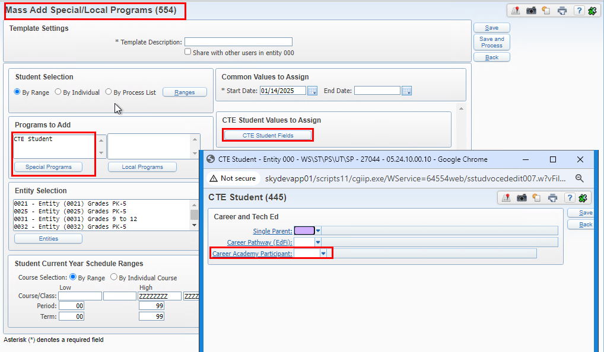
Career Academy Participant
Career Academy Participant can be updated using the Mass Add Special/Local Programs
Web Student Management > Students > Setup > Utilities > Mass Add Special/Local Programs

Slide 6
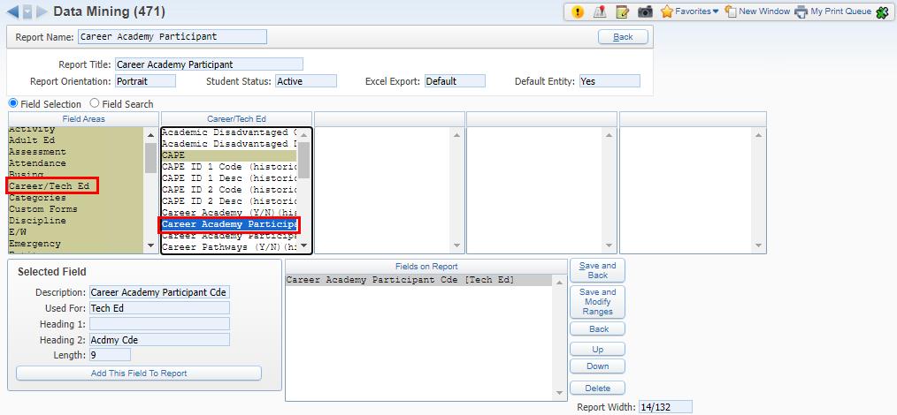
Career Academy Participant
Career Academy Participant is also available in Data Mining
Web Student Management > Students > Data Mining

Slide 7
Mass Update FTE Fields Utility
WEB STUDENT MANAGEMENT > FED/STATE REPORTING > FLORIDA > SETUP > UTILITIES > MASS UPDATE FTE FIELDS
Notes:
PR

Slide 8
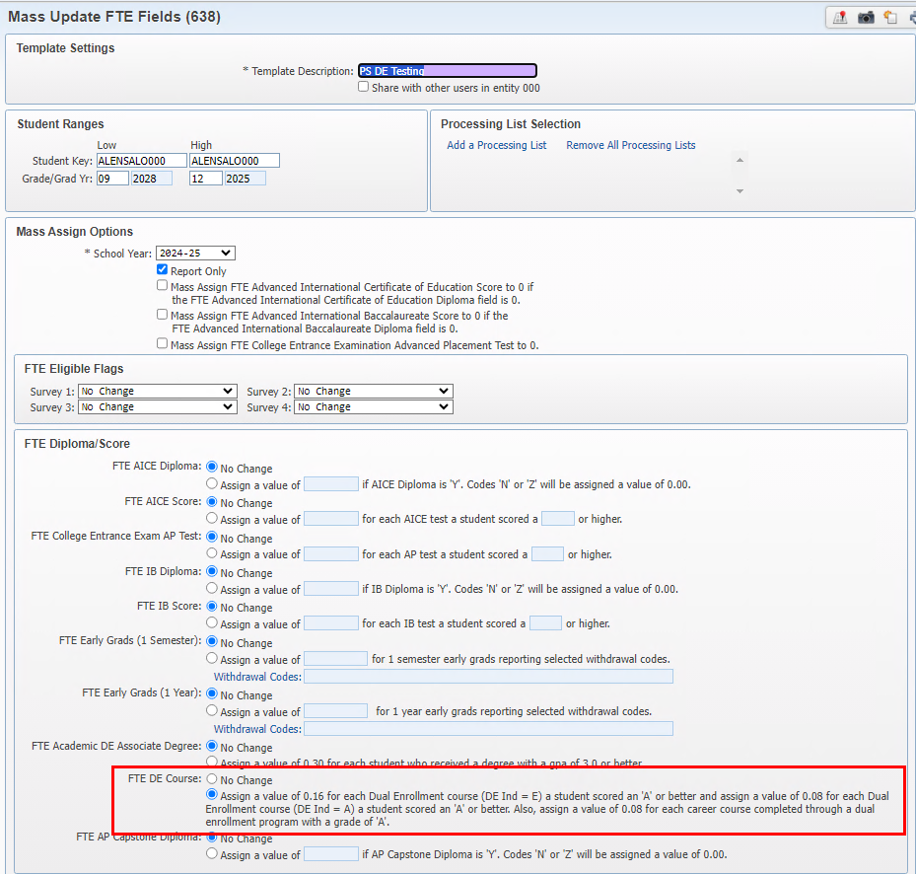
Mass Update FTE Fields Utility – FTE Dual Enrollment Course
There are 3 options for earning FTE
WEB STUDENT MANAGEMENT > FED/STATE REPORTING > FLORIDA > SETUP > UTILITIES > MASS UPDATE FTE FIELDS

Slide 9
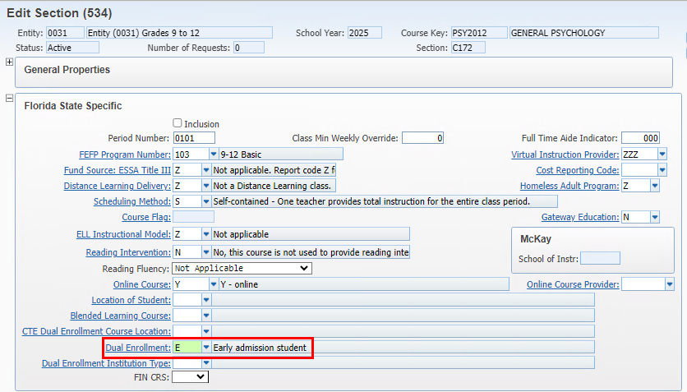
Option 1: Each course with a Dual Enrollment Indicator = E and the student earned an ‘A’ or better will be assigned 0.16.
The process will check for the Dual Enrollment Indicator in this hierarchy: Student Course Level, Course Section Level, Course Level
This is a course section view
Mass Update FTE Fields Utility – FTE Dual Enrollment Course
WEB STUDENT MANAGEMENT > FED/STATE REPORTING > FLORIDA > SETUP > UTILITIES > MASS UPDATE FTE FIELDS

Slide 10
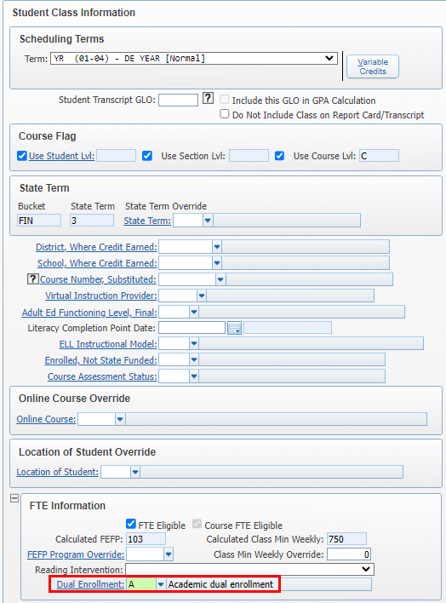
Option 2: Each course with a Dual Enrollment Indicator = A and the student earned an ‘A’ or better will be assigned 0.08.
The process will check for the Dual Enrollment Indicator in this hierarchy: Student Course Level, Course Section Level, Course Level
This is student course level view
Mass Update FTE Fields Utility – FTE Dual Enrollment Course
WEB STUDENT MANAGEMENT > FED/STATE REPORTING > FLORIDA > SETUP > UTILITIES > MASS UPDATE FTE FIELDS

Slide 11
Option 3: Each career course with a dual enrollment program and the student earned an ‘A’ or better in the final course in that program(series) will be assigned 0.08.
For this purpose, a ‘series’ is determined by the courses a student takes in the year that are tied to the same curriculum key based on the first 7-characters of that key.
For example: HMV0100, HMV0100Am HMV0100B would all be part of the same series.
If your district does not offer courses found in the following table, then this option setup is not needed:
Courses meeting requirement are found in State Defined Code table CAREER-PS-DE-CRS-FUND in WS\SR\FL\PS\CO\MS.
Students must earn full credit based on Curriculum Key CCD credit value in the current school year processed.
The program will use the 7-character curriculum key (without indicator) for the CCD credit value. If the system cannot find the 7-character curriculum key, it will use the CCD credit value from the curriculum key tied to the course.
A FIN CRS field has been added to the Curriculum, Course, and Section.
The following screens will cover the setup.
Mass Update FTE Fields Utility – FTE Dual Enrollment Course
WEB STUDENT MANAGEMENT > FED/STATE REPORTING > FLORIDA > SETUP > UTILITIES > MASS UPDATE FTE FIELDS

Slide 12
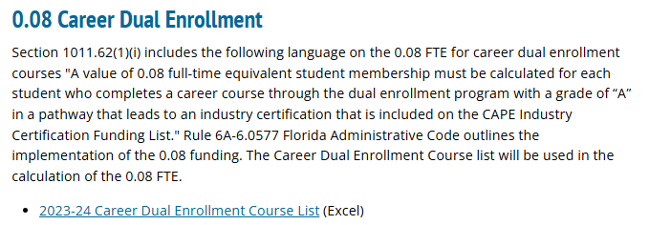
State-Defined Code table: CAREER-PS-DE-CRS-FUND
This table is maintained by Skyward based on the list provided by the state https://www.fldoe.org/academics/career-adult-edu/cape-secondary/fefpresources.stml
Mass Update FTE Fields Utility – FTE Dual Enrollment Course
WEB STUDENT MANAGEMENT > FED/STATE REPORTING > FLORIDA > SETUP > CODES > MAINTAIN STATE-DEFINED CODES

Slide 13
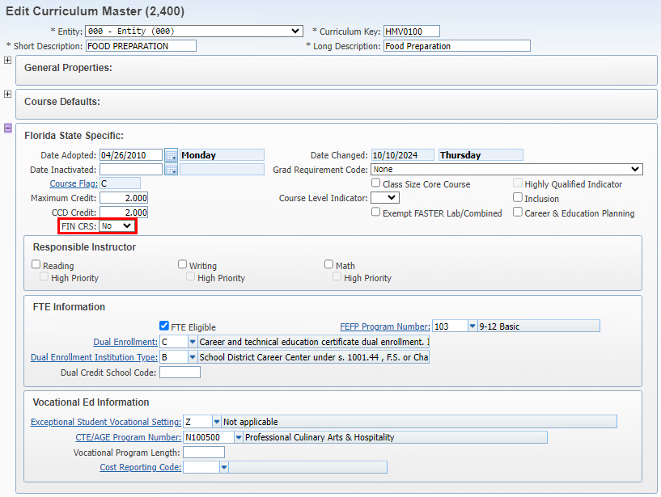
Curriculum: defaults to No. This field is not used in the calculation, it may be used with the Mass Copy Curriculum Master Information utility (WS\OF\CA\CM\PS\UT) to populate courses if all courses tied to the curriculum would be set as FIN = Yes. T
Mass Update FTE Fields Utility – FTE Dual Enrollment Course
WEB STUDENT MANAGEMENT > CURRICULUM & ASSESSMENTS > CURRICULUM > CURRICULUM MASTER

Slide 14
Course - defaults to No.
If a student can only take one section of a course, then the course may be set to Yes if it is the last course in a series.
If a student can take more than one section of a course, then it is recommended to leave the course as No and set the section value.
In the example below, if a student must take all 4 courses, typically the final one (HMV0171D) would be set as Yes.
Mass Update FTE Fields Utility – FTE Dual Enrollment Course
WEB STUDENT MANAGEMENT > OFFICE > CURRENT SCHEDULING > BUILD COURSE MASTER > COURSE MASTER

Slide 15
Section - defaults to blank.
If students can take more than one section of a course, then the course should be set to No and each applicable section should be marked as yes or no.
If only one section should be considered as the last class then that section should be marked as Yes.
In this example, a student must take both sections to complete the series.
Section CW11 would be set to No.
Section CW12 would be set to Yes.
Mass Update FTE Fields Utility – FTE Dual Enrollment Course
WEB STUDENT MANAGEMENT > OFFICE > CURRENT SCHEDULING > BUILD COURSE MASTER > COURSE MASTER

Slide 16
Possible scenarios:
Year-long course is set up semesters for flexible scheduling, typically only S2 section(s) would be set to Yes.
Curriculum to course is a 1-1 relationship, then only the final course would be set to Yes.
Separate semester courses for semester 1 and 2, then semester 2 sections could all be set to Yes where a student would only take one of the semester 2 sections.
Districts will need to determine how best to setup/flag courses to meet this requirement.
Mass Update FTE Fields Utility – FTE Dual Enrollment Course

Slide 17
The Mass Update FTE Fields Utility Report:
Will identify Overmarked/Undermarked courses - this only applies when a student has taken more than one course or more than one section of a course in the series.
Districts will need to review the courses/sections determined as under or over marked.
If a student is scheduled into 2 course/sections as Yes and receives A in both sections, FTE will calculate as .16 and reflect Overmarked. Districts will need to review and correct.
If a student is scheduled into 2 courses/sections and none are marked as Yes, the report will reflect as Undermarked.
The overmarked/undermarked only pertains to students that are scheduled into more than one course/section where all are set to No/blank or multiple are set to yes.
Mass Update FTE Fields Utility – FTE Dual Enrollment Course

Slide 18
Survey Edits Troubleshooting

Slide 19
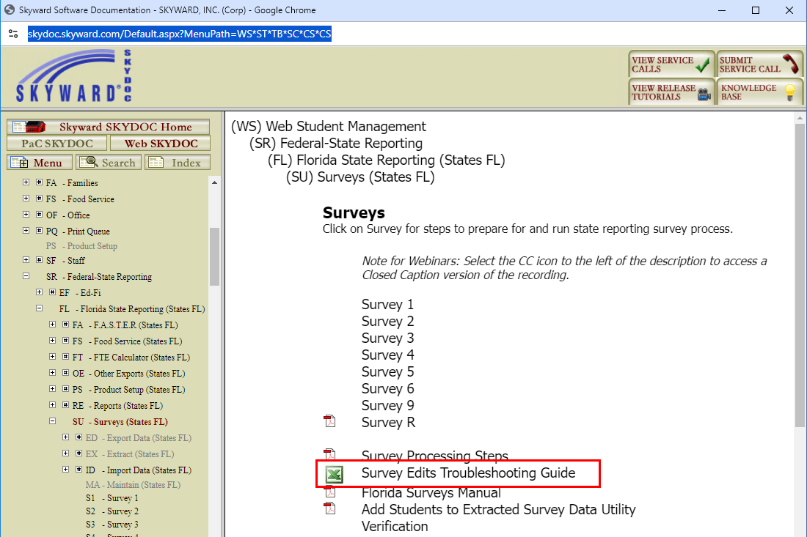
Survey Edits Documentation
https://skydoc.skyward.com/Default.aspx?MenuPath=WS*ST*TB*SC*CS*CS

Slide 20
This excel document has a tab for each form and identifies the edits that Skyward has programmed. It indicates if any DOE files need to be imported. It also provides areas to review to assist in resolving the edit.
Survey Edits Documentation
https://skydoc.skyward.com/Default.aspx?MenuPath=WS*ST*TB*SC*CS*CS

Slide 21
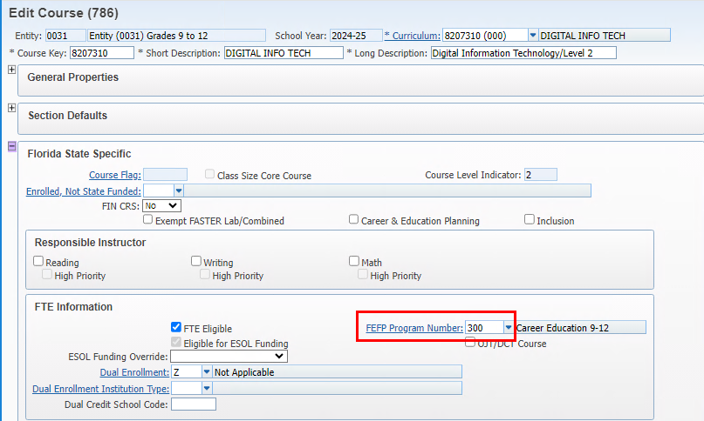
Example: Student is taking a vocational course with both course and section FEFP = 300 but Survey 2 is reporting it as 113.
FEFP is not reporting as expected
WEB STUDENT MANAGEMENT > OFFICE > CURRENT SCHEDULING > BUILD COURSE MASTER > COURSE MASTER
Notes:
Student course minutes/fte not as expected
ESE minutes with pushins/pullouts
FTE Calc Report – review of each column headings
Schedule Changes – don’t delete transactions
Schedule Changes – deletes vs drops

Slide 22
Example: Student is taking a course with FEFP = 300 but Survey 2 is reporting it as 113.
1. Verify the Course FEFP
FEFP is not reporting as expected
1. Verify the course FEFP value
WEB STUDENT MANAGEMENT > OFFICE > CURRENT SCHEDULING > BUILD COURSE MASTER > COURSE MASTER
Notes:
Student course minutes/fte not as expected
ESE minutes with pushins/pullouts
FTE Calc Report – review of each column headings
Schedule Changes – don’t delete transactions
Schedule Changes – deletes vs drops

Slide 23
Example: Student is taking a course with FEFP = 300 but Survey 2 is reporting it as 113.
2. Verify the Course Section FEFP
FEFP is not reporting as expected
2. Verify the course section FEFP value
WEB STUDENT MANAGEMENT > OFFICE > CURRENT SCHEDULING > BUILD COURSE MASTER > COURSE MASTER
Notes:
Student course minutes/fte not as expected
ESE minutes with pushins/pullouts
FTE Calc Report – review of each column headings
Schedule Changes – don’t delete transactions
Schedule Changes – deletes vs drops

Slide 24
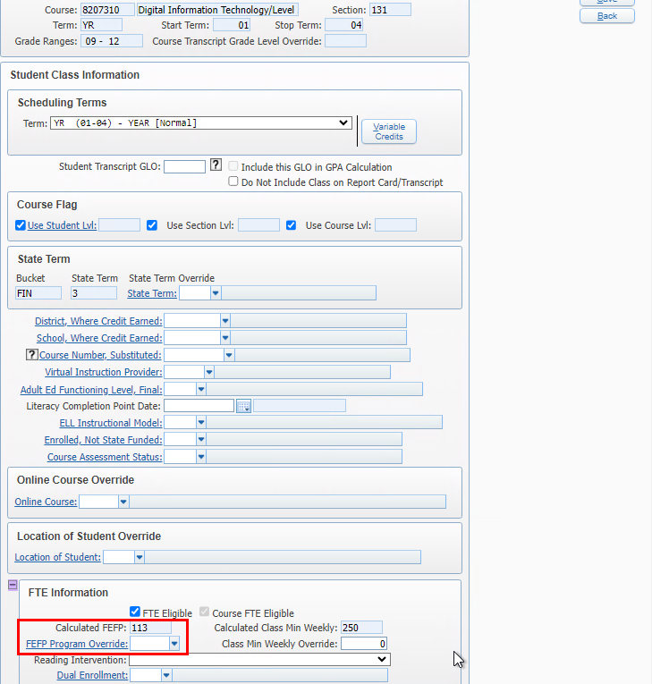
Example: Student is taking a course with FEFP = 300 but Survey 2 is reporting it as 113.
3. Verify the student class section override FEFP value
FEFP is not reporting as expected
3. Verify the student class section override FEFP value
WEB STUDENT MANAGEMENT > STUDENTS > STUDENT PROFILE > SCHEDULING TAB
Notes:
Student course minutes/fte not as expected
ESE minutes with pushins/pullouts
FTE Calc Report – review of each column headings
Schedule Changes – don’t delete transactions
Schedule Changes – deletes vs drops

Slide 25
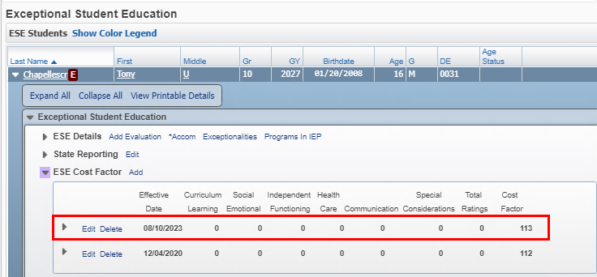
Example: Student is taking a course with FEFP = 300 but Survey 2 is reporting it as 113.
3. Verify the student ESE Cost Factor value.
FEFP is not reporting as expected
3. Verify the student ESE cost factor
Web Student Management > Students > Student Profile > ESE – Cost Factor
Notes:
Student course minutes/fte not as expected
ESE minutes with pushins/pullouts
FTE Calc Report – review of each column headings
Schedule Changes – don’t delete transactions
Schedule Changes – deletes vs drops

Slide 26
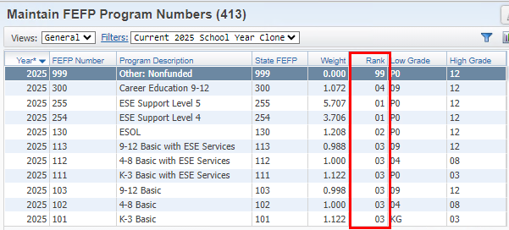
Example: Student is taking a course with FEFP = 300 but Survey 2 is reporting it as 113.
3. Verify the FEFP Rank – this is a Skyward field used to determine the hierarchy for reporting the FEFP value. Changing the rank values could negatively impact your reporting so always check with Skyward before changing the rank values.
FEFP is not reporting as expected
4. FEFP Hierarchy based on FEFP Rank
It is reporting as 113 based on the student’s ESE Cost Factor because a 113 FEFP ranks higher than the 300 FEFP rank value.
Notes:
Rank Values are indicated in the FTE Manual in Skydoc.
Student course minutes/fte not as expected
ESE minutes with pushins/pullouts
FTE Calc Report – review of each column headings
Schedule Changes – don’t delete transactions
Schedule Changes – deletes vs drops

Slide 27
Class Minutes are not the expected amount.
Notes:
Rank Values are indicated in the FTE Manual in Skydoc.
Student course minutes/fte not as expected
ESE minutes with pushins/pullouts
FTE Calc Report – review of each column headings
Schedule Changes – don’t delete transactions
Schedule Changes – deletes vs drops

Slide 28
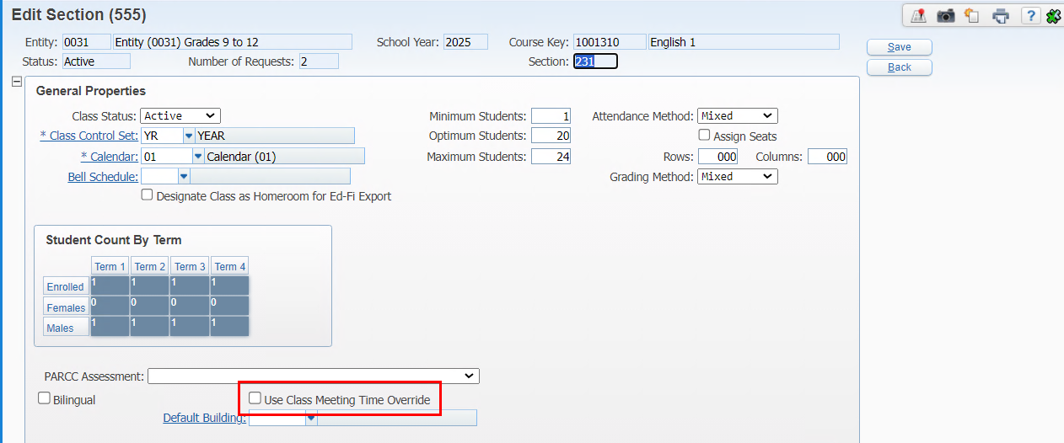
Check to see if class meeting time override is enabled on the section. If yes, verify the times on the class meet.
Class Minutes are not the expected amount.
1. Check for overrides
Web Student Management > Office > Current Scheduling > Build Course Master > Course Master – edit section
Notes:
Rank Values are indicated in the FTE Manual in Skydoc.
Student course minutes/fte not as expected
ESE minutes with pushins/pullouts
FTE Calc Report – review of each column headings
Schedule Changes – don’t delete transactions
Schedule Changes – deletes vs drops

Slide 29
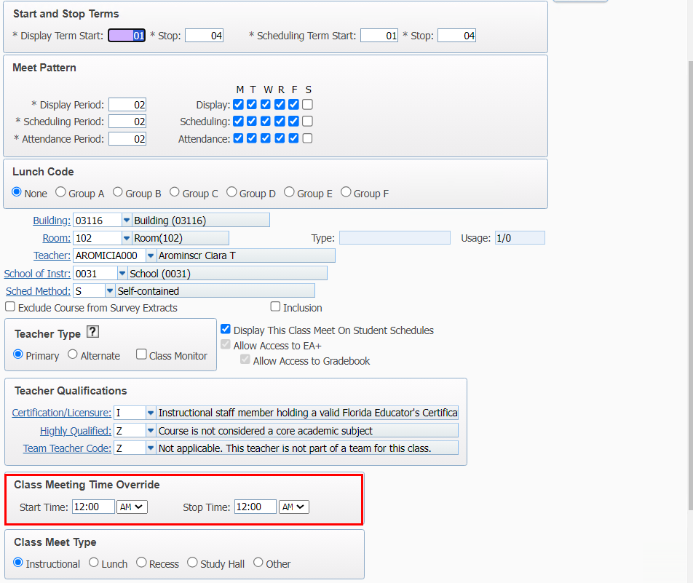
If class meeting time override is enabled on the section, verify the times on the class meet.
Class Minutes are not the expected amount.
1. Check for overrides
Web Student Management > Office > Current Scheduling > Course Master > Course Master – edit class meet
Notes:
Rank Values are indicated in the FTE Manual in Skydoc.
Student course minutes/fte not as expected
ESE minutes with pushins/pullouts
FTE Calc Report – review of each column headings
Schedule Changes – don’t delete transactions
Schedule Changes – deletes vs drops

Slide 30
Check if the override on the class section in Florida State Specific has minutes. If yes we pull minutes from here.
Class Minutes are not the expected amount.
1. Check for overrides
Web Student Management > Office > Current Scheduling > Course Master > Course Master – edit section
Notes:
Rank Values are indicated in the FTE Manual in Skydoc.
Student course minutes/fte not as expected
ESE minutes with pushins/pullouts
FTE Calc Report – review of each column headings
Schedule Changes – don’t delete transactions
Schedule Changes – deletes vs drops

Slide 31
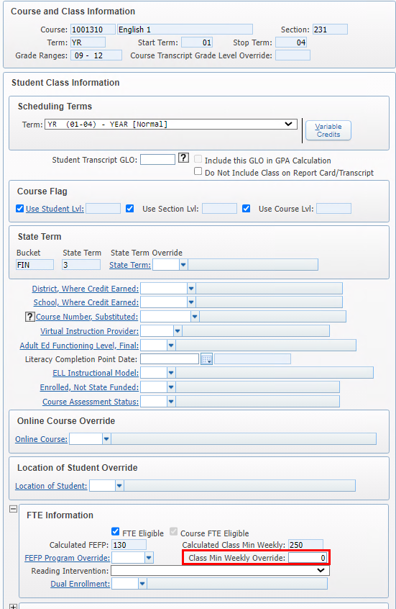
Check the override on the student class schedule
Class Minutes are not the expected amount.
1. Check for overrides
Web Student Management > Students > Student Profile > Scheduling tab.
Notes:
Rank Values are indicated in the FTE Manual in Skydoc.
Student course minutes/fte not as expected
ESE minutes with pushins/pullouts
FTE Calc Report – review of each column headings
Schedule Changes – don’t delete transactions
Schedule Changes – deletes vs drops

Slide 32
Run the FTE Calculator for the student to check for overlapping records that may be affecting the minutes. Check the S/R column for an ‘O’ indicating overlap
Class Minutes are not the expected amount.
1.Check the FTE Calculator for overlapping classes.
Web Student Management > Fed/State Reporting > Florida > FTE Calculator
Notes:
Rank Values are indicated in the FTE Manual in Skydoc.
Student course minutes/fte not as expected
ESE minutes with pushins/pullouts
FTE Calc Report – review of each column headings
Schedule Changes – don’t delete transactions
Schedule Changes – deletes vs drops

Slide 33
Open the Survey Skyward Documentation for the Survey
Student is not extracting for a survey format as expected.
Web Student Management > Fed/State Reporting > Florida > FTE Calculator
Notes:
Rank Values are indicated in the FTE Manual in Skydoc.
Student course minutes/fte not as expected
ESE minutes with pushins/pullouts
FTE Calc Report – review of each column headings
Schedule Changes – don’t delete transactions
Schedule Changes – deletes vs drops

Slide 34
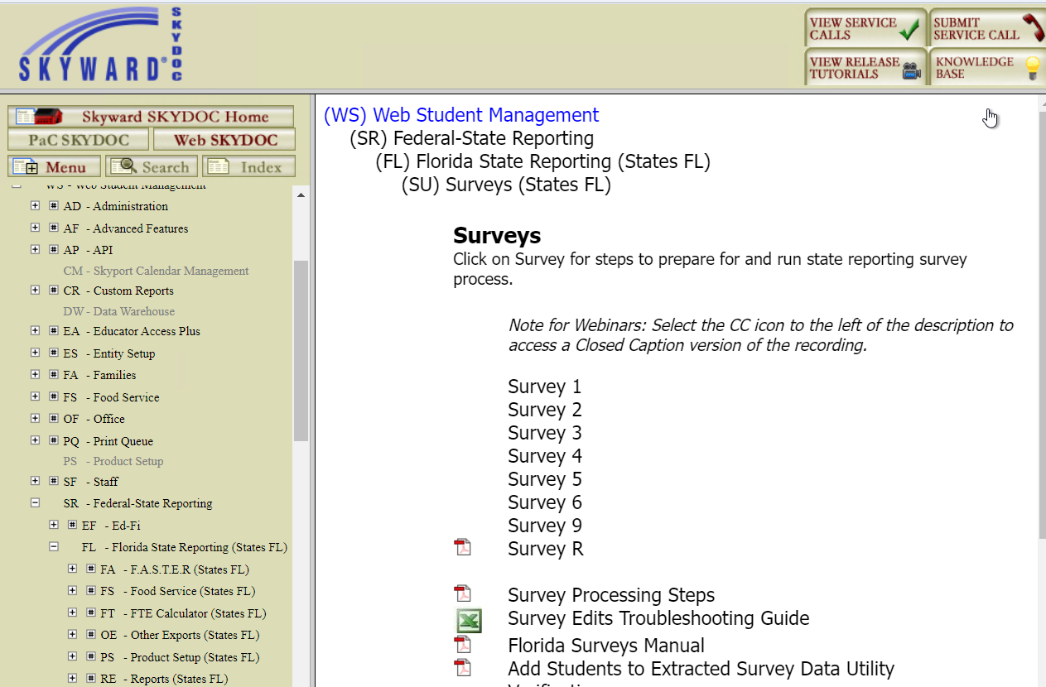
Open the Survey Skyward Documentation for the Survey being extracted
Student is not extracting for a survey format as expected.
Web Student Management > Fed/State Reporting > Florida > FTE Calculator
Notes:
Rank Values are indicated in the FTE Manual in Skydoc.
Student course minutes/fte not as expected
ESE minutes with pushins/pullouts
FTE Calc Report – review of each column headings
Schedule Changes – don’t delete transactions
Schedule Changes – deletes vs drops

Slide 35
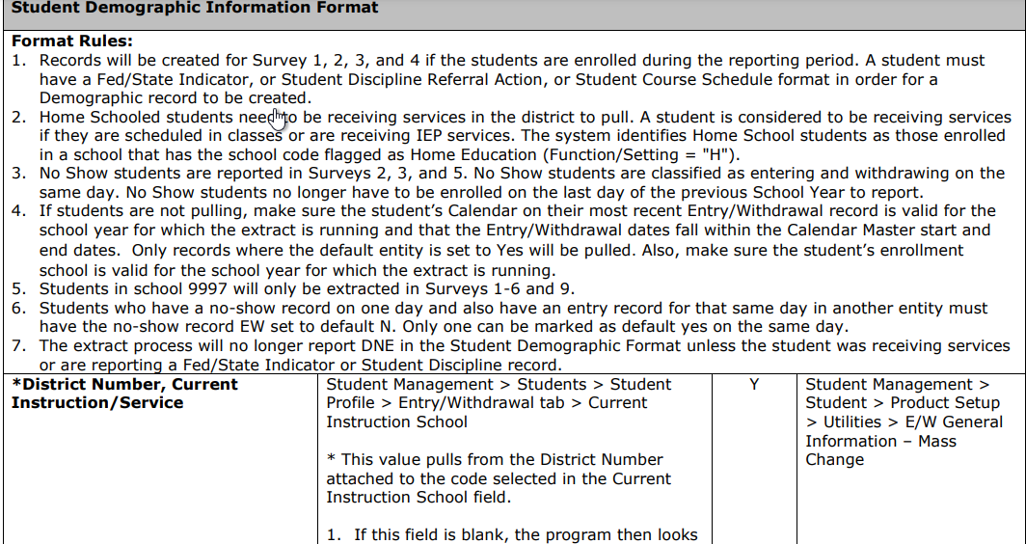
Student is not extracting for a survey format as expected.
Each format will provide rules that are used to determine what students to extract. The rules are followed by the format layout which provides information for each field. Use this information to assist in determining why the record is not extracting.
Skyward Documentation – Survey 2 link:
https://support.skyward.com/DeptDocs/Corporate/Documentation/Public%20Website/Tutorials/Software/2531621_Survey_2_Data_Elements.pdf
Notes:
Rank Values are indicated in the FTE Manual in Skydoc.
Student course minutes/fte not as expected
ESE minutes with pushins/pullouts
FTE Calc Report – review of each column headings
Schedule Changes – don’t delete transactions
Schedule Changes – deletes vs drops

Slide 36
Student is not extracting for a survey format as expected.
Common issues:
Entry Withdrawal record is not set as default = Yes
Programs such as Special Programs, ELL, or ESE program dates do not overlap the survey
Class Transactions were deleted in error
Class was dropped prior to survey date certain
Local codes not properly linked to state codes
DOE Files such as MSID and CCD have not been imported
After reviewing student records, run the Add Students to Extracted Survey Data in Report Only mode to see if record then extracts.
We at Skyward are always ready to assist!
Notes:
Rank Values are indicated in the FTE Manual in Skydoc.
Student course minutes/fte not as expected
ESE minutes with pushins/pullouts
FTE Calc Report – review of each column headings
Schedule Changes – don’t delete transactions
Schedule Changes – deletes vs drops

Slide 37
Upcoming Updates
PR 6019013 – Update the Mass Update FTE Fields Utility to update the FTE Diploma Tab for the FL Seal of Fine Arts Program based on Endorsement or manual selection
PR 5986377 - Add Teacher Transactions for FL – this will add this to the Scheduling Module
PR 5986380 – This will update the Teacher Course format to use the Teacher Transactions to extract the teacher as of Survey Date Certain.

Slide 38
Questions

Slide 39
Thank You!

