Slide 1
Other Exports
Florida User Group 2025-2026
Notes:
This session will cover Test Builder setup affecting state reporting, EOC, and Date Passed setup and troubleshooting steps.

Slide 2
Agenda
Recent Updates
NAEP - TUDA
WIDA
FES
Troubleshooting Tips
Notes:
EOC Reminders: Course and tests are linked
Grading – EOC method
-options
Mass Change Selected Grade Mark has been updated to include EOC test grade bucket

Slide 3
Recent Updates
PR 6016473 - The NAEP TUDA (National Assessment of Educational Progress / Trial Urban District Assessment) extract process has been updated with the ability to extract the Homeroom Teacher and the leading zeros for Grade Level and Month of Birth have been removed.
PR 6033160 - The WIDA Pre-ID Export file layout was updated to the newest format. Additionally, the Test Accommodation tabs were updated with accommodations for the WIDA Test and display when WIDA has been selected.

Slide 4
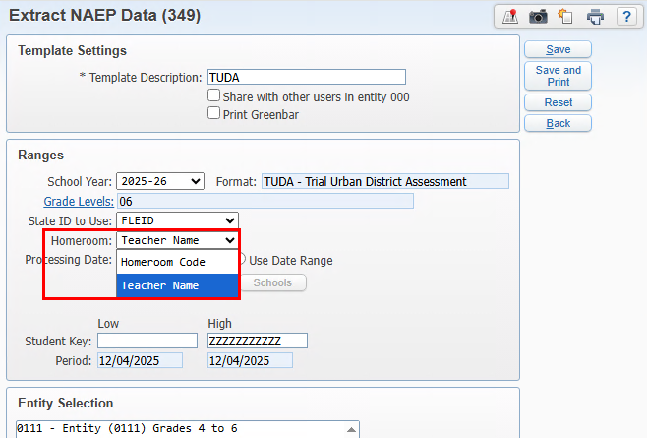
Other Exports
NAEP - TUDA
The NAEP-TUDA extract has been updated to add the option for Homeroom to be either the Homeroom Code or the Teacher Name.
Web Student Management > Fed/State Reporting > Florida > Other Exports > Extract NAEP Data
Notes:
T-Score Setup – this is only used for legacy tests and should not be setup up.
Score Ranges Override - EOC score range overrides have been added to EOC Details in Test Builder to accommodate the provisional scores that affect Algebra 1 and Geometry passing scores. NOTE: This area is no longer needed to specify different score ranges as the state had added new test score subject content codes to identity tests using provisional score ranges.

Slide 5
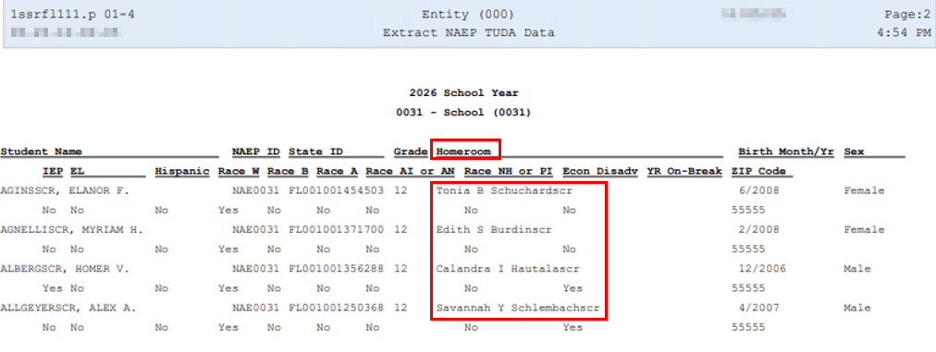
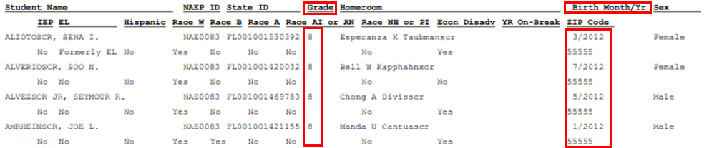
Other Exports
NAEP - TUDA
The report has been updated to print the homeroom data based on the template selection.
Grade/Birth Month has been updated to not include a leading zero
Web Student Management > Fed/State Reporting > Florida > Other Exports > Extract NAEP Data
Notes:
T-Score Setup – this is only used for legacy tests and should not be setup up.
Score Ranges Override - EOC score range overrides have been added to EOC Details in Test Builder to accommodate the provisional scores that affect Algebra 1 and Geometry passing scores. NOTE: This area is no longer needed to specify different score ranges as the state had added new test score subject content codes to identity tests using provisional score ranges.

Slide 6
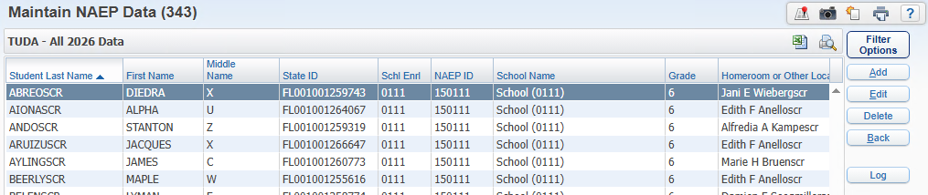
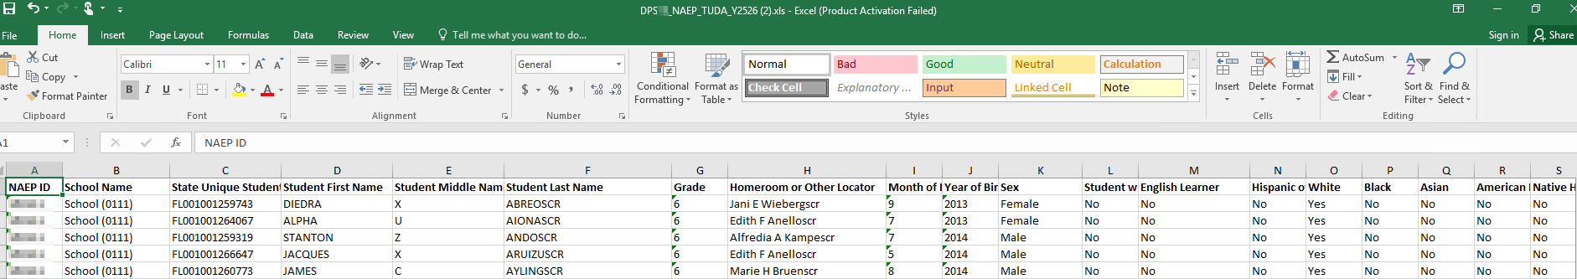
Other Exports
NAEP - TUDA
The Maintain has been updated to match the state layout. The file name and layout exports in excel.
Web Student Management > Fed/State Reporting > Florida > Other Exports > Maintain NAEP Data
Notes:
T-Score Setup – this is only used for legacy tests and should not be setup up.
Score Ranges Override - EOC score range overrides have been added to EOC Details in Test Builder to accommodate the provisional scores that affect Algebra 1 and Geometry passing scores. NOTE: This area is no longer needed to specify different score ranges as the state had added new test score subject content codes to identity tests using provisional score ranges.

Slide 7
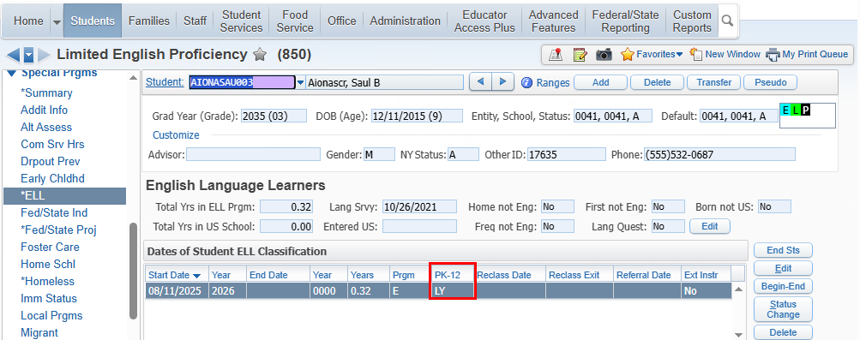
Other Exports
WIDA
The WIDA extract has been updated to pull test accommodations specific to WIDA.
This student is a 3rd grader with an ELL PK-12 status of LY.
Web Student Management > Student > Student Profile > Special Programs > Test Accommodations
Notes:
T-Score Setup – this is only used for legacy tests and should not be setup up.
Score Ranges Override - EOC score range overrides have been added to EOC Details in Test Builder to accommodate the provisional scores that affect Algebra 1 and Geometry passing scores. NOTE: This area is no longer needed to specify different score ranges as the state had added new test score subject content codes to identity tests using provisional score ranges.

Slide 8
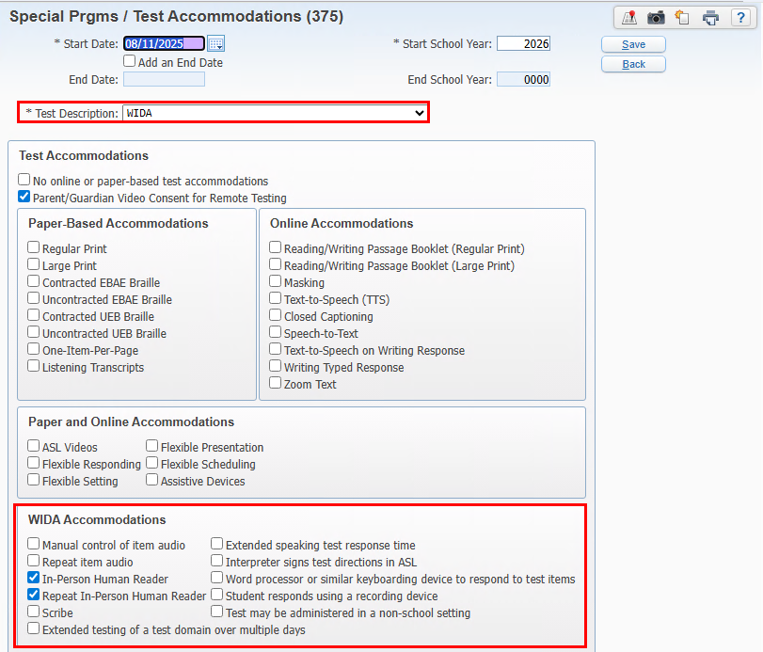
Other Exports
WIDA
When the Test Description is set to WIDA, a new WIDA Accommodations area displays and can be selected when accommodation is set to paper-based.
Web Student Management > Student > Student Profile > Special Programs > Test Accommodations
Notes:
T-Score Setup – this is only used for legacy tests and should not be setup up.
Score Ranges Override - EOC score range overrides have been added to EOC Details in Test Builder to accommodate the provisional scores that affect Algebra 1 and Geometry passing scores. NOTE: This area is no longer needed to specify different score ranges as the state had added new test score subject content codes to identity tests using provisional score ranges.

Slide 9
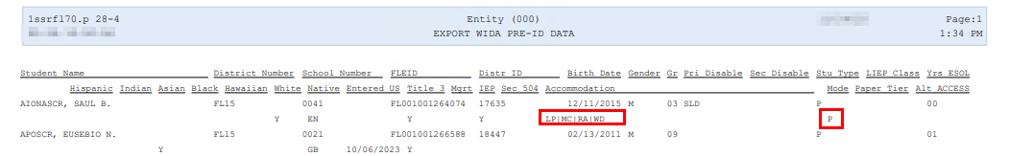
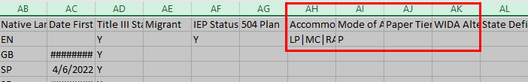
Other Exports
WIDA
The report has been updated to include the new accommodations, Mode of Administration (MODE), Paper Tier, and Alt Access. The fields have been added to the file layout.
Web Student Management > Fed/State Reporting > Florida > Other Exports > WIDA
Notes:
T-Score Setup – this is only used for legacy tests and should not be setup up.
Score Ranges Override - EOC score range overrides have been added to EOC Details in Test Builder to accommodate the provisional scores that affect Algebra 1 and Geometry passing scores. NOTE: This area is no longer needed to specify different score ranges as the state had added new test score subject content codes to identity tests using provisional score ranges.

Slide 10
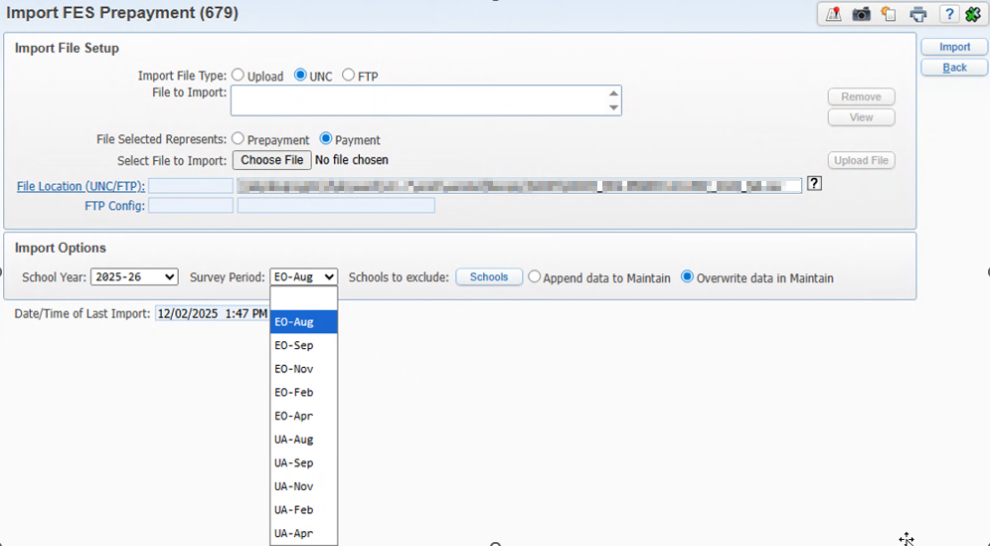
Other Exports
FES
PR 6366726 – Oct. Addendum 07 – 12/22/25
FES Import has been updated for EO and UA files. The FTC/PEP and Private Student files are coming soon.
Web Student Management > Fed/State Reporting > Florida > Other Exports > WIDA
Notes:
T-Score Setup – this is only used for legacy tests and should not be setup up.
Score Ranges Override - EOC score range overrides have been added to EOC Details in Test Builder to accommodate the provisional scores that affect Algebra 1 and Geometry passing scores. NOTE: This area is no longer needed to specify different score ranges as the state had added new test score subject content codes to identity tests using provisional score ranges.

Slide 11
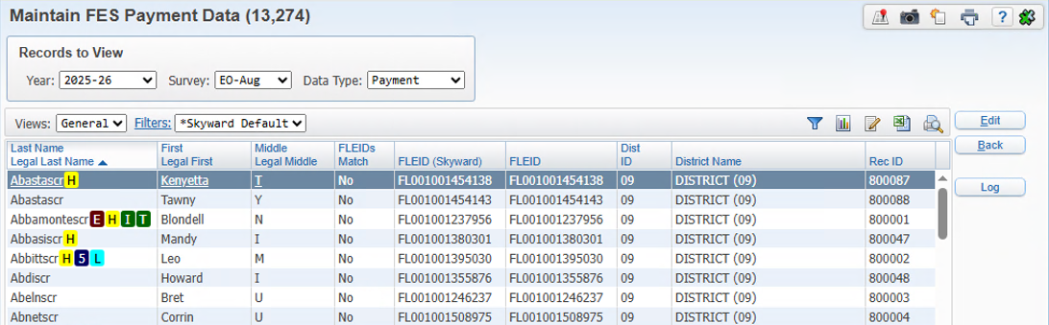
Other Exports
FES
PR 6366726 – Oct. Addendum 07 – 12/22/25
FES Maintain has been updated to match the fields and survey period imported.
Web Student Management > Fed/State Reporting > Florida > Other Exports > WIDA
Notes:
T-Score Setup – this is only used for legacy tests and should not be setup up.
Score Ranges Override - EOC score range overrides have been added to EOC Details in Test Builder to accommodate the provisional scores that affect Algebra 1 and Geometry passing scores. NOTE: This area is no longer needed to specify different score ranges as the state had added new test score subject content codes to identity tests using provisional score ranges.

Slide 12
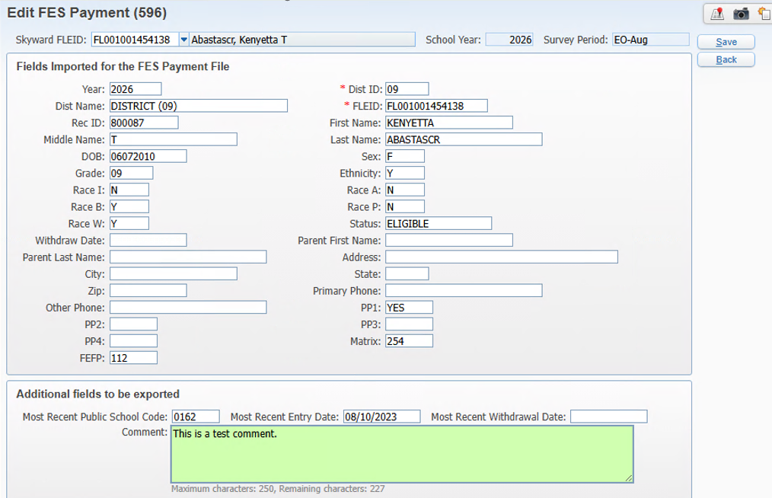
Other Exports
FES
PR 6366726 – Oct. Addendum 07 – 12/22/25
FES Import will populate the Additional fields to be exported with the student’s most recent Entry/Withdrawal information.
Web Student Management > Fed/State Reporting > Florida > Other Exports > WIDA
Notes:
T-Score Setup – this is only used for legacy tests and should not be setup up.
Score Ranges Override - EOC score range overrides have been added to EOC Details in Test Builder to accommodate the provisional scores that affect Algebra 1 and Geometry passing scores. NOTE: This area is no longer needed to specify different score ranges as the state had added new test score subject content codes to identity tests using provisional score ranges.

Slide 13
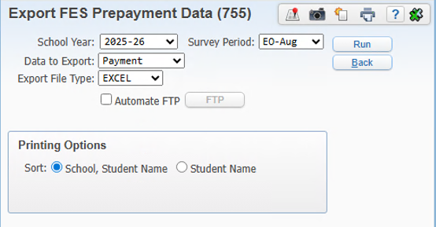
Other Exports
FES
PR 6366726 – Oct. Addendum 07 – 12/22/25
Export FES has been updated to match the survey period imported. Export File type was added to the ranges and valid values are CSV or EXCEL.
Web Student Management > Fed/State Reporting > Florida > Other Exports > WIDA
Notes:
T-Score Setup – this is only used for legacy tests and should not be setup up.
Score Ranges Override - EOC score range overrides have been added to EOC Details in Test Builder to accommodate the provisional scores that affect Algebra 1 and Geometry passing scores. NOTE: This area is no longer needed to specify different score ranges as the state had added new test score subject content codes to identity tests using provisional score ranges.

Slide 14
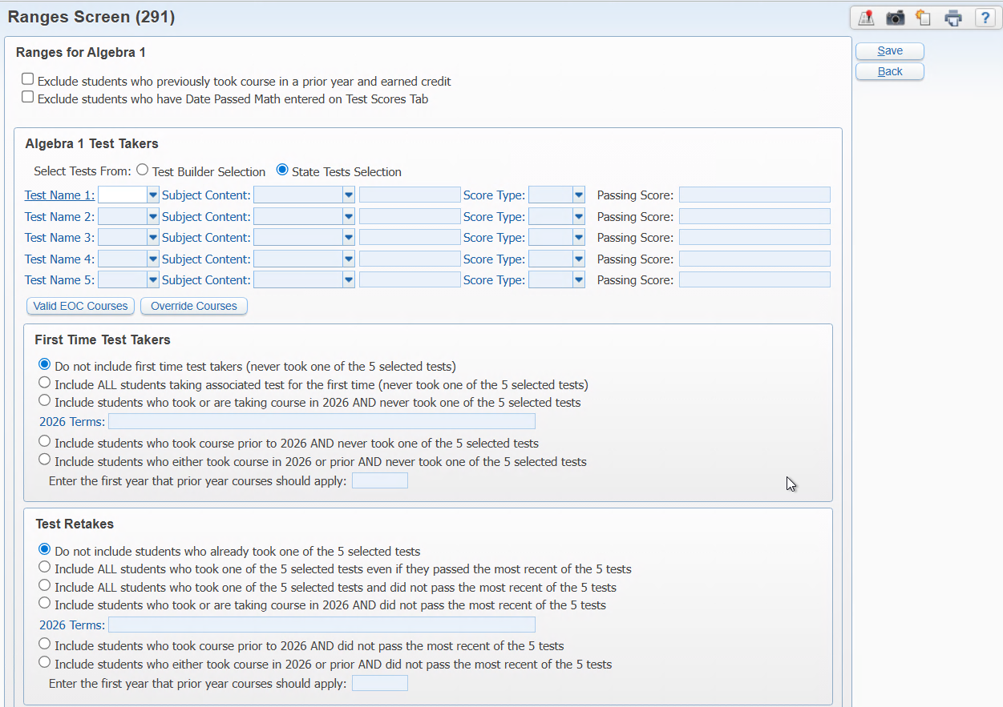
Other Exports
Pre-ID
Ranges….Are they working for you?
Web Student Management > Fed/State Reporting > Florida > Other Exports

Slide 15
Upcoming Updates
PR 6366726 – FES UA and EO updates. Estimated 12/22/25
PR 6411741 – FES FTE/PEP and Private Student list updates. Estimated 1/19/2026
Notes:
PR 5990941 -The state has posted new scale scores for the FAA Algebra 1 and Geometry tests. We will need to end the current tests taken prior to Spring 2025 and start new score ranges with Spring 2025
PR 5994638 - The state has posted new scale scores for the FAA Algebra 1 and Geometry tests. We need to update the Date Passed Mathematic logic and EOC Scores for Algebra 1 and Geometry to use the new scores beginning with Spring Test scores. Tests taken prior to May 1 should use the old passing scores and tests taken after May 1 should use the new scores.
PR 5974729 - The state has updated the valid EOC courses and we need to update our Pre-ID valid EOC course list to match the state.
Biology - remove course 2000850
US History - remove course 2100390

Slide 16
Questions

Slide 17
Thank you!

