Slide 1
ESE 20/20
-Compare ESE data entry in SMS to Qmlativ.
-Preparing Data for Migration
-New\Updated options in Section 504 (time permitting)
SMS & Qmlativ ESE & More

Slide 2
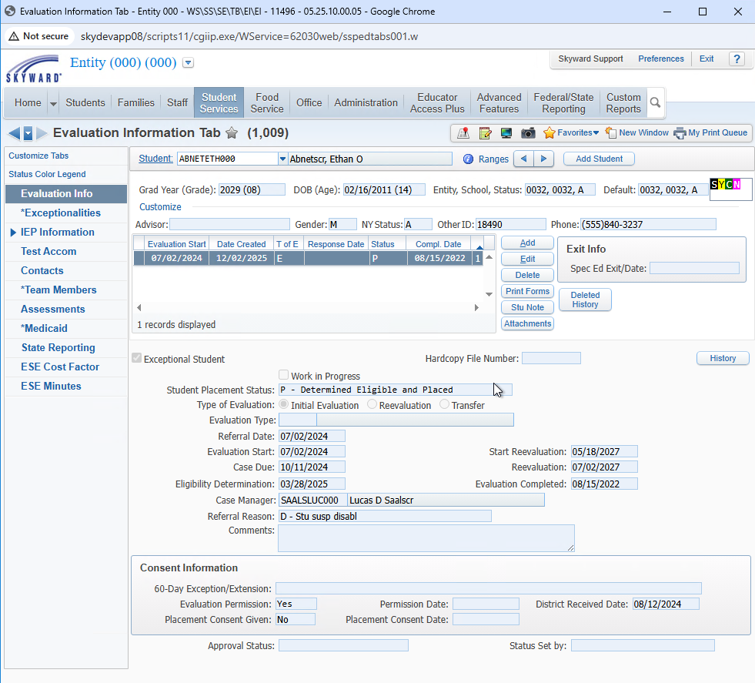
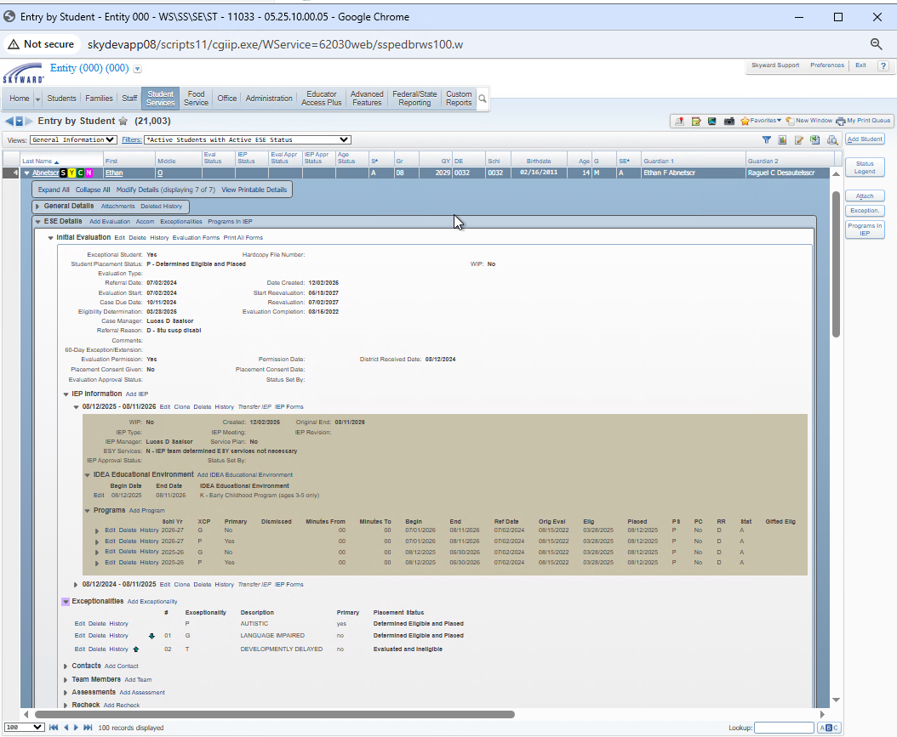
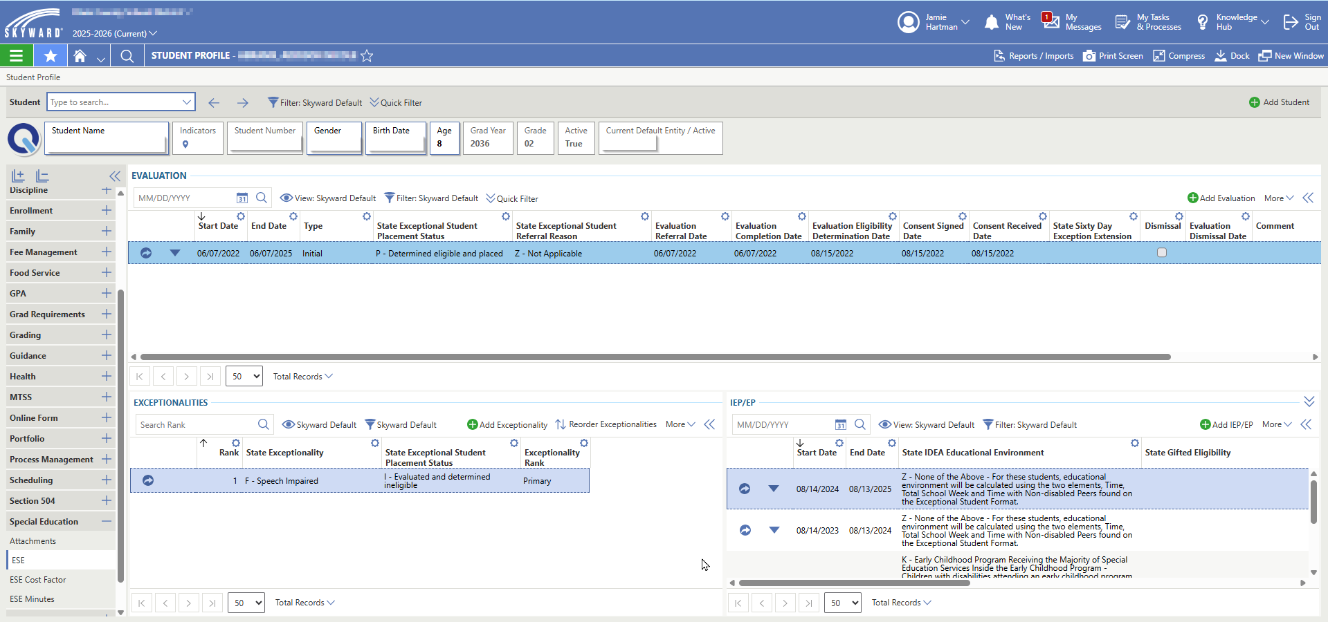
ESE Profile &
Browse

Slide 3
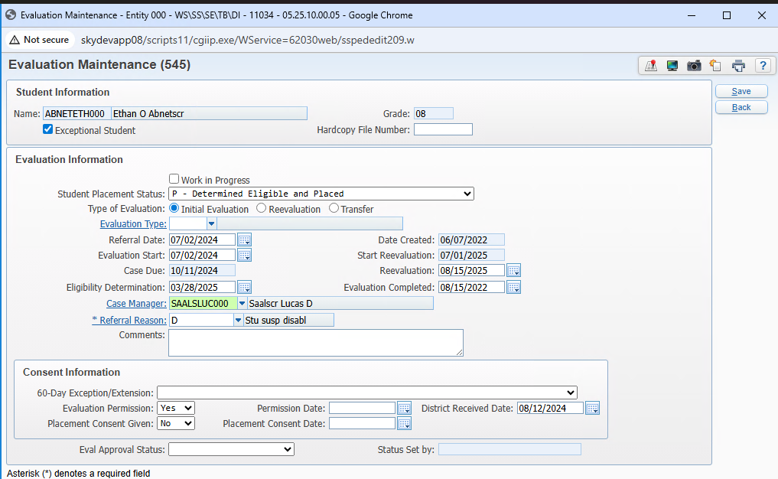
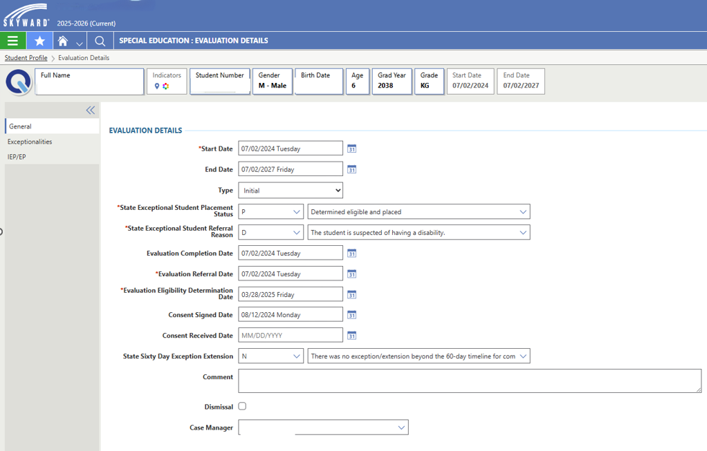
Evaluation Information
-Qmlativ has an Evaluation END Date

Slide 4
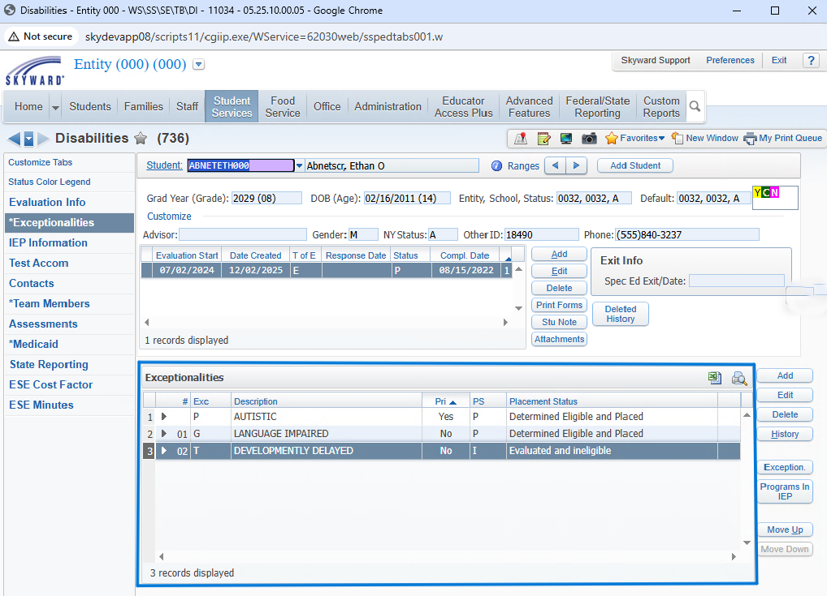
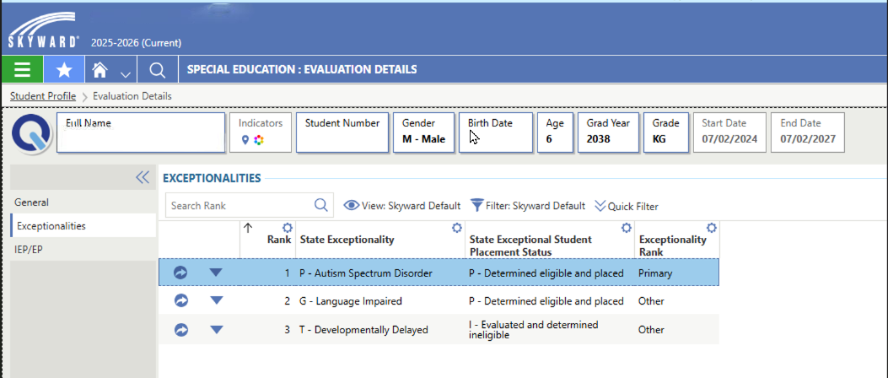
Exceptionality Information

Slide 5
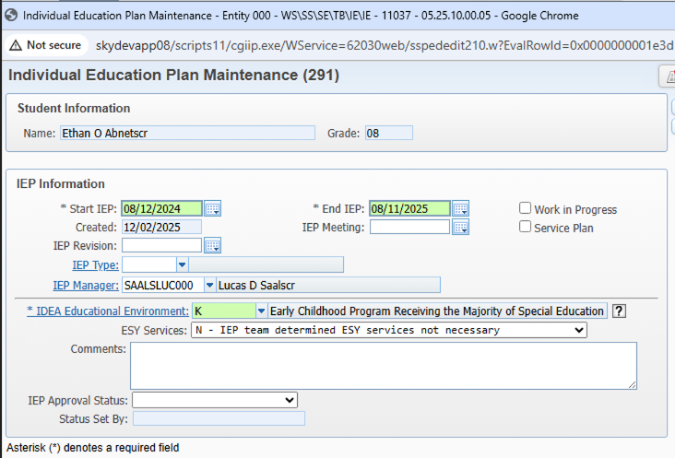
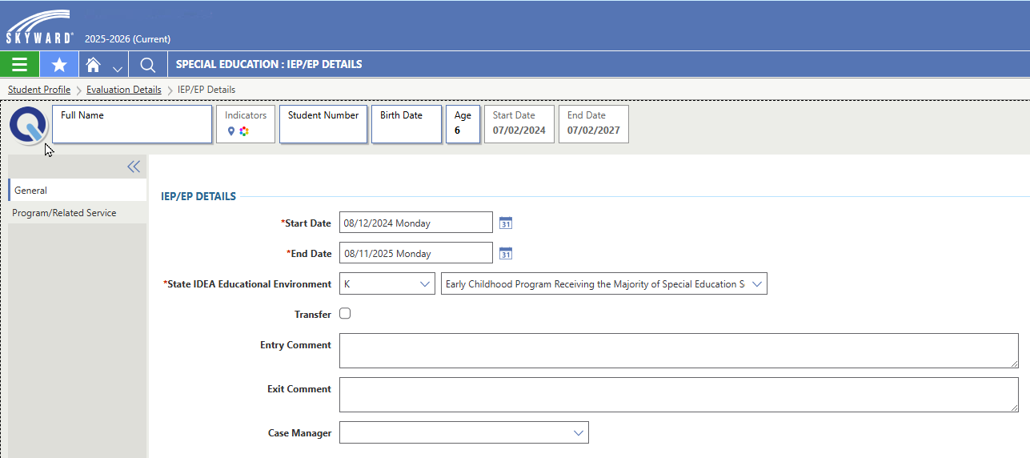
IEP\EP Information

Slide 6
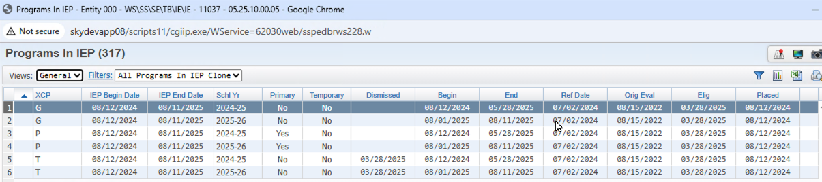
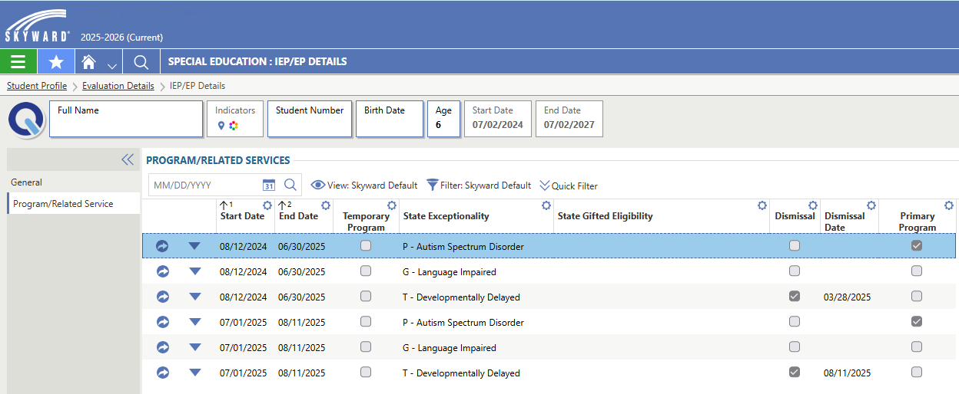
Placement Information

Slide 7
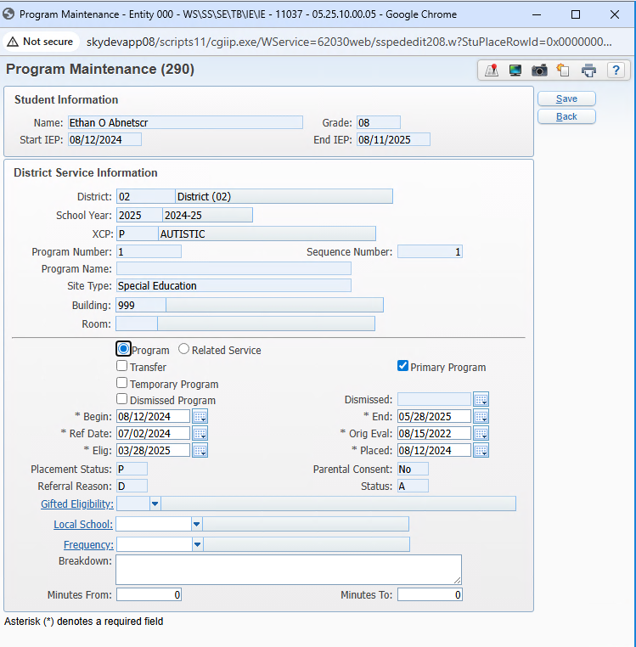
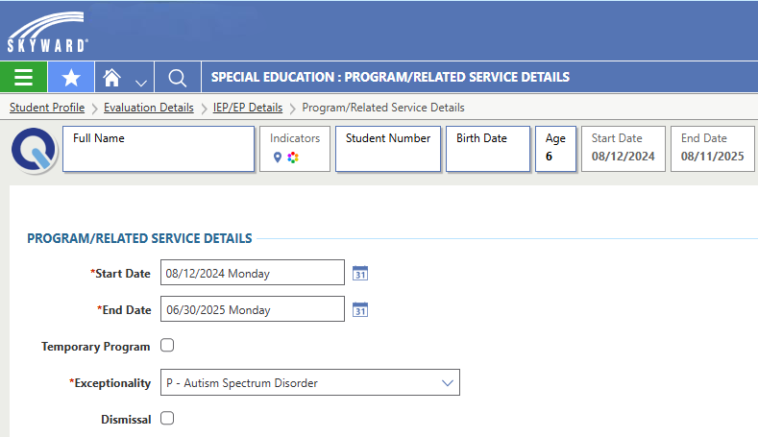
Placement Entry Screen

Slide 8
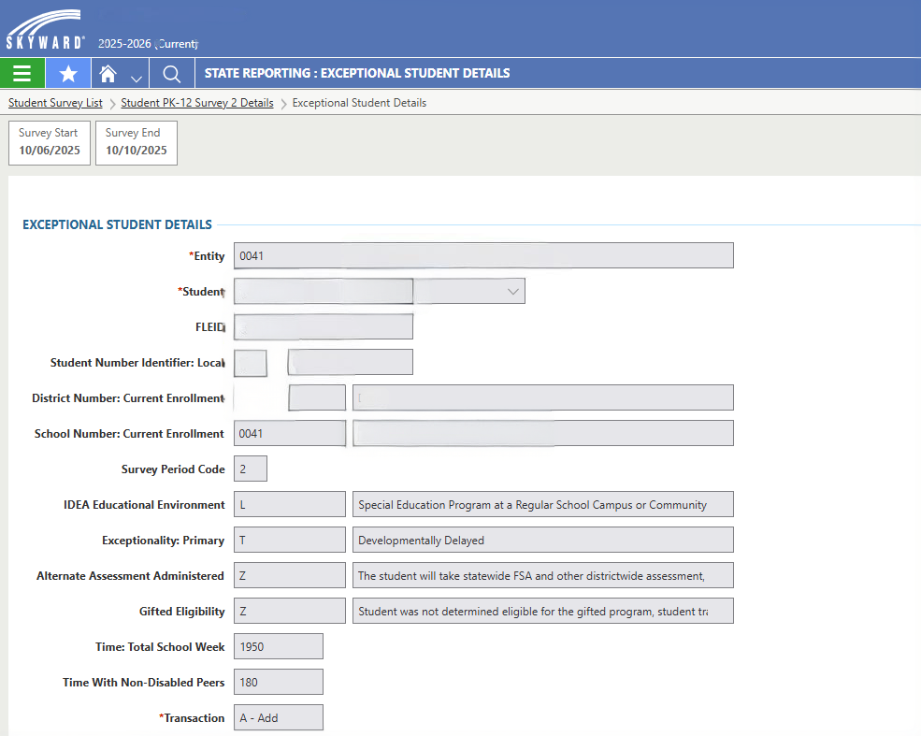
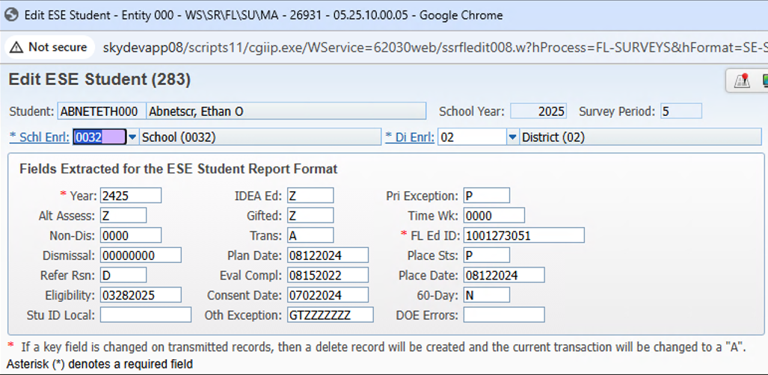
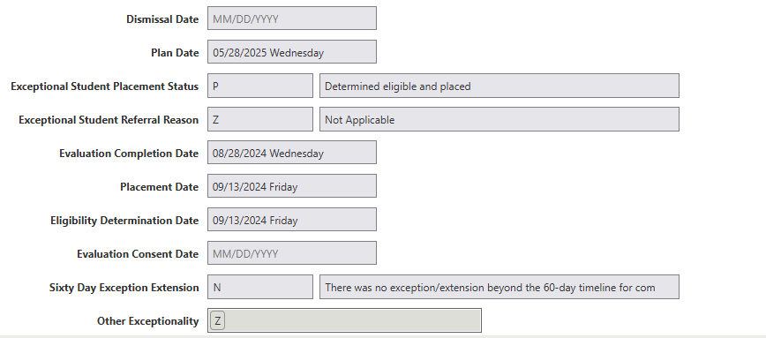
ESE Survey Format

Slide 9
Data Clean Up & Prep
*All clean up should be done in SMS prior to Migration
Evaluation
Exceptionality
IEP\EP
Cost Factor
Special Ed Check Box
Evaluation Placement Status
Type of Evaluation
Evaluation Start Date
Evaluation Completion Date
Referral
Eligibility Determination
Permission Date
Received Date
Referral reason
60 Day Exception
Case Manager
Exceptionality(s)
Primary Checkbox
Placement Status
IEP\EP Start Date
IEP\EP End Date
IDEA
IEP Manager
Cost Factor Effective Date
Levels
Special Considerations
Override (if applicable)
Placements
ESE Minutes
SEP Information
Times
Overrides (if applicable)
Placements
Primary Flag
Start Date
End Date
Dismissal (if applicable)
Dismissal Date

Slide 10
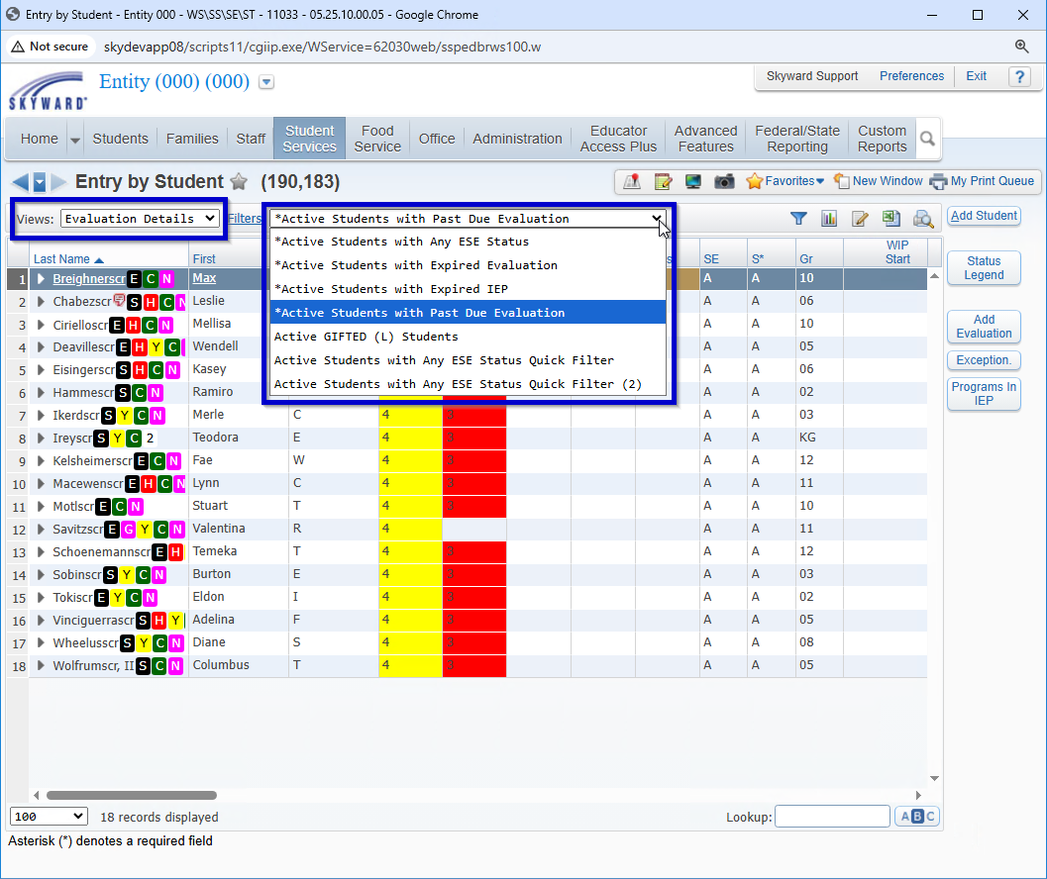
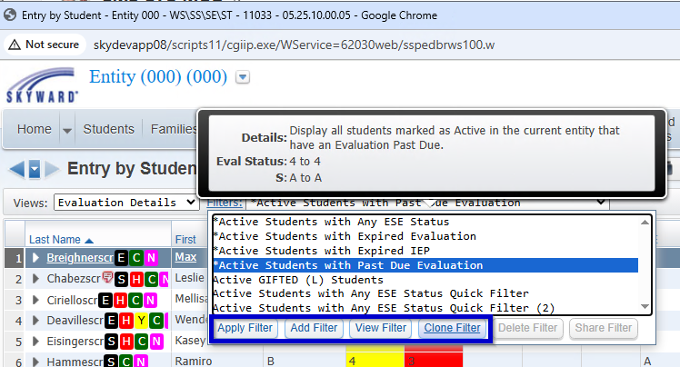
Browse Views & Filters
Data Clean Up and Review

Slide 11
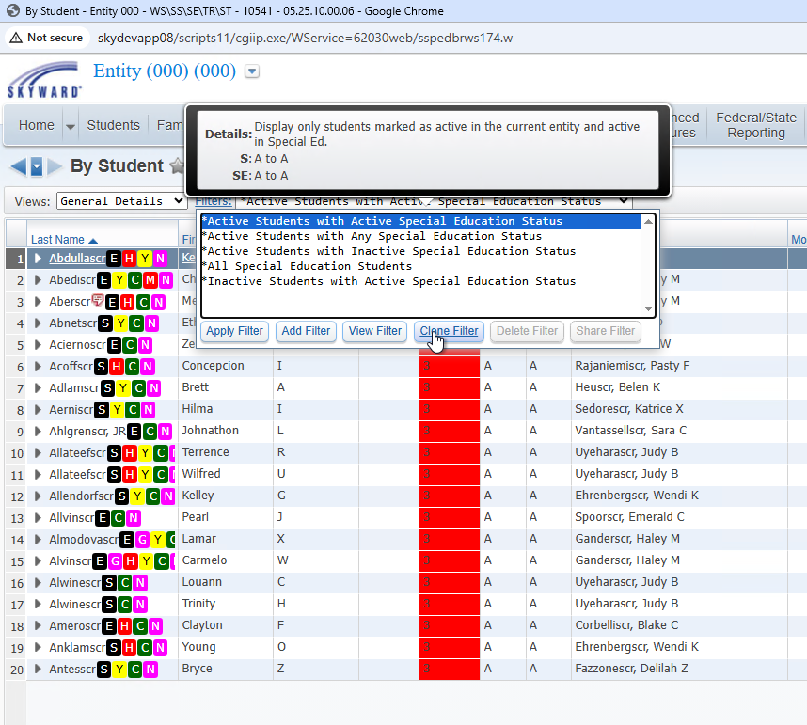
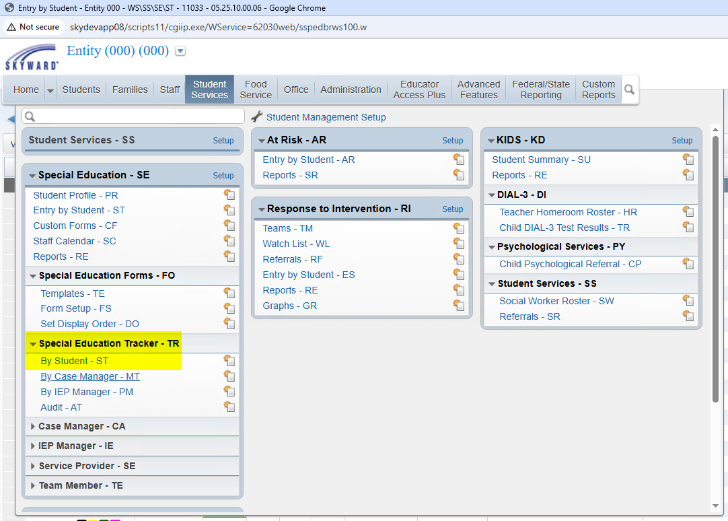
Browse Views & Filters
Data Clean Up and Review ESE Tracker

Slide 12
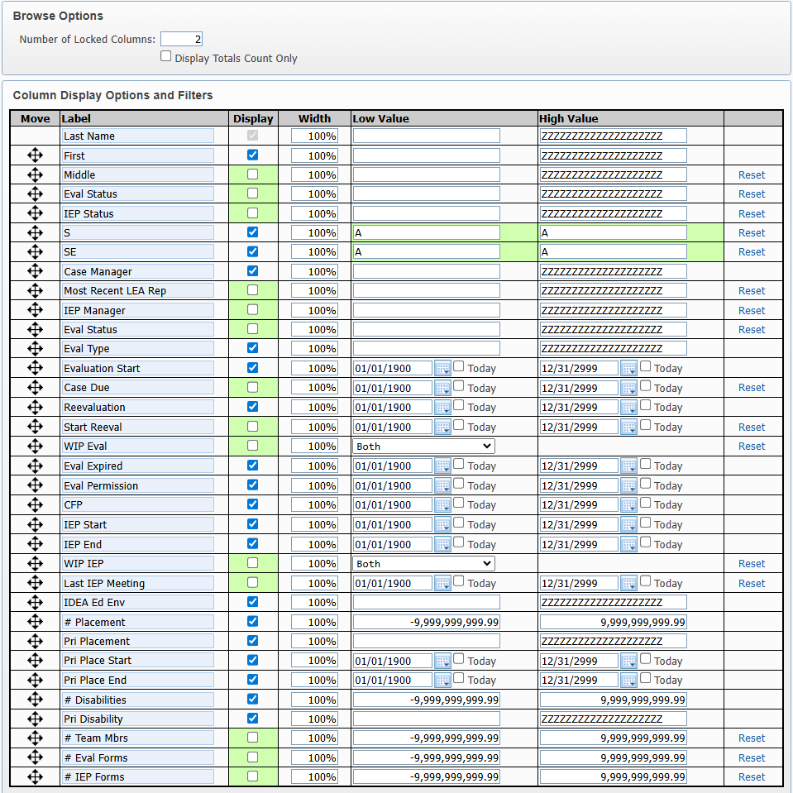
Browse Views & Filters
ESE Tracker

Slide 13
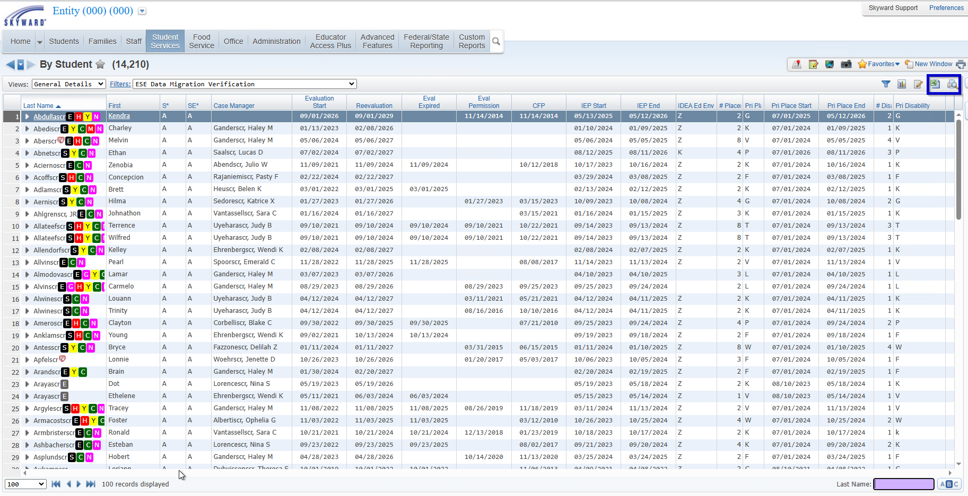
Browse Views & Filters
ESE Tracker

Slide 14
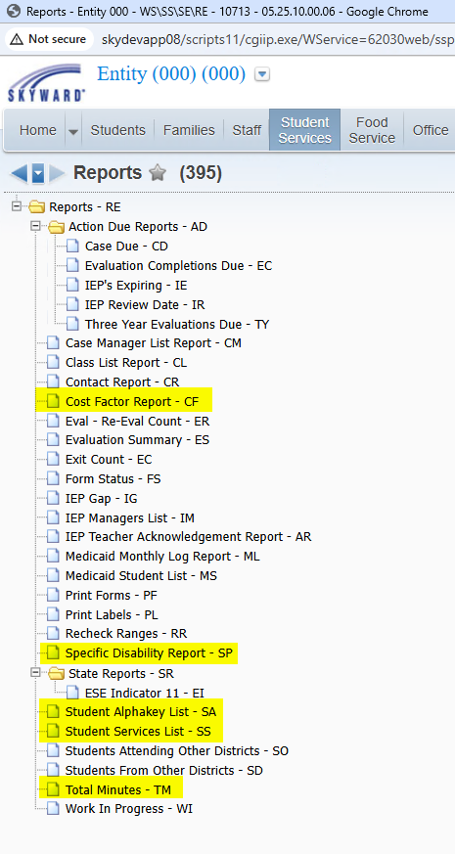
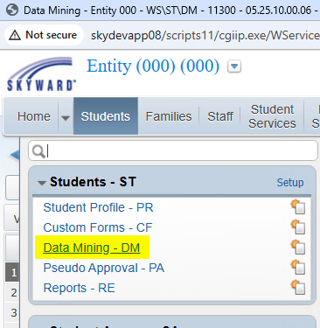
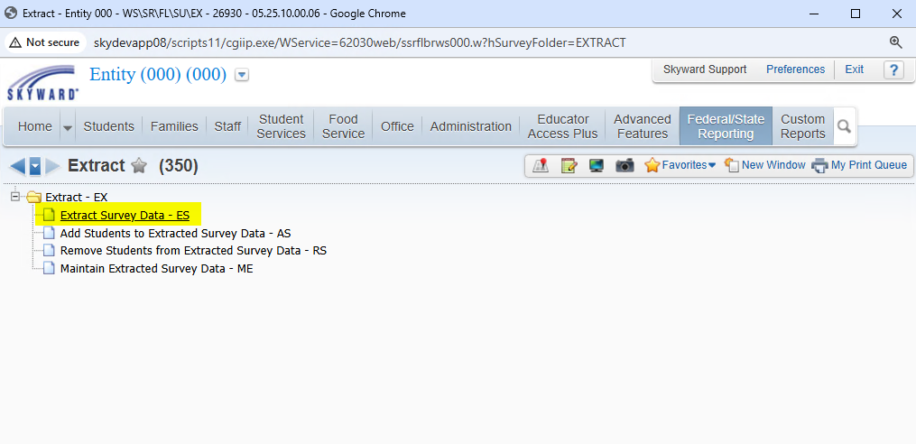
Other Report Options
ESE Reports Data Mining Survey Reports

Slide 15
Other Report Options
ESE Reports Data Mining Survey Reports

