Slide 1
Test Scores/EOC
Florida User Group 2025-2026
Notes:
This session will cover Test Builder setup affecting state reporting, EOC, and Date Passed setup and troubleshooting steps.

Slide 2
Agenda
Recent Updates
Test Builder Setups
Assessment Details
Troubleshooting Tips
Notes:
EOC Reminders: Course and tests are linked
Grading – EOC method
-options
Mass Change Selected Grade Mark has been updated to include EOC test grade bucket

Slide 3
Recent Updates
PR 6326242 - Date Passed has been updated based on state requirements 8-2025. Students who entered 9th grade in 2023-24 and 2024-25 can use earlier scores for their cohort if test taken prior to 8/19/2025.
PR 6356895 - The Date Passed and EOC have been updated for new Concordant test CLT10 and PAC (PreACT Secure).
PR 6368479 - The Date Passed Comm for AAD/UJ and AAP/UB has been updated.
PR 6386519 - The CLT and SAT state requirement has been updated for students who entered ninth grade in 2024 or 2025 to use prior scores if tests for passing scores were taken prior to 8/15/2025.

Slide 4
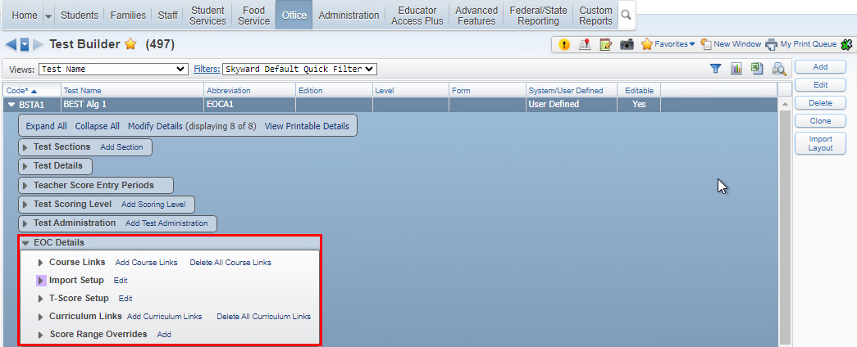
EOC Details
Course Links – be sure to include TR00 courses
Import Setup – used to determine what data us imported, overwritten, what school years for courses to include.
T-Score Setup – this is used only for Legacy tests. Be sure to ask if you are unsure if your district setup needs this.
Curriculum Links – allows you to link courses by using curriculum keys instead of course links.
Score Range Overrides – no longer needed
The following slides will go over the areas under EOC Details.
Web Student Management > Office > Curriculum & Assessment > Test Scores > Test Builder > EOC Details
Notes:
T-Score Setup – this is only used for legacy tests and should not be setup up.
Score Ranges Override - EOC score range overrides have been added to EOC Details in Test Builder to accommodate the provisional scores that affect Algebra 1 and Geometry passing scores. NOTE: This area is no longer needed to specify different score ranges as the state had added new test score subject content codes to identity tests using provisional score ranges.

Slide 5
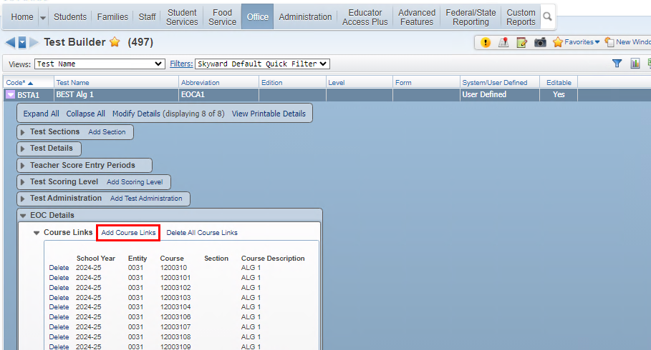
EOC Details
Course Links – be sure to include all possible courses that a student could take or have taken to meet the requirements
If a course is not applying for EOC, make sure the course has been linked to the EOC, this includes courses from TR00, Virtual, and Middle School Courses.
Web Student Management > Office > Curriculum & Assessment > Test Scores > Test Builder > Expand Test > Expand EOC Details
Notes:
T-Score Setup – this is only used for legacy tests and should not be setup up.
Score Ranges Override - EOC score range overrides have been added to EOC Details in Test Builder to accommodate the provisional scores that affect Algebra 1 and Geometry passing scores. NOTE: This area is no longer needed to specify different score ranges as the state had added new test score subject content codes to identity tests using provisional score ranges.

Slide 6
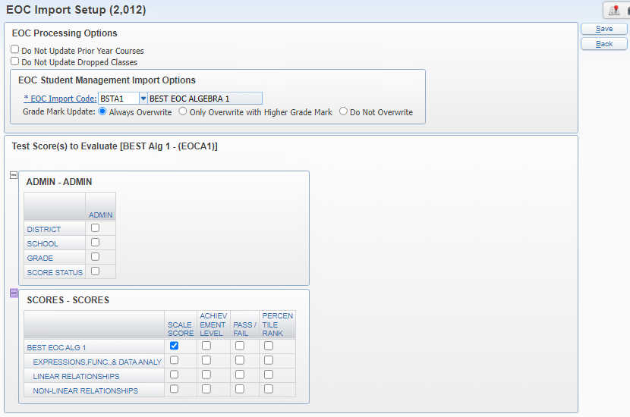
EOC Details
Import Setup – used to determine what data us imported, overwritten, what school years for courses to include.
Import Setup – used when importing test scores to indicate how courses should be processed and where to populate the score.
Web Student Management > Office > Curriculum & Assessment > Test Scores > Test Builder > Expand Test > Expand EOC Details
Notes:
Do not update prior year courses – if set it will only update courses based on year selected in import
Do not update dropped courses – if set it will not update dropped courses
EOC Import Code – this is used to identify the score ranges to grade mark that will be used to populate the EOC Test Grade when the test score is imported.
Grade Mark Update – overwrite options

Slide 7
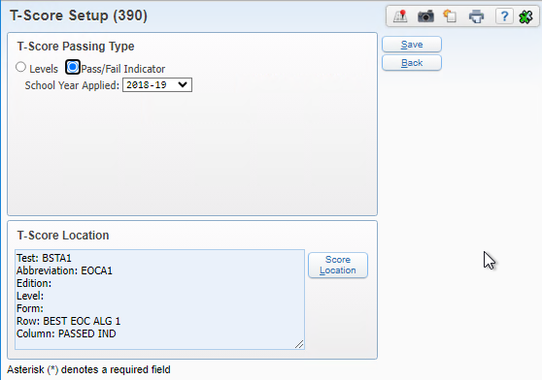
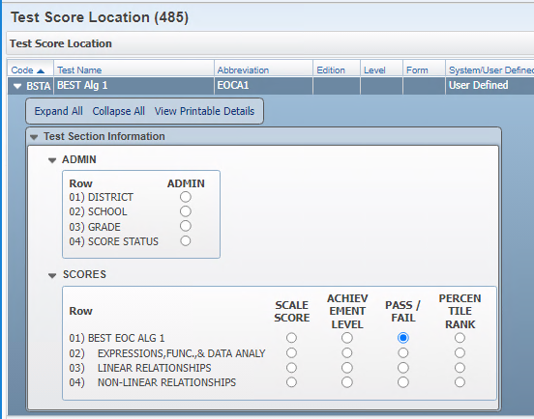
EOC Details
T-Score Setup – this is used only for Legacy tests. Be sure to ask if you are unsure if your district setup needs this.
Warning message is added regarding legacy tests.
Delete is available for T-score setup
T-scores should only be used for ‘legacy’ tests. A warning message will display if setup was added when it is not expected.
Web Student Management > Office > Curriculum & Assessment > Test Scores > Test Builder > Expand Test > Expand EOC Details
Notes:
PR 2/3/2025 Oct Release Addendum 10 estimated.

Slide 8
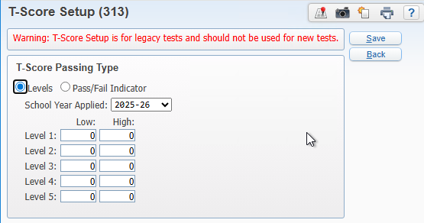
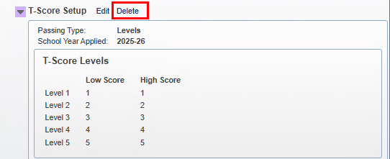
EOC Details
T-Score Setup – this is used only for Legacy tests. Be sure to ask if you are unsure if your district setup needs this.
Warning message is added regarding legacy tests.
Delete is available for T-score setup
T-scores set up in error can be deleted
Web Student Management > Office > Curriculum & Assessment > Test Scores > Test Builder > Expand Test > Expand EOC Details
Notes:
PR 2/3/2025 Oct Release Addendum 10 estimated.

Slide 9

EOC Details
Curriculum Links – allows you to link courses by using curriculum keys instead of course links.
Should only be used if ALL courses linked to the curriculum should apply
This area should only be used if ALL courses linked to the selected curriculum keys should apply for this test. If not, then use the Course Links area above.
Web Student Management > Office > Curriculum & Assessment > Test Scores > Test Builder > Expand Test > Expand EOC Details
Notes:
PR 2/3/2025 Oct Release Addendum 10 estimated.

Slide 10
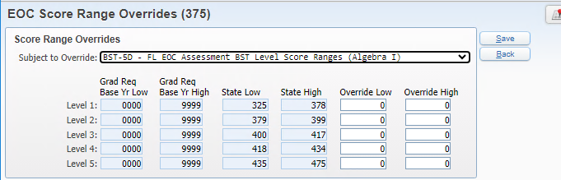
EOC Details
Score Range Overrides – no longer needed
Score Range Overrides were initially added so that different score ranges could be defined for the provisional and cut scores for tests such as Algebra 1. Since the state released separate subject content codes, this area is no longer needed for that setup.
Web Student Management > Office > Curriculum & Assessment > Test Scores > Test Builder > Expand Test > Expand EOC Details
Notes:
PR 2/3/2025 Oct Release Addendum 10 estimated.

Slide 11
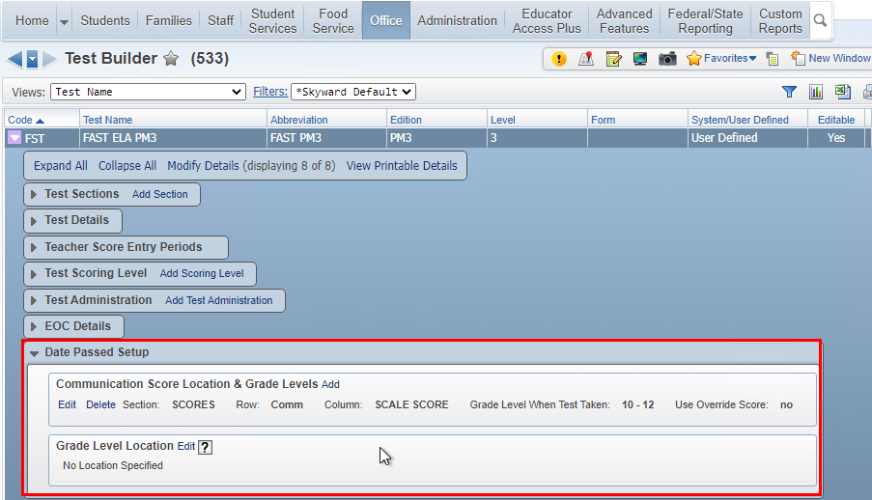
Tests Requiring Date Passed Setup
Select Add to identify score and any override values as needed
If only one score location is selected, the override is tied to that specific score location
Web Student Management > Office > Curriculum & Assessment > Test Scores > Test Builder

Slide 12
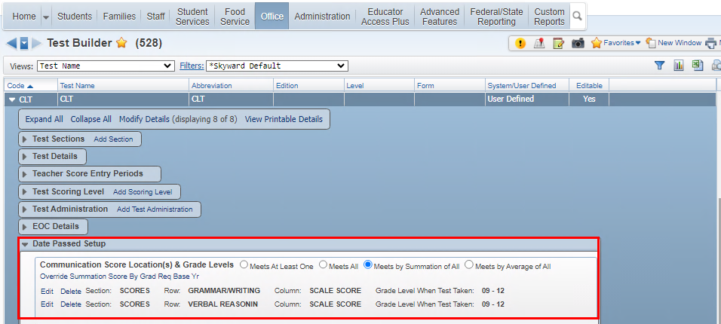
Date Passed Setup options Display based on more than one score location is selected.
When more than one score location is specified, additional options are available
If only one score location is selected, then these options do not display
Web Student Management > Office > Curriculum & Assessment > Test Scores > Test Builder

Slide 13
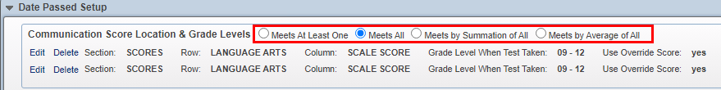
Date Passed Setup options for Score Location and Grade Levels
Meets At Least One - Student must have a passing score in one of the score locations.
Meets by Summation of All - Student must have scores from each section that combined have a passing score. Example would be the CLT (Classic Learning Test).
Meets by Average of All - Student must have scores from each section that averaged have a passing score. Example would be the ACT test.
Override Summation/Average Score By Grad Req Base Yr - When one of the new options is selected (Summation or Average), a new Override link appears. With new options, it’s the combination of both lines (either by summing or averaging) that is checked against, so overrides are entered here instead of on each individual record.
Web Student Management > Office > Curriculum & Assessment > Test Scores > Test Builder

Slide 14
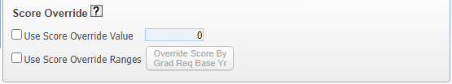
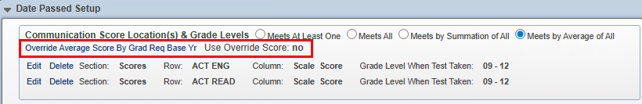
Date Passed Setup options
Overrides
Use Score Override Value: Use this option to set the override score value if Grad Req Base Yr does not apply. This option will apply the override score to Grad Req Base Yr of 0000 – 9999.
The Date Passed Setup will now indicate if the User Override Score is being used or not.
Web Student Management > Office > Curriculum & Assessment > Test Scores > Test Builder

Slide 15
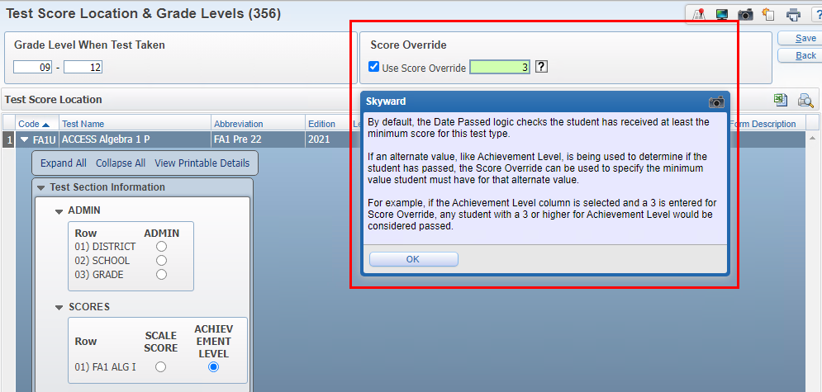
Date Passed setup for FA1/FA2 and AAP/AAD must use the Score Override when using the Achievement Level
FA1 & FA2 & AAP/AAD Date Passed Score Location and Override Setup
Web Student Management > Office > Curriculum & Assessment > Test Scores > Test Builder
Notes:
Example of using the Score Override

Slide 16

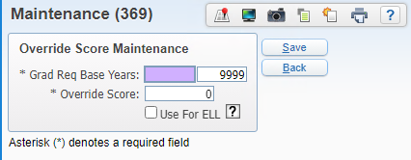
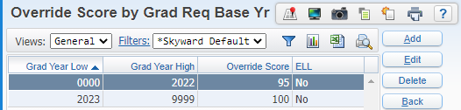
Date Passed Score Location and Override Setup using Grad Req Base Year option
Use Score Override Range: Use this option to set the override score value to only apply to students that fall within Grad Req Base Yr range. This option would be set if the passing override score value could change year to year.
Multiple records may be entered when the grad year ranges do not overlap
For Example: using a local defined test for ELL.
Web Student Management > Office > Curriculum & Assessment > Test Scores > Test Builder

Slide 17
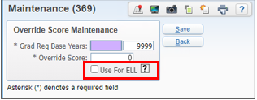
Date Passed Setup options
Overrides – Use for ELL
Use for ELL: When this option is selected, override will only be used for students that have ELL Program record. The override use will be limited to students that have a total time in an ELL Program of less then two years.
Web Student Management > Office > Curriculum & Assessment > Test Scores > Test Builder

Slide 18
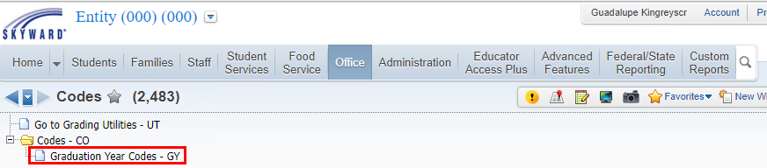
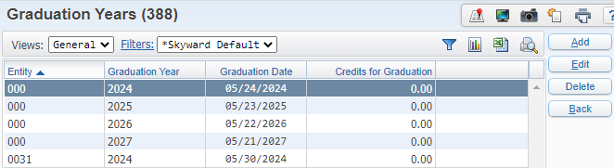
Graduation Year Codes for Date Passed ELL Option
The Graduation Year records can be set up at the district level and/or the entity level.
To use the ELL option for the date passed overrides, the student must be in ELL for less that 2 years from their graduation date.
Web Student Management > Office > Grading > Setup > Codes > Graduation Year Codes
Notes:
The logic will look first for an entity level date for the student’s current default entity, and it will use that date if available, otherwise it will use the district level date.
If a record for the student’s graduation year is not available, then this logic will not apply for the student.

Slide 19
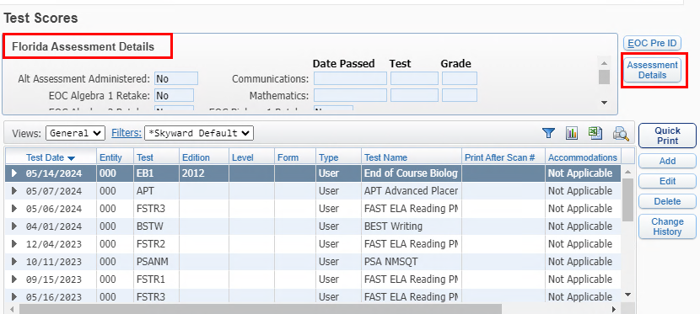
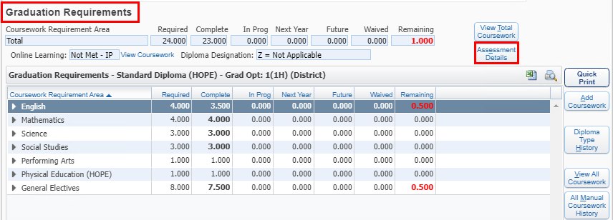
Assessment Details Security Access
Web Student Management > Students > Student Profile > Test Scores – Assessment Details OR Student Profile > Graduation Requirements > Assessment Details

Slide 20

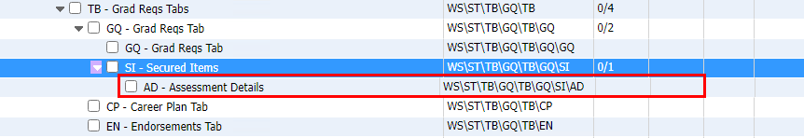
Assessment Details Security Access
Test Scores tab
Graduation Requirements tab
Requires level 1access to view
Web Student Management > Students > Student Profile > Test Scores – Assessment Details
Notes:
Security Access to the Assessment Details – need at least a level 1 to view only.

Slide 21
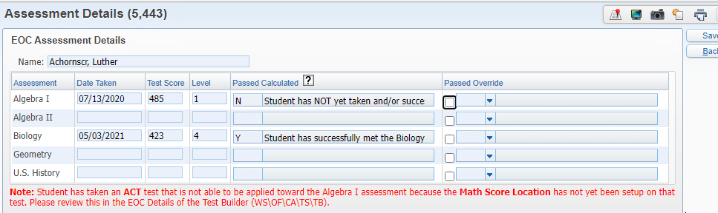
Assessment Details Information
Messages alert user to setup needed
Web Student Management > Students > Student Profile > Test Scores – Assessment Details
Notes:
The user will see a message on the Assessment Details if there is a test that based on programmed logic would apply but the test is not set up for date passed.

Slide 22
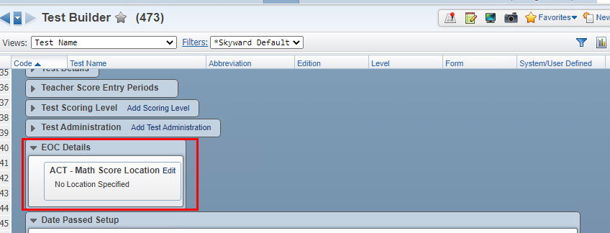
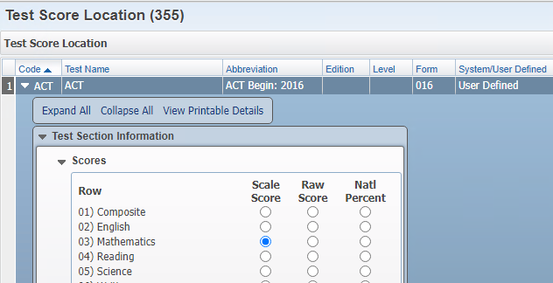
ACT/SAT/PSAT
Web Student Management > Office > Curriculum & Assessment > Test Scores > Test Builder

Slide 23
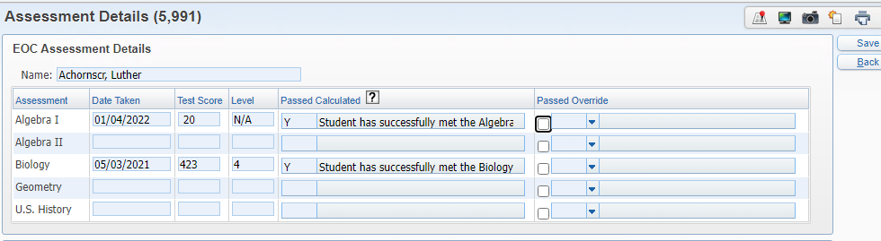
ACT test is now calculating as a passing test
Warning message is no longer populating
ACT/SAT/PSAT
Web Student Management > Students > Student Profile > Test Scores – Assessment Details

Slide 24
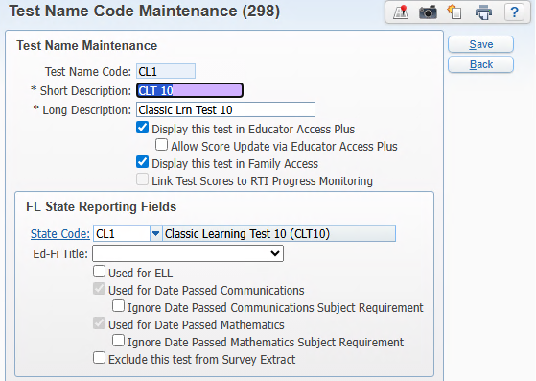
State test code: CL1 – automatically set as used for Date Passed Communications and Mathematics
State subject codes:
  Verbal Reasoning – D2
  Grammar/Writing – D3
  Quantitative Reasoning – D4
CLT10
Web Student Management > Students > Student Profile > Test Scores – Assessment Details

Slide 25
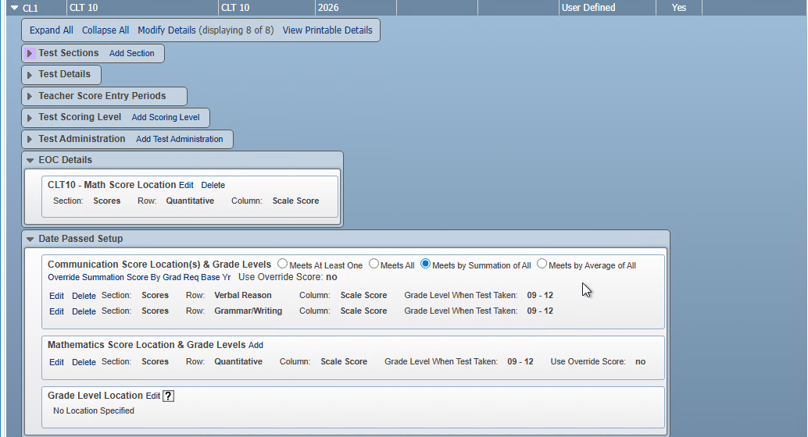
CLT10 test setup needed for both EOC and Date Passed Communications and Mathematics
Note: The CLT and CLT10 tests may not be combined for a passing score
CLT10
Web Student Management > Office > Curriculum & Assessment > Test Scores > Test Builder

Slide 26
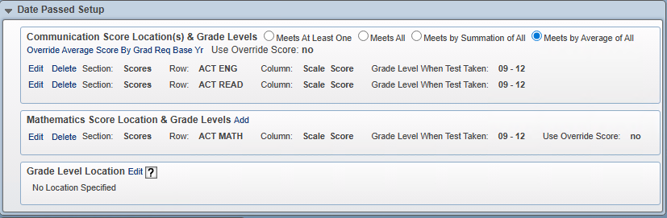
PreACT Secure
State Test Code: PAC
  English: PAC/BL
  Reading: PAC/BK
  Mathematics: PAC/BM
Note: The ACT and PreACT tests may not be combined for a passing communication score.
PAC: PreACT Secure
Web Student Management > Office > Curriculum & Assessment > Test Scores > Test Builder

Slide 27
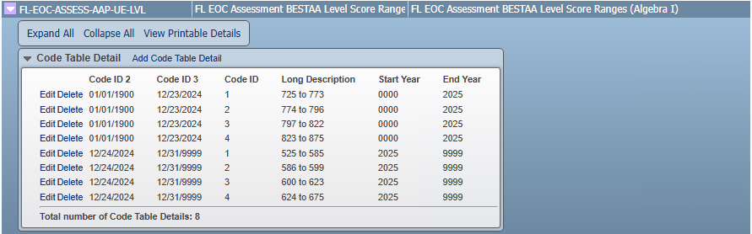
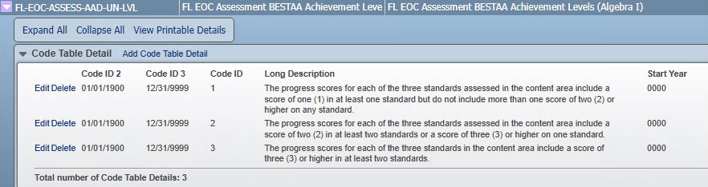
The AAD and AAP tests are replacing the FA1/FA2 alternate tests
Algebra 1 EOC (AAP/UE, AAD/UN) – passing scores held in the Maintain State-Defined tables
AAD/AAP
EOC
Web Student Management > Fed/State Reporting > Florida > Setup > Codes > Maintain State Defined Codes – System table: SYS-FL-CTM

Slide 28
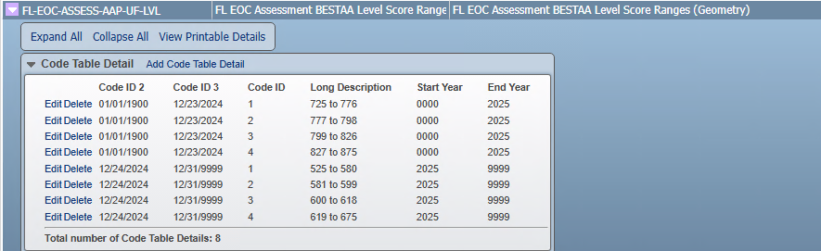
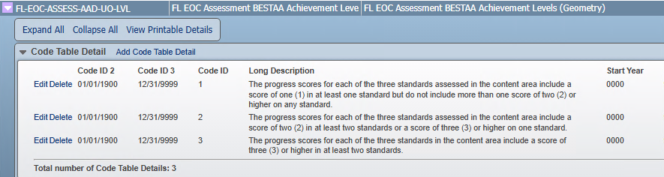
The AAD and AAP tests are replacing the FA1/FA2 alternate tests
Geometry EOC (AAP/UF, AAD/UO) – passing scores held in the Maintain State-Defined tables
AAD/AAP
EOC
Web Student Management > Fed/State Reporting > Florida > Setup > Codes > Maintain State Defined Codes – System table: SYS-FL-CTM

Slide 29
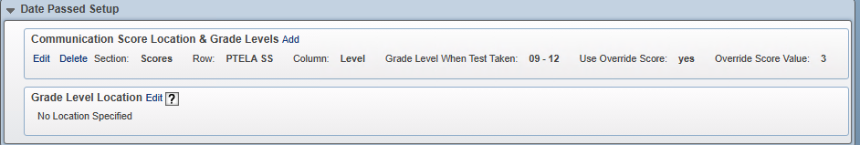
The AAD and AAP tests are replacing the FA1/FA2 alternate tests
State codes/Subject Codes for Date Passed Communications: AAP/UB, AAD/UJ
State codes/Subject Codes for Date Passed Mathematics: Algebra 1:AAP/UE, AAD/UN
  Geometry: AAP/UF, AAD/UO
Date Passed Communications and Mathematics should be set up using achievement level with score override = 3
AAD/AAP
Date Passed
Web Student Management > Office > Curriculum & Assessment > Test Scores > Test Builder

Slide 30
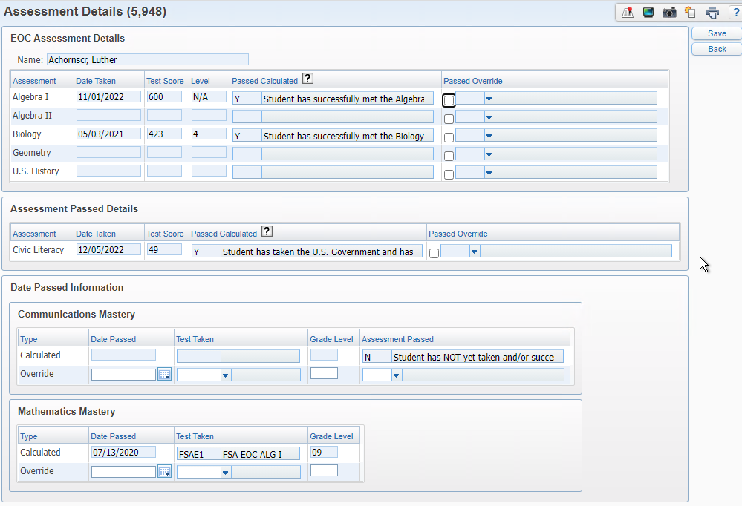
EOC Assessment Details will always populate the highest score, regardless of the test.
Date Passed will always populate the FSA/BST test first and then comparative/concordant scores.
  Configuration option to determine how scores populate for the concordant: (Date Passed) Use Earliest Concordant Passing Score
  Location: Product Setup > Skyward Contact Access > Student Management > Configuration
EOC Assessment
& Date Passed Logic
Web Student Management > Students > Student Profile > Test Scores – Assessment Details

Slide 31
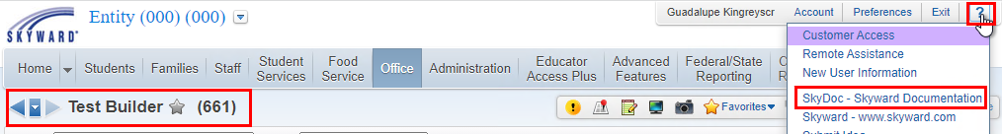
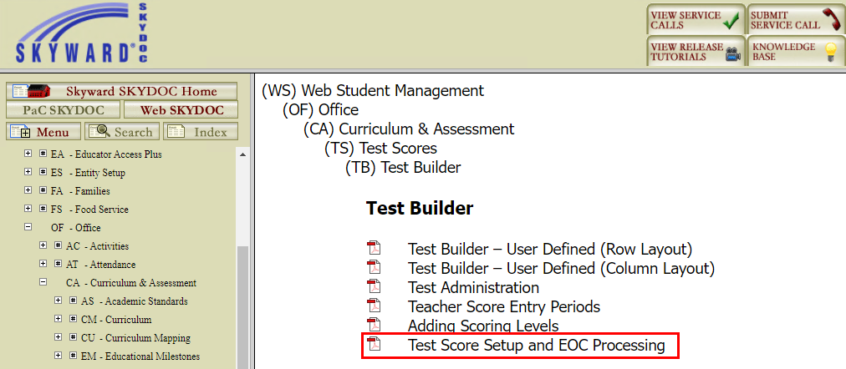
Documentation for Date Passed is included in Test Score Setup and EOC Processing available from Test Builder
Within Skyward > Question Mark > SkyDoc – Skyward Documentation
Notes:
For best search results, go to that area of the software you want documentation for and then select the question mark.

Slide 32
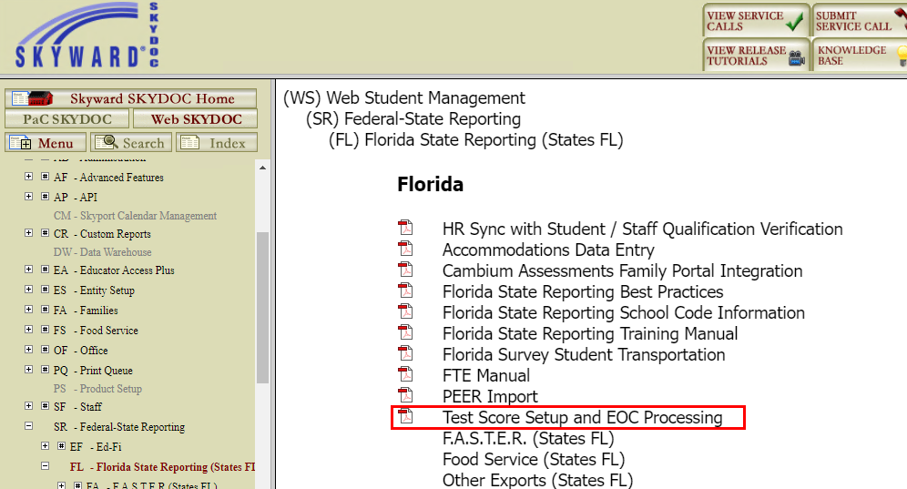
Documentation for Date Passed is included in Test Score Setup and EOC Processing available from Florida State Reporting
Within Skyward > Question Mark > SkyDoc – Skyward Documentation
Notes:
For best search results, go to that area of the software you want documentation for and then select the question mark.

Slide 33
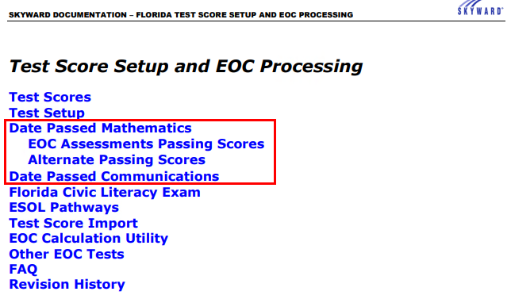
Test Score Setup and EOC Processing includes Date Passed Setup and logic.
Within Skyward > Question Mark > SkyDoc – Skyward Documentation
Notes:
This document is updated as state changes are made and our logic/setup updated.
You can see changes in the Revision History area.

Slide 34
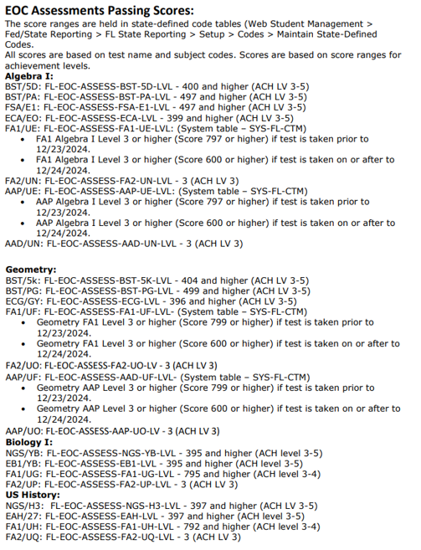
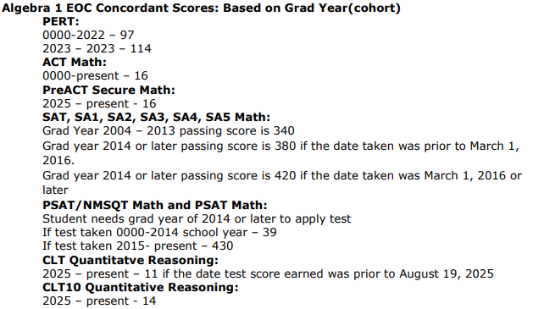
Test Score Setup and EOC Processing document also includes the EOC Passing Score Ranges
Within Skyward > Question Mark > SkyDoc – Skyward Documentation

Slide 35
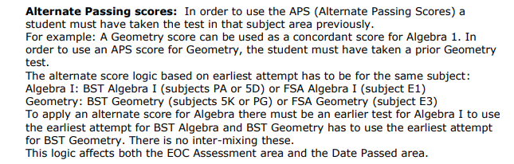
Added information regarding Alternate Passing Scores
Within Skyward > Question Mark > SkyDoc – Skyward Documentation

Slide 36
EOC Reminders
Make sure courses are cross-walked to the state EOC Assessment you will be using. Multiple can be linked
Verify that the Grading EOC Calc Methods are set up correctly especially if you have changed course lengths
Districts can use the Mass Change Selected Grade Mark utility to update EOC buckets
Notes:
EOC Reminders: Course and tests are linked
Grading – EOC method set up
Mass Change Selected Grade Mark has been updated to include EOC test grade bucket

Slide 37
Upcoming Updates
None at this time
Notes:
PR 5990941 -The state has posted new scale scores for the FAA Algebra 1 and Geometry tests. We will need to end the current tests taken prior to Spring 2025 and start new score ranges with Spring 2025
PR 5994638 - The state has posted new scale scores for the FAA Algebra 1 and Geometry tests. We need to update the Date Passed Mathematic logic and EOC Scores for Algebra 1 and Geometry to use the new scores beginning with Spring Test scores. Tests taken prior to May 1 should use the old passing scores and tests taken after May 1 should use the new scores.
PR 5974729 - The state has updated the valid EOC courses and we need to update our Pre-ID valid EOC course list to match the state.
Biology - remove course 2000850
US History - remove course 2100390

Slide 38
Questions

Slide 39
Thank you!

