Slide 1
F.A.S.T.E.R. & Grad Requirements
Florida User Group 2025 – 2026
Notes:
This session will cover recent changes for F.A.S.T.E.R. and Graduation Requirements.

Slide 2
Agenda
2024-2025
Recent state updates
Grad Requirement reminders & Troubleshooting Tips
Qmlativ Overview
Upcoming updates

Slide 3
Recent Updates
PR 6371680 - The 2025-2026 FASTER cutover changes have been completed and include updates for Good Cause Exemption, ELL Program Participation, and Alternate Assessment. Additionally, the Outgoing Transmissions screen includes a new View Raw File Data button.
PR 6033545 - An Art-Related flag has been added to the Community Service Hours record and a Total Art-Related Hours field was also added to the Community Service Hours tab and includes the total Community Service Hours of all records flagged as Art-Related. The fields have also been added to Data Mining.
PR 6352307 - The transcript has been updated with an option exclude industry certifications from printing.
PR 6362453 - FLEID has been added to the FASTER Printed Transcript.

Slide 4
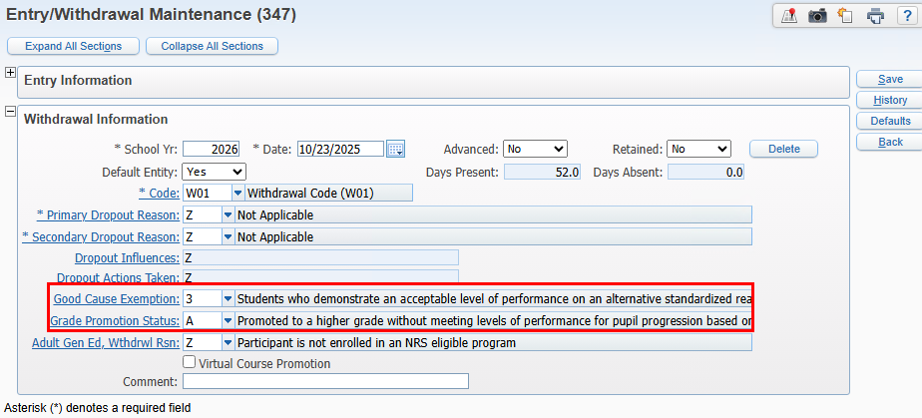
Good Cause Exemption
Good Cause Exemption will be sent in the file on the School Year record if the following is true:
1. Student has an E/W record with Grade Promotion Status = A and a Good Cause Exemption other than Z
FASTER Cutover Changes
PR 6371680
WEB STUDENT MANAGEMENT > STUDENT > STUDENT PROFILE > ENTRY/WITHDRAWAL

Slide 5
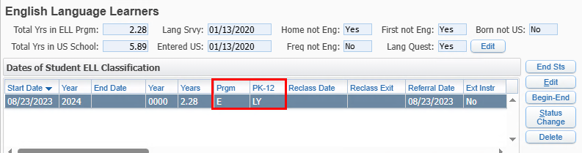
ELL - Program Participation
FASTER Cutover Changes
PR 6371680
Program Participation will be sent in the file on the CTE, ELL, Dropout record if the following is true:
1. Student has a current ELL record with a PK-12 = LY or LP and a Program Participation other than Z
WEB STUDENT MANAGEMENT > STUDENT > STUDENT PROFILE > SPECIAL PROGRAMS > ELL

Slide 6
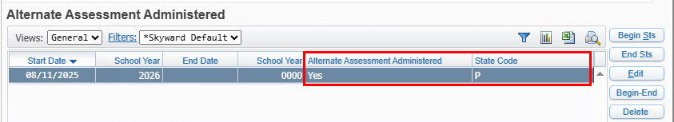
Alternate Assessment
FASTER Cutover Changes
PR 6371680
Alternate Assessment will be sent in the file on the Exceptional record if the following is true:
1. Student has a current Alternate Assessment Administered record with an Alternate Assessment Administered value of ‘Yes’ and a State Code of ‘P’.
WEB STUDENT MANAGEMENT > STUDENT > STUDENT PROFILE > SPECIAL PROGRAMS > ALT ASSESS

Slide 7
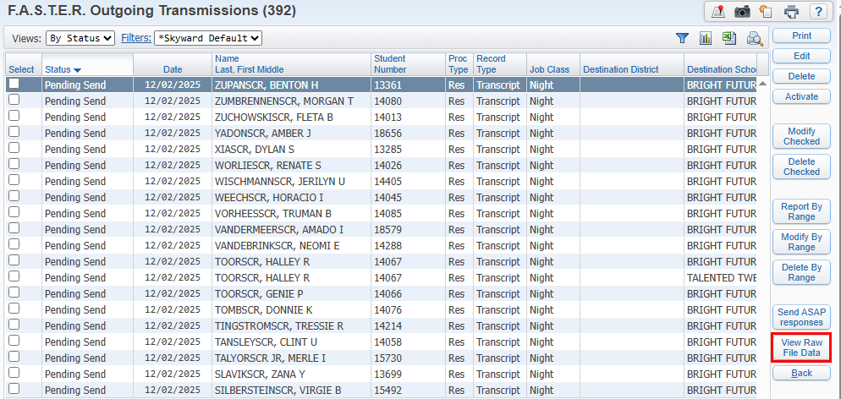
Outgoing Transmissions
View Raw File Data button has been added to Outgoing Transmissions and Incoming Students screens.
FASTER Cutover Changes
PR 6371680
WEB STUDENT MANAGEMENT > FED/STATE REPORTING > FLORIDA > FASTER > REPORTS > OUTGOING TRANSMISSIONS

Slide 8
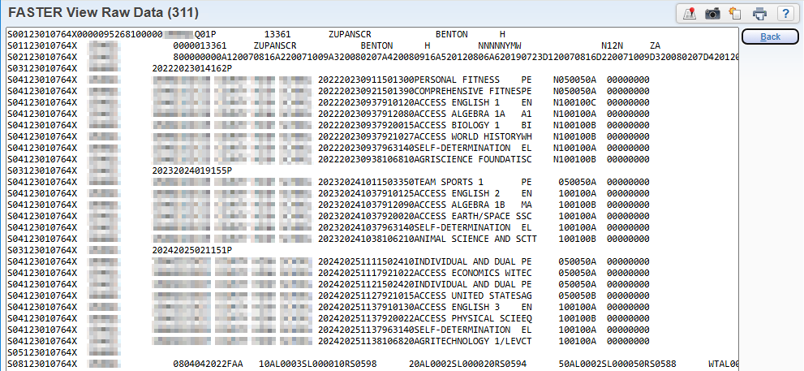
Outgoing Transmissions
View Raw File Data button has been added to Outgoing Transmissions and Incoming Students screens.
Copy raw data and paste it into a text editor that will make it easier to view values in a specific location.
FASTER Cutover Changes
PR 6371680
WEB STUDENT MANAGEMENT > FED/STATE REPORTING > FLORIDA > FASTER > REPORTS > OUTGOING TRANSMISSIONS

Slide 9
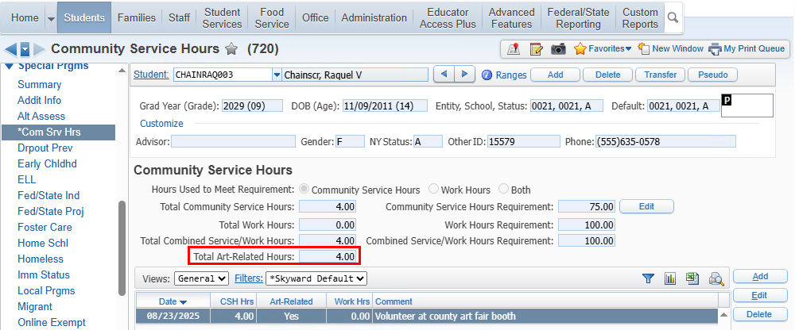
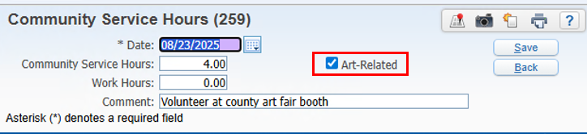
Art-Related Flag
This was added for tracking purposes for the Seal of Fine Arts Endorsement. Districts can check to see if the student has met the hour requirement for the freeform option
Community Service Hours
PR 6033545
WEB STUDENT MANAGEMENT > STUDENTS . STUDENT PROFILE > SPECIAL PROGRAMS > COM SRV HRS

Slide 10
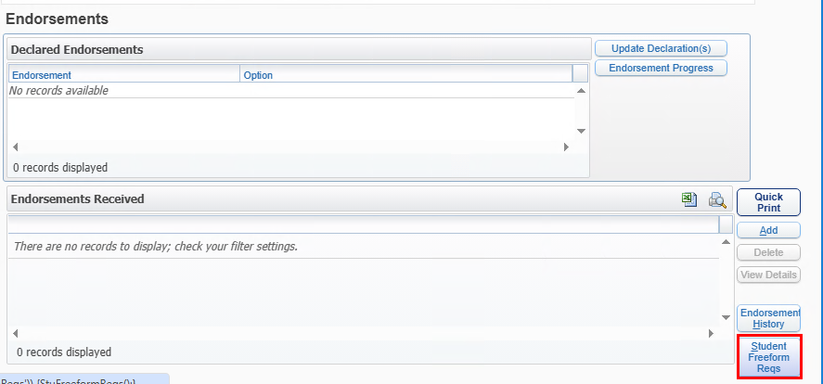
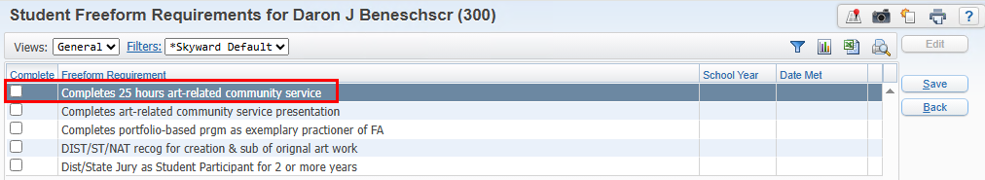
Art-Related Flag
This was added for tracking purposes for the Seal of Fine Arts Endorsement. Once the student has completed the hours, they can check the freeform endorsement requirement.
Community Service Hours
PR 6033545
WEB STUDENT MANAGEMENT > STUDENTS > STUDENT PROFILE > GRAD REQUIREMENTS > ENDORSEMENTS

Slide 11
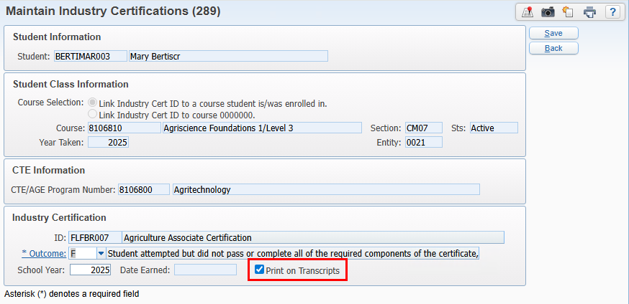
Industry Certifications
A Print on Transcripts flag has been added to the industry certification. It will default as checked to print. Districts can uncheck to exclude a certification from printing on the transcript as needed.
FASTER – Exclude Industry Cert
PR 6352307
WEB STUDENT MANAGEMENT > STUDENTS > STUDENT PROFILE > CAREE/TECH ED > INDUSTRY CERTS
Notes:
There is not a separate security item for this at this time. Might be something we need to add.

Slide 12
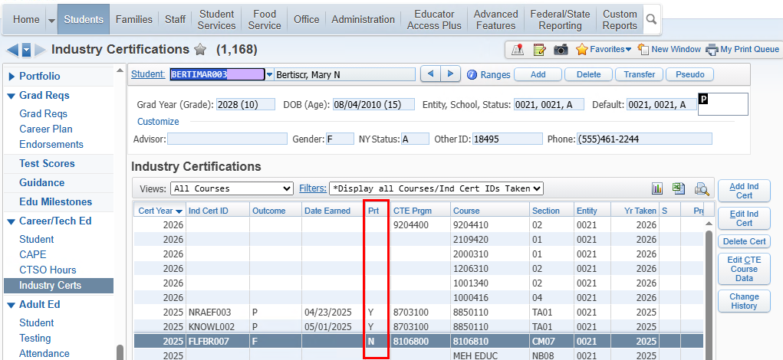
Industry Certifications
The industry certification browse has a Prt column to identify if the industry cert is flagged to print on the transcript.
FASTER – Exclude Industry Cert
PR 6352307
WEB STUDENT MANAGEMENT > STUDENTS > STUDENT PROFILE > CAREE/TECH ED > INDUSTRY CERTS

Slide 13
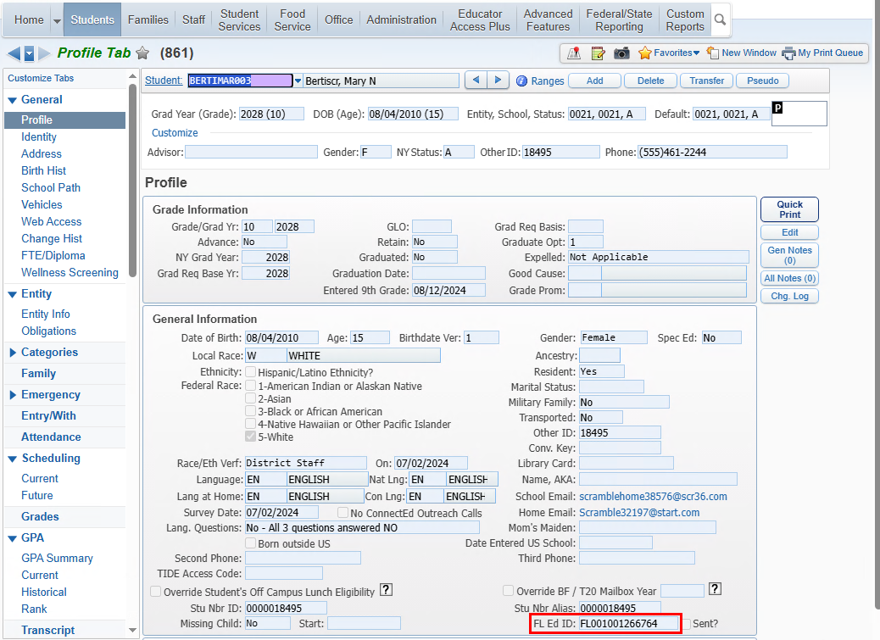
FASTER Inter-district and Secondary Transcripts
The transcripts include the FLEID and now print on both the inter-district and secondary transcripts.
Student Profile has FLEID:
FASTER – Includes FLEID
PR 6362453
WEB STUDENT MANAGEMENT > STUDENTS > STUDENT PROFILE > CAREE/TECH ED > INDUSTRY CERTS

Slide 14
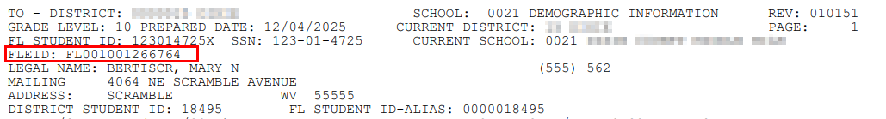
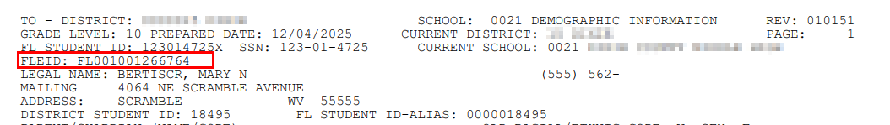
FASTER Inter-district and Secondary Transcripts
The transcripts include the FLEID and now print on both the inter-district and secondary transcripts.
FLEID is included in header record. Note: FASTER does not validate the FLEID.
FASTER – Includes FLEID
PR 6362453
Inter-district Transcript:
Secondary Transcript:
WEB STUDENT MANAGEMENT > STUDENTS > STUDENT PROFILE > CAREE/TECH ED > INDUSTRY CERTS

Slide 15
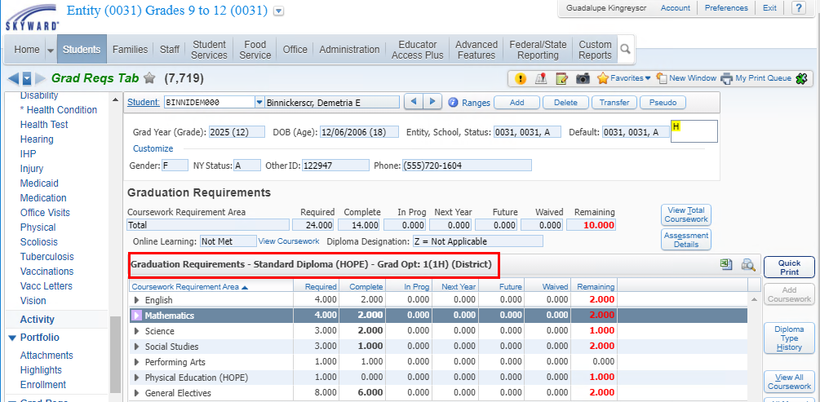
Grad Requirement Troubleshooting Tips
When a course is not applying to graduation requirements plan:
Verify the student’s graduation plan
WEB STUDENT MANAGEMENT > STUDENTS > STUDENT PROFILE > GRADES > CLASS HISTORY

Slide 16
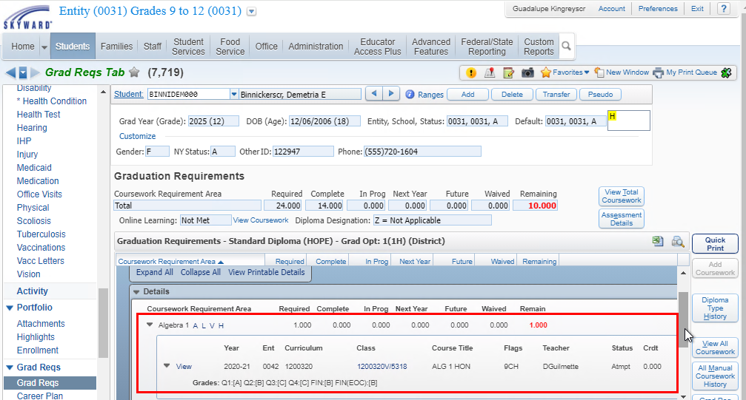
For example, this student’s Algebra requirement is not met. The student has grades that should earn credit. Make note of the entity, school year, and course.
Grad Requirement Troubleshooting Tips
WEB STUDENT MANAGEMENT > STUDENTS > STUDENT PROFILE > GRAD REQS > GRAD REQS

Slide 17
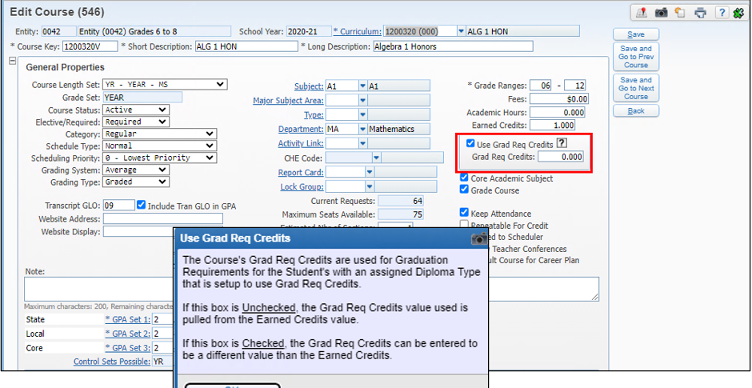
Navigate to the course: for this example, the course is set to use Grad Req Credits and the value is set to 0.00 which is why it is not showing as earned for Grad Reqs.
Grad Requirement Troubleshooting Tips
WEB STUDENT MANAGEMENT > OFFICE > CURRENT SCHEDULING > BUILD COURSE MASTER > COURSE MASTER

Slide 18
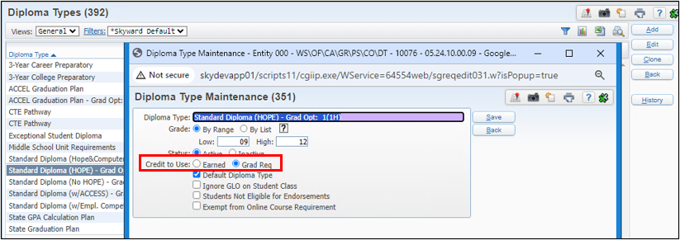
Verify the Diploma Type Code for that Grad Plan is set to use Grad Req Credits.
Grad Requirement Troubleshooting Tips
WEB STUDENT MANAGEMENT > OFFICE . CURRICULUM & ASSESSMENTS > GRADUATION REQUIREMENTS > SETUP > CODES > DIPLOMA TYPE CODES

Slide 19
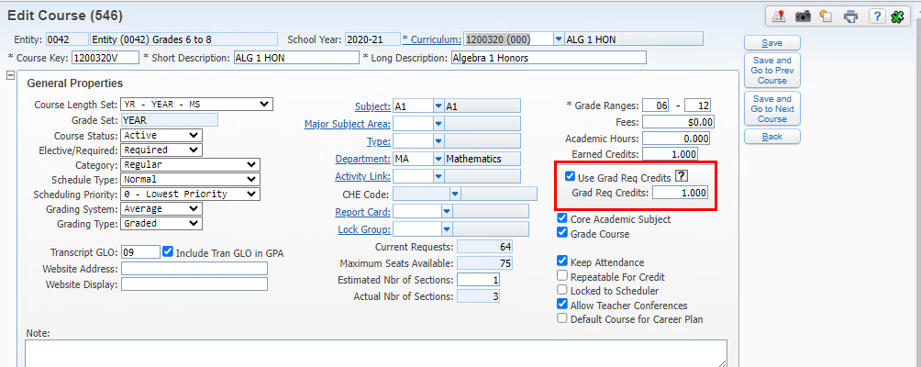
The district can update the grad req credits on the course if accurate. Upon saving, a utility runs in the print queue to update student records that are linked to that course.
Grad Requirement Troubleshooting Tips
WEB STUDENT MANAGEMENT > OFFICE > CURRENT SCHEDULING > BUILD COURSE MASTER > COURSE MASTER

Slide 20
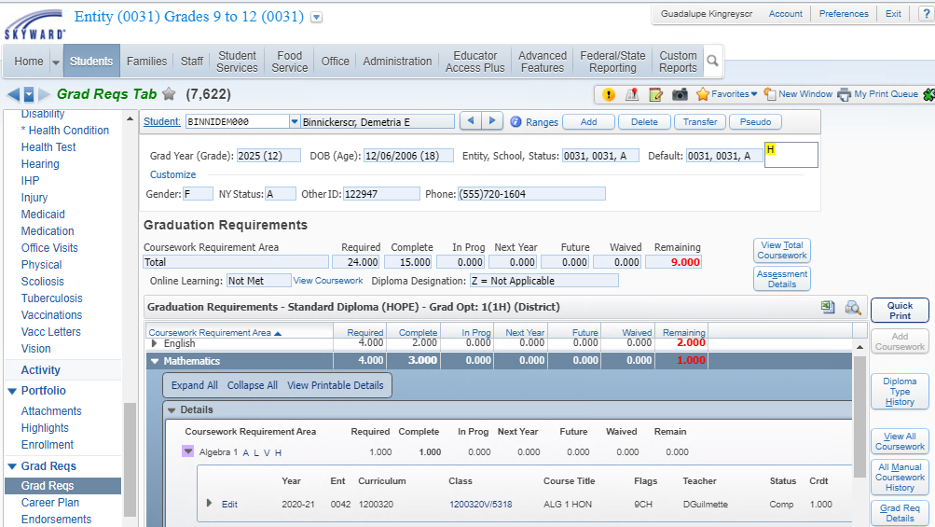
The student’s grad plan now shows as Algebra has earned credit and that requirement has been met.
Grad Requirement Troubleshooting Tips
WEB STUDENT MANAGEMENT > STUDENTS > STUDENT PROFILE > GRAD REQS > GRAD REQS

Slide 21
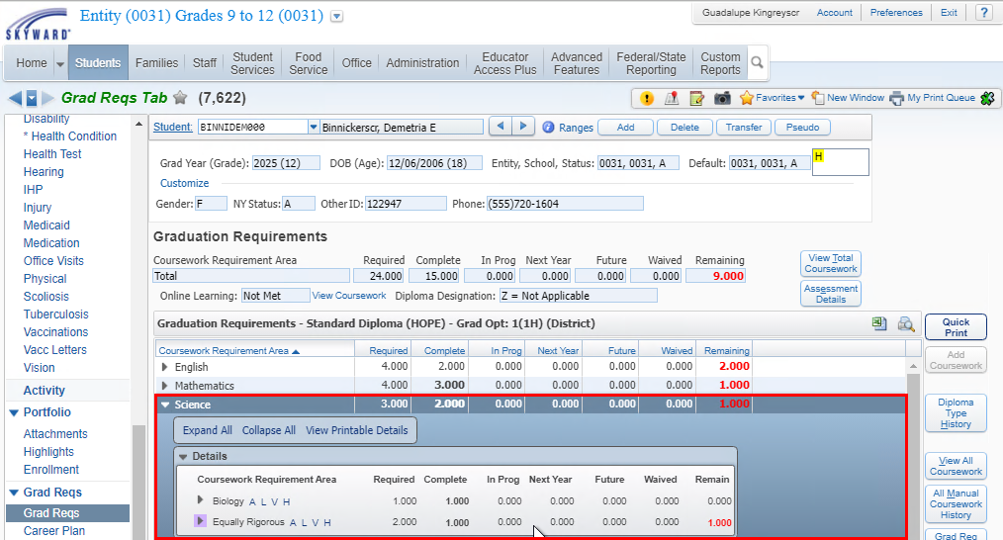
For this example, the student has not met the Equally Rigorous area for Science
Grad Requirement Troubleshooting Tips
WEB STUDENT MANAGEMENT > STUDENTS > STUDENT PROFILE > GRAD REQS > GRAD REQS

Slide 22
Look up the curriculum key tied to the course (2000360 in this example)
Grad Requirement Troubleshooting Tips
WEB STUDENT MANAGEMENT > STUDENTS > STUDENT PROFILE > GRAD REQS > GRAD REQS

Slide 23
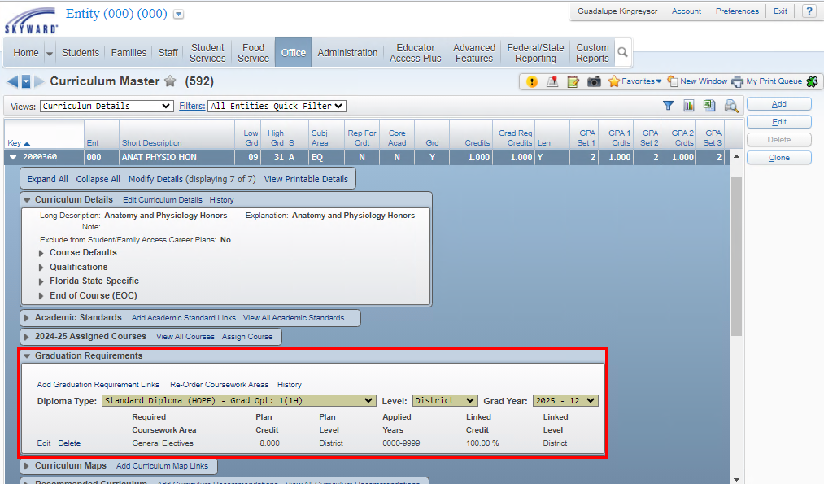
Look up the curriculum key tied to the course (2000360 in this example). For this grad plan, it is only linked to General Electives.
Grad Requirement Troubleshooting Tips
WEB STUDENT MANAGEMENT > CURRICULUM & ASSESSMENTS > CURRICULUM > CURRICULUM MASTER

Slide 24
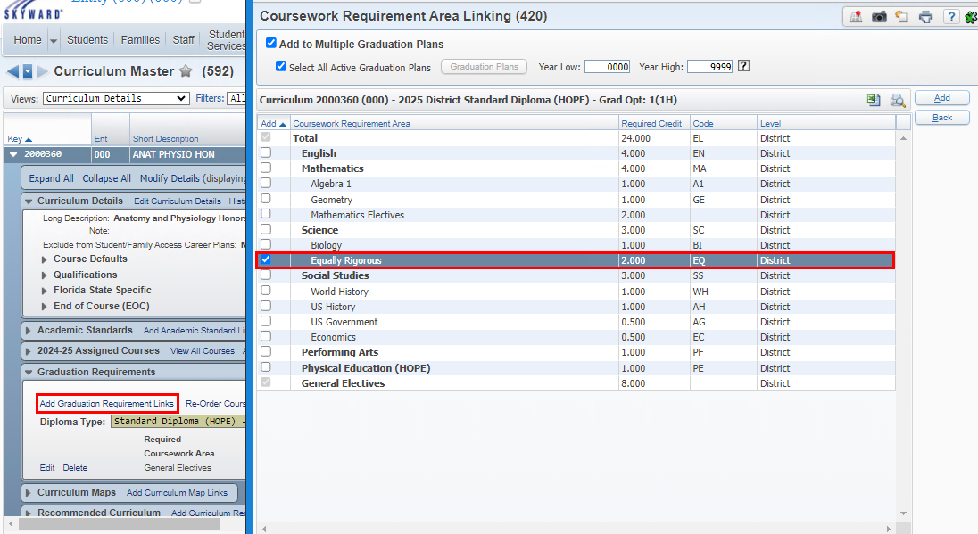
If appropriate for this plan, use the Add Graduation Requirements Links to link it to Science > Equally Rigorous
Grad Requirement Troubleshooting Tips
WEB STUDENT MANAGEMENT > CURRICULUM & ASSESSMENTS > CURRICULUM > CURRICULUM MASTER

Slide 25
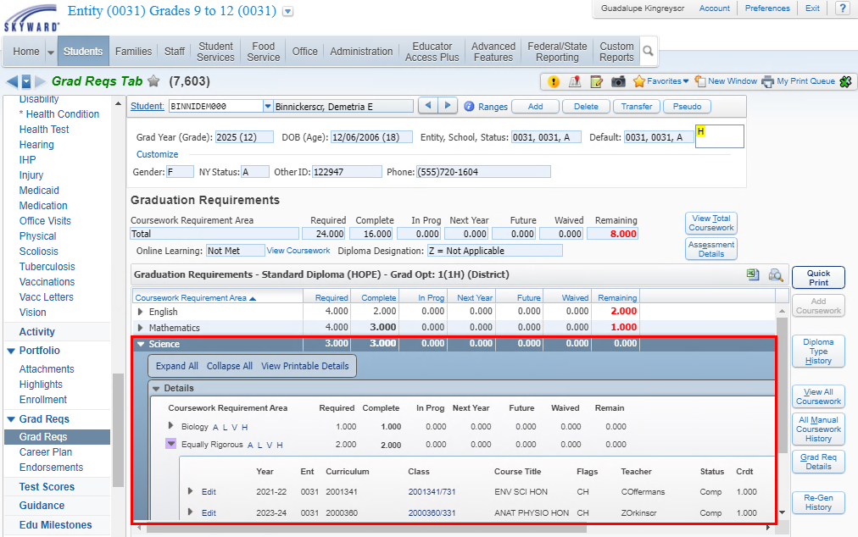
The student course is now applying to Science > EQ as expected
Grad Requirement Troubleshooting Tips
WEB STUDENT MANAGEMENT > STUDENTS > STUDENT PROFILE > GRAD REQS > GRAD REQS

Slide 26
Grad Requirement Troubleshooting Tips
When a course is not applying to graduation requirements plan:
Verify the student’s graduation plan
Look up the course in the course master for the year applied and verify the curriculum key
Go to the curriculum master and verify the grad requirement areas the curriculum key is linked to for the student’s graduation plan
Go to the student’s grad reqs tab and verify if the course is being applied to any of the areas.
Courses apply based on not only the areas they can apply to but also based on the availability of the remaining areas, meaning if they can apply to 3 areas but by the time the student takes the class, it can only apply to 1 area, it will be used over another course that can still satisfy more than one area.
WEB STUDENT MANAGEMENT > STUDENTS > STUDENT PROFILE > GRAD REQS > GRAD REQS
Notes:
Courses can be flagged at the student level if it can’t be flagged at the course/section level.

Slide 27
Upcoming Updates
None at this time.

Slide 28
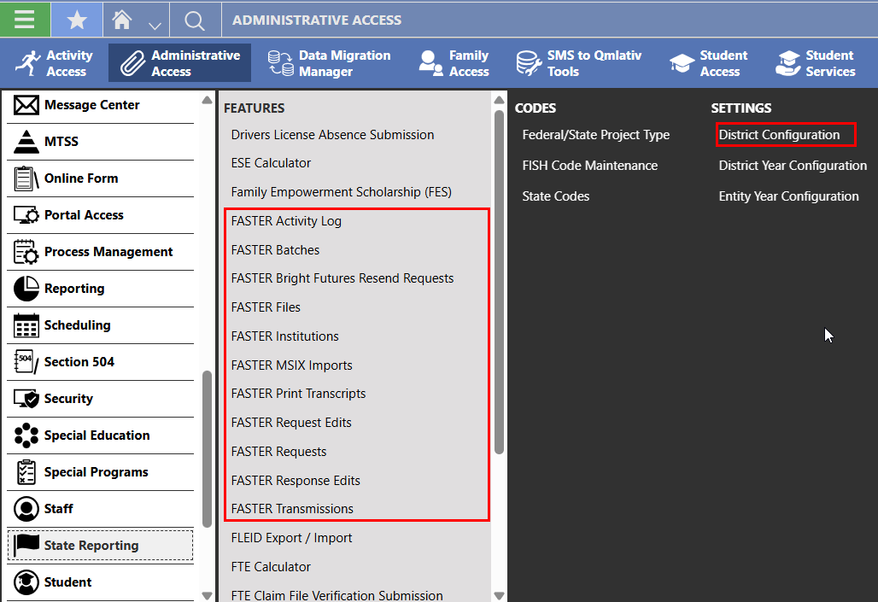
FASTER Overview
FASTER Qmlativ

Slide 29
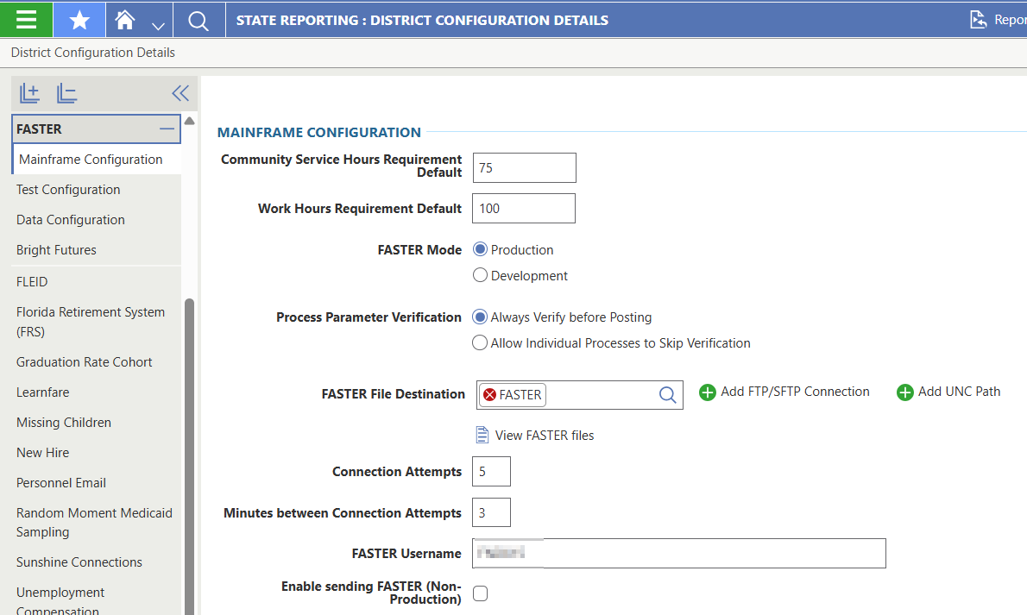
FASTER Qmlativ
District Configuration>
FASTER:
Mainframe
Test Configuration
Data Configuration
Bright Futures

Slide 30
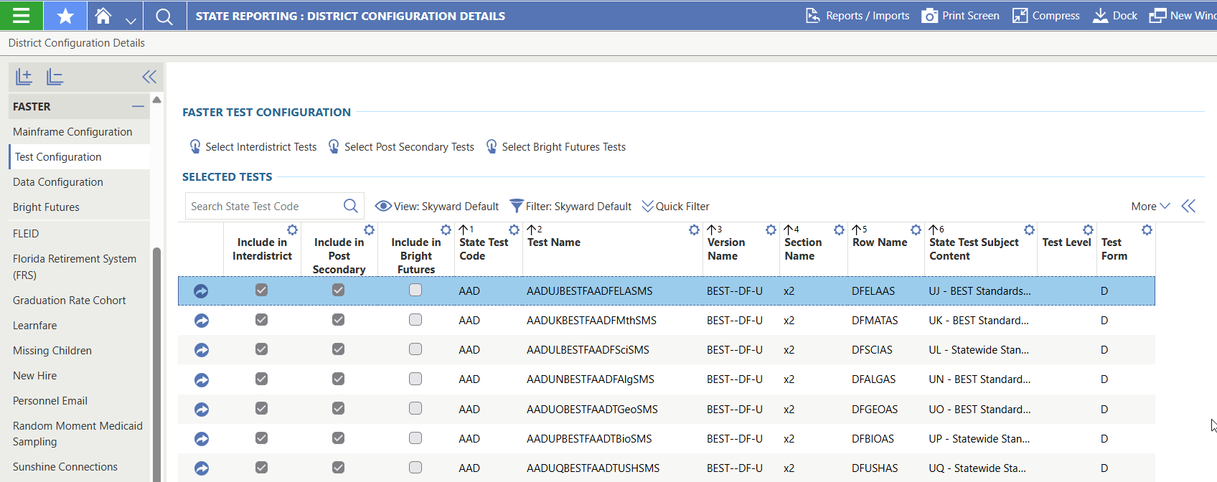
Test Configuration is used to identify the test/fields to send on the transcript.
FASTER Qmlativ
District Configuration>
FASTER:
Mainframe
Test Configuration
Data Configuration
Bright Futures

Slide 31
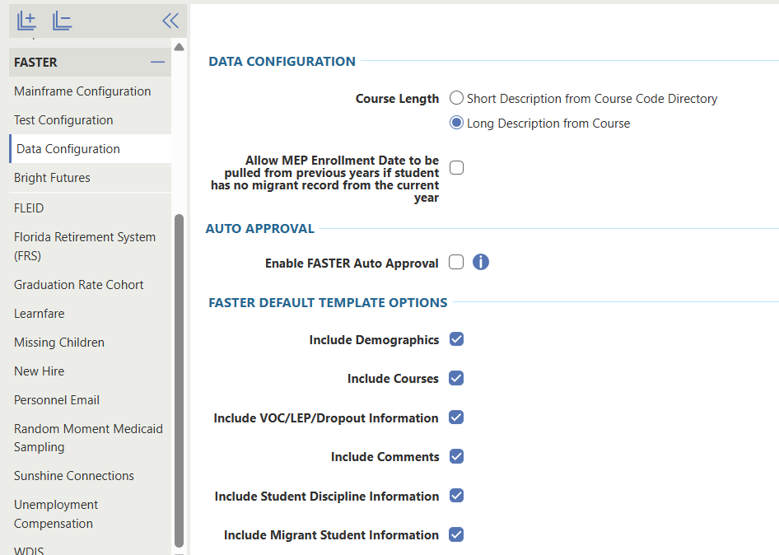
Data configuration are options for what is sent on transcripts.
FASTER Qmlativ
District Configuration>
FASTER:
Mainframe
Test Configuration
Data Configuration
Bright Futures

Slide 32
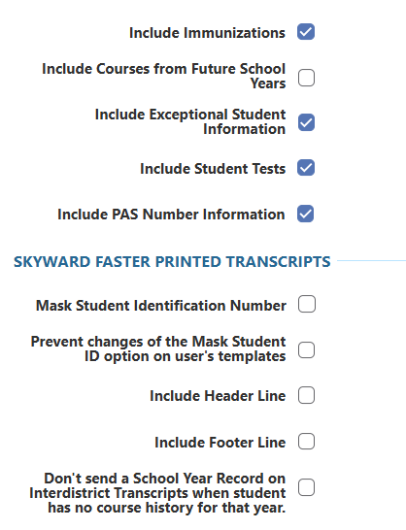
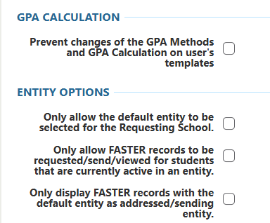
Data configuration are options for what is sent on transcripts.
FASTER Qmlativ
District Configuration>
FASTER:
Mainframe
Test Configuration
Data Configuration
Bright Futures

Slide 33
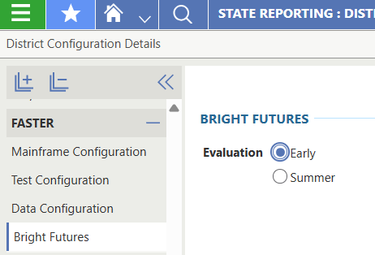
Bright Futures selection.
FASTER Qmlativ
District Configuration>
FASTER:
Mainframe
Test Configuration
Data Configuration
Bright Futures

Slide 34
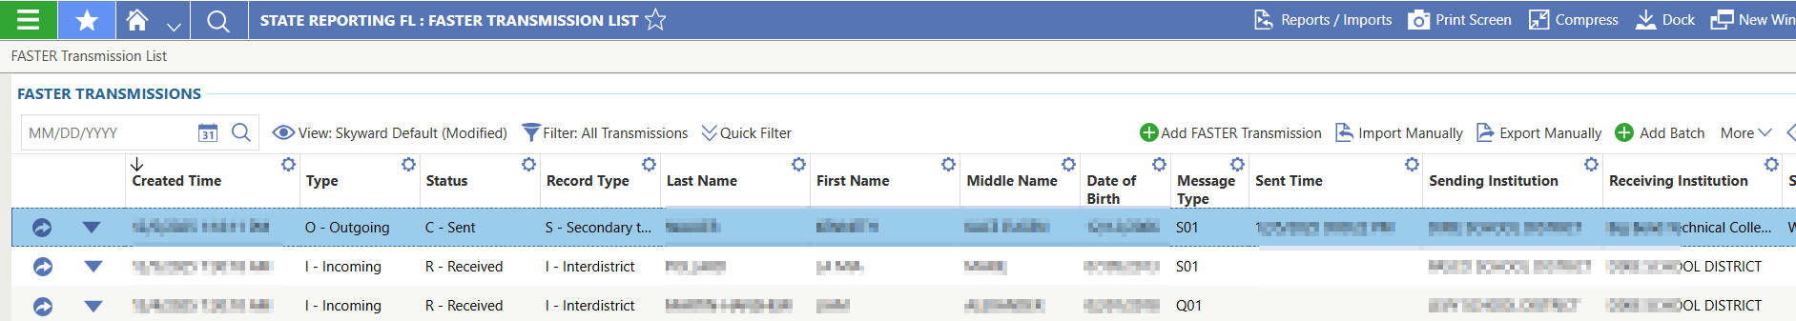
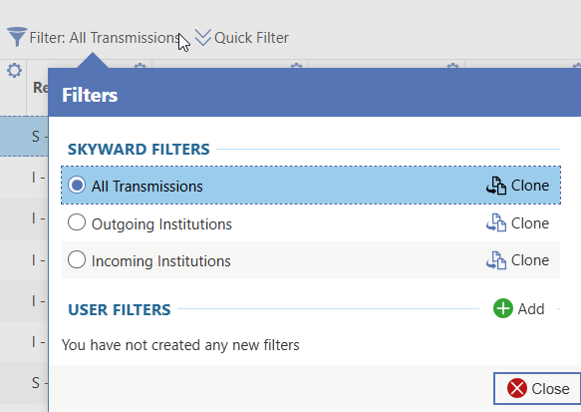
FASTER Transmissions – incoming and outgoing in one place.
FASTER Qmlativ
FASTER Transmissions

Slide 35
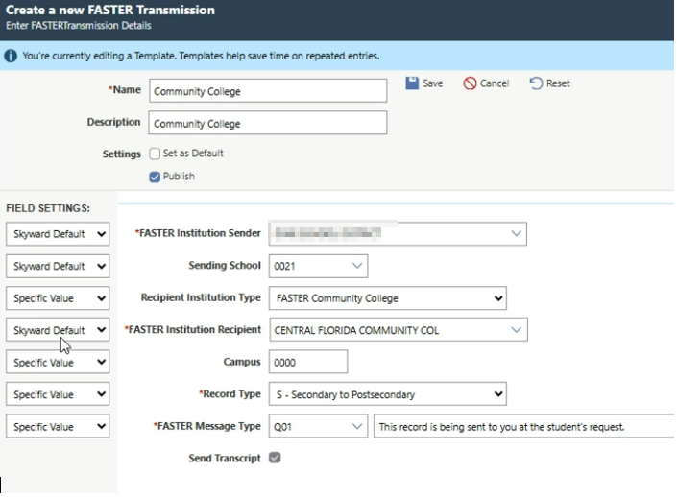
FASTER Transmissions – incoming and outgoing in one place.
FASTER Qmlativ
FASTER Transmissions

Slide 36
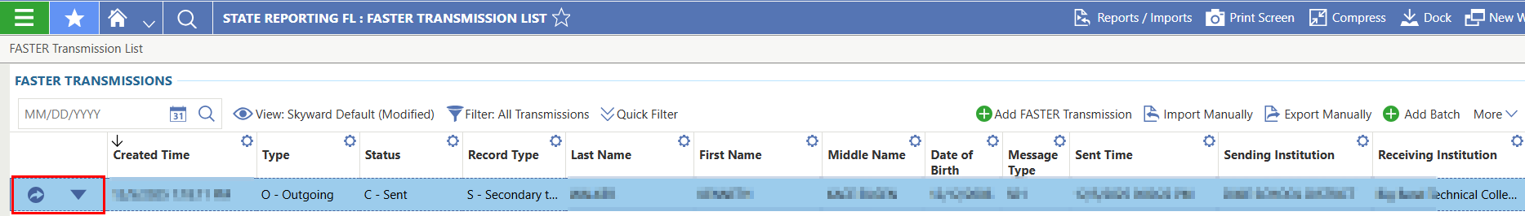
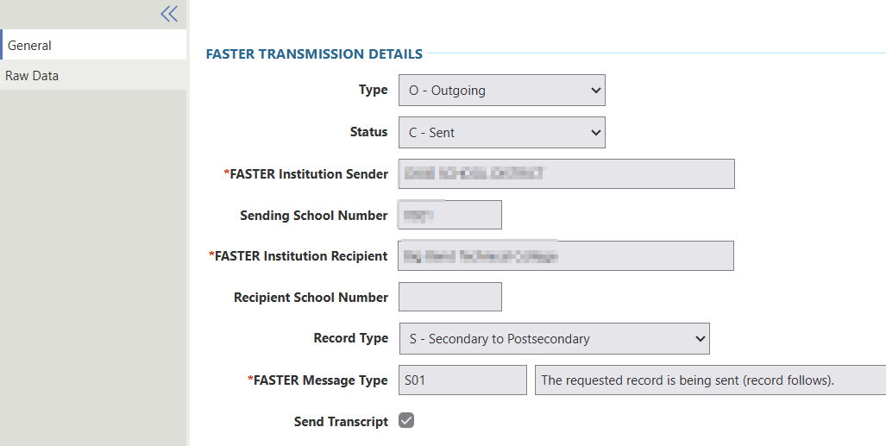
Dropdown allows you to view the record information and the raw data file
FASTER Qmlativ
FASTER Transmissions

Slide 37
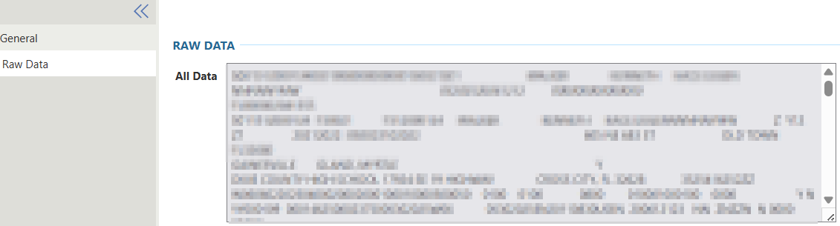
Dropdown allows you to view the record information and the raw data file
FASTER Qmlativ
FASTER Transmissions

Slide 38
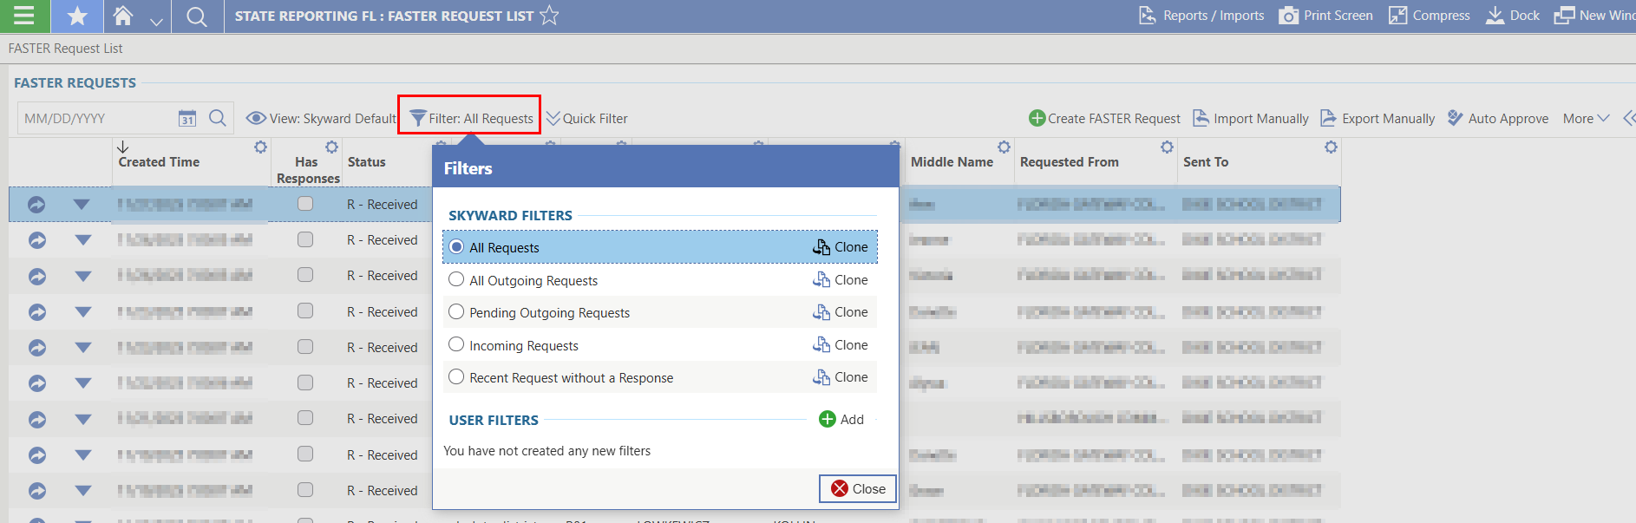
Request filters can be used to narrow down what requests to review.
FASTER Qmlativ
FASTER Requests

Slide 39
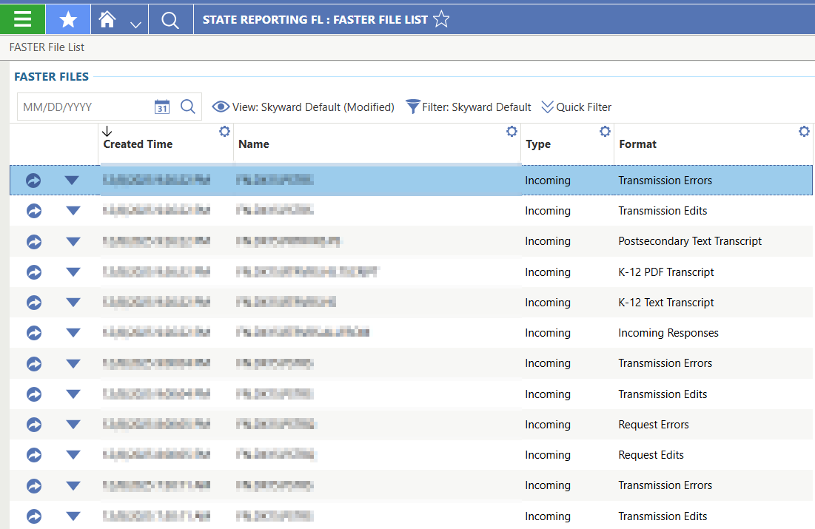
FASTER Files allows you to see the incoming files
FASTER Qmlativ
FASTER Files

Slide 40
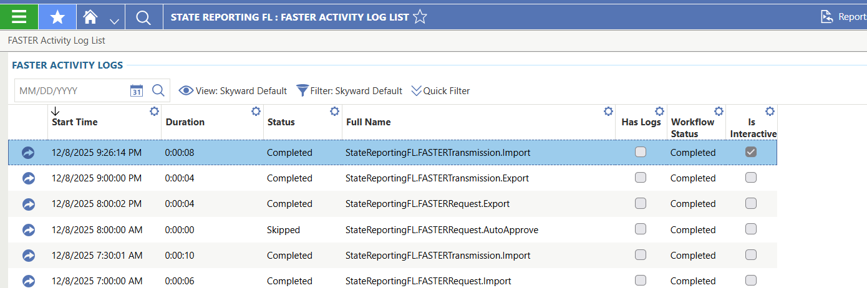
Activity log can be used for troubleshooting
FASTER Qmlativ
FASTER Files

Slide 41
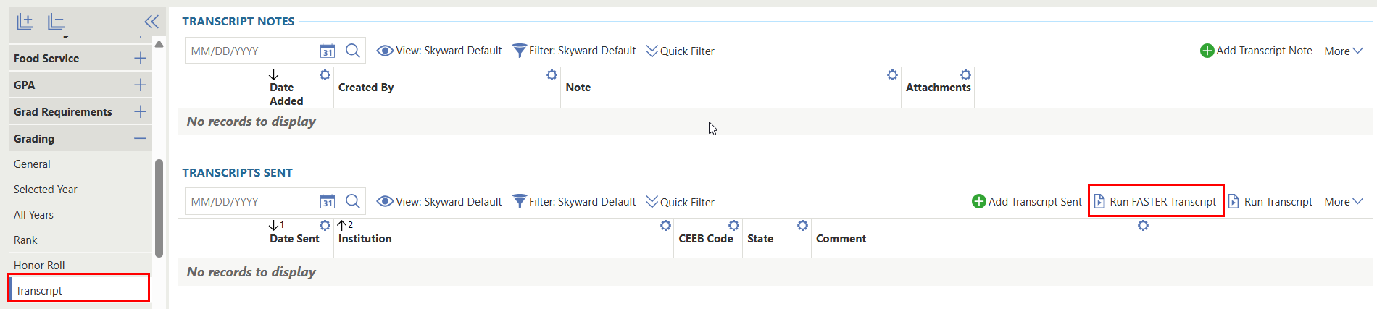
The FASTER Transcript can be printed from the student profile.
FASTER Qmlativ
Student Profile > Grading > Transcript

Slide 42
Questions

Slide 43
Thank You

