Slide 1
Survey Processing Trouble-shooting Errors
Florida User Group 2025-2026
Notes:
This session will cover recent and upcoming state reporting updates. How to troubleshoot errors and how to update survey data prior to and during state submission.
Ideas to discuss:
Cape Participant, added to mass update special programs,
Student course minutes/fte not as expected
ESE minutes with pushins/pullouts
FTE Calc Report – review of each column headings
Schedule Changes – don’t delete transactions
Schedule Changes – deletes vs drops
Teacher Transactions – future PR

Slide 2
Agenda
2025-2026 Reminders
Recent state updates
Survey Troubleshooting pointers
Survey Edits Documentation
Upcoming updates

Slide 3
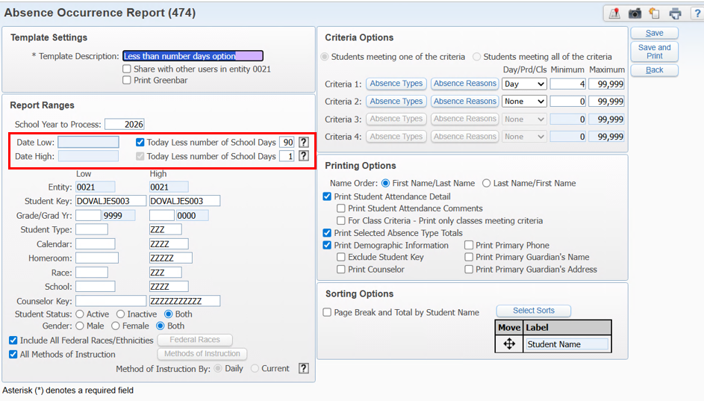
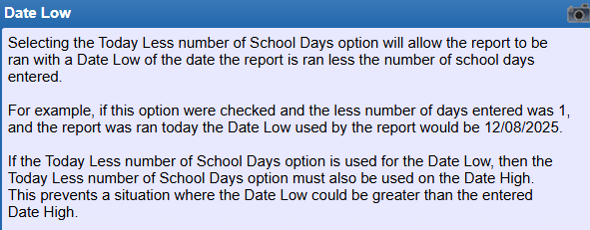
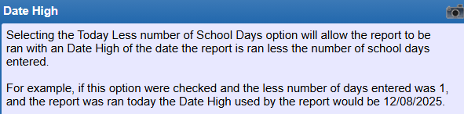
Recent Updates
PR 6353675: Update Absence Occurrence Report to use day status and update date range to use -90 days. Oct Add. 06 – 11/24/25

Slide 4
Recent Updates
PR 6367729 - Student's reporting schools 3450 and 3950 on the Surveys Student Course Format will now report an FEFP of 999 and a FTE value of 0000. Students enrolled in schools 3450 and 3950 will now report a Grad Option of Z (Demographic Edit #31). June Rel Add 04 – 11/10/2025
Note: We are aware of an issue with the FEFP for students dual enrolling into a virtual school (7004 for example) where it is not reporting the FEFP as 999. This was due to Student Course edit 5Q which has been updated by the state and the edits are getting updated in SMS with PR 6354930.
PR 6366571 – The Withdrawal Reason, Industry Certification IDs, and CTE Program/Course Code Combinations File (F61730) were updated for 2026. Additionally, Surveys ESE Student Edits #2B, 2C, and 2F were updated. Oct Add. 06 - 11/24/25

Slide 5
Survey Edits Troubleshooting

Slide 6
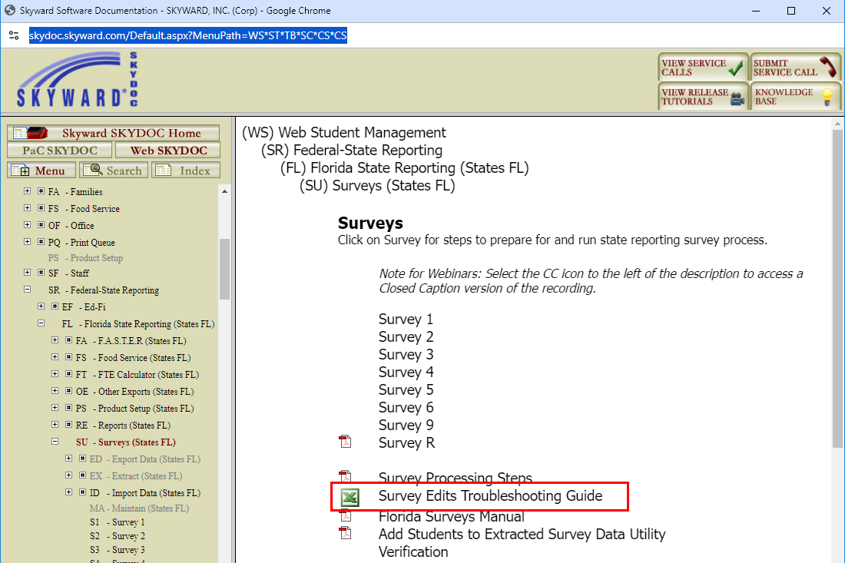
Survey Edits Documentation
https://skydoc.skyward.com/Default.aspx?MenuPath=WS*ST*TB*SC*CS*CS

Slide 7
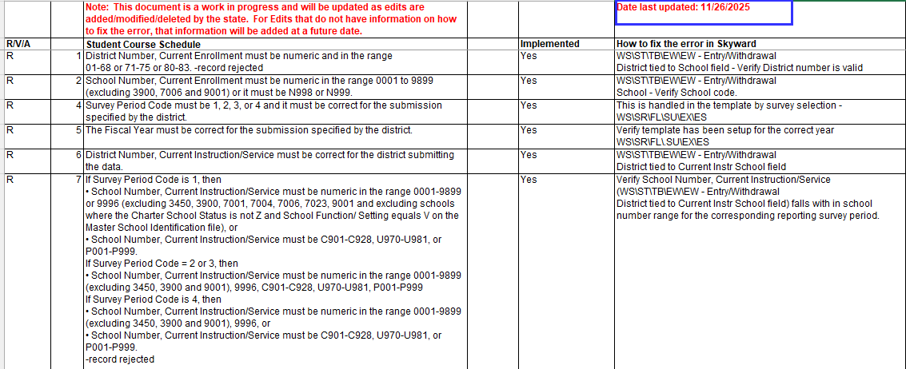
This excel document has a tab for each form and identifies the edits that Skyward has programmed. It indicates if any DOE files need to be imported. It also provides areas to review to assist in resolving the edit.
Survey Edits Documentation
https://skydoc.skyward.com/Default.aspx?MenuPath=WS*ST*TB*SC*CS*CS

Slide 8
Survey Troubleshooting

Slide 9
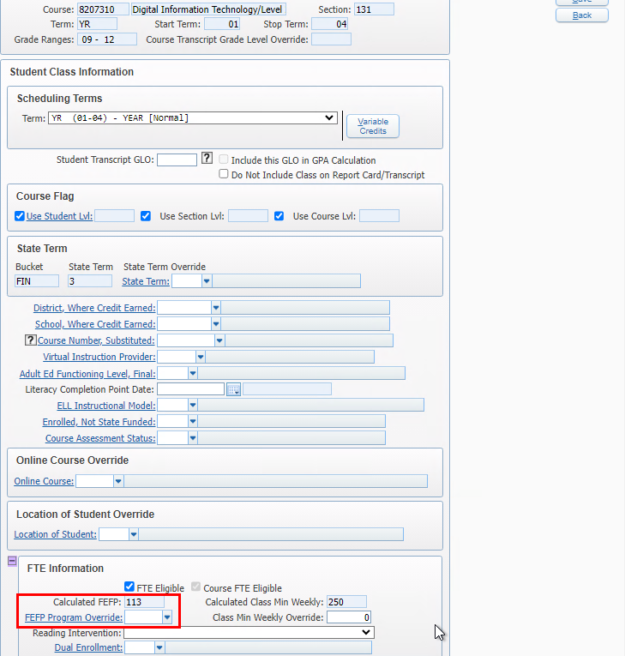
Example: Student is taking a course with FEFP = 300 but Survey 2 is reporting it as 113.
1. Verify the student class section override FEFP value
FEFP is not reporting as expected
1. Verify the student class override FEFP value
WEB STUDENT MANAGEMENT > STUDENTS > STUDENT PROFILE > SCHEDULING TAB
Notes:
Student course minutes/fte not as expected
ESE minutes with pushins/pullouts
FTE Calc Report – review of each column headings
Schedule Changes – don’t delete transactions
Schedule Changes – deletes vs drops

Slide 10
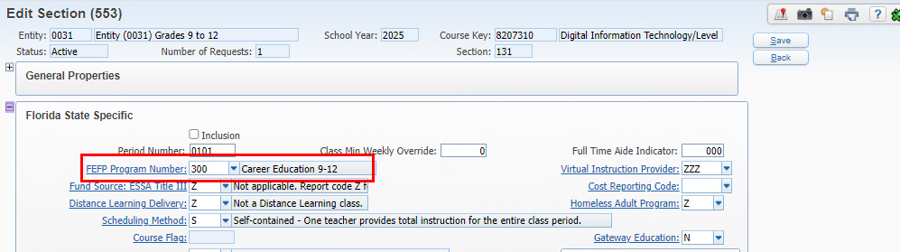
Example: Student is taking a course with FEFP = 300 but Survey 2 is reporting it as 113.
2. Verify the Course Section FEFP
FEFP is not reporting as expected
2. Verify the course section FEFP value
WEB STUDENT MANAGEMENT > OFFICE > CURRENT SCHEDULING > BUILD COURSE MASTER > COURSE MASTER > SECTION
Notes:
Student course minutes/fte not as expected
ESE minutes with pushins/pullouts
FTE Calc Report – review of each column headings
Schedule Changes – don’t delete transactions
Schedule Changes – deletes vs drops

Slide 11
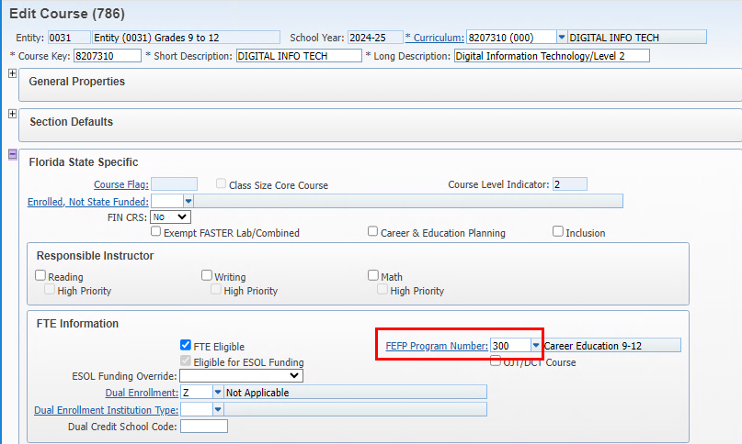
Example: Student is taking a course with FEFP = 300 but Survey 2 is reporting it as 113.
3. Verify the Course FEFP
FEFP is not reporting as expected
1. Verify the course FEFP value
WEB STUDENT MANAGEMENT > OFFICE > CURRENT SCHEDULING > BUILD COURSE MASTER > COURSE MASTER
Notes:
Student course minutes/fte not as expected
ESE minutes with pushins/pullouts
FTE Calc Report – review of each column headings
Schedule Changes – don’t delete transactions
Schedule Changes – deletes vs drops

Slide 12
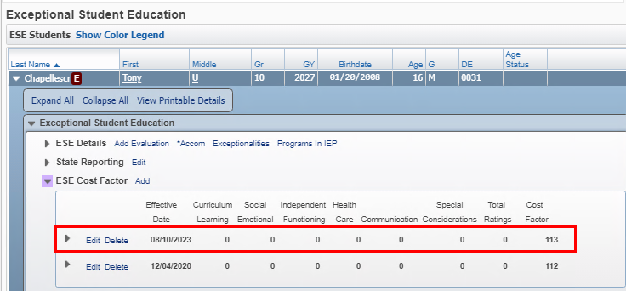
Example: Student is taking a course with FEFP = 300 but Survey 2 is reporting it as 113.
4. Verify the student ESE Cost Factor value.
FEFP is not reporting as expected
4. Verify the student ESE cost factor
Web Student Management > Students > Student Profile > ESE – Cost Factor
Notes:
Student course minutes/fte not as expected
ESE minutes with pushins/pullouts
FTE Calc Report – review of each column headings
Schedule Changes – don’t delete transactions
Schedule Changes – deletes vs drops

Slide 13
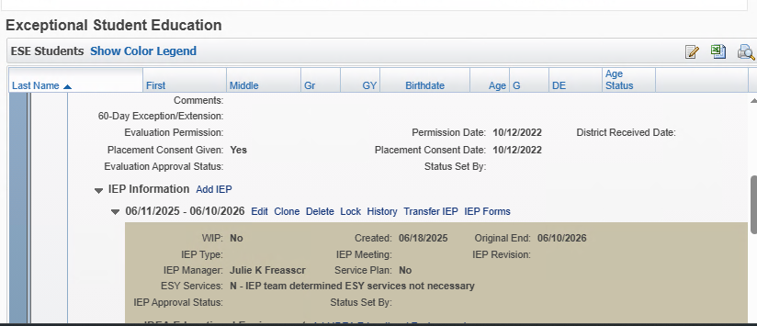
Example: Student is taking a course with FEFP = 300 but Survey 2 is reporting it as 113.
5. Verify the student’s current ESE IEP is active as of survey date certain. If running prior to the survey and the IEP expires between the run date and survey date certain they will report a basic FEFP.
FEFP is not reporting as expected
5. Verify the student ESE IEP is active over survey date certain.
Web Student Management > Students > Student Profile > ESE – IEP
Notes:
Student course minutes/fte not as expected
ESE minutes with pushins/pullouts
FTE Calc Report – review of each column headings
Schedule Changes – don’t delete transactions
Schedule Changes – deletes vs drops

Slide 14
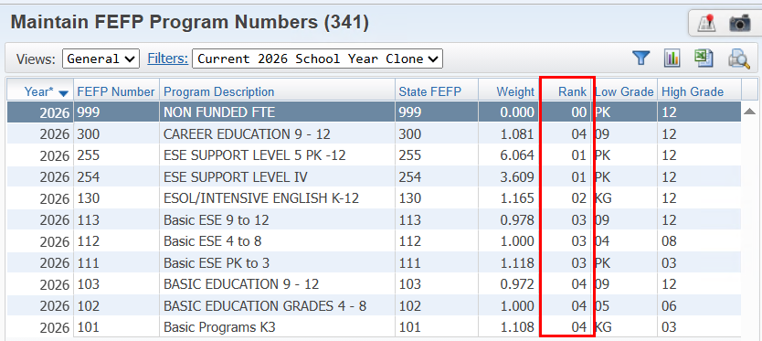
Example: Student is taking a course with FEFP = 300 but Survey 2 is reporting it as 113.
6. Verify the FEFP Rank – this is a Skyward field used to determine the hierarchy for reporting the FEFP value. Changing the rank values could negatively impact your reporting so always check with Skyward before changing the rank values.
FEFP is not reporting as expected
6. FEFP Hierarchy based on FEFP Rank
It is reporting as 113 based on the student’s ESE Cost Factor because a 113 FEFP ranks higher than the 300 FEFP rank value.
Web Student Management > Fed/State Reporting > FL > Setup > Codes > Maintain FEFP Program Numbers
Notes:
Rank Values are indicated in the FTE Manual in Skydoc.
Student course minutes/fte not as expected
ESE minutes with pushins/pullouts
FTE Calc Report – review of each column headings
Schedule Changes – don’t delete transactions
Schedule Changes – deletes vs drops

Slide 15
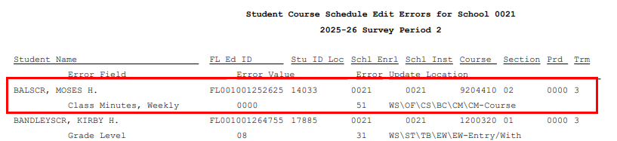
Class Minutes are not the expected amount.
Notes:
Rank Values are indicated in the FTE Manual in Skydoc.
Student course minutes/fte not as expected
ESE minutes with pushins/pullouts
FTE Calc Report – review of each column headings
Schedule Changes – don’t delete transactions
Schedule Changes – deletes vs drops

Slide 16
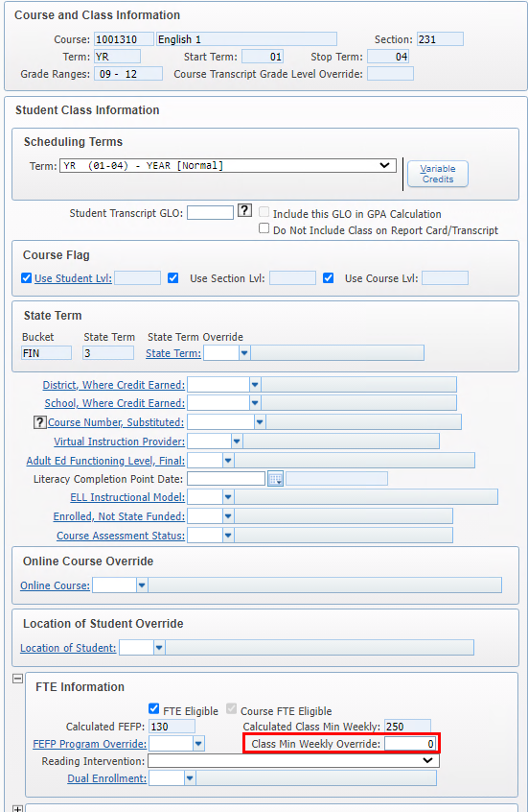
Check the override on the student class schedule
Class Minutes are not the expected amount.
1. Check for student class schedule override
Web Student Management > Students > Student Profile > Scheduling tab.
Notes:
Rank Values are indicated in the FTE Manual in Skydoc.
Student course minutes/fte not as expected
ESE minutes with pushins/pullouts
FTE Calc Report – review of each column headings
Schedule Changes – don’t delete transactions
Schedule Changes – deletes vs drops

Slide 17
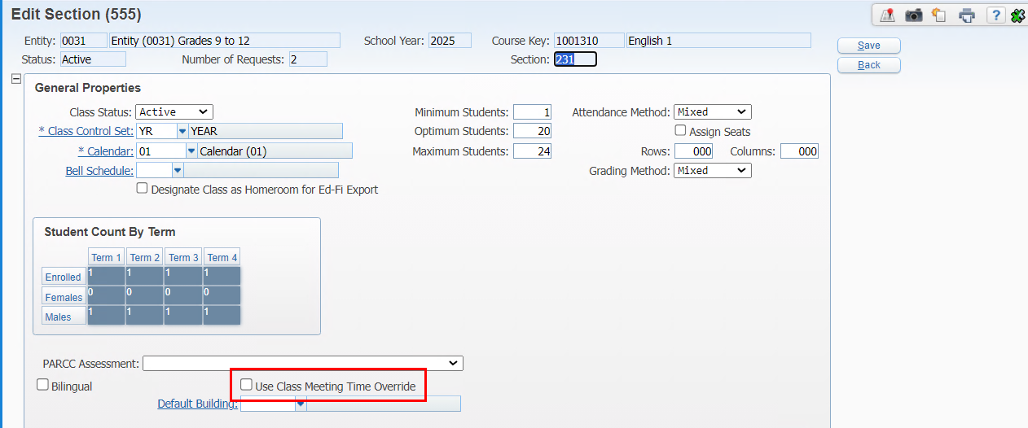
Check to see if class meeting time override is enabled on the section. If yes, verify the times on the class meet.
Class Minutes are not the expected amount.
2. Check for section overrides
Web Student Management > Office > Current Scheduling > Build Course Master > Course Master – edit section
Notes:
Rank Values are indicated in the FTE Manual in Skydoc.
Student course minutes/fte not as expected
ESE minutes with pushins/pullouts
FTE Calc Report – review of each column headings
Schedule Changes – don’t delete transactions
Schedule Changes – deletes vs drops

Slide 18
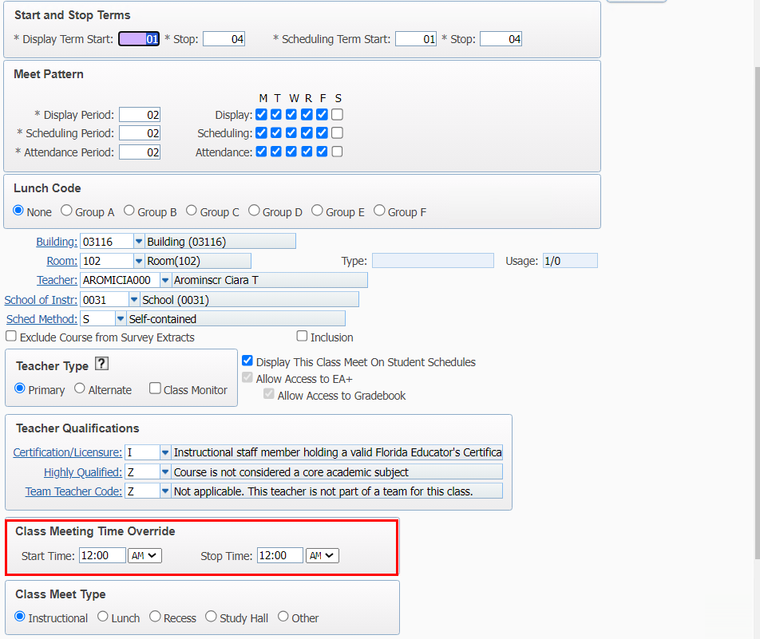
If class meeting time override is enabled on the section, verify the times are set correctly on the class meet.
Class Minutes are not the expected amount.
3. Check the class meeting time override values
Web Student Management > Office > Current Scheduling > Course Master > Course Master – edit class meet
Notes:
Rank Values are indicated in the FTE Manual in Skydoc.
Student course minutes/fte not as expected
ESE minutes with pushins/pullouts
FTE Calc Report – review of each column headings
Schedule Changes – don’t delete transactions
Schedule Changes – deletes vs drops

Slide 19
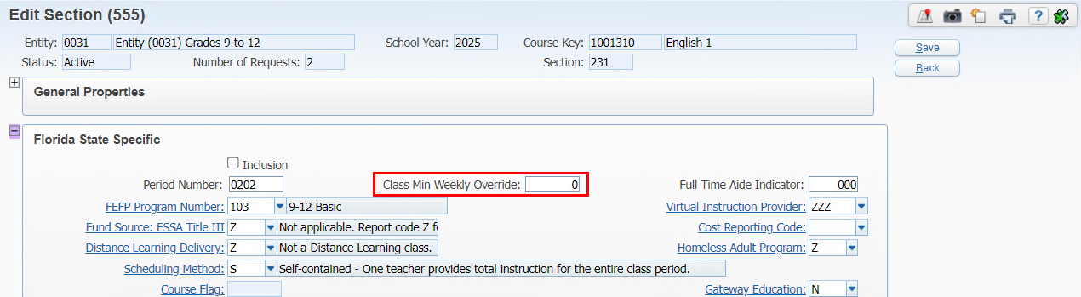
Check if the override on the class section in Florida State Specific has minutes. If yes, we pull minutes from here.
Class Minutes are not the expected amount.
4. Check for section - FL Specific override
Web Student Management > Office > Current Scheduling > Course Master > Course Master – edit section
Notes:
Rank Values are indicated in the FTE Manual in Skydoc.
Student course minutes/fte not as expected
ESE minutes with pushins/pullouts
FTE Calc Report – review of each column headings
Schedule Changes – don’t delete transactions
Schedule Changes – deletes vs drops

Slide 20
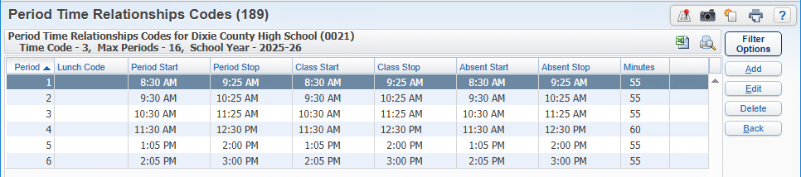
Check the class bell to verify the minutes
Class Minutes are not the expected amount.
5. Check the calendar bell period times.
Web Student Management > Office > Current Scheduling > Course Master > Course Master – edit section
Notes:
Rank Values are indicated in the FTE Manual in Skydoc.
Student course minutes/fte not as expected
ESE minutes with pushins/pullouts
FTE Calc Report – review of each column headings
Schedule Changes – don’t delete transactions
Schedule Changes – deletes vs drops

Slide 21
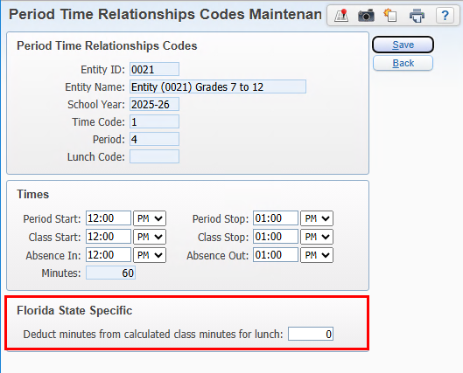
The bell period may be deducting minutes if this option is being used. This would most likely be used when the lunch is in the middle of the class time.
Class Minutes are not the expected amount.
6. Check for lunch minutes deducted from class minutes on bell period times
Notes:
Rank Values are indicated in the FTE Manual in Skydoc.
Student course minutes/fte not as expected
ESE minutes with pushins/pullouts
FTE Calc Report – review of each column headings
Schedule Changes – don’t delete transactions
Schedule Changes – deletes vs drops

Slide 22
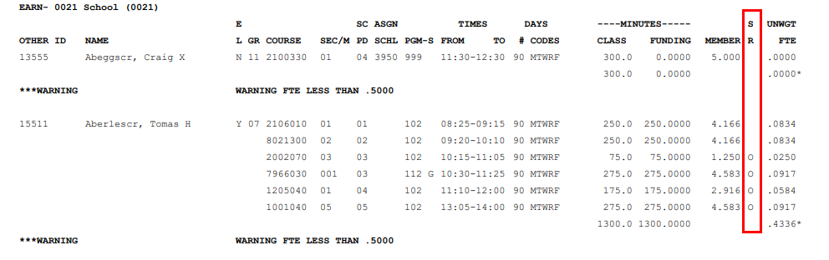
Run the FTE Calculator for the student to check for overlapping records that may be affecting the minutes. Check the S/R column for an ‘O’ indicating overlap
Class Minutes are not the expected amount.
6.Check the FTE Calculator for overlapping classes.
Web Student Management > Fed/State Reporting > Florida > FTE Calculator
Notes:
Rank Values are indicated in the FTE Manual in Skydoc.
Student course minutes/fte not as expected
ESE minutes with pushins/pullouts
FTE Calc Report – review of each column headings
Schedule Changes – don’t delete transactions
Schedule Changes – deletes vs drops

Slide 23
How are minutes assigned when a student is both ESE and ESOL?
Check to see if student is active ESE
Remember that if the IEP ends between the date used when running the calculator or survey and survey date certain, the student will receive BASIC funding.
First apply FEFP based on ESE which applies to all of the student’s classes including ESOL
If not ESE, then check if student is ESOL. If yes, then apply ESOL funding to student classes that are eligible for ESOL
Class Minutes are not the expected amount.
Web Student Management > Students > Student Profile – ESE and ELL records
Notes:
Rank Values are indicated in the FTE Manual in Skydoc.
Student course minutes/fte not as expected
ESE minutes with pushins/pullouts
FTE Calc Report – review of each column headings
Schedule Changes – don’t delete transactions
Schedule Changes – deletes vs drops

Slide 24
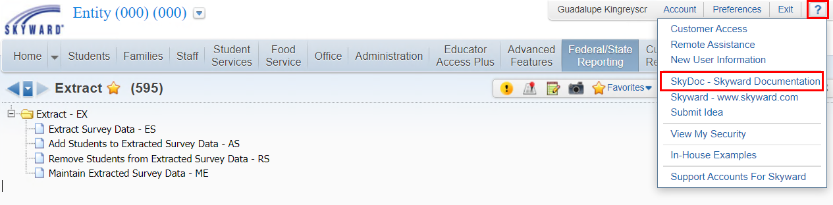
Open the Survey Skyward Documentation for the Survey
Student is not extracting for a survey format as expected.
Web Student Management > Fed/State Reporting > Florida > FTE Calculator
Notes:
Rank Values are indicated in the FTE Manual in Skydoc.
Student course minutes/fte not as expected
ESE minutes with pushins/pullouts
FTE Calc Report – review of each column headings
Schedule Changes – don’t delete transactions
Schedule Changes – deletes vs drops

Slide 25
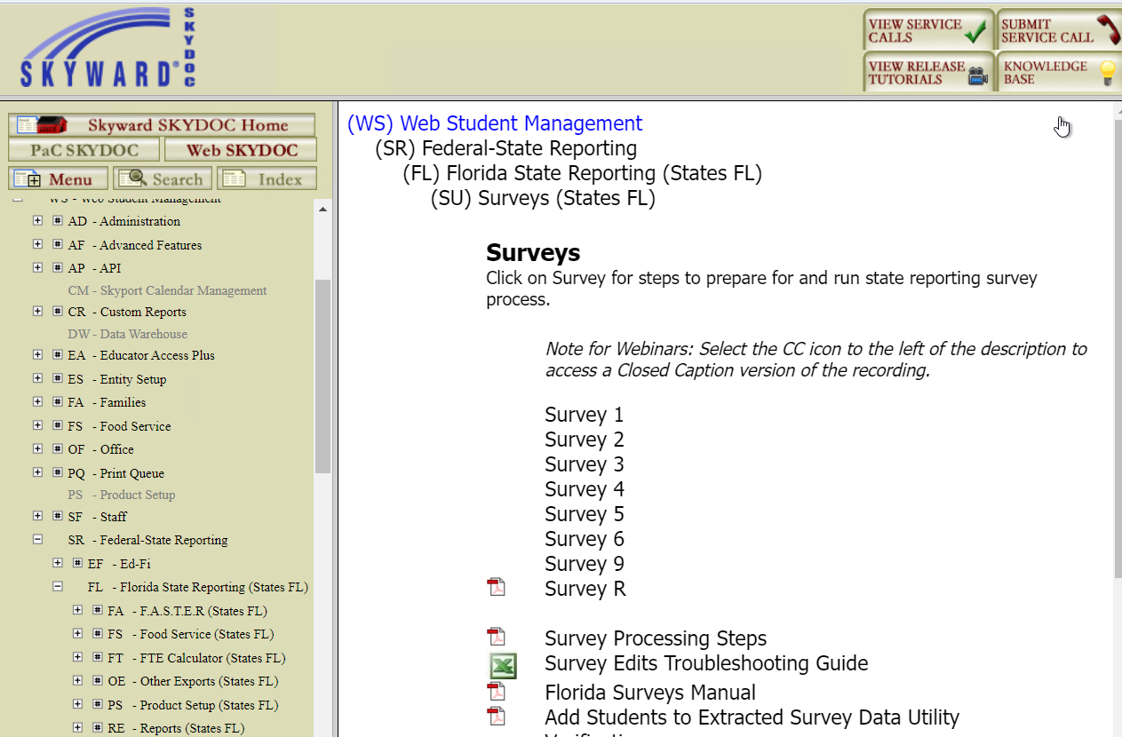
Open the Survey Skyward Documentation for the Survey being extracted
Student is not extracting for a survey format as expected.
Web Student Management > Fed/State Reporting > Florida > FTE Calculator
Notes:
Rank Values are indicated in the FTE Manual in Skydoc.
Student course minutes/fte not as expected
ESE minutes with pushins/pullouts
FTE Calc Report – review of each column headings
Schedule Changes – don’t delete transactions
Schedule Changes – deletes vs drops

Slide 26
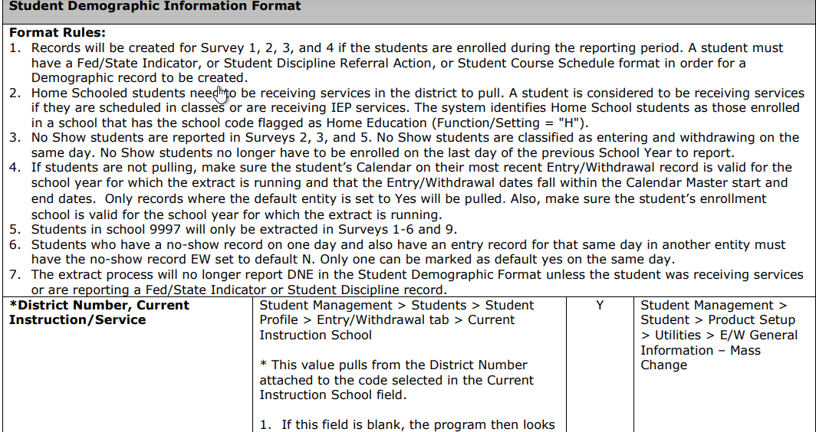
Student is not extracting for a survey format as expected.
Each format will provide rules that are used to determine what students to extract. The rules are followed by the format layout which provides information for each field. Use this information to assist in determining why the record is not extracting.
Skyward Documentation – Survey 2 link:
https://support.skyward.com/DeptDocs/Corporate/Documentation/Public%20Website/Tutorials/Software/2531621_Survey_2_Data_Elements.pdf
Notes:
Rank Values are indicated in the FTE Manual in Skydoc.
Student course minutes/fte not as expected
ESE minutes with pushins/pullouts
FTE Calc Report – review of each column headings
Schedule Changes – don’t delete transactions
Schedule Changes – deletes vs drops

Slide 27
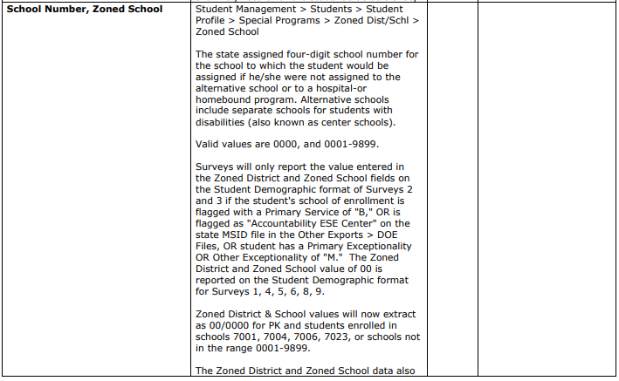
The specific field also has additional information which can impact data being extracted.
For example:
Zoned/School
Note: an update is coming for this field to first check if the student has a Primary or Other Exceptionality of ‘M’ and if yes, then report the values. Currently we are checking the school information first and based on the school settings, the data may not be extracted, even if they have an exceptional of ‘M’.
Student is not extracting for a survey format as expected.
Skyward Documentation – Survey 2 link:
https://support.skyward.com/DeptDocs/Corporate/Documentation/Public%20Website/Tutorials/Software/2531621_Survey_2_Data_Elements.pdf
Notes:
Rank Values are indicated in the FTE Manual in Skydoc.
Student course minutes/fte not as expected
ESE minutes with pushins/pullouts
FTE Calc Report – review of each column headings
Schedule Changes – don’t delete transactions
Schedule Changes – deletes vs drops

Slide 28
Student is not extracting for a survey format as expected.
Common issues:
Entry Withdrawal record is not set as default = Yes
Programs such as Special Programs, ELL, or ESE program dates do not overlap the survey
Class Transactions were deleted in error
Class was dropped prior to survey date certain
Local codes not properly linked to state codes
DOE Files such as MSID and CCD have not been imported (these are used for data entry and validations)
After reviewing student records, run the Add Students to Extracted Survey Data in Report Only mode to see if record then extracts or if the values show as being updated.
Notes:
Rank Values are indicated in the FTE Manual in Skydoc.
Student course minutes/fte not as expected
ESE minutes with pushins/pullouts
FTE Calc Report – review of each column headings
Schedule Changes – don’t delete transactions
Schedule Changes – deletes vs drops

Slide 29
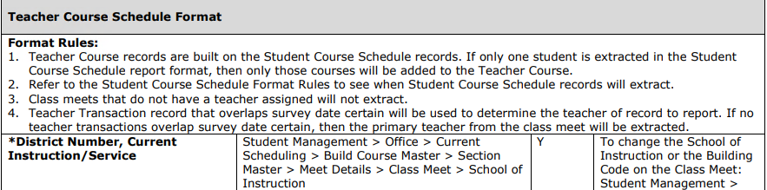
Check the Teacher Transaction records for the transaction that overlaps survey date certain.
Teacher is not extracting for a survey format as expected.
Skyward Documentation – Survey 2 link:
https://support.skyward.com/DeptDocs/Corporate/Documentation/Public%20Website/Tutorials/Software/2531621_Survey_2_Data_Elements.pdf
Notes:
Rank Values are indicated in the FTE Manual in Skydoc.
Student course minutes/fte not as expected
ESE minutes with pushins/pullouts
FTE Calc Report – review of each column headings
Schedule Changes – don’t delete transactions
Schedule Changes – deletes vs drops

Slide 30
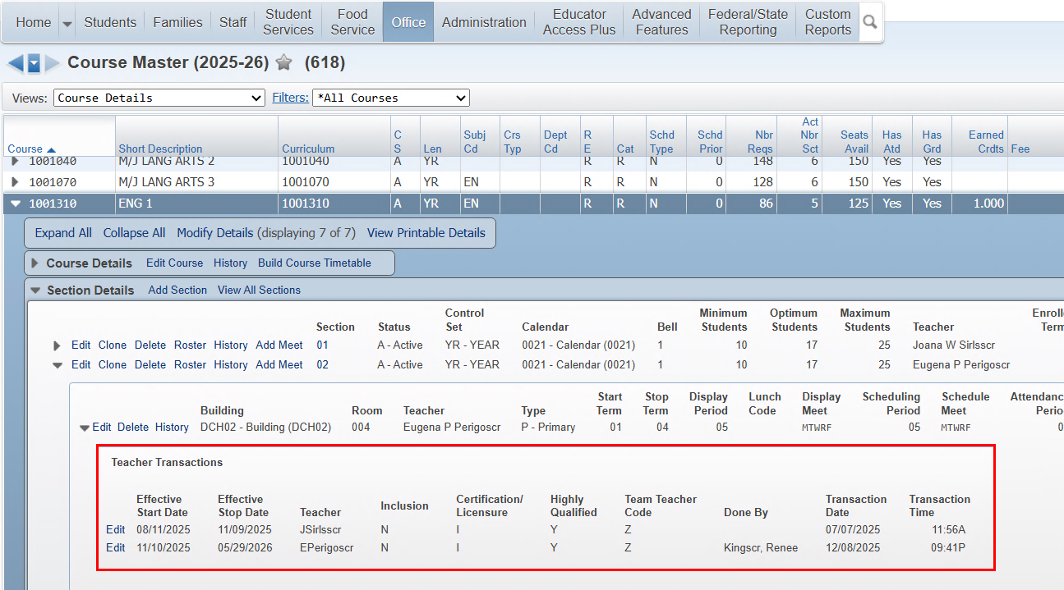
Check the Teacher Transaction records for the transaction that overlaps survey date certain.
Teacher is not extracting for a survey format as expected.
Notes:
Rank Values are indicated in the FTE Manual in Skydoc.
Student course minutes/fte not as expected
ESE minutes with pushins/pullouts
FTE Calc Report – review of each column headings
Schedule Changes – don’t delete transactions
Schedule Changes – deletes vs drops

Slide 31
Upcoming Updates
PR 6409989 - The Apprenticeship Sponsor codes were updated to the latest copy of DOE Appendix O. Oct. Addendum 07 – 12/22/25
PR 6366726 - The FES process has been updated for the new EO and UA layouts. Oct. Addendum 07 – 12/22/25
PR 6354930 – Weekly Updates 10/3/2025 – edit updates for Prior Sch, Student Course, Demographic, Teacher Course, CTE Teacher Course. Estimated 1/5/2026
PR 6366981 – Update Demographic Zoned District/school based on Demographic edit 5C. Estimated 1/5/2026
PR 6411741 – Update FES process to add files for FTC/PEP and Private Student list layouts. Estimate Oct. Addendum 08 1/12/26
PR 6416221 – Weekly Updates 12/5/2025 – estimated 1/19/2026

Slide 32
Questions

Slide 33
Thank You!

