Slide 1
Future Scheduling Prep through Completion
Wifi:
Skyward
Putnam25!
Session 1
Liz Kelley Vang – Customer Success

Slide 2
Future Scheduling Prep through Completion
Future Scheduling Utilities
Course Master Clean-up
Staff Maintenance
Course Request Entry
Building the Master Schedule
Auto Scheduler
Reports

Slide 3
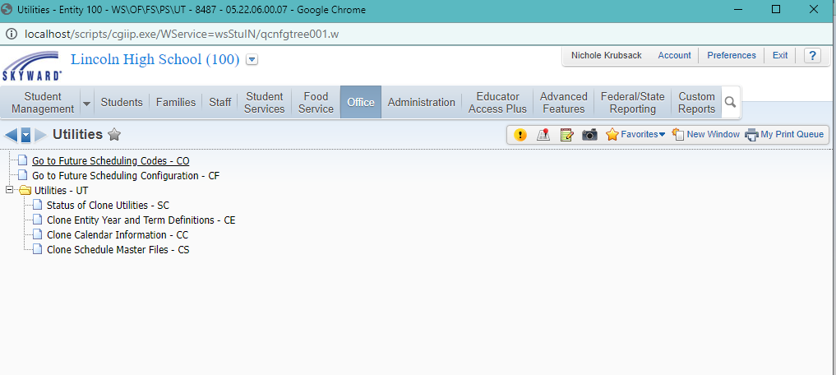
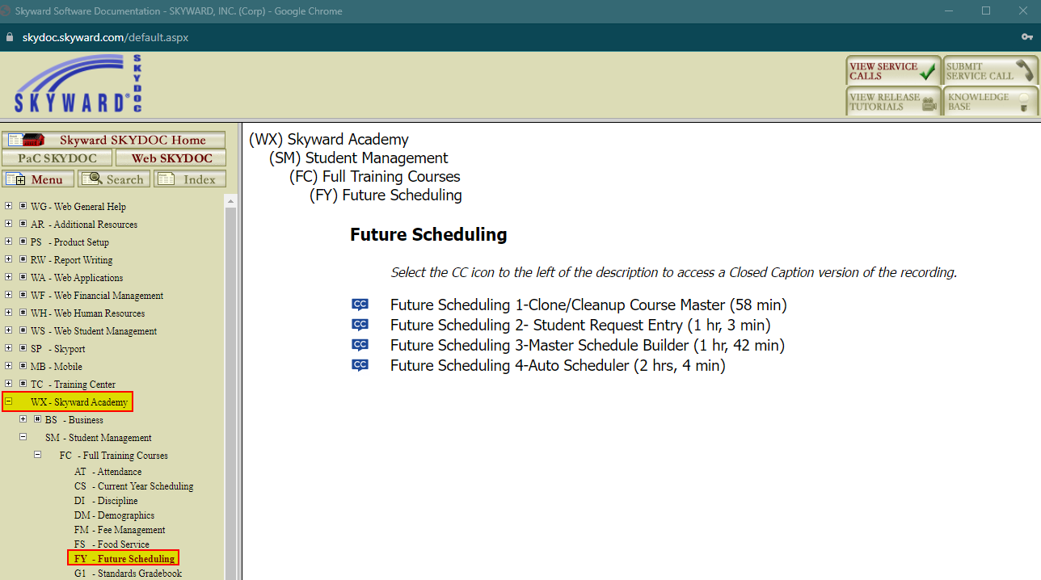
Future Scheduling Utilities
Menu Path: Office > Future Scheduling > Setup > Utilities
Clone Entity Year and Term Definitions
Clone Calendar Information
Clone Schedule Master Files

Slide 4
Course Master Clean-Up
Menu Path: Office > Current Scheduling > Build Course Master > Course Master
Course Keys
Course Length Sets
Course Status
Schedule Type
Normal
Manually Scheduled
Special Ed
Dropped
Scheduling Priority
Grade Ranges
Team Scheduling Priority
Available to Online Scheduling
State Reporting Fields

Slide 5
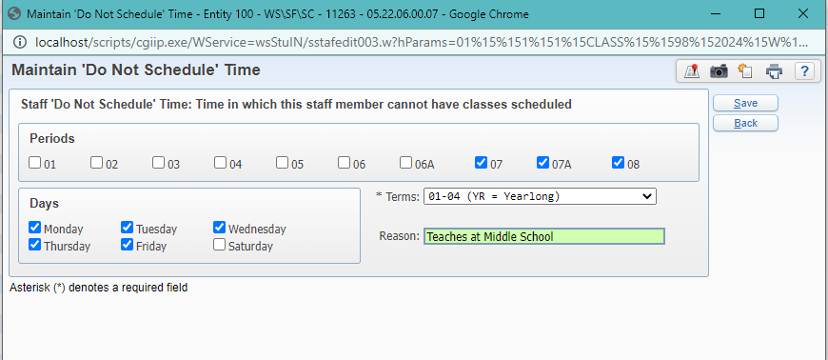
Staff Maintenance
Menu Path: Staff > Staff > Staff
Check NY Status
Default Building/Room Number
Do Not Schedule Times
Schedule > View Schedule Matrix for Current/Next Year and Edit ‘Do Not Schedule’ Time

Slide 6
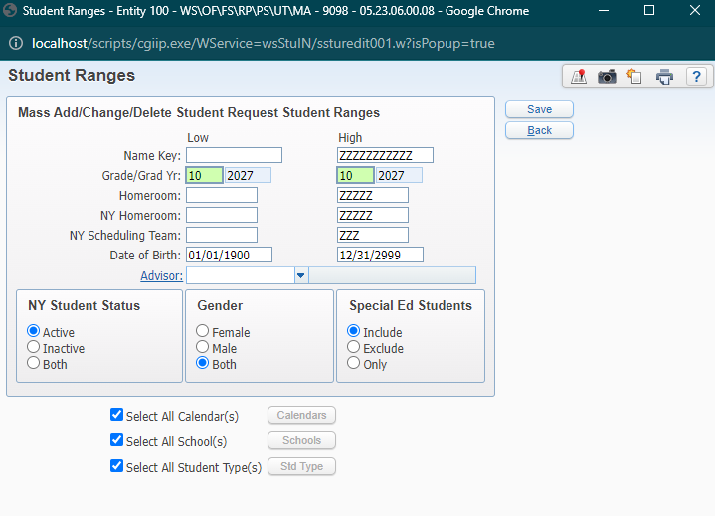
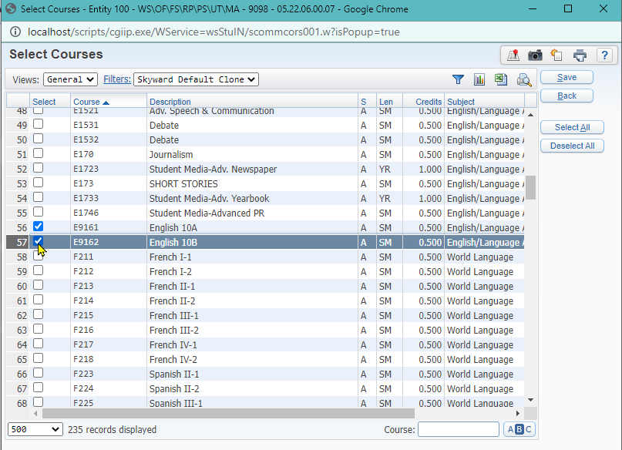
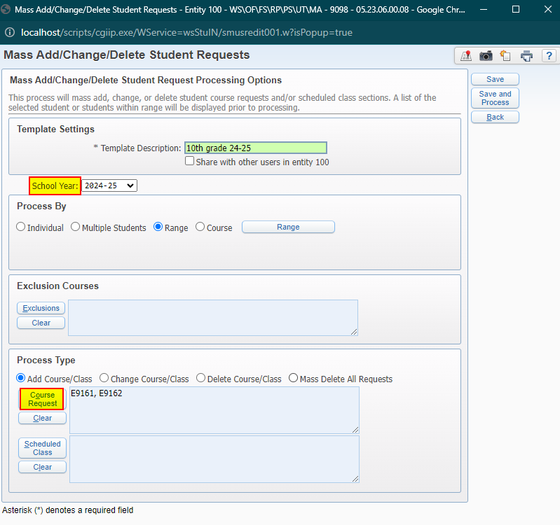
Course Requests
Menu Path: Office > Future Scheduling > Request Processing > Setup > Utilities
Mass Add/Change/Delete Student Requests
Create NEW Templates EVERY Year
Process By: Individual, Multiple Students, Range, Course
Process Type: Add, Change, Delete, Mass Delete All Requests
Course Requests
Scheduled Classes
Adding Course Requests in Mass

Slide 7
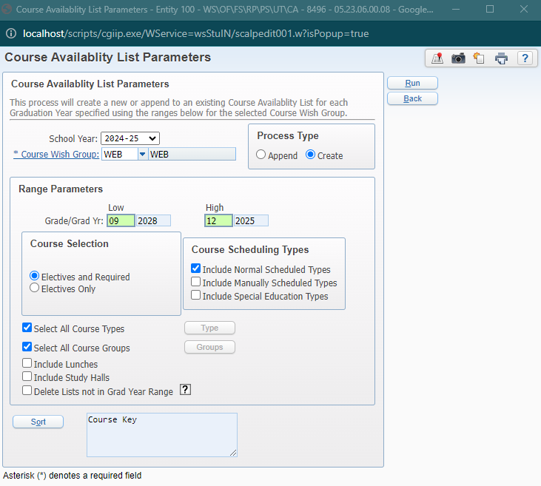
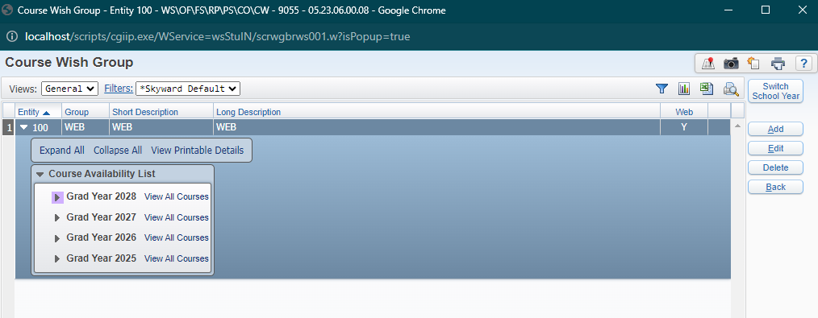
Course Requests
Menu Path: Office > Future Scheduling > Request Processing > Setup > Utilities > Create Course Availability List
Menu Path: Office > Future Scheduling > Request Processing > Setup > Codes > Course Wish Group
Process Type: Create
Grade Ranges
Electives or Electives/Required
Only ONE Wish Group can be used at a time, so most schools should only have one code
Check Box: Use This Course Availability List in Family/Student Access
Adding Course Requests through Family/Student Access

Slide 8
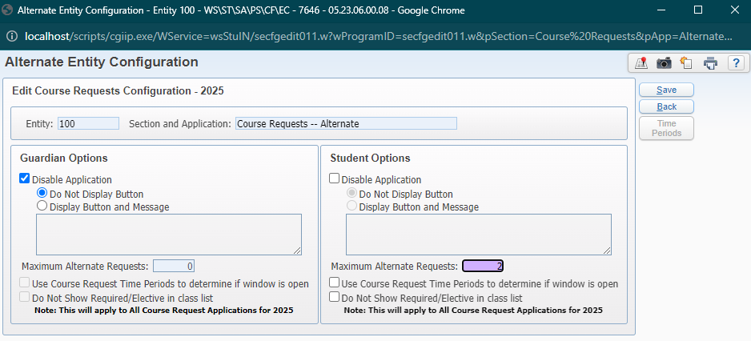
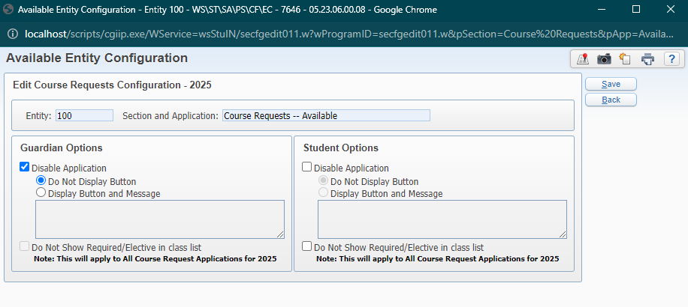
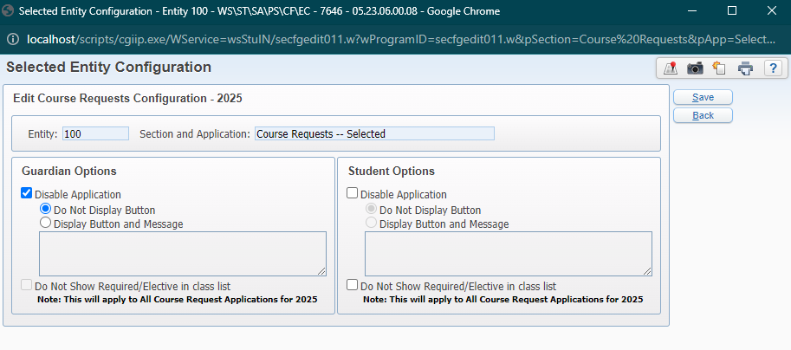
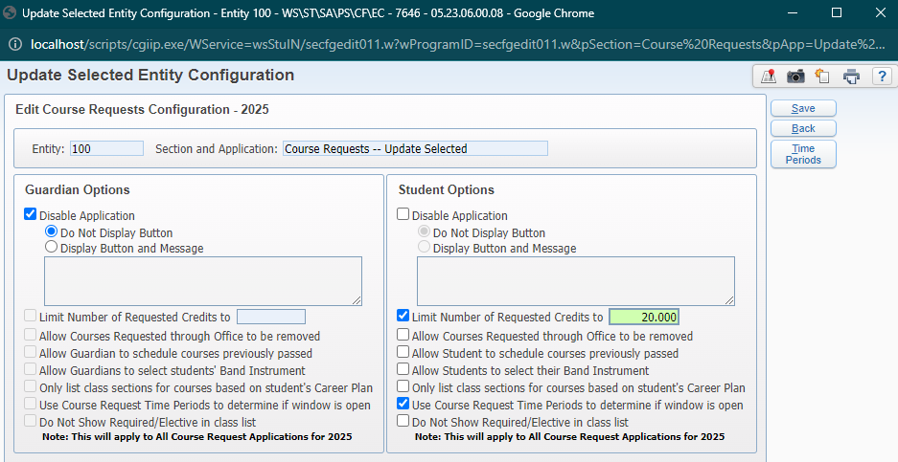
Course Requests
Menu Path: Students > Student Access > Setup > Configuration > Entity Configuration
Course Requests
Enable Alternate, Available, Selected, and Update Selected for future year
Adding Course Requests through Family/Student Access

Slide 9
Menu Path: Office > Future Scheduling > Request Processing > Entry By Student
Browse screen of students
Expand the record for a student
Add by Course > Request button
Menu Path: Office > Future Scheduling > Request Processing > Quick Entry
Student by student
Type in each course key
Menu Path: Students > Student Profile > Scheduling > Future
Add Course
Request Quick Entry
Course Requests
Entry by Student
Quick Entry
Manual Adds

Slide 10
Build Master Schedule
Menu Path: Office > Future Scheduling > Build Master Schedule > Setup > Utilities
Create a Schedule Master Save Point
Recommend creating save points throughout scheduling process
These only capture specific settings on the sections and meets- no information about student schedules is stored
Update Estimated Number of Sections*
Skyward can help to anticipate how many sections to offer for each course based on the existing course requests
Initialize Class Meet Details
Places all Sections in Period 00
OPTIONAL
Create Course Conflict Matrix
Helps determine best possible period to schedule a class
Required for analysis tools to function properly
Update Estimated Class Counts by Grade
Updates Est. Number of Students column when analyzing classes
*Menu Path: Office > Future Scheduling > Build Course Schedule > Setup > Utilities
Prep

Slide 11
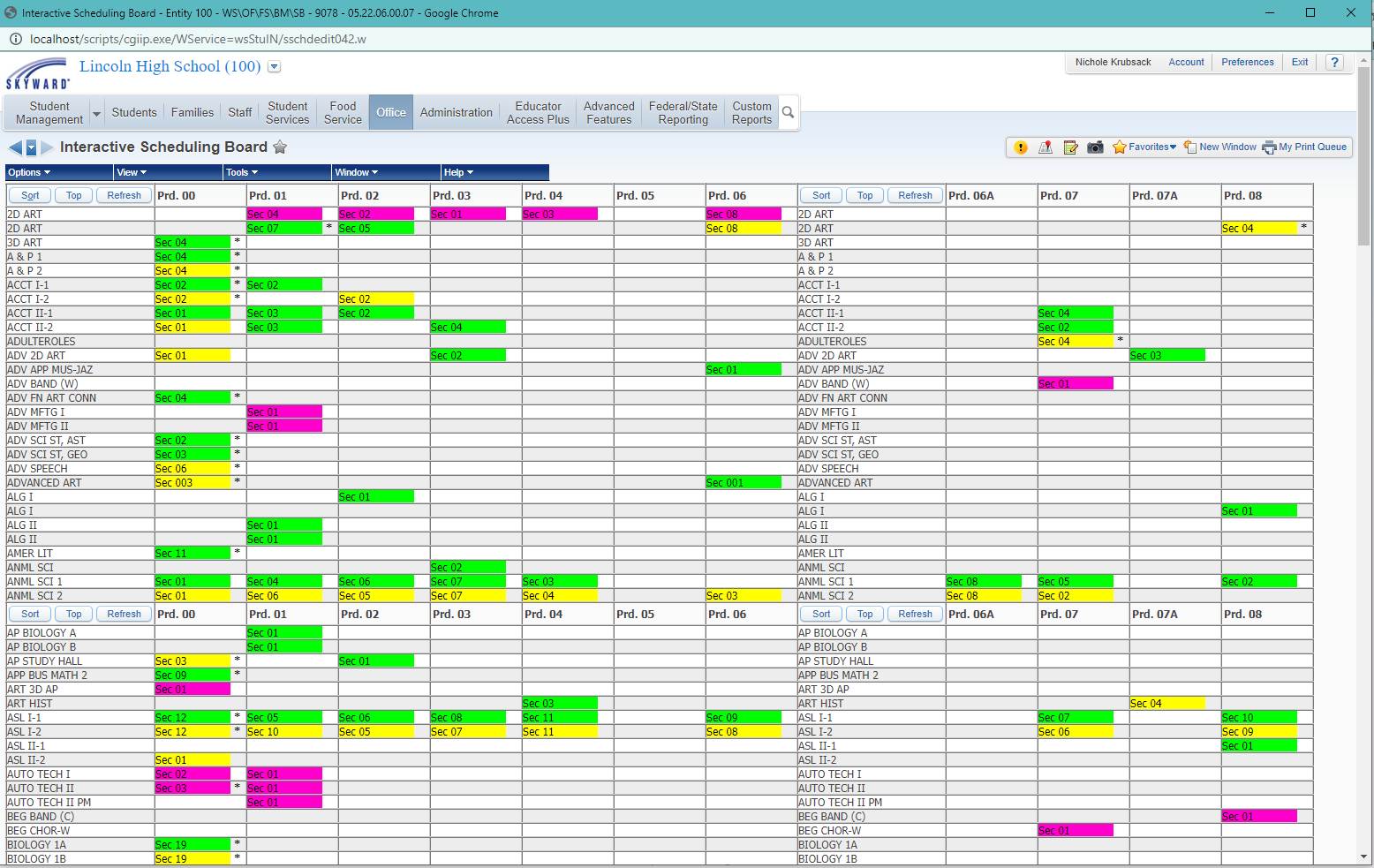
Build Master Schedule
Menu Path: Office > Future Scheduling > Build Master Schedule > Interactive Scheduling Board
Change Views: Courses, Teachers, Departments
Move “chips” to make changes in real time
Analyze classes for placement recommendations
Export to Excel
Save your settings!
Interactive Master Scheduling Board

Slide 12
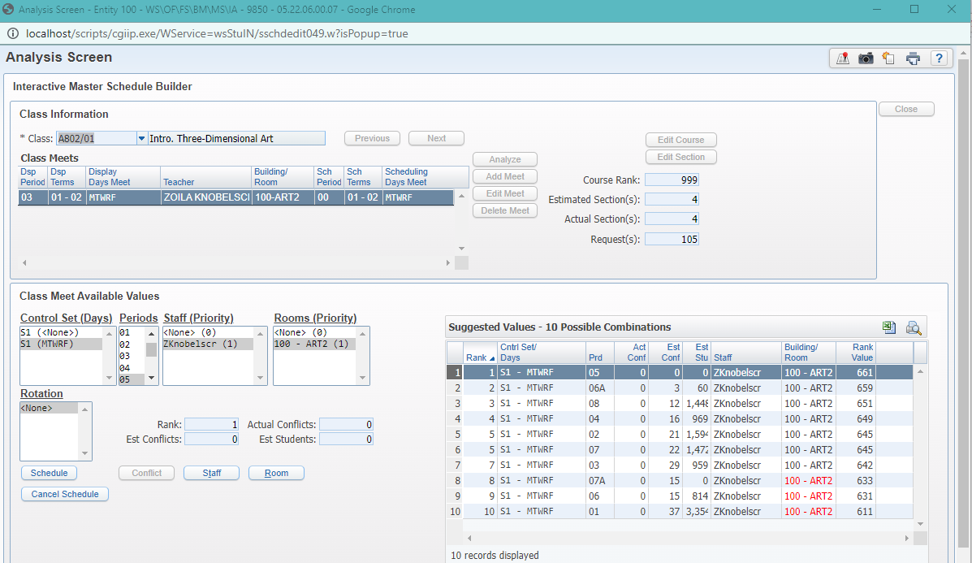
Build Master Schedule
Menu Path: Office > Future Scheduling > Build Master Schedule > Master Schedule Builder > Interactive Master Schedule Builder
Analyze each class individually to see potential conflicts and then lock in the details
A version can be accessed from the Interactive Master Scheduling Board
Efficient for placing multiple sections of same course
Interactive Master Schedule Builder

Slide 13
Build Master Schedule
Menu Path: Office > Future Scheduling > Build Master Schedule > Master Schedule Builder > Automated Master Schedule Builder
Same logic as the Interactive Master Schedule Builder, but Skyward chooses the top-ranked values for you
Analyzes conflicts and places classes into the period with the lowest degree of conflict
Typically used AFTER placing Gotta-Be’s and Singletons
Efficient way to place classes without needing to touch each one
Pro Tip: Create a save point before running!
Automated Master Schedule Builder

Slide 14
Auto Scheduler
Menu Path: Office > Future Scheduling > Student Schedule Generation > Auto Scheduler > Generate Student Schedules
Create NEW templates each year, but templates can be reused within a given year
Grade Ranges to Process
Close Sections when Filled
Create Student Conflict Detail
Scheduling Run to Perform
Actual (multiple runs)
Imperative
Pseudo***
Do NOT complete more than one actual run in a row for the same students without unscheduling first (or consulting with Skyward)
Generate Student Schedules

Slide 15
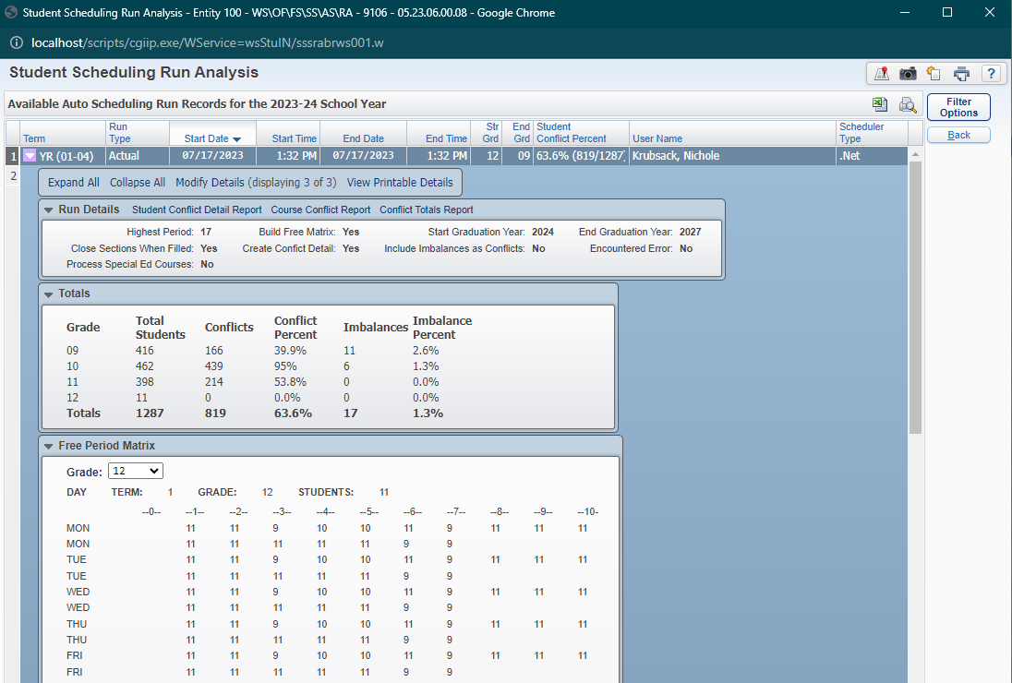
Auto Scheduler
Menu Path: Office > Future Scheduling > Student Schedule Generation > Auto Scheduler > Scheduling Run Analysis
Conflict Percentage
Course Conflict Report
Student Conflict Detail Report
Free Period Matrix
Scheduling Run Analysis

Slide 16
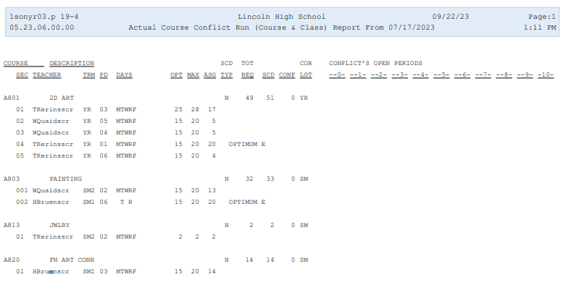
Course Conflict Report
Menu Path: Office > Future Scheduling > Student Schedule Generation > Auto Scheduler > Scheduling Run Analysis
Print both Courses & Classes
Review number of conflicts for each course
Verify period/teacher/class sizes and other meet details
See how balanced the sections are for each course

Slide 17
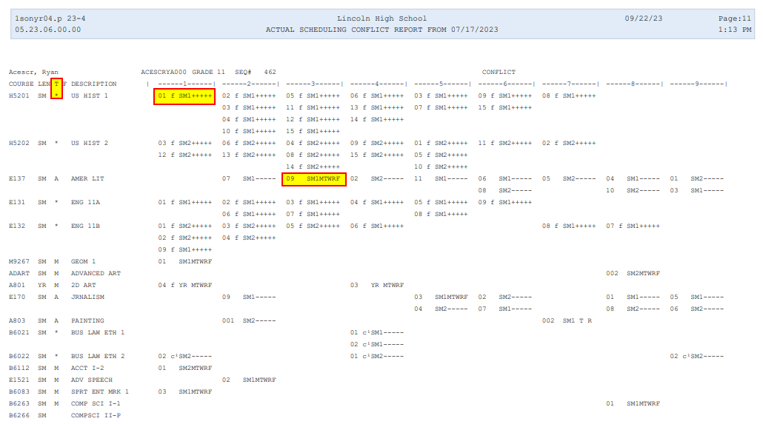
Student Conflict Detail Report
Menu Path: Office > Future Scheduling > Student Schedule Generation > Auto Scheduler > Scheduling Run Analysis
Recommended settings: Landscape and 1 conflict per page
Helps to diagnose scheduling issues for those students with conflicts
Classes with an Asterisk * are in conflict

Slide 18
Reports
Menu Path: Office > Future Scheduling > Student Schedule Generation > Reports
Student Conflict Report
Only works after an Actual run has been completed
Find remaining students with conflicts so you can resolve them manually
Free Period Report
Used to determine which students aren’t scheduled during a given term/period so that you can ensure that they get a class and are accounted for every period of the day
Menu Path: Office > Future Scheduling > Reports
Student Schedules Report
Print List or Matrix View
Sorting options if printing for distributing to students
Student Conflict Report
Free Period Report
Student Schedules

Slide 19
Thank you for attending!

