Slide 1
Welcome to Florida User Group
Attendance Letters
Setup of Attendance Letters
Viewing and Reporting Attendance Letters
Troubleshooting
Student is not generating a letter
Student is generating the same letter repeatedly
Student is generating a letter incorrectly

Slide 2
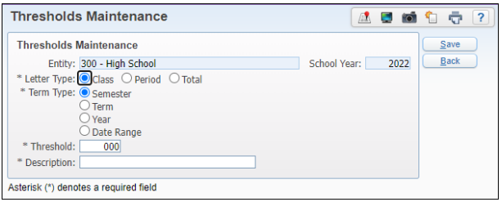
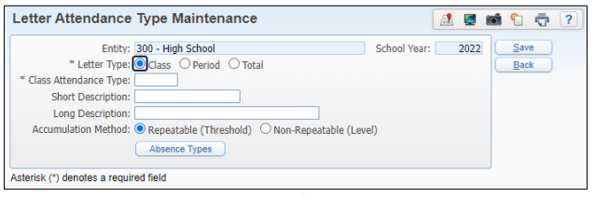
Attendance Letter Setup
Guide to Creating Attendance Letters SkyDoc
Threshold Codes
Letter Attendance Type Codes
Notes:
A Threshold Code determines the number of absences a student must miss during a specific time frame before an attendance letter is generated.
A Letter Attendance Type Code defines which specific absence codes will be counted during the Attendance Letter Process.

Slide 3
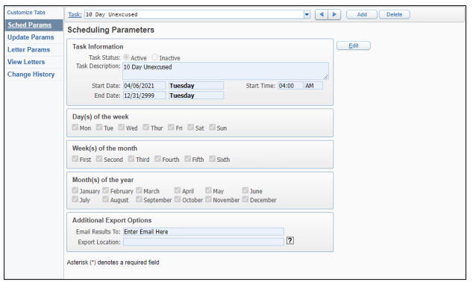
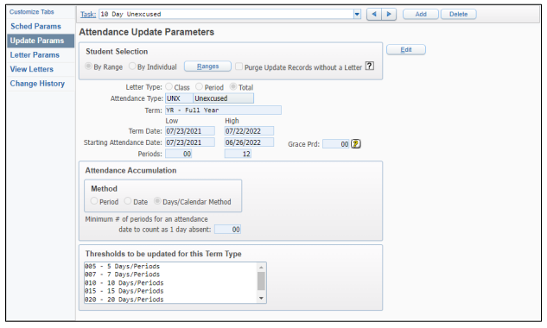
Attendance Letter Setup
Scheduling Parameters
Attendance Update Parameters
Notes:
These options are located in Office > Attendance > Attendance Letters > Schedule Letters
Scheduling Params is used to create the Scheduled Task that runs the Attendance letters
Update Params is where we define which attendance letter we are create, includes Student Ranges, Letter type, attendance type, and date ranges

Slide 4
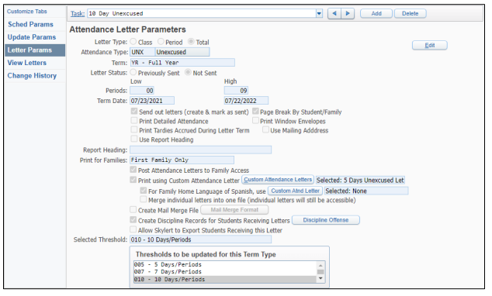
Attendance Letter Setup
Attendance Letter Parameters
Notes:
Letter Params have options related to the actual letter that is sent out
- Includes how it is sent. Print to family access, mail merge letter, etc.

Slide 5
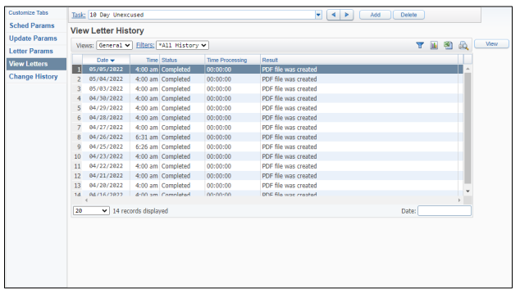
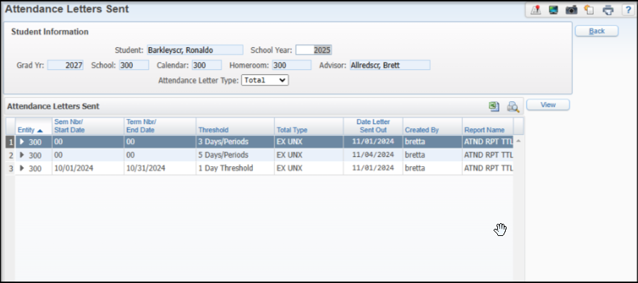
Viewing Attendance Letters
View Letters
Student Profile > Attendance Tab > Letters
Notes:
- View letters from the tab on the Scheduled Letters
In the Schedule Params there was the option to email the results to an individual
Student profile attendance tab

Slide 6
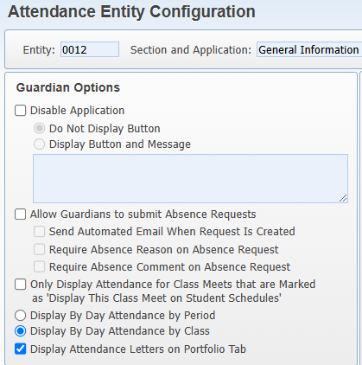
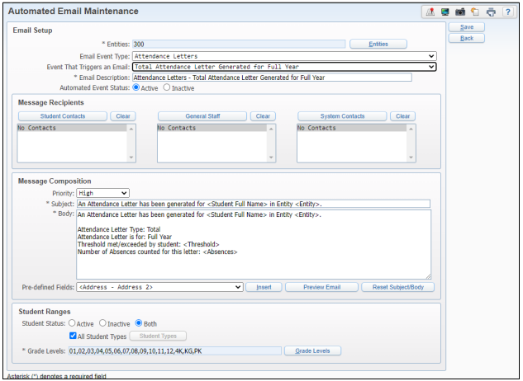
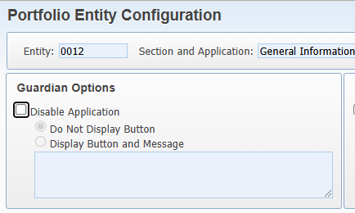
Viewing Attendance Letters
Posting Letters to Family Access
Automated Emails
Notes:
For families, we can display this in Family Access
Can send Automated Emails – will go to Family Access to view the letter
Also the option in Skylert, if using School Messneger

Slide 7
“A Student is Not Generating an Attendance Letter”
Verify the student is within the Student Ranges of the Update Parameters
WS\OF\AT\AL\SL > Update Params > Student Ranges
Verify that the Receive Forms checkbox on the Family is checked
Review on the Family from WS\TB\ST\FA\FA
Verify that the student’s Calendar is setup correctly
Review the Student’s Calendar assigned from WS\ST\TB\EW\EW
Review the Day Rotation assigned, Periods checked on the Calendar Days, etc. in WS\OF\PS\CO\CC

Slide 8
“A Student is Not Generating an Attendance Letter”
Verify the Attendance on the student calculates to the Threshold based on the calculation chosen
Ex. If it’s a Total Period Letter with “040” as the Threshold, make sure the student has 40 total periods of the selected absence types)
Review Attendance From WS\ST\TB\AT\AT
For Class Letters: Verify the student has missed a class (course/section) the amount of times as designated by the Threshold
Additionally, review Scheduling Transactions are correct to show that the student was added, and not dropped from the class during the date range of the letter
Verify the Attendance is happening during the date range of the Attendance Letter
Review Date Range from WS\OF\AT\AL\SL > Update Params

Slide 9
“A Student is Generating an Attendance Letter Repeatedly”
Verify that Attendance that was captured in the previous Attendance Letter was not deleted.
Ex. If a student was gone on 09/10, 09/11, 09/12, and 09/13 and the 3 Day Absent Letter generated on 09/12, if someone deletes 09/10, 09/11, or 09/12, the letter will regenerate using the 09/13 date to substitute the deleted date.
To see this go to the Transaction Tracking for Attendance (Office > Attendance) and go through the By Student option to find any potential deletes
If using Scheduled Attendance Letters, make sure that there’s no other letters that overlap time wise with each other that use the same Letter Type/Attendance Type/Term.
Ex. If you are running a 3 Day and 5 Day Absent Letter and they are set to run at the same time, this could potentially cause issues since the Update for both letters will be running at the same time.
If the above two options are not occurring, go to the Attendance Letter that runs first in the order and go into the Update Parameters. Then check the box for “Purge Update Records Without A Letter” and run the Attendance Letter. This should remove any records that are “hung up” in the system.
After the letter has run, uncheck the box as it should not be left checked.

Slide 10
“A Student is Generating an Attendance Letter Incorrectly”
For Total Letters, look at the Calculation Method this selected on the Update Parameters and make sure that the correct Calculation Method is selected.
Ex. if the Attendance Letter is for 5 Days Absent but the Calculation Method of “Period” is selected, it’s looking for 5 Periods Absent instead of 5 Days Absent.
For Period Letters, remember the difference between Period and Class Letters.
Ex. An absence in Biology in Period 01 and Math in Period 01 would be two absences towards a period letter but would only be count one for a class letter.
For Class Letters, if a student switches sections of the same class, it will restart the counter.
Ex. A student could miss a class four times, switch to a different section, and miss another four times but never pull for a 5 Day Absent Class Letter
Check the Attendance Letter Type code that holds which Absence Type Codes matter to the Letter. Make sure that the correct Absence Type codes are entered onto the Letter Type code.

