Slide 1
F.A.S.T.E.R. & Grad Requirements
Florida User Group 2024 – 2025
Notes:
This session will cover recent changes for F.A.S.T.E.R. and Graduation Requirements. It will include the new FL Seal of Fine Arts Program Endorsement, and upcoming changes

Slide 2
Agenda
2024-2025
Recent state updates
Seal of Fine Arts Program Endorsement
F.A.S.T.E.R updates
Grad Requirement reminders & Troubleshooting Tips
Upcoming updates

Slide 3
Recent Updates
PR 5841682 – Added Seal of Fine Arts Program Endorsement
PR 5991073 -Update logic for FASTER School in Header
Notes:
PR 5841682 – Added the Seal of Fine Arts Program Endorsement
PR 5991073 - The FASTER logic has been updated to make a check on the default school and if it is not a valid school based on the FASTER list of valid schools for School Number, then Current Enrollment for the FASTER header will look back to the next enrollment record that has a valid school with Default Entity = Yes and use the address information for that school.

Slide 4
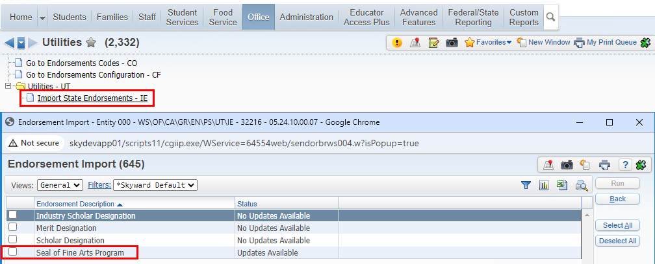
Import the Seal of Fine Arts Program Endorsement
WEB STUDENT MANAGEMENT > OFFICE > CURRICULUM & ASSESSMENTS > GRAD REQUIREMENTS > ENDORSEMENTS > SETUP > UTILITIES > IMPORT STATE ENDORSEMENTS
Notes:
The endorsement can be imported

Slide 5
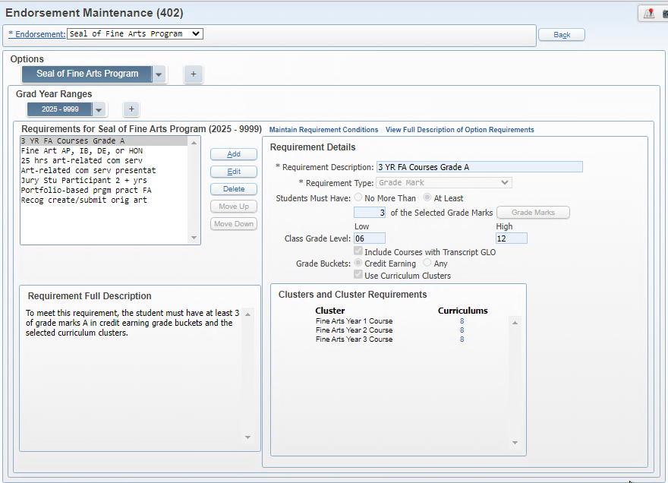
Endorsement Maintenance
Link curriculum keys for the Fine Arts requirement
Link curriculum keys for the AP, IB, DE, and HON requirement
Note: there are more updates coming for this endorsement in PR 6026499
WEB STUDENT MANAGEMENT > OFFICE > CURRICULUM & ASSESSMENTS > GRAD REQUIREMENTS > ENDORSEMENTS > SETUP > CONFIGURATION > ENDORSEMENT MAINTENANCE
Notes:
The 3YR Fine Arts Courses need to have curriculum keys linked to each cluster, only one course can meet a cluster requirement
The Fine Arts AP, IB, Dual Enrollment, and Honors courses that apply will need to be linked
The remainder of the requirements are not calculated but are freeform requirements
This is being updated in PR 6026499
Note: PR is needed to update the endorsement for the Fine Arts AP, IB, Dual Enrollment, and Honors requirement and freeform requirements to apply any of those 2 types to count as meeting the endorsement.
Changes to the screen will be covered later in this presentation

Slide 6
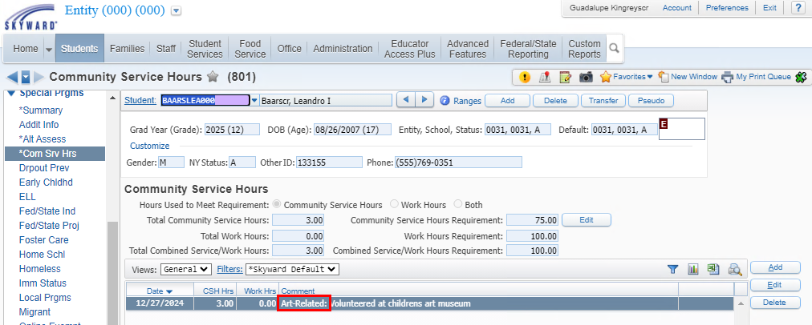
Community Service Hours Special Program records
Records can be used to track Art-related community service hours using the comment field
PR 6033545 will be making updates for tracking those hours that are art-related
WEB STUDENT MANAGEMENT > STUDENTS > STUDENT PROFILE > SPECIAL PROGRAMS > COM SRV HRS
Notes:
The community service hours special program records can be used to track the 25 hours of art-related community service. This would be a manual calculation. The comment can be used to indicate Art-Related.
PR 6033545 – adding an Art-related checkbox/flag to the record to indicate which are art-related. Adding a total to the top for Total Art-Related Hours, updating Data Mining to add the Total Art-Related Hours.

Slide 7
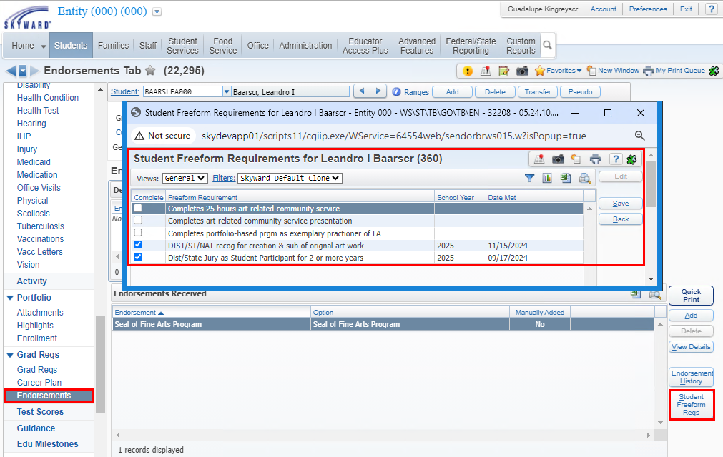
Seal of Fine Arts Program Endorsement
Select Student Freeform Reqs button to indicate when a student has completed a freeform requirement.
Enter year (defaults to current year) and date requirement met
WEB STUDENT MANAGEMENT > OFFICE > CURRICULUM & ASSESSMENTS > GRAD REQUIREMENTS > ENDORSEMENTS > SETUP > UTILITIES > IMPORT STATE ENDORSEMENTS
Notes:
The remaining requirements for the Seal of Fine Arts are freeform requirements. This means that when a student has satisfactorily met a requirement, the student’s endorsement tab will need to be updated to select the requirement(s) met. When you check the requirement, it populates with the current school year. Edit the record to enter the date met and change school year if needed. The edit is only available for a requirement that is checked.
PR 6033693 is an enhancement project:
1. Make Freeform Endorsements a separate security line item
2. Update current Freeform Endorsement functionality when indicating as met
3. Add a browse to the Endorsement screen to display Freeform Endorsements met

Slide 8
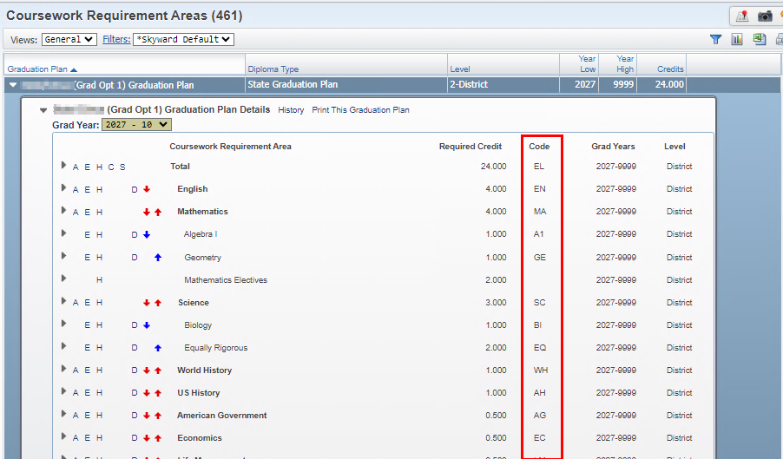
Graduation Requirement Reminders
System will use the subject code tied to course if that subject code is a valid state code
FASTER configurations can determine the subject area/code that the course is displayed as on the transcript
WEB STUDENT MANAGEMENT > OFFICE > CURRICULUM & ASSESSMENTS > GRAD REQUIREMENTS > SETUP > CODES > COURSEWORK REQUIREMENTS
Notes:
The grad plan identifies the subject area that courses can apply to.

Slide 9
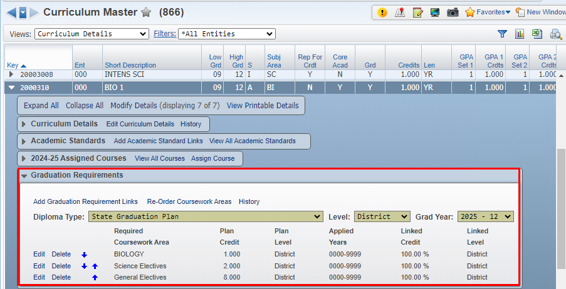
Graduation Requirement Reminders
Districts determine the areas the curriculum key can apply to per grad plan.
Courses that can apply to only one area take precedent over courses that can apply to multiple areas.
Some courses that can apply to multiple areas may take precedent over another course with fewer areas if there is only one area that hasn’t been satisfied for the course.
WEB STUDENT MANAGEMENT > OFFICE > CURRICULUM & ASSESSMENTS > CURRICULUM > CURRICULUM MASTER
Notes:
Curriculum can apply to multiple areas.

Slide 10
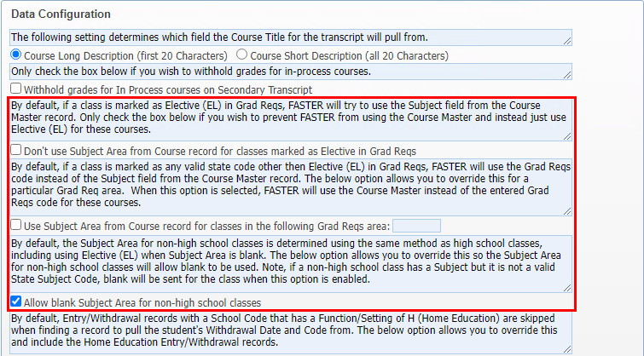
F.A.S.T.E.R. Reminders
Subject Codes have logic affecting the F.A.S.T.E.R. cumulative summary
F.A.S.T.E.R. configurations affecting subject codes
WEB STUDENT MANAGEMENT > OFFICE > CURRICULUM & ASSESSMENTS > GRAD REQUIREMENTS > SETUP
Notes:
Subject Codes logic:
Don't use Subject Area from Course record for classes marked as Elective in Grad Reqs: If checked, the program will prevent the system from pulling the Subject for the course off the Course Master and will instead use (EL) for these courses.
Use Subject Area from Course record for classes in the following Grad Reqs area: When selected the user can enter one Subject Area code. The system will then look at courses attached to Subject Area in the Graduation Requirements plan, and will report the subject code from the course instead of this Subject Code tied to the plan.
Allow blank Subject Area for non-high school classes: This option will override the subject area and send subject as blank.

Slide 11
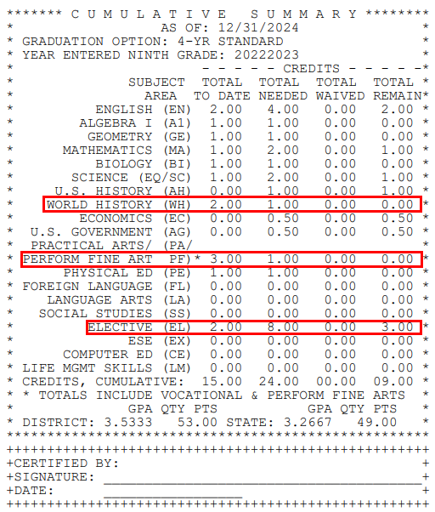
F.A.S.T.E.R. Reminders
Cumulative Summary:
Don't use Subject Area from Course record for classes marked as Elective in Grad Reqs: Not Checked. Credits are applied based on course subject code.
When Total to Date shows as greater than the Total Needed, those additional credits are subtracted from the Electives Total Needed.
WEB STUDENT MANAGEMENT > STUDENTS > STUDENT PROFILE > TRANSCRIPTS
Notes:
Cumulative Summary: In this example, the world history credits are being included in the world history credits even though in the grad plan they are being applied to general electives.

Slide 12
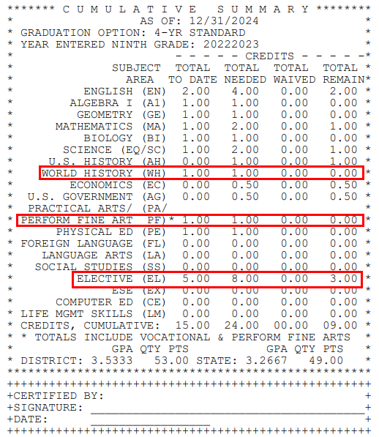
F.A.S.T.E.R. Reminders
Cumulative Summary:
Don't use Subject Area from Course record for classes marked as Elective in Grad Reqs: Is Checked.
Course credits display for the subject area it is applied to, instead of the subject from the course.
WEB STUDENT MANAGEMENT > STUDENTS > STUDENT PROFILE > TRANSCRIPTS
Notes:
Cumulative Summary: In this case since the credits for World History are tied to Electives, the credits are displaying in Electives

Slide 13
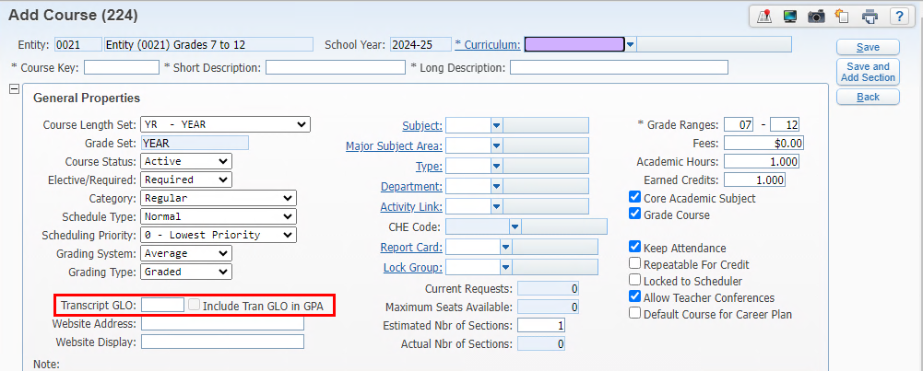
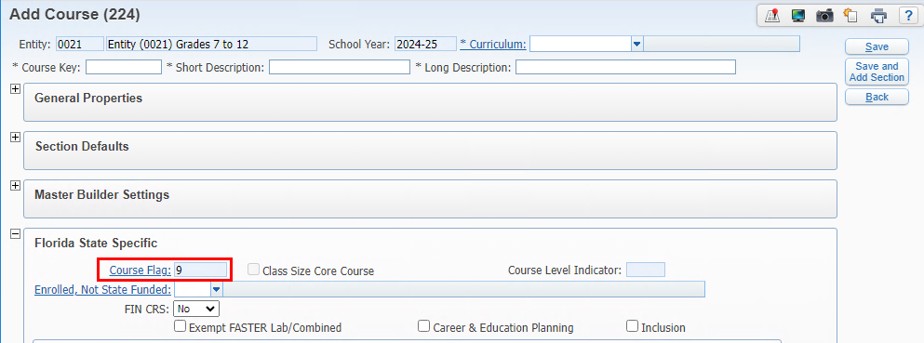
F.A.S.T.E.R. Reminders
Courses taken prior to 9th grade
Flag course if settings apply to all students taking any section of a course
WEB STUDENT MANAGEMENT > OFFICE > CURRENT SCHEDULING > BUILD COURSE MASTER > COURSE MASTER
Notes:
Courses should be flagged with Transcript GLO = 09 and Include in GPA – only if it applies to ALL students taking the course

Slide 14
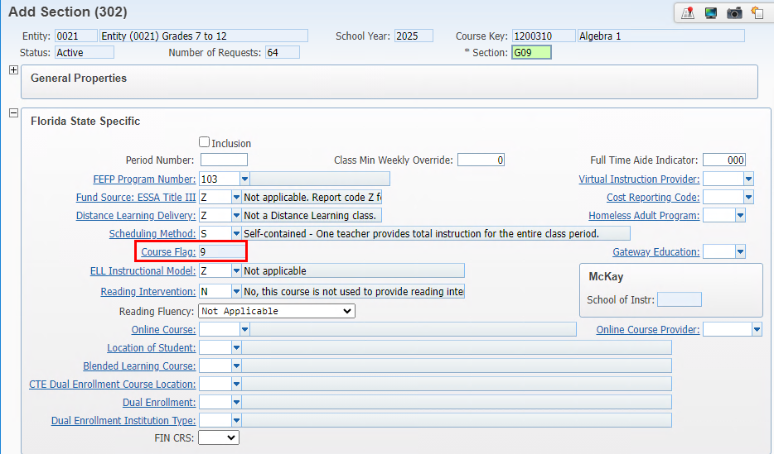
F.A.S.T.E.R. Reminders
Courses taken prior to 9th grade
Set course flags on section if it can’t be set at the course level
WEB STUDENT MANAGEMENT > OFFICE > CURRENT SCHEDULING > BUILD COURSE MASTER > COURSE MASTER > EDIT SECTION
Notes:
Courses should be flagged with Transcript GLO = 09 and Include in GPA – only if it applies to ALL students taking the course

Slide 15
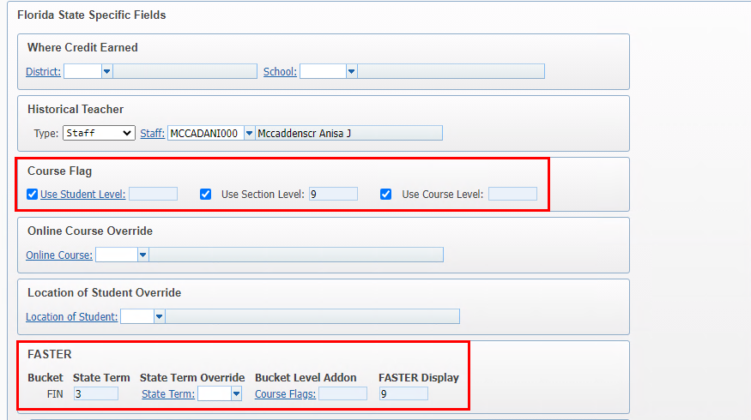
F.A.S.T.E.R. Reminders
Courses taken prior to 9th grade
Update individual student grade records
WEB STUDENT MANAGEMENT > STUDENTS > STUDENT PROFILE > GRADES > CLASS HISTORY
Notes:
Courses can be flagged at the student level if it can’t be flagged at the course/section level.

Slide 16
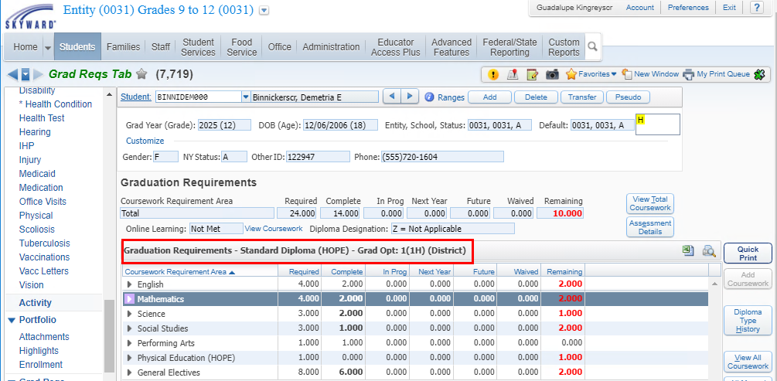
Grad Requirement Troubleshooting Tips
When a course is not applying to graduation requirements plan:
Verify the student’s graduation plan
WEB STUDENT MANAGEMENT > STUDENTS > STUDENT PROFILE > GRADES > CLASS HISTORY

Slide 17
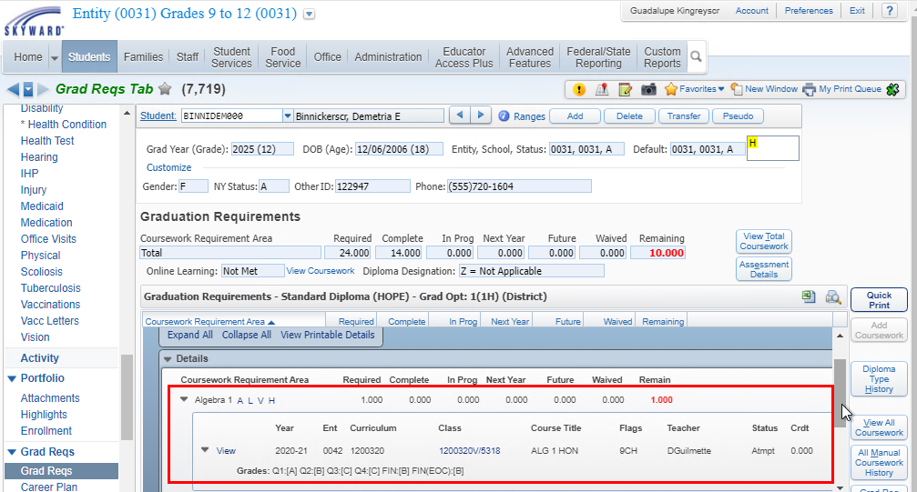
For example, this student’s Algebra requirement is not met. The student has grades that should earn credit. Make note of the entity, school year, and course.
Grad Requirement Troubleshooting Tips
WEB STUDENT MANAGEMENT > STUDENTS > STUDENT PROFILE > GRAD REQS > GRAD REQS

Slide 18
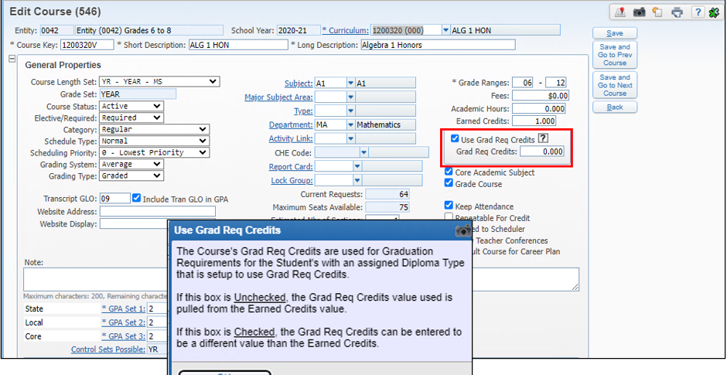
Navigate to the course: for this example, the course is set to use Grad Req Credits and the value is set to 0.00 which is why it is not showing as earned for Grad Reqs.
Grad Requirement Troubleshooting Tips
WEB STUDENT MANAGEMENT > OFFICE > CURRENT SCHEDULING > BUILD COURSE MASTER > COURSE MASTER

Slide 19
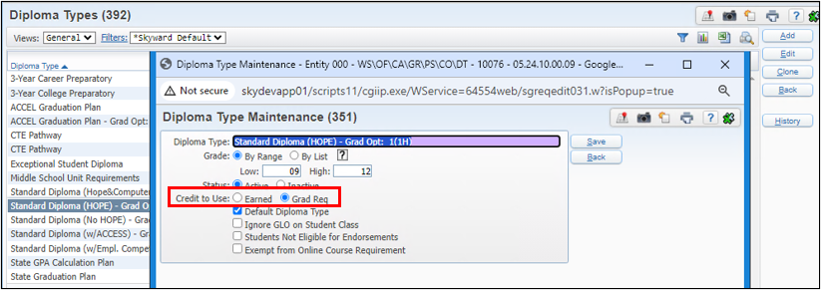
Verify the Diploma Type Code for that Grad Plan is set to use Grad Req Credits.
Grad Requirement Troubleshooting Tips
WEB STUDENT MANAGEMENT > OFFICE . CURRICULUM & ASSESSMENTS > GRADUATION REQUIREMENTS > SETUP > CODES > DIPLOMA TYPE CODES

Slide 20
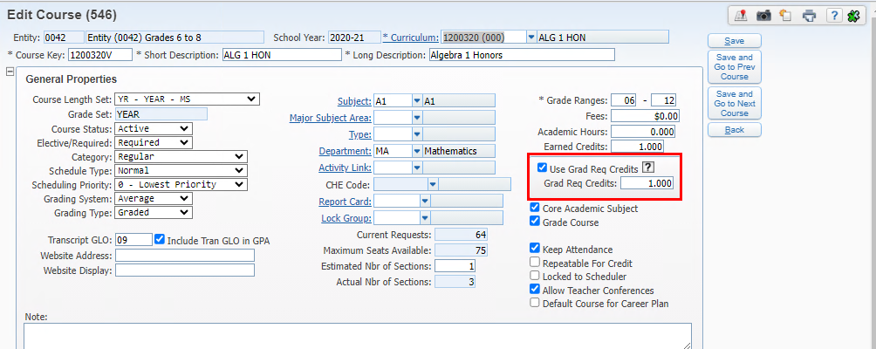
The district can update the grad req credits on the course if accurate. Upon saving, a utility runs in the print queue to update student records that are linked to that course.
Grad Requirement Troubleshooting Tips
WEB STUDENT MANAGEMENT > OFFICE > CURRENT SCHEDULING > BUILD COURSE MASTER > COURSE MASTER

Slide 21
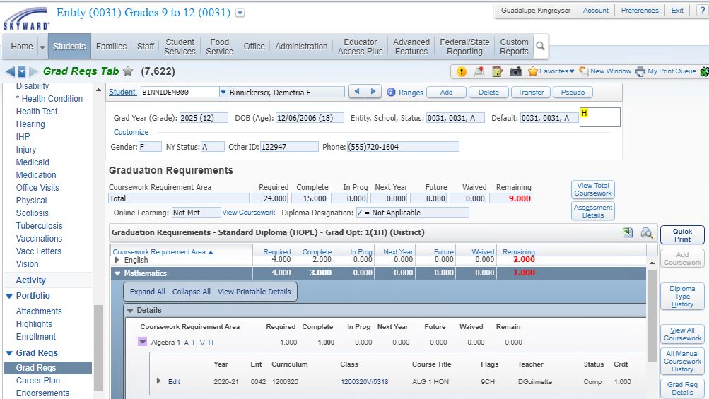
The student’s grad plan now shows as Algebra has earned credit and that requirement has been met.
Grad Requirement Troubleshooting Tips
WEB STUDENT MANAGEMENT > STUDENTS > STUDENT PROFILE > GRAD REQS > GRAD REQS

Slide 22
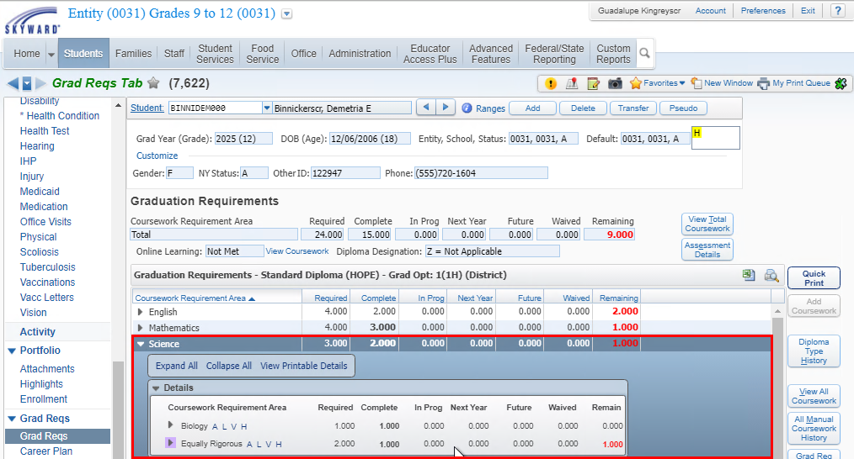
For this example, the student has not met the Equally Rigorous area for Science
Grad Requirement Troubleshooting Tips
WEB STUDENT MANAGEMENT > STUDENTS > STUDENT PROFILE > GRAD REQS > GRAD REQS

Slide 23
Look up the curriculum key tied to the course (2000360 in this example)
Grad Requirement Troubleshooting Tips
WEB STUDENT MANAGEMENT > STUDENTS > STUDENT PROFILE > GRAD REQS > GRAD REQS

Slide 24
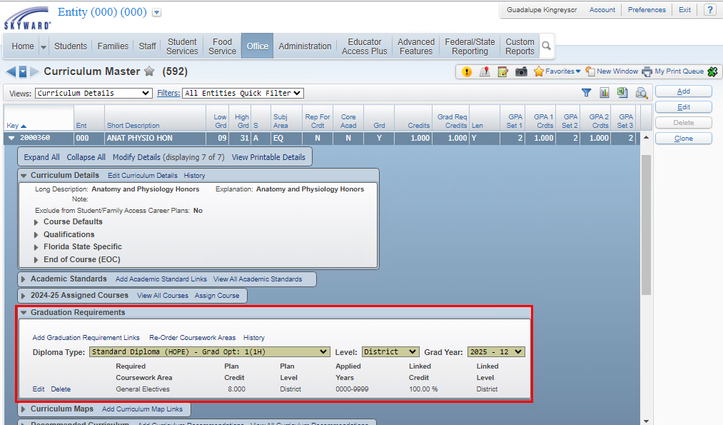
Look up the curriculum key tied to the course (2000360 in this example). For this grad plan, it is only linked to General Electives.
Grad Requirement Troubleshooting Tips
WEB STUDENT MANAGEMENT > CURRICULUM & ASSESSMENTS > CURRICULUM > CURRICULUM MASTER

Slide 25
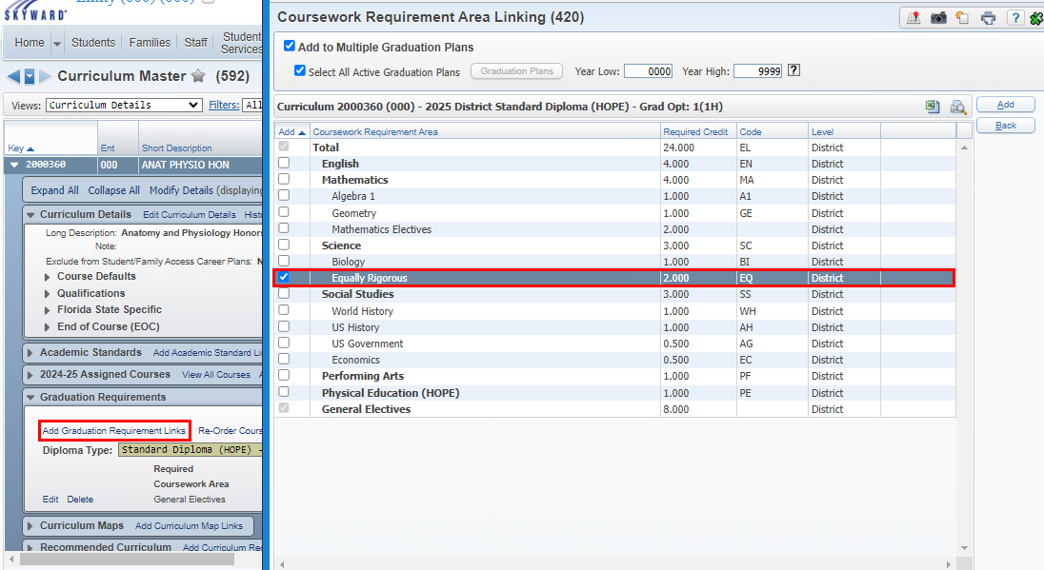
If appropriate for this plan, use the Add Graduation Requirements Links to link it to Science > Equally Rigorous
Grad Requirement Troubleshooting Tips
WEB STUDENT MANAGEMENT > CURRICULUM & ASSESSMENTS > CURRICULUM > CURRICULUM MASTER

Slide 26
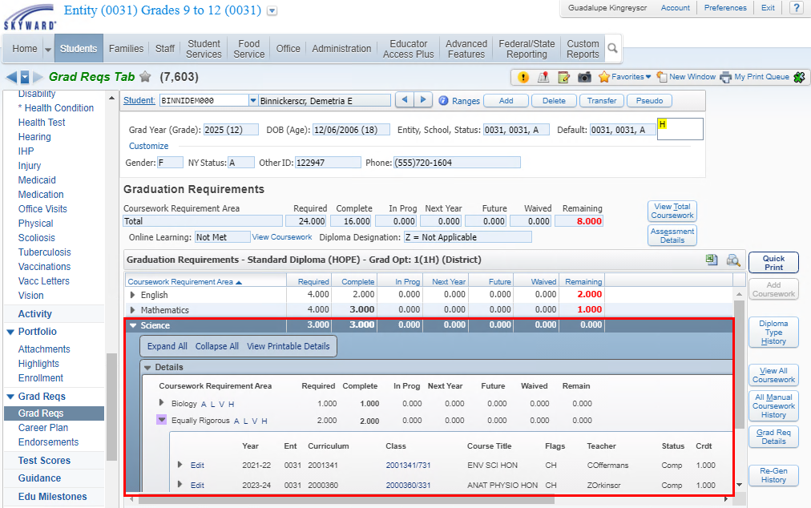
The student course is now applying to Science > EQ as expected
Grad Requirement Troubleshooting Tips
WEB STUDENT MANAGEMENT > STUDENTS > STUDENT PROFILE > GRAD REQS > GRAD REQS

Slide 27
Grad Requirement Troubleshooting Tips
When a course is not applying to graduation requirements plan:
Verify the student’s graduation plan
Look up the course in the course master for the year applied and verify the curriculum key
Go to the curriculum master and verify the grad requirement areas the curriculum key is linked to for the student’s graduation plan
Go to the student’s grad reqs tab and verify if the course is being applied to any of the areas.
Courses apply based on not only the areas they can apply to but also based on the availability of the remaining areas, meaning if they can apply to 3 areas but by the time the student takes the class, it can only apply to 1 area, it will be used over another course that can still satisfy more than one area.
WEB STUDENT MANAGEMENT > STUDENTS > STUDENT PROFILE > GRAD REQS > GRAD REQS
Notes:
Courses can be flagged at the student level if it can’t be flagged at the course/section level.

Slide 28
Upcoming Updates
PR 6011888 - Remove JCL Options and FTP option
PR 6011893 - Updates for T-Score area
PR 6026499 – Updates for FL Seal of Fine Arts Program Endorsement
Notes:
PR 6011888 - Remove JCL Options and FTP option: FASTER no longer uses JCLs and the recommended/secure way to send data is to use SFTP. This project will clean up the FASTER configuration screen to remove the JCL options as well as the FTP options.
PR 6011893 - Updates for T-Score area: 1. Allow T-Score Setup to be removed/deleted, 2. Add warning message indicating 'This area is for legacy tests and should not be used on new test setup without consulting Skyward’
PR 6026499 – Updates for FL Seal of Fine Arts Program

Slide 29
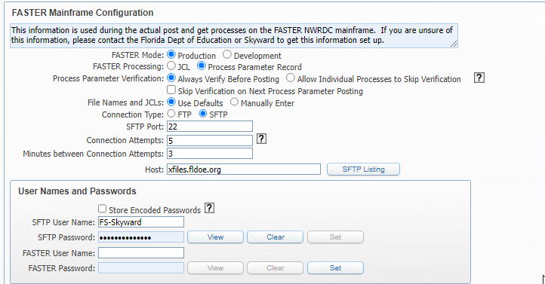
FASTER Processing will no longer display JCL as an option.
Connection Type will no longer display FTE as an option
PR 6011888 - Remove JCL Options and FTP option
WEB STUDENT MANAGEMENT > FED/STATE REPORTING > FLORIDA > FASTER > SETUP > CONFIGURATION > FASTER CONFIGURATION

Slide 30
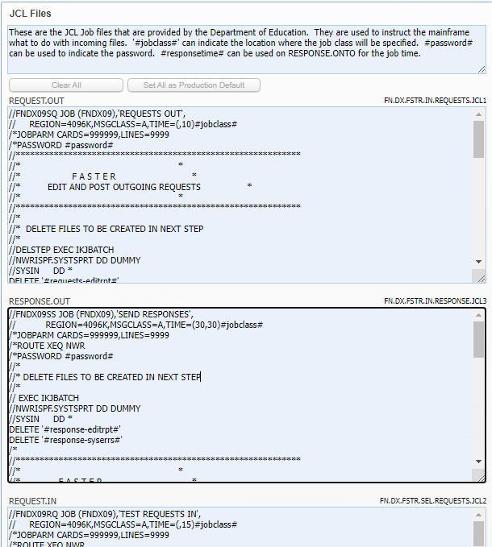
FASTER JCL Files will also be removed
PR 6011888 - Remove JCL Options and FTP option
WEB STUDENT MANAGEMENT > FED/STATE REPORTING > FLORIDA > FASTER > SETUP > CONFIGURATION > FASTER CONFIGURATION

Slide 31
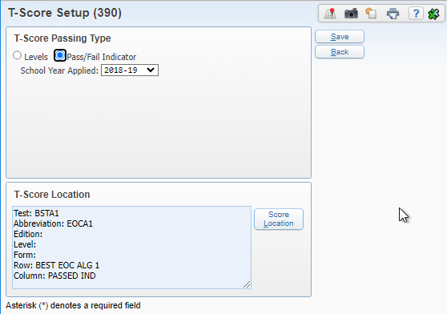
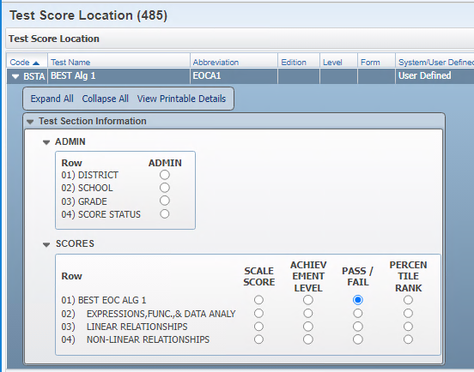
PR 6011893 - Updates for T-Score area
T-Score Setup – this is used only for Legacy tests. Be sure to ask if you are unsure if your district setup needs this.
PR 6011893 – Updates:
1. Allow T-Score Setup to be removed/deleted
2. Add warning message indicating 'This area is for legacy tests and should not be used on new test setup without consulting Skyward'
T-scores should only be used for ‘legacy’ tests. PR 6011893 will be updating this area in a future addendum to add a warning message as well as allow setup to be deleted.
Web Student Management > Office > Curriculum & Assessment > Test Scores > Test Builder > Expand Test > Expand EOC Details
Notes:
PR 2/3/2025 Oct Release Addendum 10 estimated.

Slide 32
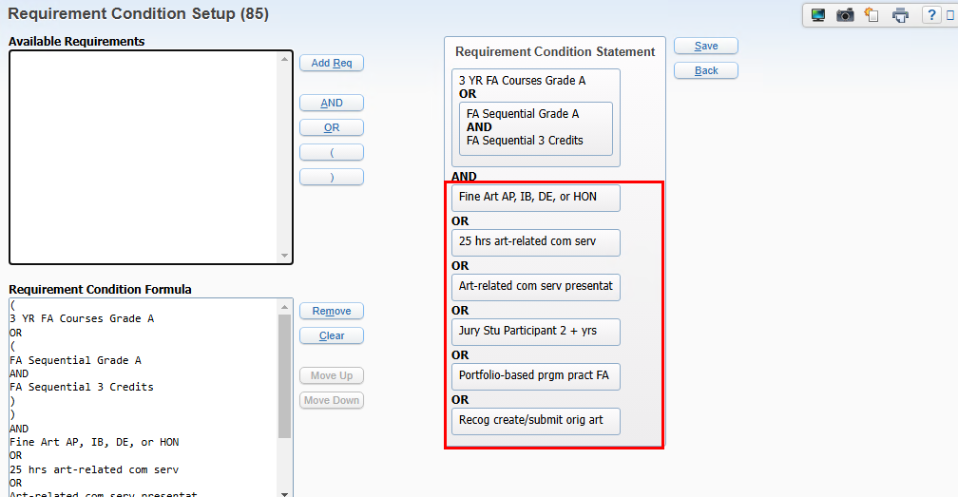
PR 6026499 – Updates for FL Seal of Fine Arts Program Endorsement
Adding option to allow the condition statement to read that the student must complete 2 of any of these grouped requirements.
Web Student Management > Office > Curriculum & Assessment > Graduation Requirements > Endorsements
Notes:
Also note: the first part of the requirements has also been modified that will be updated when the import is run. So students can complete 3 year long FA courses with grade of A or better. Districts will select the courses.
Or
They can complete sequential courses with a grade of A or better where the courses must equal 3 credits. This would be for any semester length Fine Art courses.

Slide 33
Questions

Slide 34
Thank You

