Slide 1
API
Session 5
Liz Kelley Vang – Senior Consultant – Customer Success

Slide 2
API
The Skyward API is a tool that allows real-time data syncs between Skyward and other systems. This session will review the functionalities of the LMS and OneRoster APIs in Skyward (SMS 2.0) and how to go about troubleshooting when discrepancies or sync issues arise. Available resources on the topic will also be presented for future reference.
What is an API?
Is our database set up to use an API?
Which vendors are utilizing our API?
Try it Out!
Common Questions/Troubleshooting Tips
Resources

Slide 3
What is an API?
Application Programming Interface
A way for two or more programs to share data, ensuring consistent data across systems

Slide 4
In the context of SMS 2.0 Student databases…
Two APIs available:
LMS API (aka Skyward API)
OneRoster API
Vendors can use either API to retrieve information from your Skyward database on their terms (often multiple times throughout the day)
Both APIs can be used to sync specific types of data back to Skyward
Once configured, both the LMS and OneRoster APIs are available
Use them for as many integrations as you like
Read-Only API – No additional license is needed
A license is required to use passback to sync data back to Skyward

Slide 5
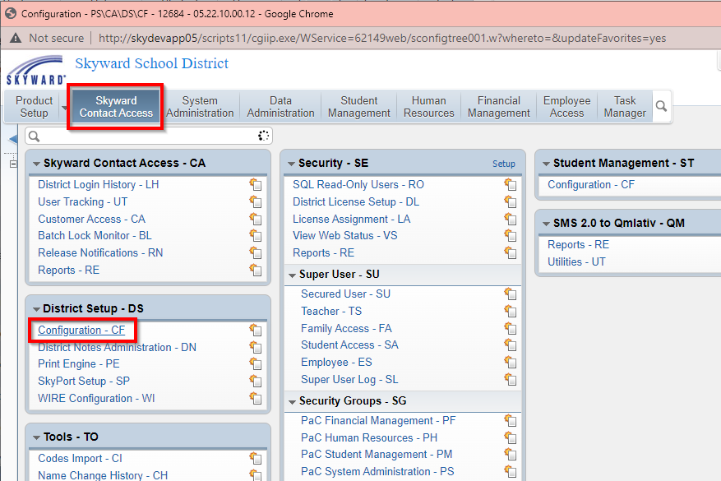
Is my district using API?
Navigate to…
Product Setup >
Skyward Contact Access >
District Setup >
Configuration >
API Configuration

Slide 6
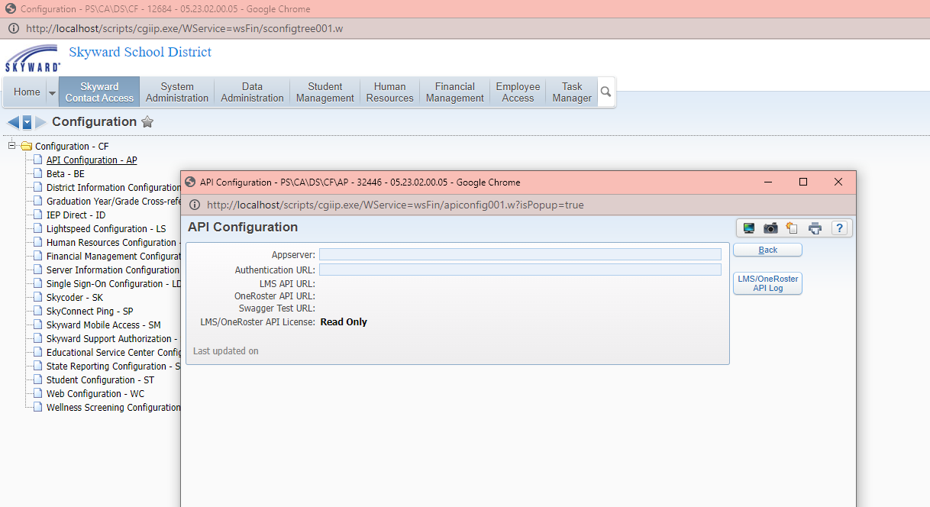
API is not configured.
X Outgoing
X Incoming

Slide 7
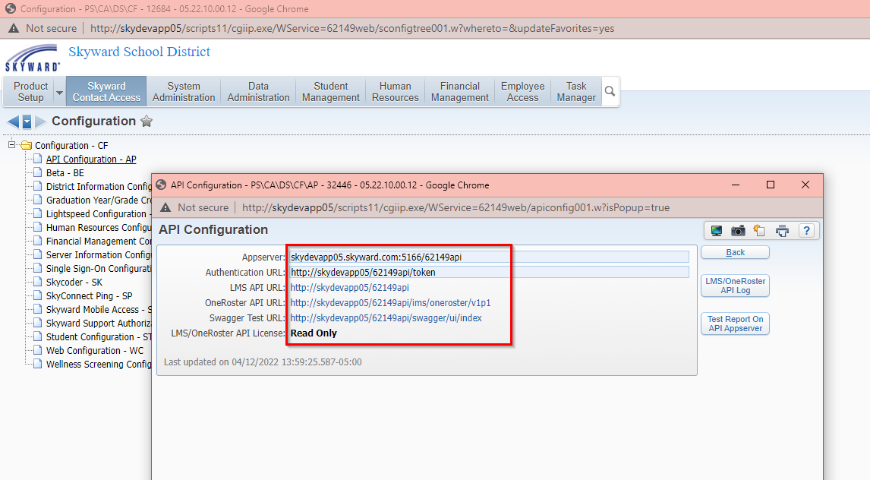
Read-Only API is configured.
✓ Outgoing
X Incoming

Slide 8
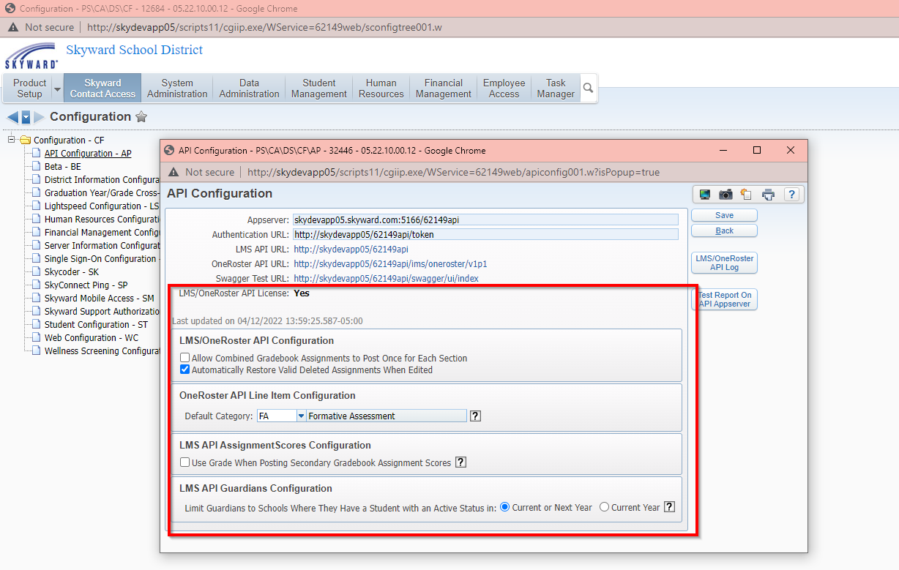
Read-Only and passback API are both configured.
✓ Outgoing
✓ Incoming

Slide 9
How do I start using API?
Confirm whether your API is already configured.
If your API is not configured…
Self hosted? Follow setup instructions in the API Launch Kit.
ISCorp hosted? Submit a ticket to ISCorp.
Interested in purchasing the passback license? Reach out to your account manager to get a quote and initiate the setup process.

Slide 10
Which vendors are accessing our data?
Secured User Records
See which vendors are set up with API credentials
Secured User browse > locate records where API Secret Assigned = Yes
API Log
Detailed logs of when vendors retrieved/synced specific types of records
User Tracking
Additional tracking information (necessary to see records of data being pulled from the LMS API)
Notes:
Show secured user browse, API Config screen, and API Log

Slide 11
Try it Out!
To test your API, you’ll need:
Swagger URL
Found in API Configurations
Key and secret for a vendor
Locate the secured user record for a vendor and click the API button
Internal ID for example student/staff/etc.
Notes:
Log into swagger and show how to pull records

Slide 12
Common Questions
Why doesn’t a specific student/staff member appear in the third-party program?
Why aren’t assignments/scores syncing to Skyward for a teacher?
Can we change what fields/data are available in the API?
Can I limit which information is available to certain third parties?
Can the passback API be used with standards-based gradebooks?
Are you programming the 1.2 OneRoster specifications?
What options should I use on the API Configuration screen?
How can a contact from a third party speak with Skyward directly?

Slide 13
Common Passback Errors – LMS API
Record Type | Error | Explanation/Suggestion
Assignments | Grading Category is not valid. Use the Grading Categories endpoint to see what is available for this Section. Please note that a Section may use different Grading Categories for each Grading Period. | Ensure that the category associated with the assignment in the third party is valid/selected in the Skyward gradebook for that grading period.
 | Assignment is marked as deleted. The teacher may restore this Assignment in his or her Skyward Gradebook, provided that it is not in a locked Grading Period. | Teachers can restore deleted assignments under Display Options in the gradebook. If this error appears often, consider enabling the configuration “Automatically Restore Valid Deleted Assignments When Edited”.
 | Unable to create the assignment. An assignment for this gradebook, title, and due date already exists. | Confirm that the assignment has a unique title and due date in that gradebook.
Assignment Scores | Student was not enrolled in Section for Assignment. | Review the student’s scheduling transactions. Assignments can only be updated via sync if the student was enrolled in the class on the dates associated with the assignment.
 | Assignment Score is not valid. Assignment Scores must be non-negative numbers. | Assignment scores of 0-999.99 can be synced.
 | Special Code is not valid. Use the Special Codes endpoint to see what is available. | Valid special codes can also be viewed within the gradebook when scoring an assignment.
 | Section uses a standards gradebook. Standards gradebooks must be set to Manually Enter Grades in order to post grades. | This is set on the Academic Area associated with the class.
 | Grade Mark is not valid for Student and Assignment. | This usually means that the rarely used configuration “Use Grade When Posting Secondary Gradebook Assignment Scores” in the API Configurations screen is enabled. This should likely be turned off.

Slide 14
Common Passback Errors – OneRoster API
Record Type | Error | Explanation/Suggestion
Line Items (aka Assignments) | A Line Item with the due date of and title already exist for this Class. | Assignments must have a unique title and due date.
 | The Line Item failed to be created. Assign date is not in class start/stop dates | Assign date must fall between the class start/stop dates.
 | Assign date is not within the start/stop dates of any grading period | Confirm the assign date in the third-party gradebook and grading period dates.
 | Actual due date is not in class start/stop dates | Due dates must fall between the class start/stop dates.
 | Actual due date is not within the start/stop dates of any grading period | Confirm the due date in the third-party gradebook and grading period dates.
Results (aka Assignment Scores) | The resultValueMax must be greater than or equal to 0 and less than or equal to 999. | The total possible points must be 0-999.
 | The Line Item Result sourcedId is not valid. | Confirm that the assignment exists in the Skyward gradebook and has not been altered.
 | The Line Item is in a locked Grading Period or is outside the Grading Periods used by the Class. | Scores cannot be synced after both the grading period and grade input window are over.

Slide 15
Troubleshooting
Verify how the vendor is retrieving data from Skyward
Use the API Log/User Tracking to confirm which records the vendor is referencing
Get specific examples that exhibit the issue and review the associated records/values in Skyward
Use Swagger to confirm how the records look in the API
Reference our documentation, like the FAQ Guide
Submit a service call
Suggest the vendor connect with Skyward directly via the Partner Portal

Slide 16
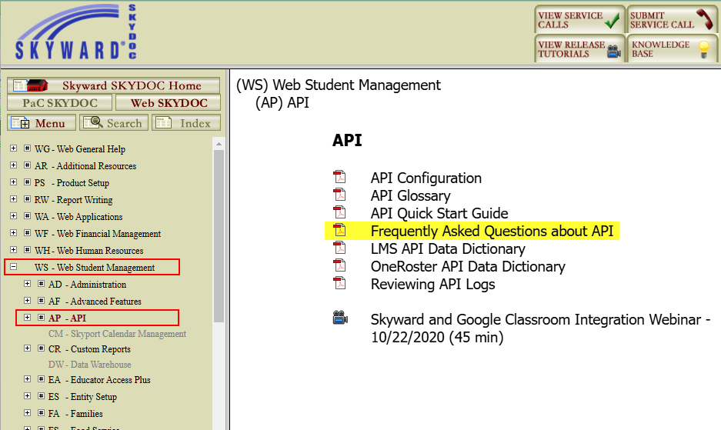
API Resources

Slide 17
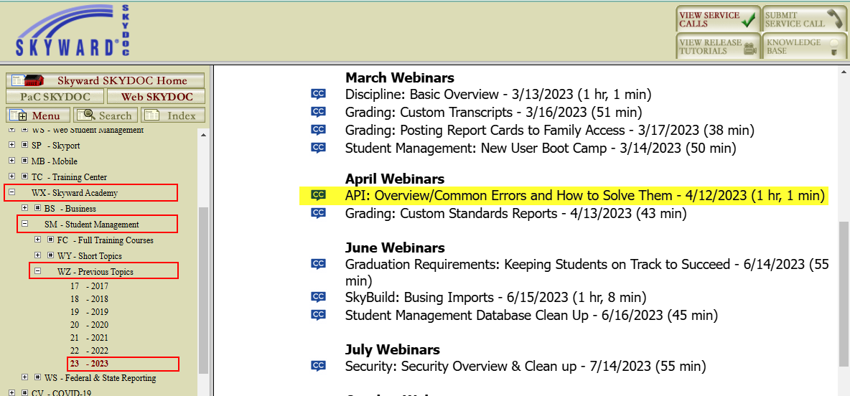
API Resources

Slide 18
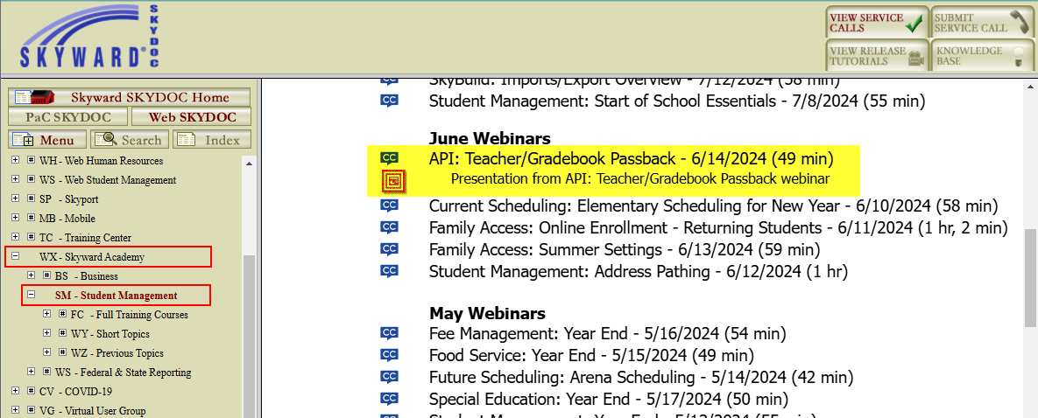
API Resources

Slide 19
Questions? Thank you for attending this session!

