Slide 1
Family Access/NSOE/ Family Maintenance
Wifi:
Skyward
meetup2025
Session 1
Liz Kelley Vang – Senior Consultant – Customer Success

Slide 2
Family Access/NSOE/Family Maintenance
In this session we will review several ways in which family information can be added and maintained within Skyward. Attendees will have the opportunity to share example situations/pain points so that we can learn how other districts address them and discuss potential solutions.
Best Practices
What is a family?
Matching Name Records
Check your Work
Troubleshooting Tools
Points of Entry
NSOE
Online Registration
Family Access - Pseudo Changes
Reports

Slide 3
Family Access/ NSOE/Family Maintenance
Best Practices - What is a Family?
In Skyward, families are a set of people that…
Reside at the same address
Should be able to access the same students’ records
Family records in Skyward don’t always mimic the family’s true structure. It’s sometimes necessary to use distinct Family IDs in Skyward for a single family to ensure the accuracy of contact information and relationship detail and maintain privacy.
When adding/updating a family, consider:
Which guardians should have access to which students in Family Access?
Does each member of the family have an accurate address and phone number?

Slide 4
Family Access/ NSOE/Family Maintenance
Best Practices - Matching Name Records
Avoid duplicate records
When searching for possible matches…
Search for possible legal names and partial names
Verify birthdate
Review name types* (make sure you’re not matching a guardian to a student record, for example)
“Display Guardians Only” – Be careful!
Use Name Maintenance and/or Name Change History to investigate potential matches
Add all information for new records right away- don’t plan to finish adding the details later
*If the only existing record for the person has a Student name type, create a new non-student record for them

Slide 5
Family Access/ NSOE/Family Maintenance
Best Practices - Check your Work
Before leaving a screen, confirm that you did not inadvertently…
change the family order for the student
change the guardian order within a family
make updates for other families with shared guardians/students
connect a guardian with a student they’re not responsible for
remove the connection between a guardian and student
Verify sibling connections
Are students grouped correctly as siblings?
If updates were made for one student, should changes be applied to the siblings too?
Should emergency contacts be updated?
Remember that if you have a combined database, some updates may need to be made from HR, not Student Management

Slide 6
Family Access/ NSOE/Family Maintenance
Best Practices – Troubleshooting Tools
Student Profile
Family tab
Edit family > Chg Hist and Chg Log
Web Access tab
Change History tab
Also check the Special Programs History button
Name Maintenance
Use the different views depending on what you’re looking for
Name Change History
Product Setup > Skyward Contact Access > Tools
Family Browse
Use the various views
Family Access Users
Quick way to see which student records a guardian has access to and what notifications they receive

Slide 7
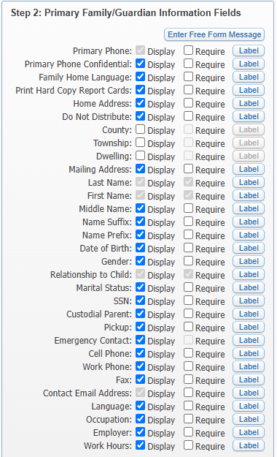
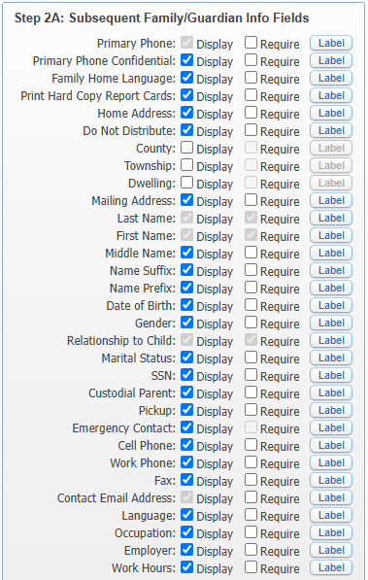
NSOE

Slide 8
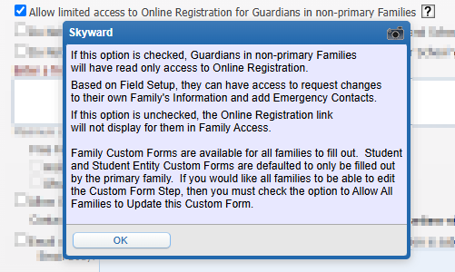
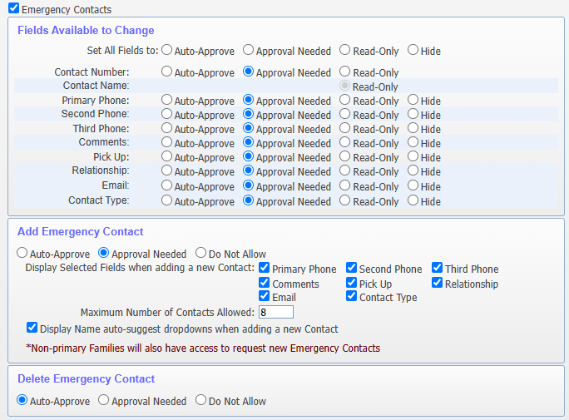
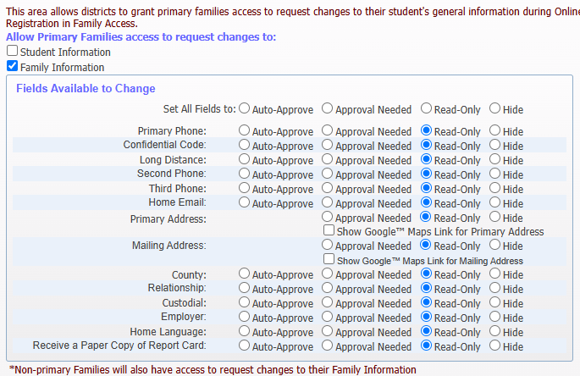
Online Registration

Slide 9
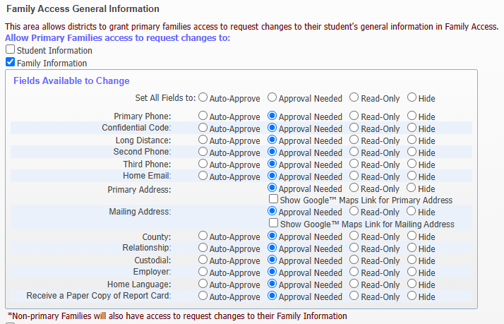
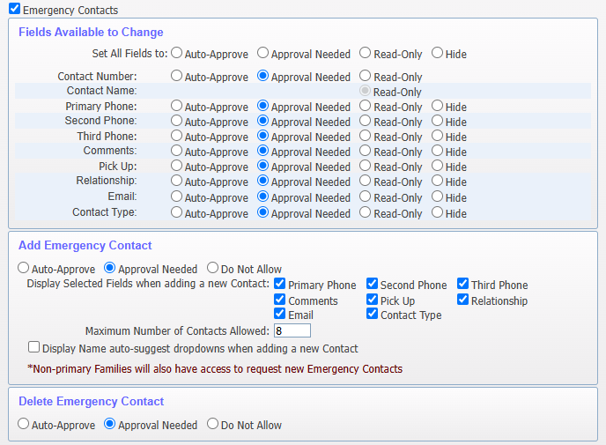
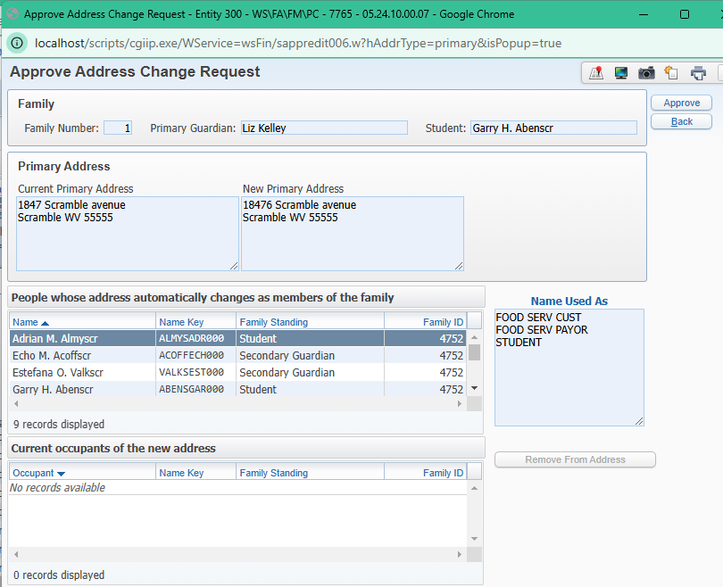
Family Access – Pseudo Changes

Slide 10
Family Access/ NSOE/Family Maintenance
Family/Guardian Reports
Families browse with various views
Duplicate Family Report - WS\FA\RE\DF
Reveal families living at the same address and/or shared phone number – and show students attached to each family to aid in the verification and clean-up process.
Family Census Report - WS\FA\RE\FC
Choose from 7 different format options to gather census data and family information, as well as create family labels -- a great option when only 1 label per family is desired.
Family Notes Report - WS\FA\RE\FN
View notes for a Range of families or Individual families, and generate for a specific note type, date entered, created by (specific person), as well as *protected notes*.
Address Change Report - WS\AF\NA\RE\AC
Find the address changes that were made during a specific date range
Data Mining vs Skybuild

Slide 11
What issues related to family/guardian records cause headaches in your district? “I wonder how other districts handle situations such as…” Interested in hearing how other districts use specific features or processes?

Slide 12
Questions? Thank you for attending this session!

