Slide 1
Test Scores/EOC
Florida User Group 2023 - 2024

Slide 2
Agenda
Test Builder:
New Date Passed setup options
Date Passed Setup for CIV
SkyDoc – Date Passed
New 2023-2024 scores
PR 5591448
EOC reminders
Notes:
EOC Reminders: Course and tests are linked
Grading – EOC method
-options
Mass Change Selected Grade Mark has been updated to include EOC test grade bucket

Slide 3
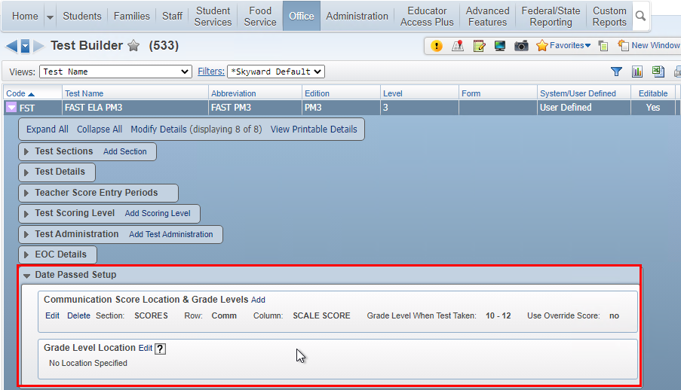
Date Passed Setup options
Score Location
Select Add to identify score and any override values as needed
If only one score location is selected, the override is tied to that specific score location
Web Student Management > Office > Curriculum & Assessment > Test Scores > Test Builder

Slide 4
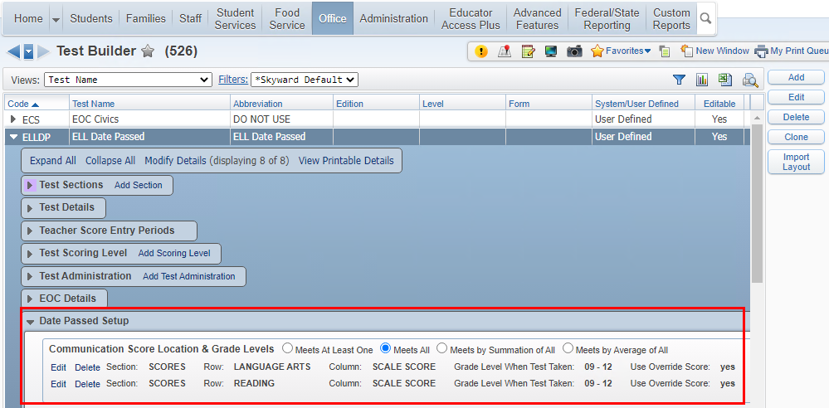
Date Passed Setup options
When more than one score location is specified, additional options are available
If only one score location is selected, then these options do not display
Web Student Management > Office > Curriculum & Assessment > Test Scores > Test Builder

Slide 5
Date Passed Setup options
Meets At Least One - Student must have a passing score in one of the score locations.
Meets by Summation of All - Student must have scores from each section that combined have a passing score. As long as the test/edition are the same, the scores can come from different test dates and will display the sum like it does above for the ACT Average scores.
Meets by Average of All - Student must have scores from each section that averaged have a passing score. As long as the test/edition are the same, the scores can come from different test dates and will display the average like it does above for the ACT Average scores.
Override Summation/Average Score By Grad Req Base Yr - When one of the new options is selected (Summation or Average), a new Override link appears. With new options, it’s the combination of both lines (either by summing or averaging) that is checked against, so overrides are entered here instead of on each individual record.
Web Student Management > Office > Curriculum & Assessment > Test Scores > Test Builder
Notes:
We will discuss override setups when Meets by Summation or Average is selected in an upcoming slide

Slide 6
Date Passed Setup options
Overrides
Use Score Override Value: Use this option to set the override score value if Grad Req Base Yr does not apply. This option will apply the override score to Grad Req Base Yr of 0000 – 9999.
Web Student Management > Office > Curriculum & Assessment > Test Scores > Test Builder

Slide 7
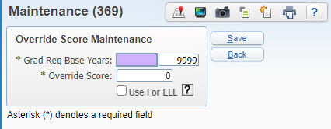
Date Passed Setup options
Overrides
Use Score Override Range: Use this option to set the override score value to only apply to students that fall within Grad Req Base Yr range. This option would be set if the passing override score value could change year to year.
Multiple records may be entered if the grad year ranges do not overlap
Web Student Management > Office > Curriculum & Assessment > Test Scores > Test Builder

Slide 8
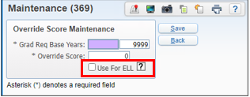
Date Passed Setup options
Overrides – Use for ELL
Use for ELL: When this option is selected, override will only be used for students that have ELL Program record. The override use will be limited to students that have a total time in an ELL Program of less then two years.
Web Student Management > Office > Curriculum & Assessment > Test Scores > Test Builder

Slide 9
Graduation Year Codes for Date Passed ELL Option
The Graduation Year records can be set up at the district level and/or the entity level.
To use the ELL option for the date passed overrides, the student must be in ELL for less that 2 years from their graduation date.
Web Student Management > Office > Grading > Setup > Codes > Graduation Year Codes
Notes:
The logic will look first for an entity level date for the student’s current default entity, and it will use that date if available, otherwise it will use the district level date.
If a record for the student’s graduation year is not available, then this logic will not apply for the student.

Slide 10
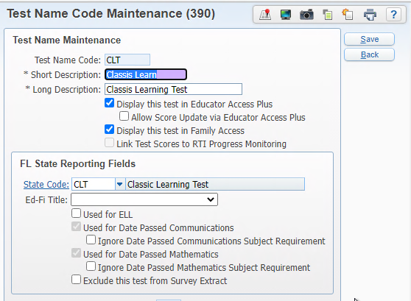
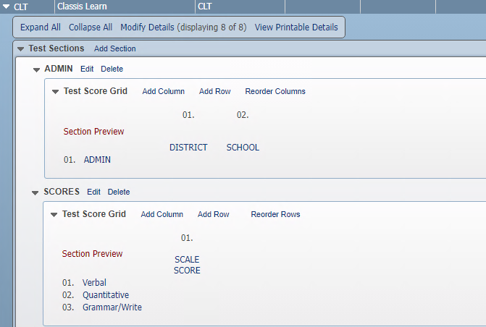
Test Builder – CLT Setup
Web Student Management > Office > Curriculum & Assessment > Test Scores > Test Builder
Notes:
Test must be cross-walked to state code and test set up with valid subject codes and test score type

Slide 11
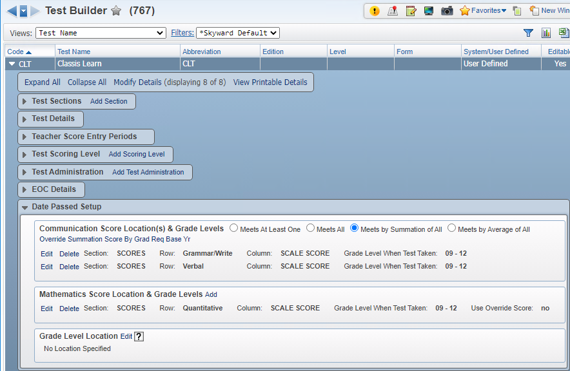
CLT – Classic Learning Test
Web Student Management > Office > Curriculum & Assessment > Test Scores > Test Builder
Notes:
The CLT should be set up as meets by Summation of All for Communications. If overrides values are needed for Communications, you don’t set it on each score subject but instead set an override for the total value.
Math will still be set on the one score location.

Slide 12
Assessment Details Information
Web Student Management > Students > Student Profile > Test Scores – Assessment Details
Notes:
The user will see a message on the Assessment Details if there is a test that based on programmed logic would apply but the test is not set up for date passed.

Slide 13
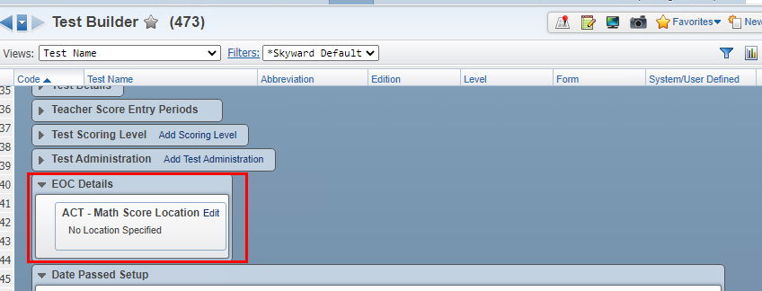
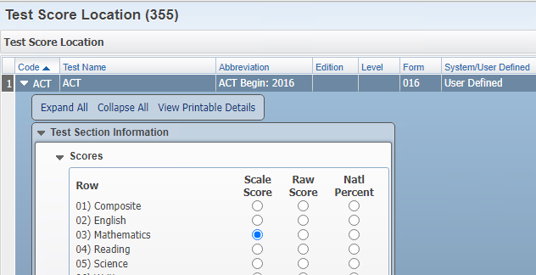
ACT/SAT/PSAT
Web Student Management > Office > Curriculum & Assessment > Test Scores > Test Builder

Slide 14
ACT test is now calculating as a passing test
Warning message is no longer populating
ACT/SAT/PSAT
Web Student Management > Students > Student Profile > Test Scores – Assessment Details

Slide 15
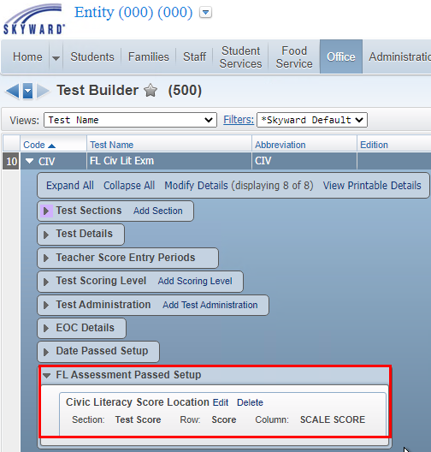
Setup the Civic Literacy Score Location under FL Assessment Pass Setup
Florida Civic Literacy Exam
Web Student Management > Office > Curriculum & Assessment > Test Scores > Test Builder

Slide 16
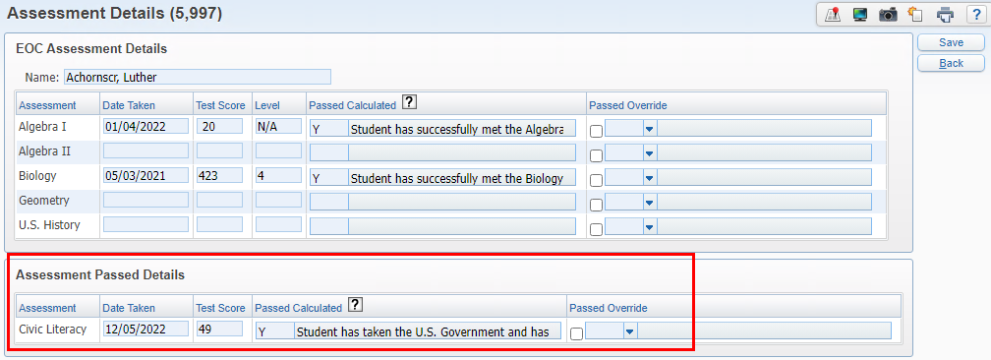
Florida Civic Literacy Exam will display under Assessment Passed Detail on the Test Score tab
Florida Civic Literacy Exam
Web Student Management > Students > Student Profile > Test Scores – Assessment Details

Slide 17
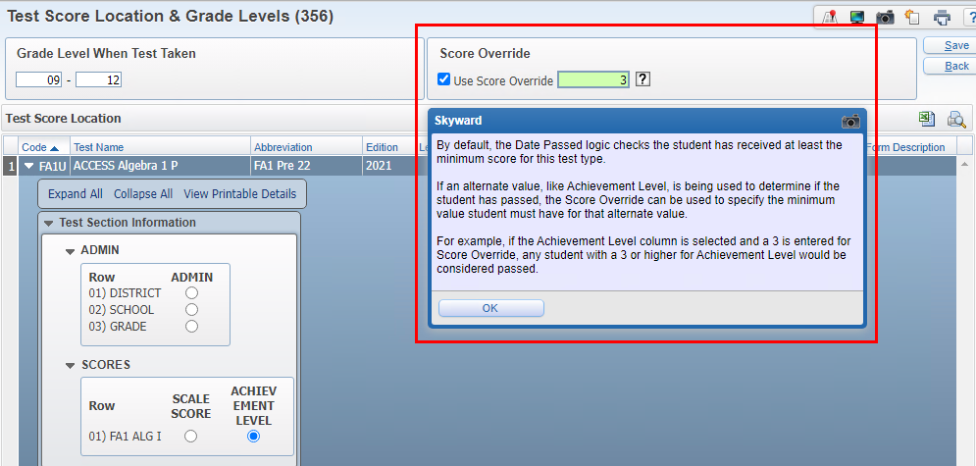
Date Passed setup for FA1 and FA2 must use the Score Override when using the Achievement Level
FA1 & FA2
Web Student Management > Office > Curriculum & Assessment > Test Scores > Test Builder
Notes:
Example of using the Score Override

Slide 18
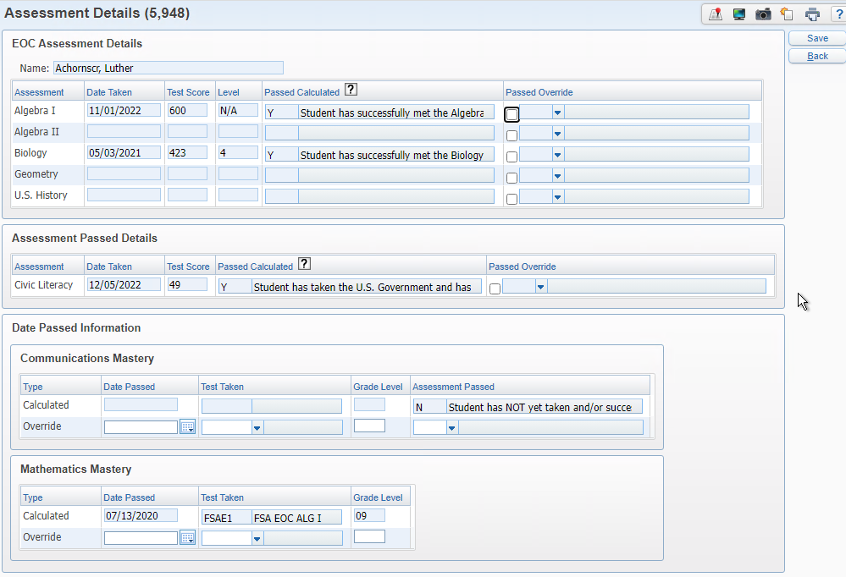
EOC Assessment Details will always populate the highest score, regardless of the test.
Date Passed will always populate the FSA test first and then comparative/concordant scores.
Configuration option to determine how scores populate for the concordant: (Date Passed) Use Earliest Concordant Passing Score
Location: Product Setup > Skyward Contact Access > Student Management > Configuration
EOC Assessment
& Date Passed Logic
Web Student Management > Students > Student Profile > Test Scores – Assessment Details

Slide 19
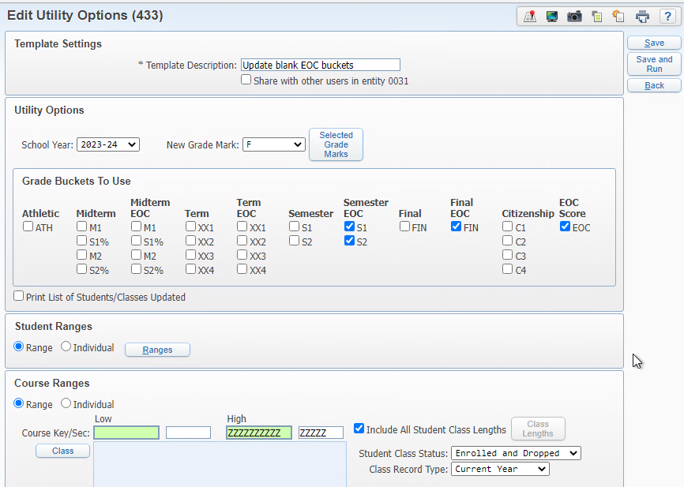
Mass Change Selected Grade Marks
Web Student Management > Office > Grading > Product Setup > Utilities > Grade Marks
Notes:
This utility has been updated to include the EOC grade buckets including the EOC Score.
This utility may be run from the district or entity level.
Based on your district policies, the EOC Score might need to be populated if the student took the course but did not sit for the test as expected.

Slide 20
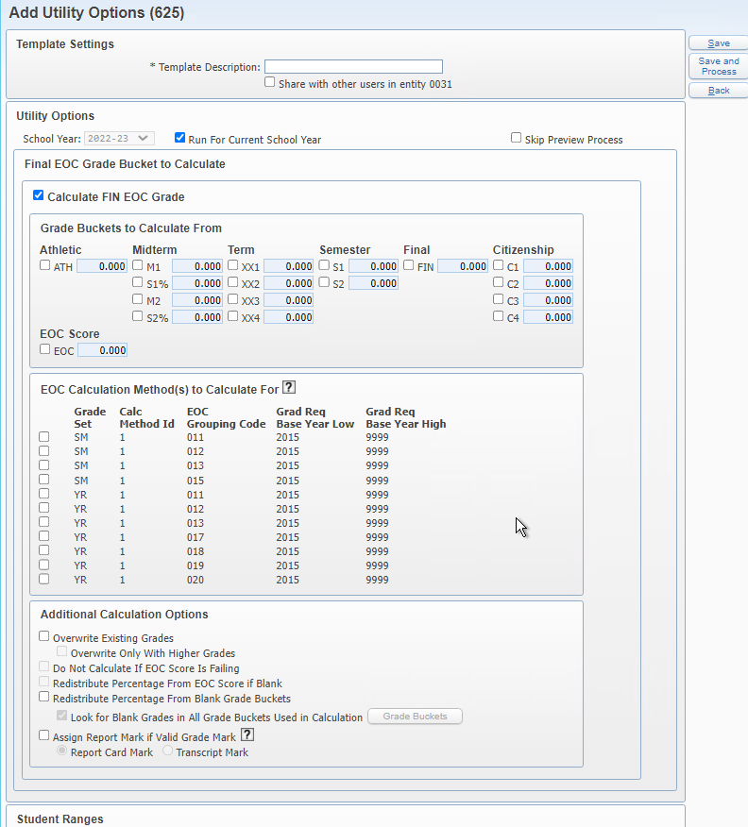
EOC Grade Calc Utility
Web Student Management > Office > Grading > Setup > Configuration > GPA Setup > Calculation Methods > EOC Calculation Methods
Notes:
This can be run at the entity level by range, individual selection, or processing list

Slide 21
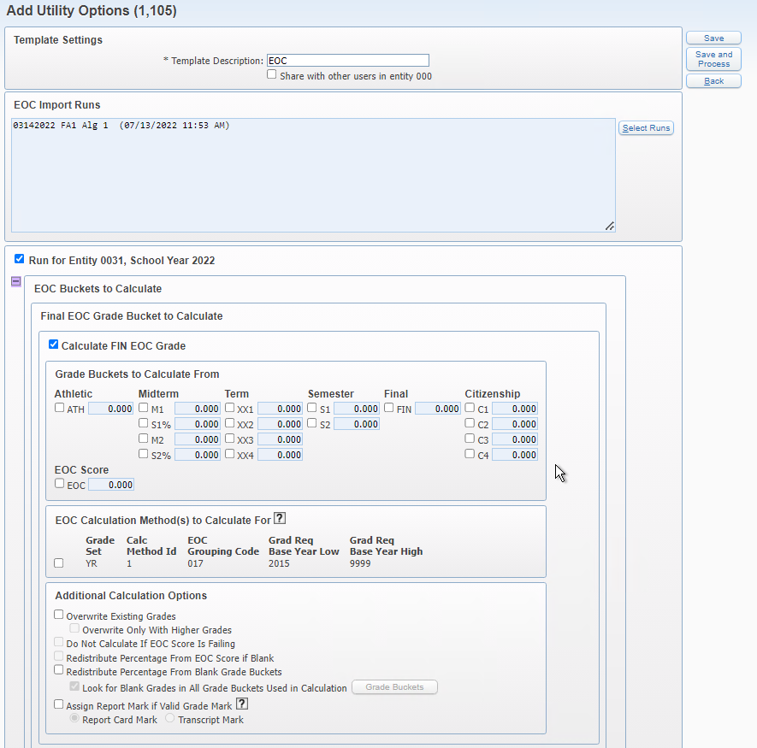
EOC Grade Calculation by EOC Import Run
Web Student Management > Office > Grading > Setup > Utilities
Notes:
This option can be run from either the district or entity level.
It uses a Test score Import run file to determine the students/classes to process

Slide 22
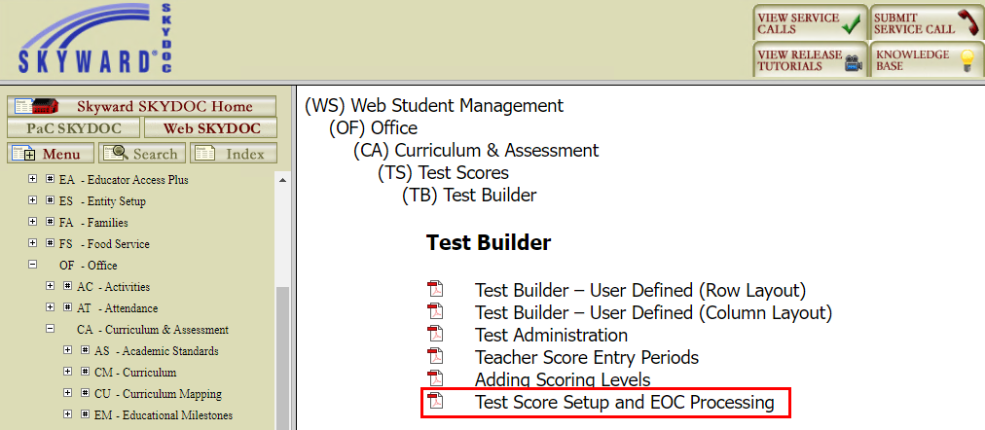
SkyDoc for Date Passed is included in Test Score Setup and EOC Processing
Within Skyward > Question Mark > SkyDoc – Skyward Documentation
Notes:
For best search results, go to that area of the software you want documentation for and then select the question mark.

Slide 23
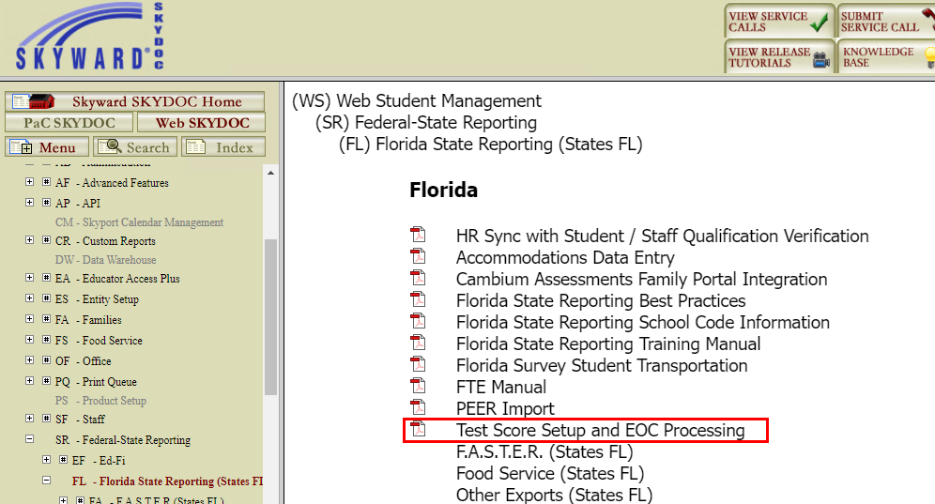
SkyDoc for Date Passed is included in Test Score Setup and EOC Processing
Within Skyward > Question Mark > SkyDoc – Skyward Documentation
Notes:
For best search results, go to that area of the software you want documentation for and then select the question mark.

Slide 24
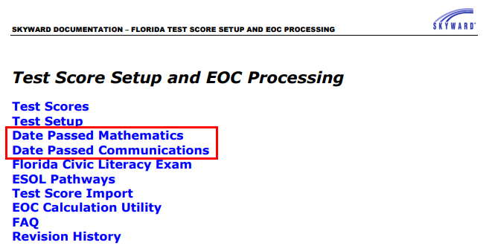
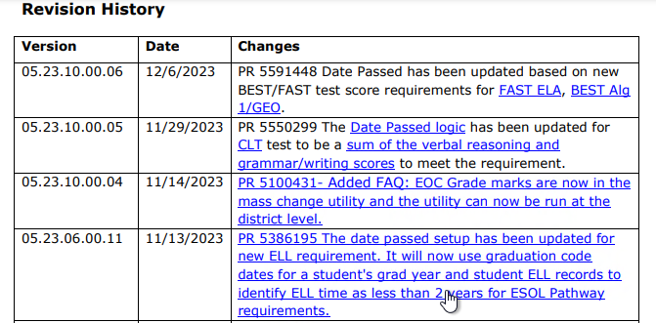
SkyDoc for Date Passed is included in Test Score Setup and EOC Processing
Within Skyward > Question Mark > SkyDoc – Skyward Documentation
Notes:
This document is updated as state changes are made and our logic/setup updated.
You can see changes in the Revision History area.
Bring up the doc on the screen

Slide 25
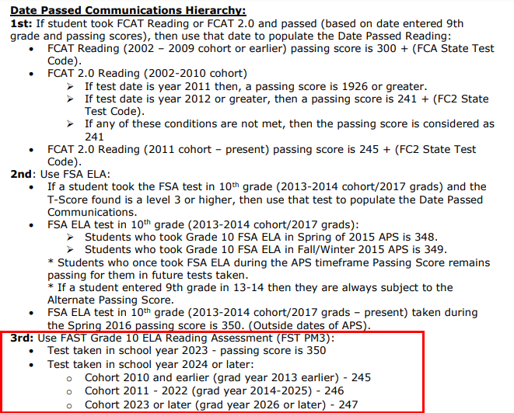
New 2023-2024 scores
PR 5591448
FAST ELA Reading
Within Skyward > Question Mark > SkyDoc – Skyward Documentation
Notes:
This document is updated as state changes are made and our logic/setup updated.
You can see changes in the Revision History area.
Bring up the doc on the screen

Slide 26
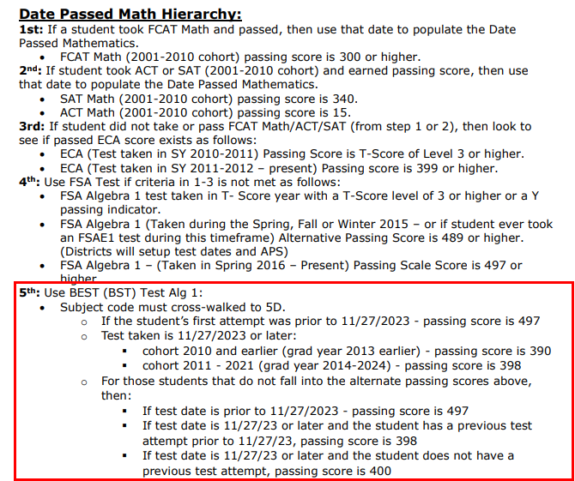
New 2023-2024 scores
PR 5591448
BEST Algebra 1
Within Skyward > Question Mark > SkyDoc – Skyward Documentation
Notes:
This document is updated as state changes are made and our logic/setup updated.
You can see changes in the Revision History area.
Bring up the doc on the screen

Slide 27
Hierarchy for Mathematics Date Passed, BEST Geometry falls within 7th: Comparative Scores
New 2023-2024 scores
PR 5591448
Best Geometry
Within Skyward > Question Mark > SkyDoc – Skyward Documentation
Notes:
This document is updated as state changes are made and our logic/setup updated.
You can see changes in the Revision History area.
Bring up the doc on the screen

Slide 28
If loading FAST ELA scores on the provision scale (passing 350)
Modify existing test Date Passed Communications area to use score override of 350
If loading FAST ELA scores on the new scale (passing 245, 246, or 247 based on cohort)
Create new 2024 test for new cut scores, no override needed
New 2023-2024 scores
PR 5591448
Notes:
Discussion with districts in attendance

Slide 29
EOC Reminders
No new changes for the 2024 school year as of now
Make sure courses are cross-walked to the state EOC Assessment you will be using. Multiple can be linked
Verify that the Grading EOC Calc Methods are set up correctly especially if you have changed course lengths
Districts can use the Mass Change Selected Grade Mark utility to update EOC buckets
Notes:
EOC Reminders: Course and tests are linked
Grading – EOC method
-options
Mass Change Selected Grade Mark has been updated to include EOC test grade bucket

Slide 30
Upcoming Updates
PR 5596724 - Update 2024 submissions to include FAST Read/Math
Notes:
Update 2024 submissions to include FAST Read/Math
Update 1: Update the Fall 2023, Winter 2023, Spring 2024, and Summer 2024 EOC submissions to include the FAST Progress Monitoring Reading and Math
Update 2: If student is included in Alg1 or Geometry, then exclude the student from FAST Math

Slide 31
Questions

Slide 32
Thank you

