Slide 1
Florida State Reporting
Florida User Group 2023 – 2024

Slide 2
Agenda
2023-2024 Reminders
23-24 Updates/Changes
Functionality Updates
FTP Troubleshooting
Edit Updates

Slide 3
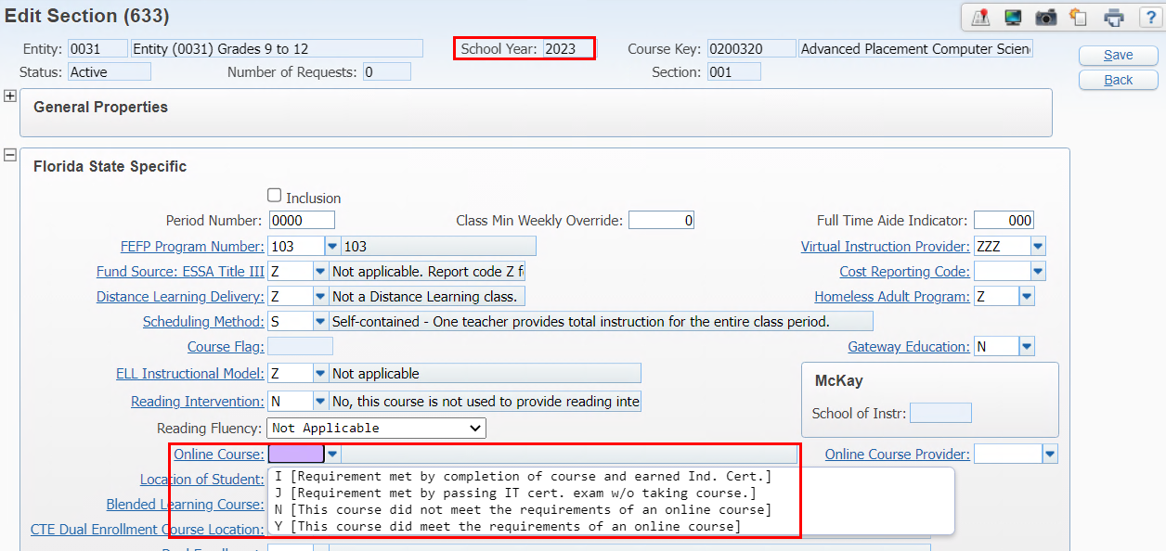
Online Course local code beginning with 2024
2023 and earlier, only the state codes display for the field.
Web Student Management > Office > Current Scheduling > Build Course Master > Course Master
Notes:
PR 5569621 - Online Course now uses a local code beginning with 2024 to allow districts to still track the courses that are online.
A new local online course code table has been added to Florida when the school year is greater than 2023. If the school year is equal to or less than 2023 the state defined online course code table is still used. The new online course code table update applies to:
Skybuild Import and Export
Student Profile Grade Entry Screen
Mass Change Course Master Field Values Utility
Course Master Section Screen
Student Profile Current Scheduling Class Edit Screen

Slide 4
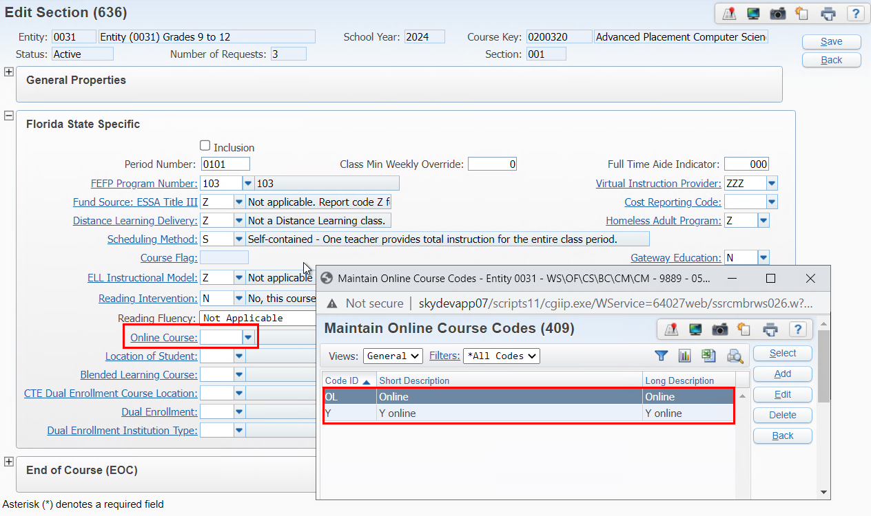
Online Course local code beginning with 2024
A new local online course code table has been added to Florida when the school year is greater than 2023. If the school year is equal to or less than 2023 the state defined online course code table is still used.
Local codes are district wide, but they must be added from a school entity level.
Web Student Management > Office > Current Scheduling > Build Course Master > Course Master
Notes:
PR 5569621 - Online Course now uses a local code beginning with 2024 to allow districts to still track the courses that are online.
A new local online course code table has been added to Florida when the school year is greater than 2023. If the school year is equal to or less than 2023 the state defined online course code table is still used. The new online course code table update applies to:
Skybuild Import and Export
Student Profile Grade Entry Screen
Mass Change Course Master Field Values Utility
Course Master Section Screen
Student Profile Current Scheduling Class Edit Screen

Slide 5
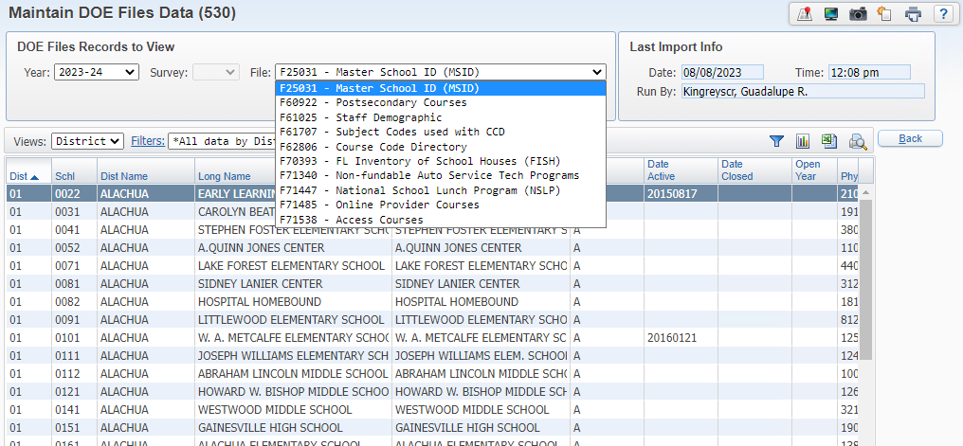
Import DOE Files
Web Student Management > Fed/State Reporting > Florida > Other Exports > DOE Files
Notes:
These should be imported prior to survey processing to ensure the district data can be validated prior to submitting data to the state.
PR 5491068 - Districts can import the Staff Demographic file into the DOE File to use for validating the Teacher Course format

Slide 6
Mass Update FTE Fields
Reset FTE Eligible Flags at the start of a new school year
Update the FTE Diploma/Score fields for Additional Funding Format
Web Student Management > Fed/State Reporting > Florida > Setup > Utilities
Notes:
This is a versatile utility that may be used to update the FTE Diploma screen information primarily for the Student Additional Funding format for survey 5.
It can be used to update the FTE/Diploma fields for the new school year for those areas such as AP/IB/AICE where they earned the additional funding last year but now you want the fields cleared for the new year.
Mass Update FTE Fields for AP/IB/AICE to award FTE if student was enrolled in the course and passed the test. No longer looking for a passing grade in the course.

Slide 7
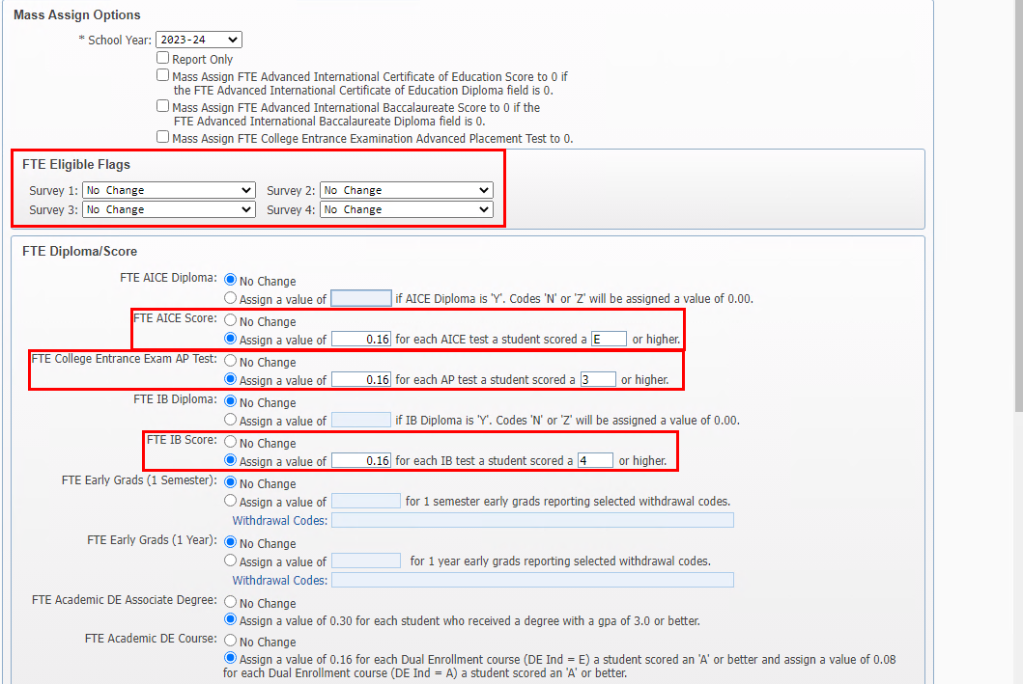
Mass Update FTE Fields
Web Student Management > Fed/State Reporting > Florida > Setup > Utilities
Notes:
This is a versatile utility that may be used to update the FTE Diploma screen information primarily for the Student Additional Funding format for survey 5.
It can be used to update the FTE/Diploma fields for the new school year for those areas such as AP/IB/AICE where they earned the additional funding last year but now you want the fields cleared for the new year.
PR 5474197 - Mass Update FTE Fields for AP/IB/AICE to award FTE if student was enrolled in the course and passed the test. No longer looking for a passing grade in the course.

Slide 8
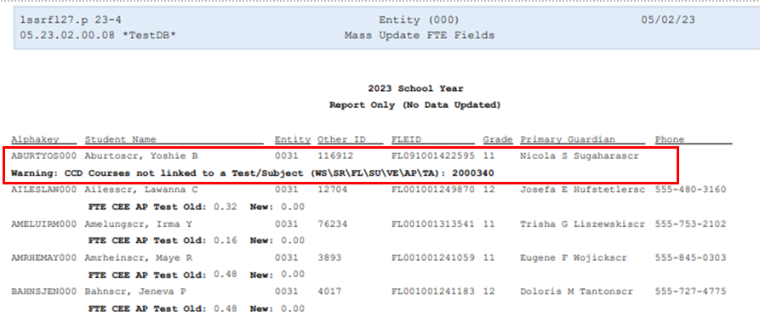
Mass Update FTE Fields
Web Student Management > Fed/State Reporting > Florida > Setup > Utilities
Notes:
PR 5377111 A warning message was added to the Mass Update FTE Fields utility to let users know about AP, IB, or AICE Courses that may not be properly linked to a Test/Subject under Test Associations.

Slide 9
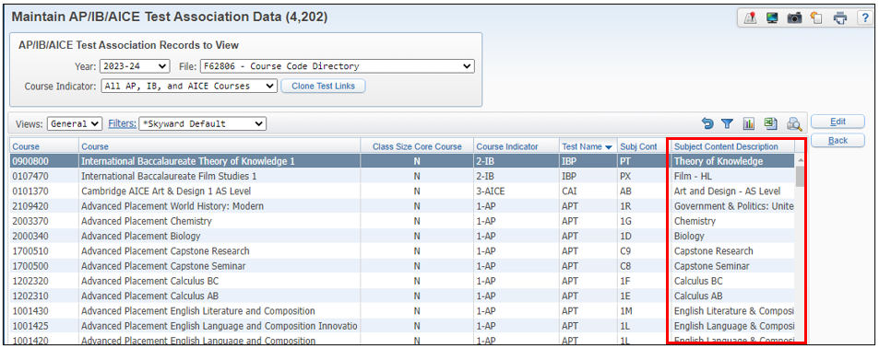
Mass Update FTE Fields
Web Student Management > Fed/State Reporting > Florida > Surveys > Verifications > AP/IB/AICE Teacher Bonus > Test Associations
Notes:
5346243 A new column was added to the AICE/IB/AP Test Association Data maintain for “Subject Content Description."

Slide 10
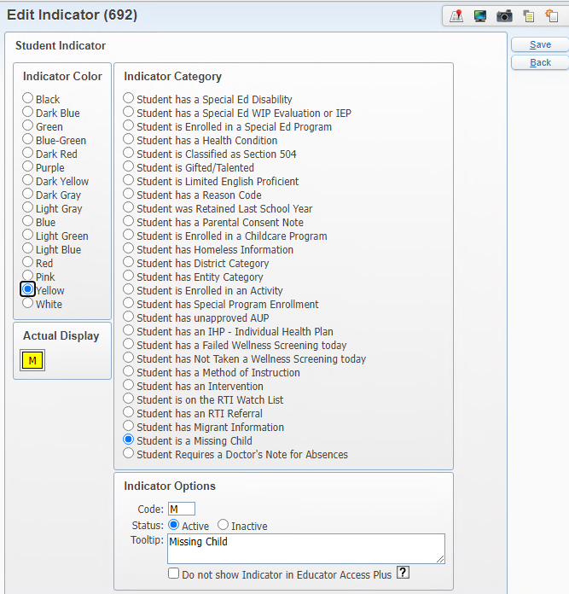
Missing Children Indicator was added
Web Student Management > Advanced Features > Advanced Features > Student Indicators
Notes:
PR 5479962 - Be sure to indicate if your district does not want the indicator to display in EA+
They must be set up per entity

Slide 11
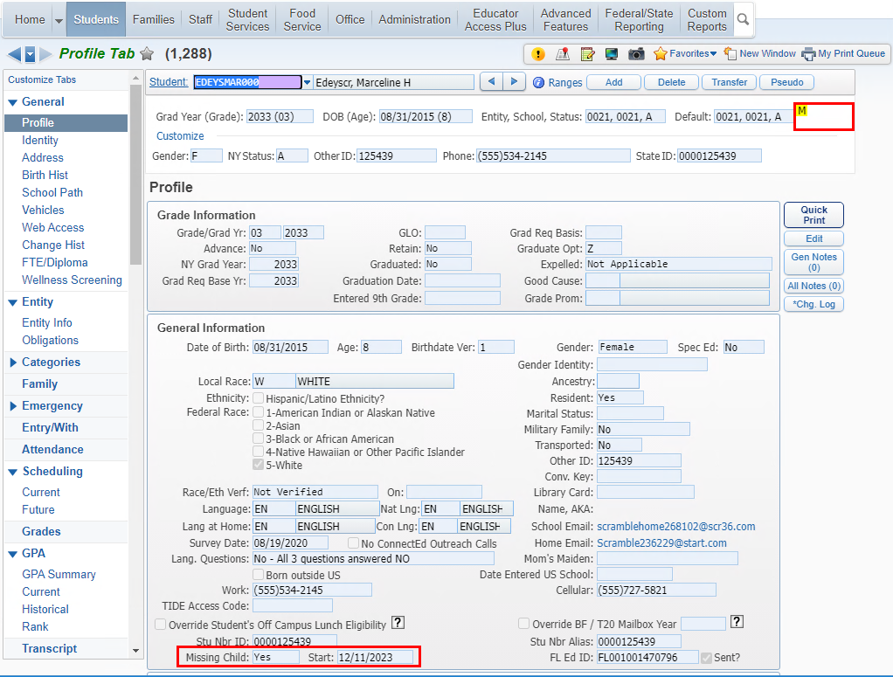
Missing Children Indicator was added
Web Student Management > Advanced Features > Advanced Features > Student Indicators
Notes:
Be sure to indicate if your district does not want the indicator to display in EA+

Slide 12
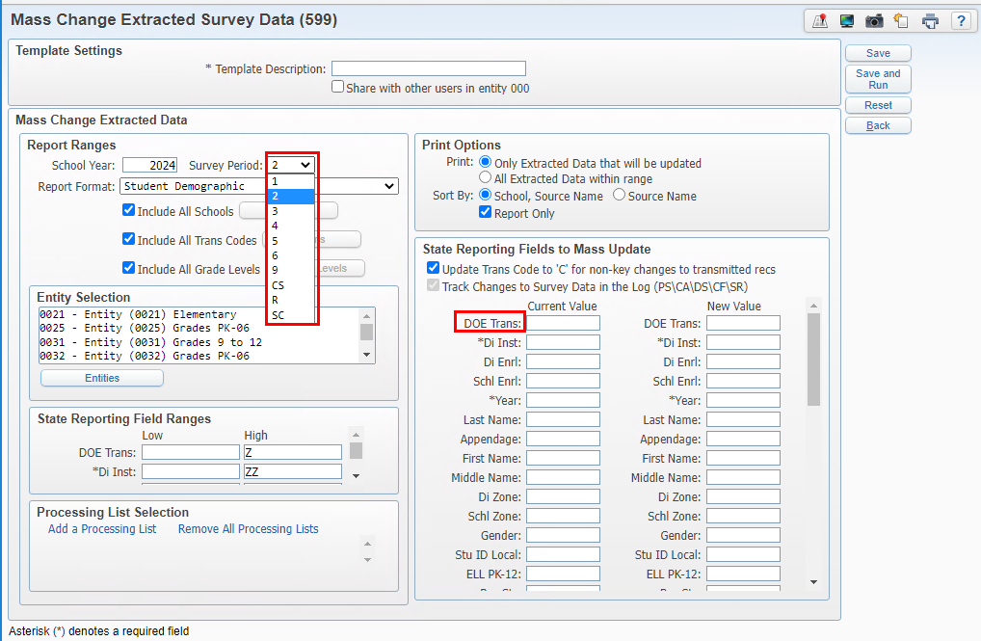
Mass Change Extracted Survey Data
Web Student Management > Fed/State Reporting > Florida > Surveys > Utilities
Notes:
PR: 5185358 - Skyward Transaction Codes and DOE Transaction Codes can be changed in the survey maintain using the Mass Change Extracted Survey Data
The Survey Period for Class Size and Sunshine Connections was added to the utility
- The Mass Change Survey Data can now change data for Class Sze (Survey Period = CS) and Sunshine Connections (Survey Period = SC).

Slide 13
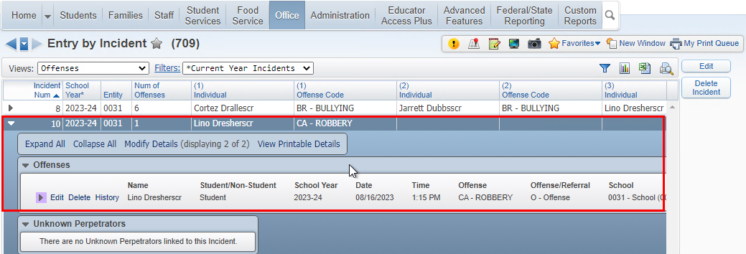
Discipline Entry
When updating an offense for a single incident, the incident details are automatically updated.
When an incident has only one offense, any changes to the offense details are auto-updated on the incident.
Web Student Management > Office > Discipline > Entry by Incident/Entry by Student/Unknown Perpetrator
Web Student Management > Students > Student Profile > Discipline
Notes:
When updating an offense for a single incident, the incident details are automatically updated.

Slide 14
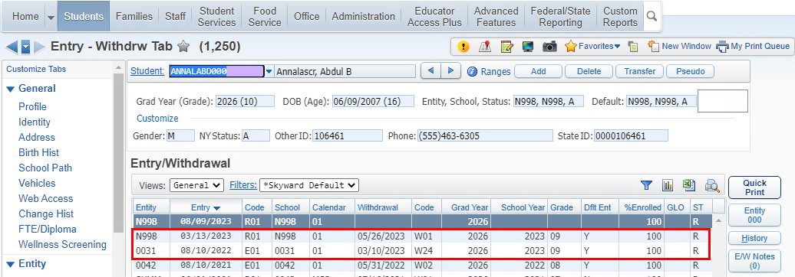
Student Transcript format for N998
When updating an offense for a single incident, the incident details are automatically updated.
Student was enrolled in 0031 prior to enrolling in N998
Web Student Management > Students > Student Profile > Entry/Withdrawal
Notes:
PR: 5557965 - Student Course Transcript format will now extract for a student with default entity N998 at the end of the year IF they were also enrolled in the district at some point during the year. The Current, School of Enrollment will match the most recent school in the district where they were enrolled.

Slide 15
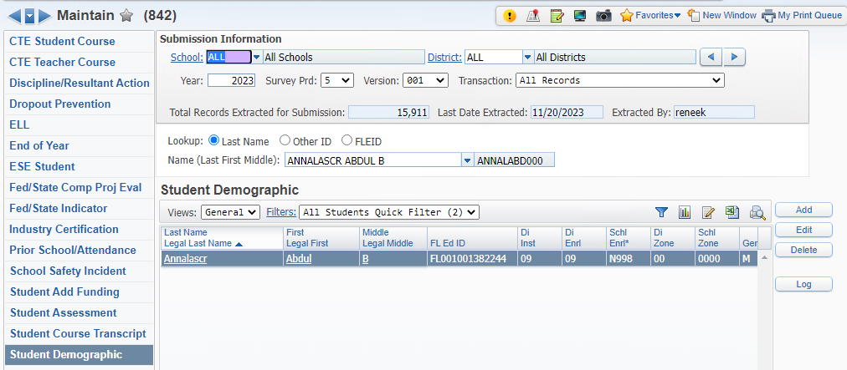
Student Transcript format for N998
When updating an offense for a single incident, the incident details are automatically updated.
Student Demographic reports school of enrollment as N998
Web Student Management > Fed/State Reporting > Florida > Surveys > Maintain

Slide 16
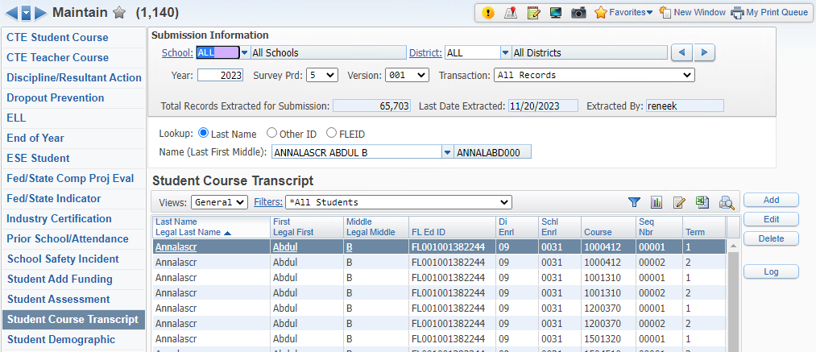
Student Transcript format for N998
When updating an offense for a single incident, the incident details are automatically updated.
Student Transcript reports the school of enrollment as most recent brick and mortar school where student took courses.
Web Student Management > Fed/State Reporting > Florida > Surveys > Maintain

Slide 17
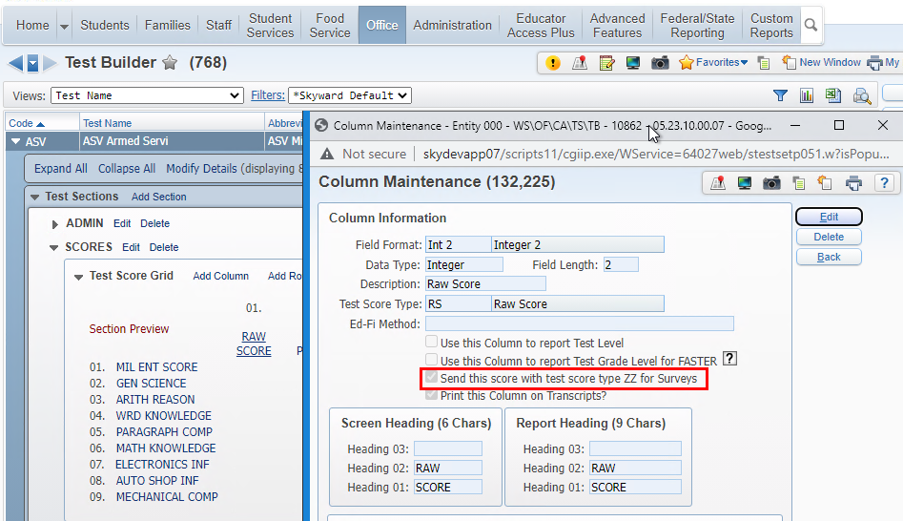
Student Assessment Test Score Type
When updating an offense for a single incident, the incident details are automatically updated.
Web Student Management > Office > Curriculum & Assessments > Test Scores > Test Builder
Notes:
PR 5471620 - Student Assessment will pull Test score type of ZZ if the score column has option selected “Send this score with test score type ZZ for Surveys”
Make sure only one score column is set for ZZ.

Slide 18
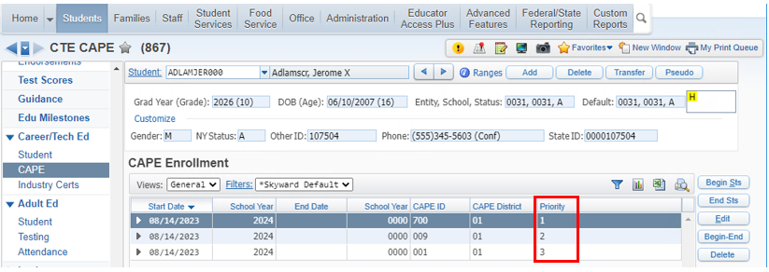
Extract CAPE IDs
If there are multiple CAPE records, the record with priority 1 pulls as CAPE ID, First. The record with priority 2 now pulls as CAPE ID, Second.
Web Student Management > Students > Student Profile > Career/Tech Ed > CAPE
Notes:
PR 5565221 - The Surveys Fed/State Indicator was also updated to properly pull the CAPE ID 1 and 2 values by priority set when there are more than 2 CTE CAPE records that start on the same date.

Slide 19
FLEID Export
Any record with a change that you do not want to send needs to be marked as ‘Set as No Change’.
Date Range can be set up to view changes.
Even though Surveys no longer collect/send Alias IDs, the FLEID Vault still collects the data
Web Student Management > Fed/State Reporting > Florida > Other Exports > FL ED ID
Notes:
5377146 The FLEID Export’s Other Corrections file was updated to not include records with a Change Type of No Change. The View Students with Name Changes screen now has a Date Changed range option above the browse to increase program loading times. Additionally, the Set as No Change option will now update records for Other Correction fields, such as the FLEID and Birthdate. Previously, the option would not allow users to change from Correction to No Change for the Other Corrections view.

Slide 20
FTE Claim File
A filter can be used to display only those records with District of Instruction as your district.
The shared district column populates on import to indicate other districts also claiming the student.
Web Student Management > Fed/State Reporting > Florida > Other Exports > FTE Claim File
Notes:
PR 5033808 - A “Shared District” column was added to the FTE Claim File Maintain screen and will be populated on import to indicate the other districts also claiming the student. The match will be based on Last Name, First Name, FLEID, and Date of Birth.

Slide 21
Updates for the incoming 9th graders beginning with the 2024 school year:
Graduation Requirement Plans
Clone your current grad requirement plan (district level) to create a new plan starting with grad year 2027
Add a new area (from the total line) for Personal Financial Literacy
Add Curriculum keys to course work areas for any changes for the new year (new courses, CTE courses etc)
Endorsements
End the Merit Scholar Designation as of 2026
PR 5601101 – Import Industry Scholar Diploma Designation – starts with grad year 2027
Graduation Requirements / Endorsements
Web Student Management > Office > Curriculum & Assessments > Graduations Requirements
Notes:
PR 5601101 – estimated date 2/1/2024 so it will be available early spring

Slide 22
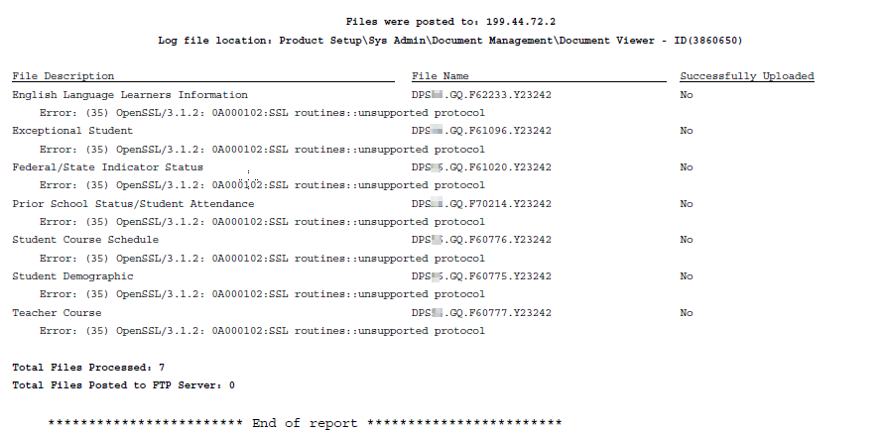
FTP Connection Troubleshooting
Error (35) OpenSSL/3.1.2: 0A000102.SSL routines: unsupported protocol
Web Student Management > Fed/State Reporting > Florida > Setup > Configuration
Notes:
We have seen a lot of service recently and they are receiving this error – for any FTP connection to NWRDC

Slide 23
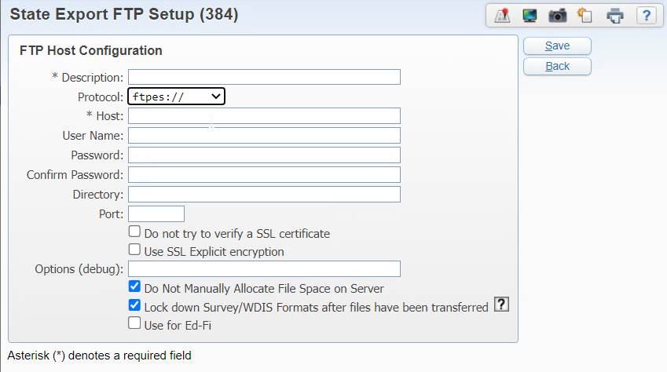
FTP
Connection Troubleshooting
Port – Typically, this field is left blank.
When blank, the Port will default based on the protocol selected. Example: for ftp/ftpes, the port will be defaulted to “21”. Sftp, defaults as “22”.
**For ftp/ftpes, if the transfer is not successful, try entering port 1990.
Web Student Management > Fed/State Reporting > Florida > Setup > Configuration
Notes:
Port – Typically, this field is left blank. When blank, the Port will default based on the protocol selected. Example: for ftp/ftpes, the port will be defaulted to “21”. Sftp, defaults as “22”. **For ftp/ftpes, if the transfer is not successful, try entering port 1990.

Slide 24
Upcoming Updates
PR 5599360 - 2024 FASTER Cutover Changes
PR 5576597 - Add Students to Extracted Survey Data to log
PR 5561953 - Update NAEP Other Export so it can be used with TUDA Reporting
Notes:
FASTER – 12/21/23
Survey Data to log – NA – not sure
NAEP – Other Exports: 4/11/24 –National Assessment of Educational Progress Is submitted by the state for districts. TUDA is the Trial Urban Districts Assessments that is voluntary so districts must submit directly.

Slide 25
Edits Documentation Did you know…
This area is great for verifying FISH data and error resolution
Web Student Management > Fed/State Reporting > Florida > Setup > Configuration
Notes:
Navigate to District State Reporting Configuration in the 000 entity. Open up the Room Resources. Then look at the building and room that are associated with the two courses. If the courses have the same FISH values on them, that is why they are calculating together. One of these will need to be changed.
The building and room are in the creation of the FISH number. However, for the Class Size report in Skyward it is built strictly off data from the Survey Maintain. (Course Number, Section, Period, Term, and School Number Current Instruction) Student Course/Teacher Course. So the issue that you were receiving was due to the Student Course Schedule records extracted for Course 5010041/001 that have identical key fields. However, the teacher course records that are reported should have the FISH number which should be different because the buildings and rooms are different.
Ensure that the FISH information is unique for each Teacher Course record.

Slide 26
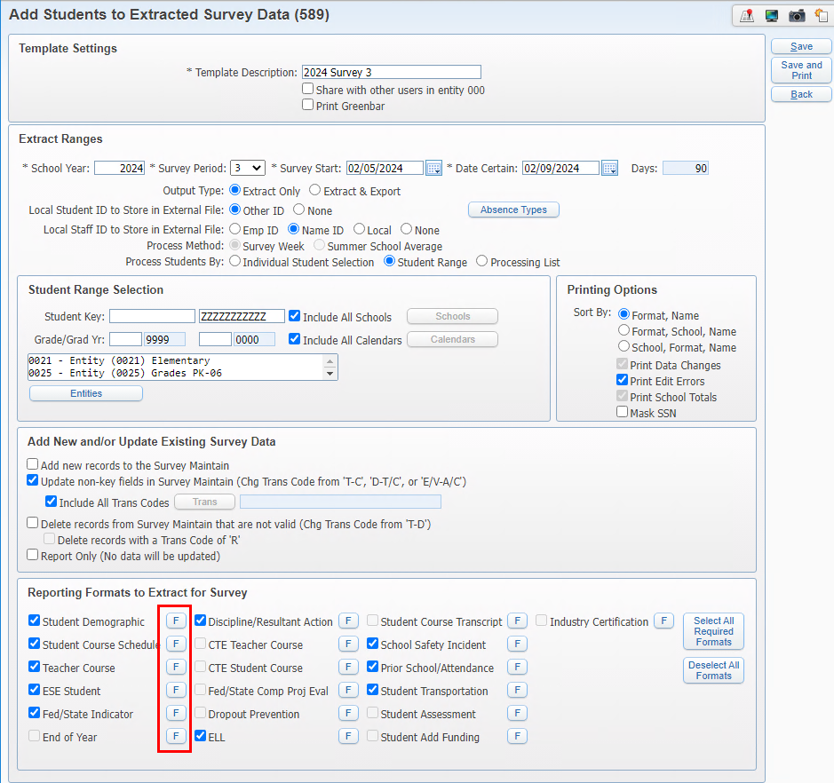
Add Students to Extracted Survey Data
Web Student Management > Fed/State Reporting > Florida > Surveys > Extract
Notes:
The Field option is available when the Update is the only option selected.
Allows you to update specific fields instead of updating the whole format such as the FLEID.
This would be used if you want only the FLEID updated but you do not want to re-extract other data for that format.

Slide 27
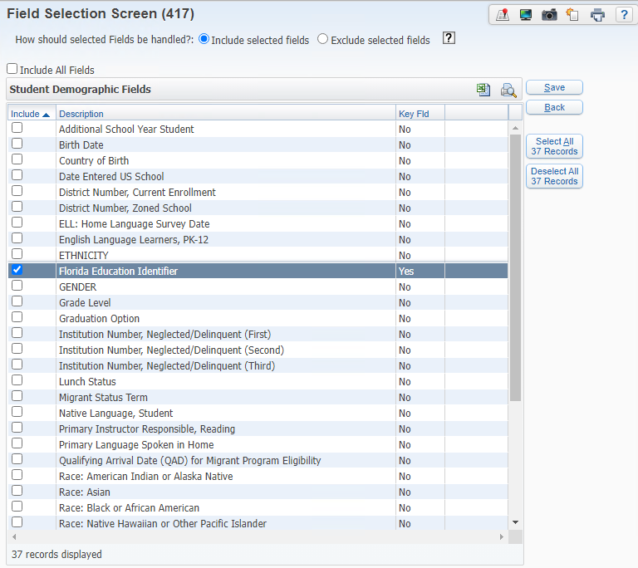
Add Students to Extracted Survey Data
Web Student Management > Fed/State Reporting > Florida > Surveys > Extract
Notes:
You can select one or more fields to update
Use either the include or exclude option.
An example is when the FLEID is updated but you don’t want to re-extract all the data, just update the FLEID

Slide 28
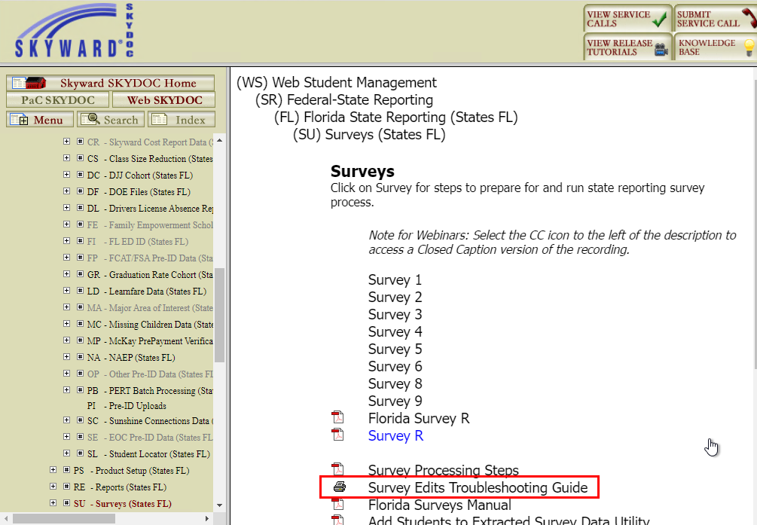
Edits Documentation
Notes:
Reminders
This can assist you in where to start trouble-shooting your edits.

Slide 29
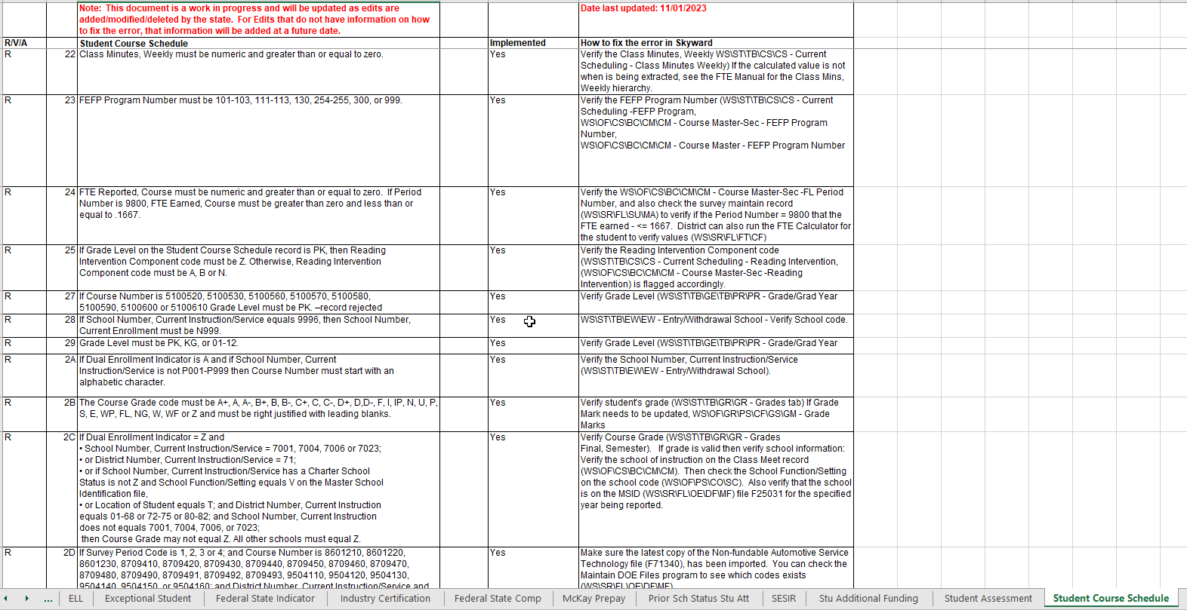
Edits Documentation
Notes:
Reminders
This document is a work in progress. If there are edit changes, the edit is updated and the information about where to start looking will also be updated.
The top row shows the date the page was last updated. This is per tab.

Slide 30
Questions

Slide 31
Thank You!

Slide 32
Survey Processing Reminders
Make corrections in source and re-extract or use the Add Students to Extracted Survey Data
Import DOE Files used for data validations
Verify FTE by running the FTE Calculator and/or FTE Debug
Verify Survey Period Setup dates
Verify Calendar Setup
Verify Student E/W dates and default entity
Verify Scheduling Transactions

Slide 33
Steps for troubleshooting FTE
Which State Reporting Configuration
Run FTE Calculator
FTE Debug Report
FTE Eligible fields
Calendars, Bells, E/W and Transaction dates
Notes:
Reminder: This config is district wide:
Average Over the Entire Semester: This would be used when you have classes that only meet for terms.
If the option is selected in the Scheduling Entity Year Setup > Scheduling Options (WS\OF\CS\PS\CF) to Report Term 6/7/8/9 courses in Survey 2 or 3 then those courses will also be included when processing Surveys and FTE.
The system will add up the total minutes that class met and averages the minutes for the entire semester.
The semester is based off the control sets
If this option is selected and you have some entities that are M-F “normal” then the Class Minutes Weekly should calculate the same as option 1. (Assuming that the class meets the same amount of minutes each week).

Slide 34
Steps for troubleshooting FTE
Product Setup > Skyward Contact Access > District > District Configuration > State Reporting Configuration
Survey Week only for Weekday entities; two week average for Day Rotation entities:
Average Over the Entire Semester
Survey Week for both Day Rotation and Weekday Entities:
Notes:
Reminder: This config is district wide:
Average Over the Entire Semester: This would be used when you have classes that only meet for terms.
If the option is selected in the Scheduling Entity Year Setup > Scheduling Options (WS\OF\CS\PS\CF) to Report Term 6/7/8/9 courses in Survey 2 or 3 then those courses will also be included when processing Surveys and FTE.
The system will add up the total minutes that class met and averages the minutes for the entire semester.
The semester is based off the control sets
If this option is selected and you have some entities that are M-F “normal” then the Class Minutes Weekly should calculate the same as option 1. (Assuming that the class meets the same amount of minutes each week).

Slide 35
FTE Calculator
Class Minutes Weekly:
Class Minutes from Student Class Override
Class Minutes from Course Section
Class Times for the Course based on the following:
Pull-Out Records
“Use Class Meeting Time Override” is selected on Course Section
Course Section: Bell
If no Bell Schedule is setup on the Course Section, then the Bell setup for each Calendar Day

Slide 36
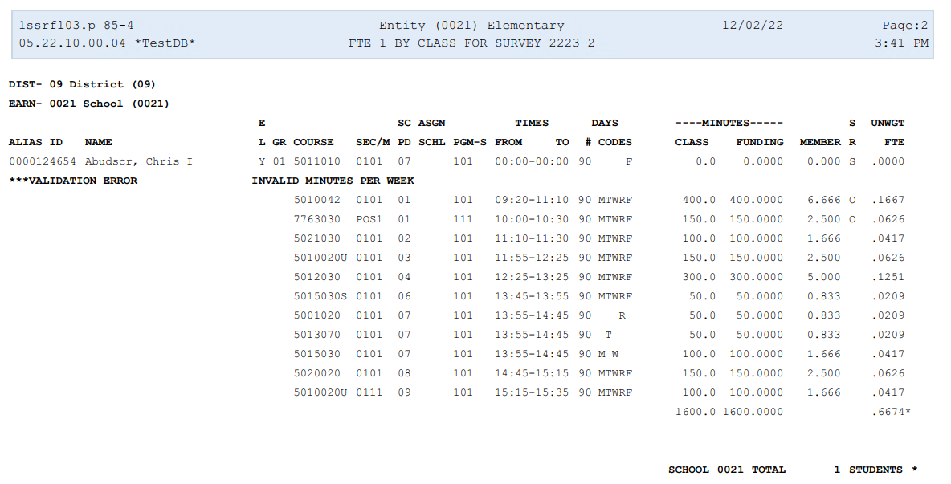
FTE Calculator
O = Minutes were adjusted due to overlapping class times
S = Class Meeting Time override
Notes:
Import Column is SR. = O and S. O means minutes were adjusted due to overlapping class times.
S means class meeting time overrides is being used.
**Very important: The FTE Calc /system cannot handle and will not properly calculate mins and FTE if there is more than 2 overlapping courses.
-Look at this report and start by looking at the period numbers. Then the class times and then what days the course is meeting.
Invalid Minutes: Also check for courses that are getting zero minutes. Check the class meet override . Lot of times we see districts that have this set with 1200 – 1200 which is the default override times. They either didn’t update it or the section really should not be flagged to use Class Meeting override.
-If it is not an Class Meeting Time override, then the first step would be to reviewing the hierarchy

Slide 37
FTE Debug
Product Setup > Skyward Contact Access > Tools > Fix Programs > Program: zfxfledit038.w
Notes:
Plan to show the detail from an example here. If your district does not have this listed.

Slide 38
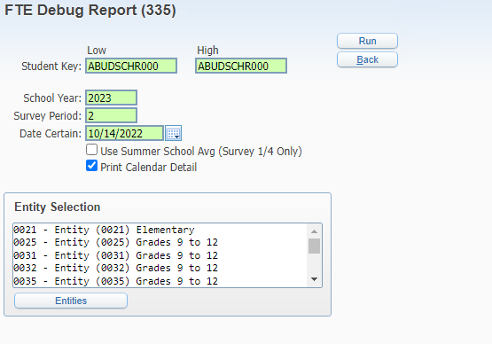
Product Setup > Skyward Contact Access > Tools > Fix Programs > Program: zfxfledit038.w
Highlight the program and Click Run
FTE Debug

Slide 39
FTE Debug

Slide 40
FTE Debug

Slide 41
FTE Eligible flags
Notes:
Check FTE Flags on both FTE & Diploma screen and Class Record.
Reminder: This flag is used to determine if the students courses should all report as zero FFTE and FEFP 999. If the was not in attendance during 11-day Survey window.
Also check if the course and student class level is flagged as FTE Eligible

Slide 42
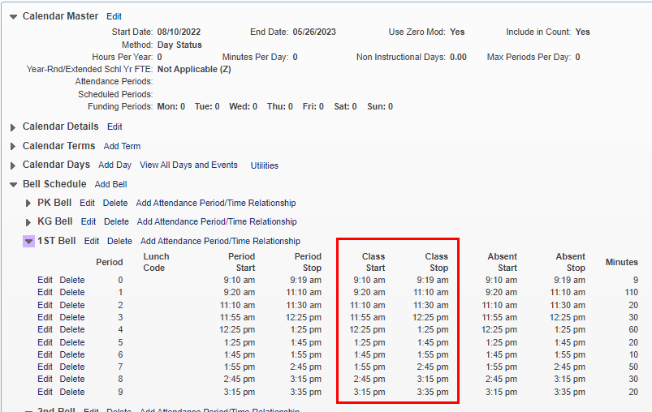
Calendar/Bell
Notes:
FL state reporting will pull always pull from the Class Start and Stop times. Not the Period Start/Stop Times

Slide 43
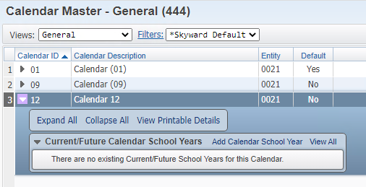
Calendar/Bell
Notes:
Ensuring correct calendar is set on the course. We have seen many of times where a non default calendar was selected but the calendar school year was not created.

Slide 44
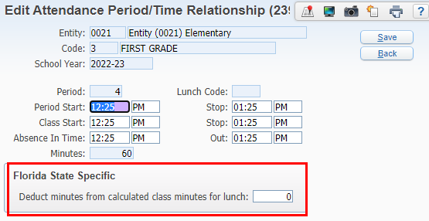
Calendar/Bell
Notes:
Florida State Specific:
This would be typically only be used for those class periods where they break for lunch in the middle of their class period. The amount of minutes entered here will be deducted from the overall minutes from the course.- period.

Slide 45
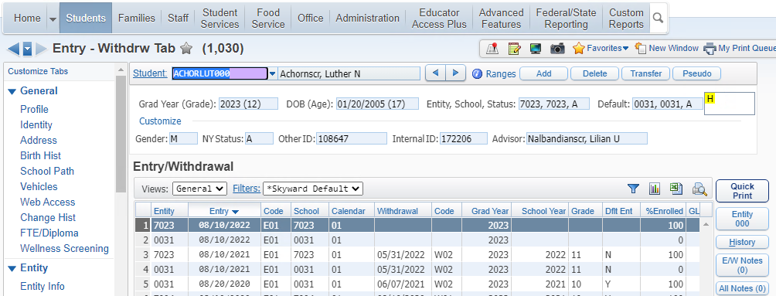
E/W Dates
Notes:
Reminders:
Record must be active as of Date Certain,
If there are multiple enrollments, and are overlapping records, only one can be flagged as default

Slide 46
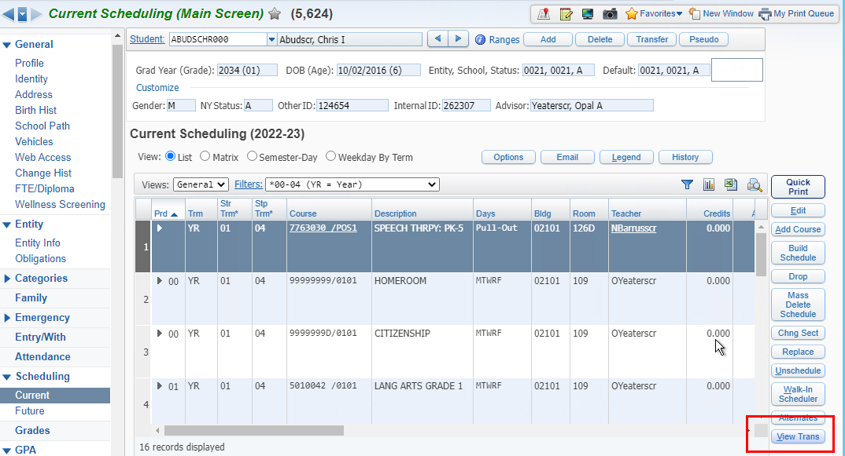
Class Transactions Dates
Notes:
Reminders:
Class Transaction: Remember the Effective Date is what is used to determine if that class is active over Date Certain.
We do find that a lot of users are deleting transaction records which can cause issues for reporting Class Mins.

