Slide 1
New Features
Florida User Group 2023 – 2024

Slide 2
Agenda
Name, AKA field for Custom Forms
Preferred Language Added for Family Access
Incident values will auto update from Offense
ESE Fields added to Data Mining, including Eligibility Determination Date
Modernization of the Skyward Mobile App
Mass Delete Portfolio Name File Associated
Security Notifications
Mass Delete Provider Information
Add Skycoder to EA+
Create a Status Field for Bell Schedules

Slide 3
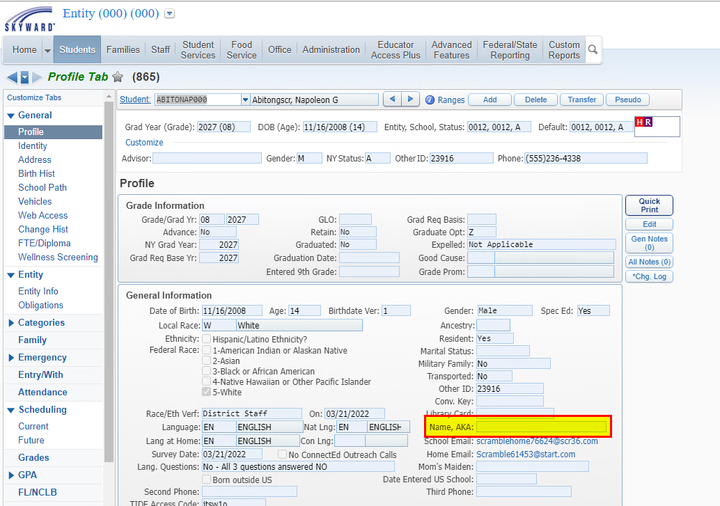
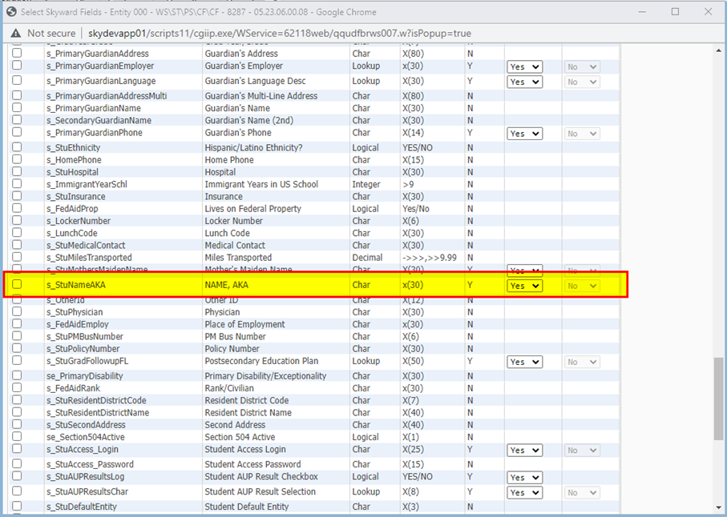
Name, AKA field for Custom Forms

Slide 4
  Add Preferred Languages for Family Communication to Family Access modules:
    New Student Online Enrollment
    Online Registration
    Student Info (Pseudo Changes)
    Custom Forms
  Add Preferred Languages for Family Communication to Data Mining
  Add existing Student Profile Language fields to Family Access Online Forms
    Add Student Home Language to Online Registration
    Add Student Home Language to Student Info (Pseudo Changes)
    Add Student Home Language and Student Native Language to Custom Student Forms
Preferred Language Added for Family Access

Slide 5
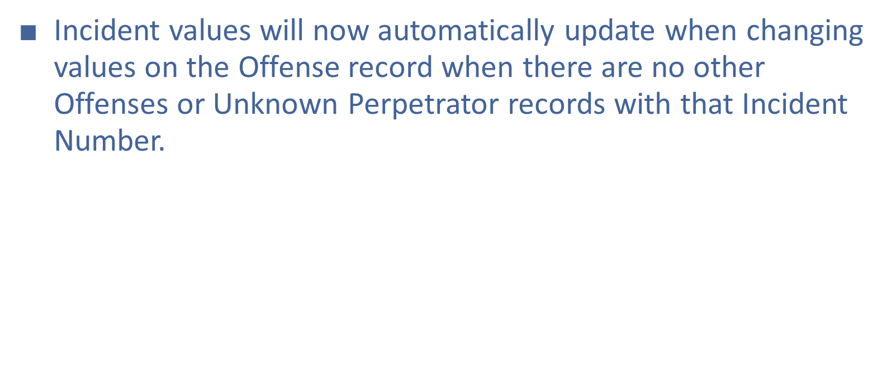
Incident values will auto update from Offense

Slide 6
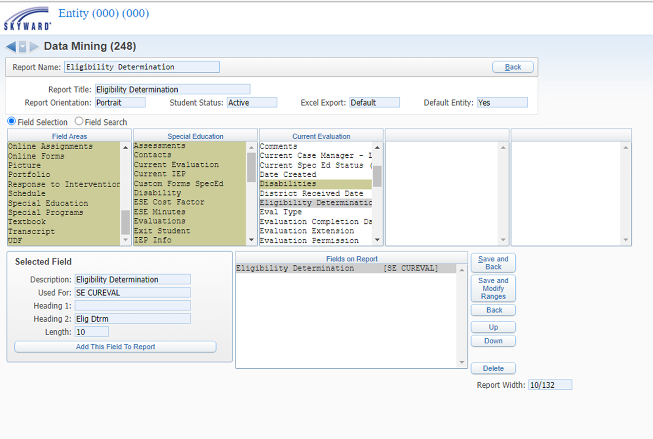
ESE Fields added to Data Mining,
including
Eligibility Determination Date

Slide 7
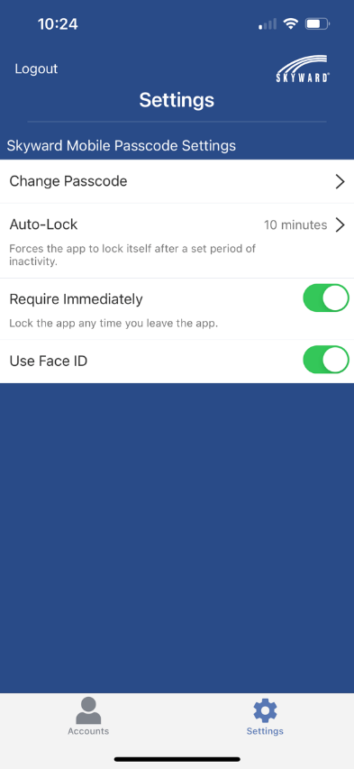
Modernization of
the Skyward
Mobile App
Single Sign On (SSO) for SMS.
Ability to change a password within the app.
Ability to set up and send push notifications from message center.
New Validation for PIN.
Improved Account set up experience.
Improved navigation and labels.
Improved performance.

Slide 8
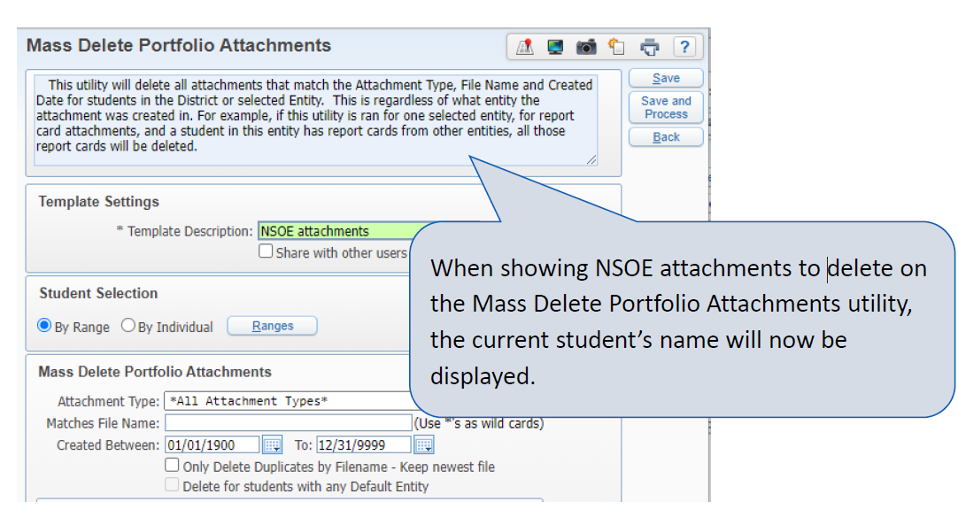
Mass Delete Portfolio
Name File Associated
WS\ST\ PS\UT\PA

Slide 9
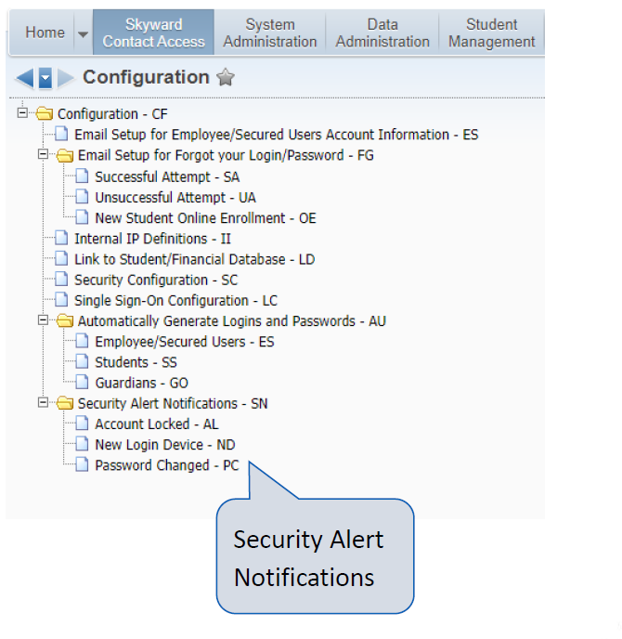
Security
Notifications
• Enable New Login Device and Password Changed email
• Send alert with new device add or password change
• Security emails new device sent for failed logins
PS\CA\SE\PS\CF\SN

Slide 10
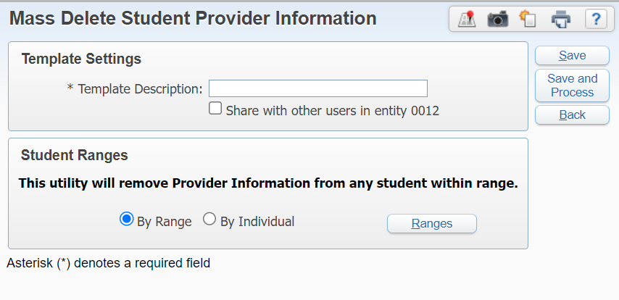
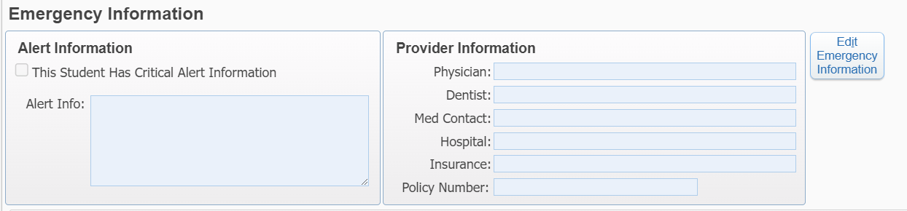
Mass Delete Provider
information
WS\ST\PS\UT\PR

Slide 11
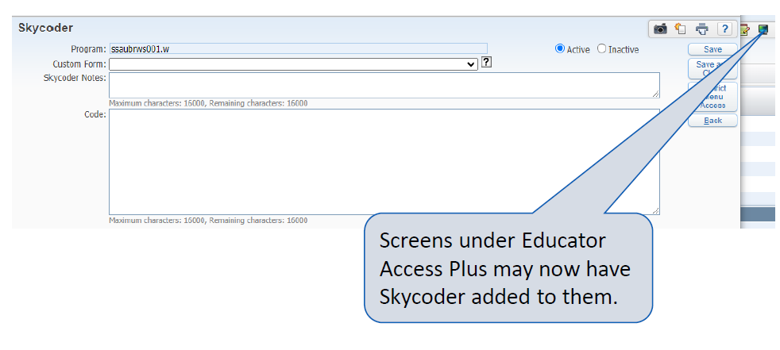
Add
Skycoder to
Educator Access Plus

Slide 12
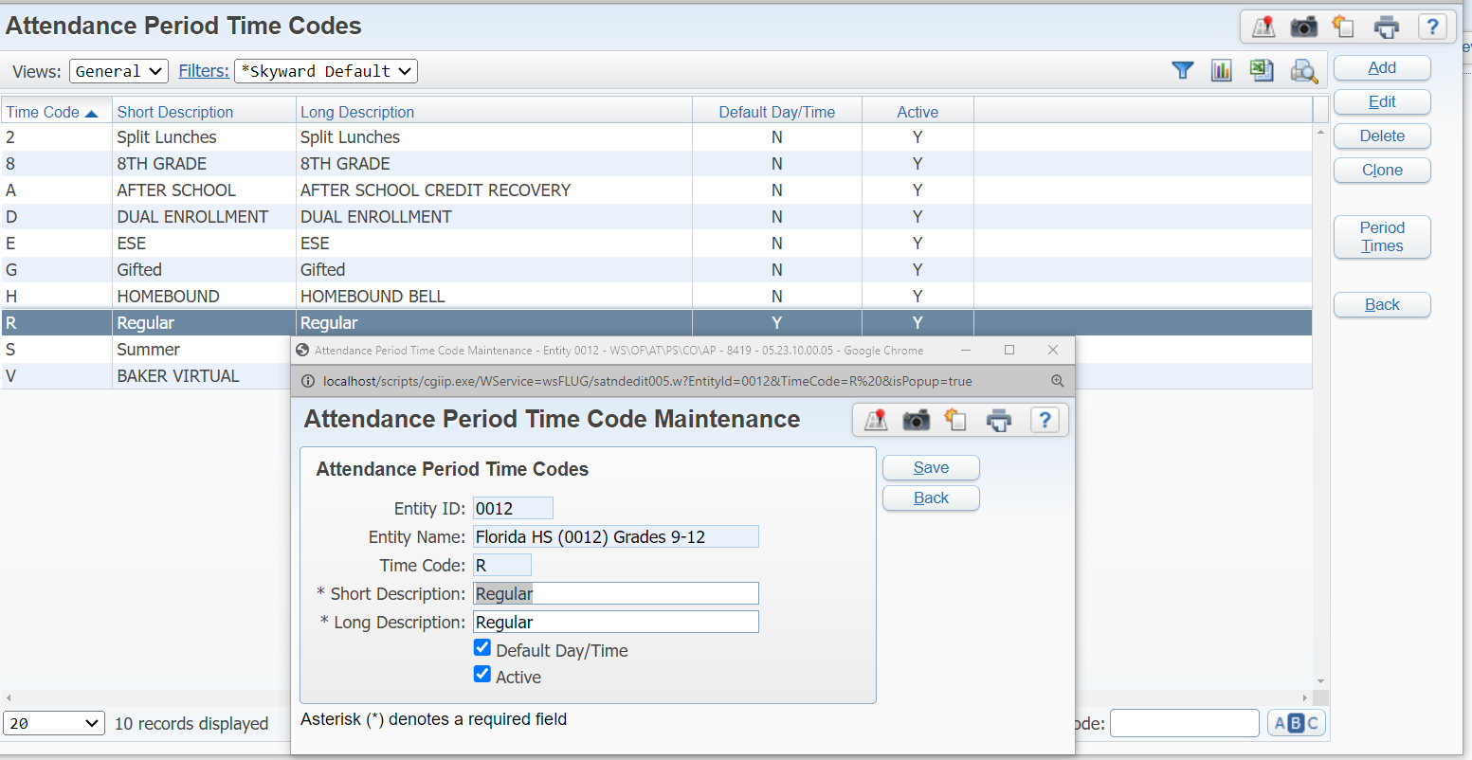
Create a Status field
for Bell Schedules
WS\OF\AT\PS\CO\AP

Slide 13
Questions

