Slide 1
SESIR/Discipline Reporting
Florida User Group 2023 – 2024

Slide 2
Agenda
2023-2024 Reminders
Recent state updates
SESIR data entry for HOPE Scholarship Notifications
Troubleshooting pointers
Upcoming updates

Slide 3
Recent Updates
PR 5555800 – Add HSN check box to Offense codes
PR 5554100 – Update Discipline Resultant/Action to pull if incident occurs prior to start of school year
PR 5536472 - Florida 2023-24 School Year Updates Surveys 2-5
Notes:
5555800 – this added a check box for Hope Scholarship Notification to the Offense Codes.
5554100 – this was added to match what we do for the Incident. This is to allow records that occur within the reporting year but could occur prior to the first day of school. Such as during Teacher Workshop days
5536472 – This added the new Hope Scholarship Notification data element, Discipline Action codes were updated, and Incident type codes were updated, along with SESIR and Discipline Resultant Action edit updates .

Slide 4
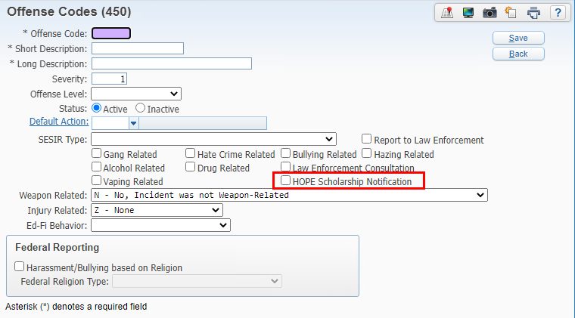
Offense Code Setup
WEB STUDENT MANAGEMENT > OFFICE > DISCIPLINE > SETUP > CODES > OFFENSE CODES
Notes:
The HOPE Scholarship Notification checkbox was added to the Offense codes. This allows a district to create any ‘local’ code to identify as a Hope scholarship notification. There are only certain state codes that allow the notifications to be reported on the incident :“BAT, BUL, FIT, HAR, HAZ, KID, PHA, ROB, SXA, SXB, SXH, SXO, TRE, UBL, UHR, USA, USB”. Districts should not set the flag on these offense codes as that will default the box as checked on every offense when the code is added and districts would need to remember to uncheck the notification if one was not given out to the student on that offense. Rather it should only be set on the local codes being used by the district to track notifications being given out. At this point the state is not tracking who the notification was given out to but rather the number of notifications given out for a given incident number. Local codes can be used and do not need to be tied to a SESIR Type. The SESIR Type of “HSN” will be allowed even though it technically ended in 2023 but districts will need to be careful not to transfer that to the Incident record to avoid getting SESIR Edit errors. Districts will need to ensure that a valid primary offense is valid for reporting the notifications. Skyward edits will be produced if the notifications are greater that 0 where the primary offense is not one of the required SESIR codes.
The SESIR Type of “HSN” will be allowed even though it technically ended in 2023 but districts will need to be careful not to transfer that to the Incident record to avoid getting SESIR Edit errors.

Slide 5
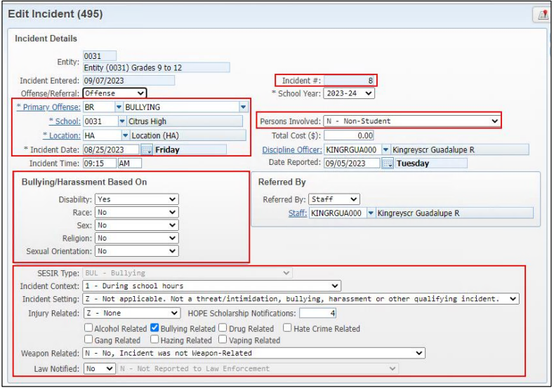
INCIDENT Fields for HOPE Scholarship Notifications
WEB STUDENT MANAGEMENT > OFFICE > DISCIPLINE > ENTRY BY INCIDENT
Notes:
The fields on the incident are an accumulation of values from all existing offense records tied to the same incident number.
Fields display based on the primary offense, for example if the offense is bullying, then the bullying/harassment based on fields display
The HOPE Scholarship Notifications field will auto-populate based on the number of notifications tied to all offense, victim, unknown perpetrator records tied to the incident however, this field can be manually updated as well.

Slide 6
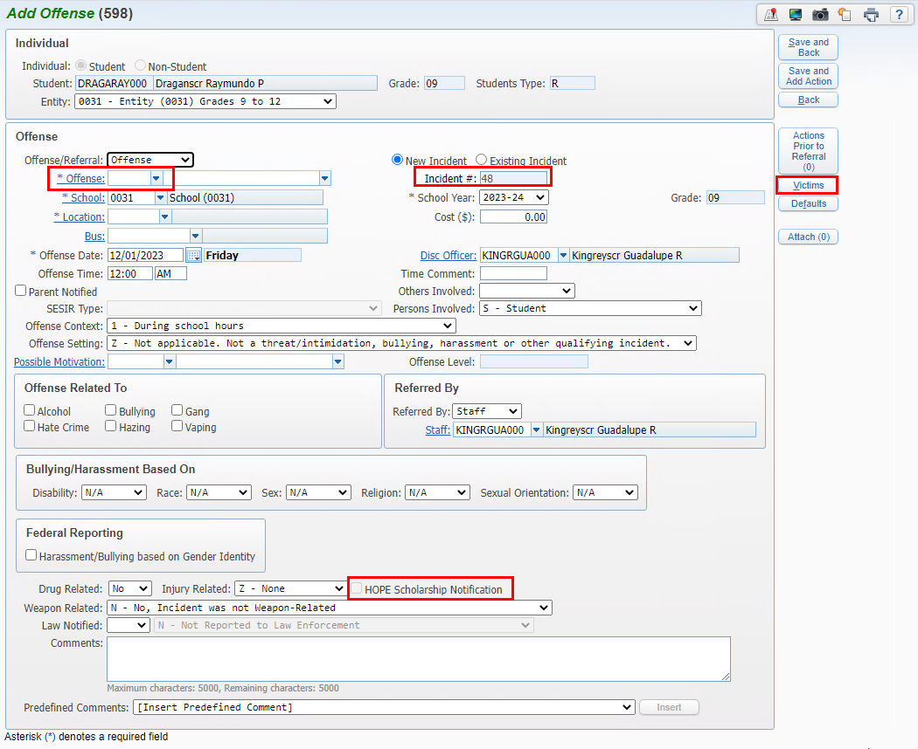
OFFENSE Fields for HOPE Scholarship Notifications
WEB STUDENT MANAGEMENT > OFFICE > DISCIPLINE > ENTRY BY STUDENT
WEB STUDENT MANAGEMENT > STUDENT > STUDENT PROFILE > DISCIPLINE
Notes:
The fields on the Offense can be updated to the incident when saving the record
HOPE Scholarship will only be available to select if the Offense code is one of the state codes indicated on the data element OR if the selected code has the HOPE Scholarship notification checked on the code setup which will automatically default as checked on the offense when the code is selected.
HOPE notifications can also be set on the victim screen tied to an offense.

Slide 7
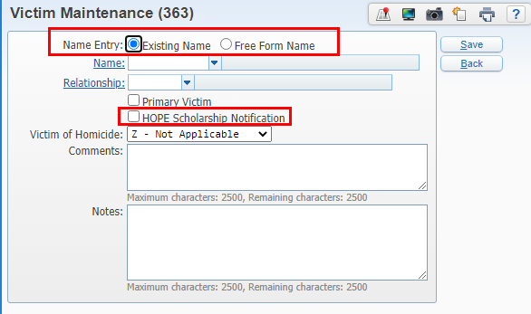
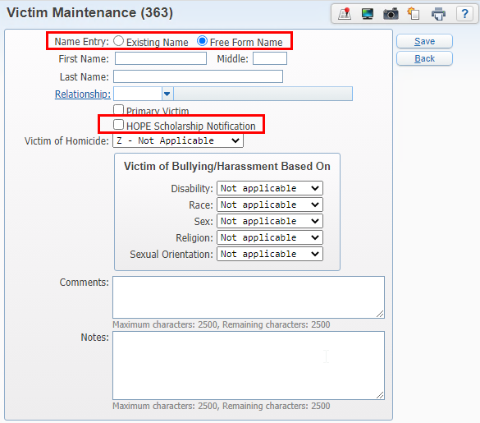
VICTIM Fields for HOPE Scholarship Notifications
WEB STUDENT MANAGEMENT > OFFICE > DISCIPLINE > ENTRY BY STUDENT > OFFENSE RECORD > VICTIM
Notes:
The victim screen can also be used to track Hope Scholarship Notifications
Districts that want to use this option but not indicate the actual student name can use Free Form but you will need to create unique names such as NA for last name/NA for first name, then next time NA1, NA2 etc. if you are adding multiple victim records to this same offense record.
Other options on the Victim screen will need to be populated for this victim based on the type of offense code used on the offense.

Slide 8
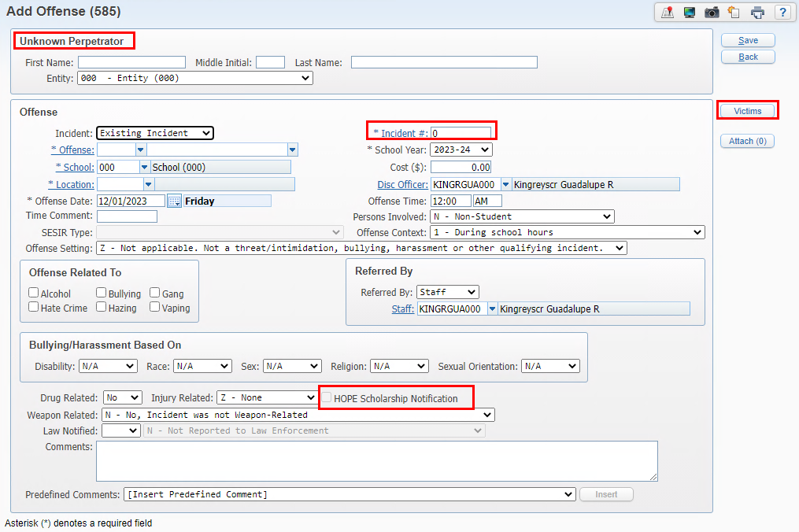
Unknown Perpetrator State Reporting Fields
WEB STUDENT MANAGEMENT > OFFICE > DISCIPLINE > UNKNOWN PERPETRATOR
Notes:
The Unknown Perpetrator screen can also be used to indicate HOPE Scholarship Notifications.
Make sure to indicate it as an Existing Incident.
The Hope Scholarship Notification field will be available based on the Offense code entered.
If there is a true Unknown Perpetrator record that has a victim – the unknown perpetrator record would not have the HOPE Scholarship Notification checked but the Victim button if being used would.

Slide 9
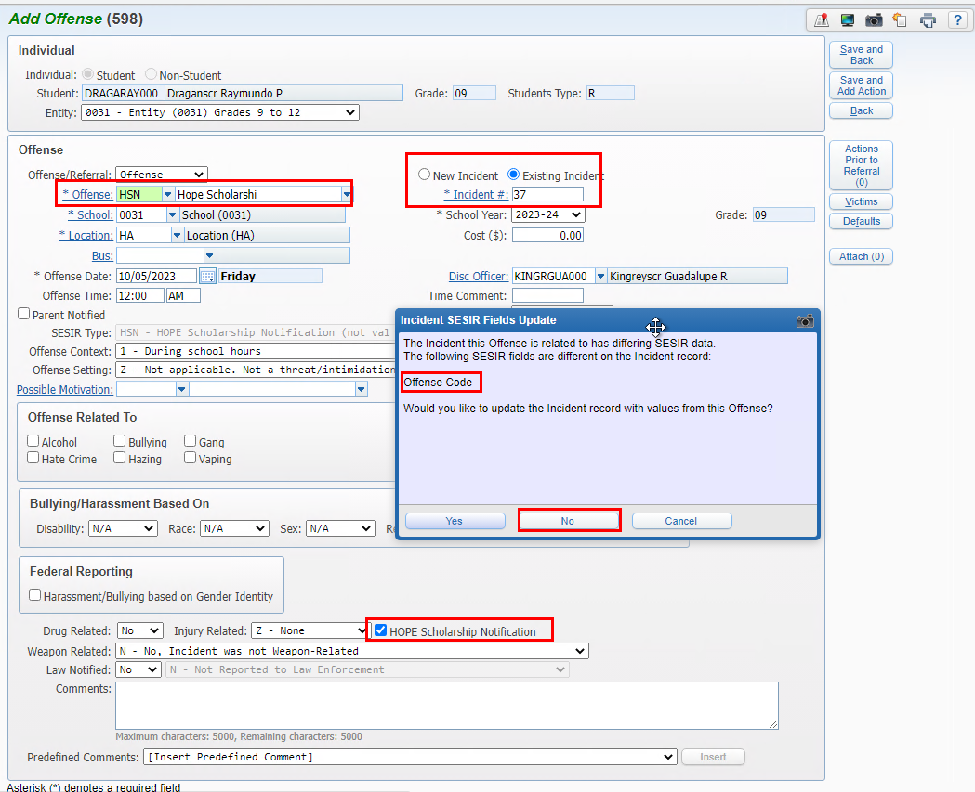
Saving HOPE Notification records
WEB STUDENT MANAGEMENT > OFFICE > DISCIPLINE > ENTRY BY STUDENT
WEB STUDENT MANAGEMENT > STUDENT > STUDENT PROFILE > DISCIPLINE
Notes:
Whether you are creating an Offense or Unknown Perpetrator record to record the HOPE Scholarship Notification, it is very important to read the popup when saving the record.
If the offense on the record is not one of the allowed SESIR codes for notifications and is instead your local code being used to track notifications, then make sure you select NO so that the Incident Primary Offense is not updated with this offense code. If you say yes, you will get edits when processing your survey data.

Slide 10
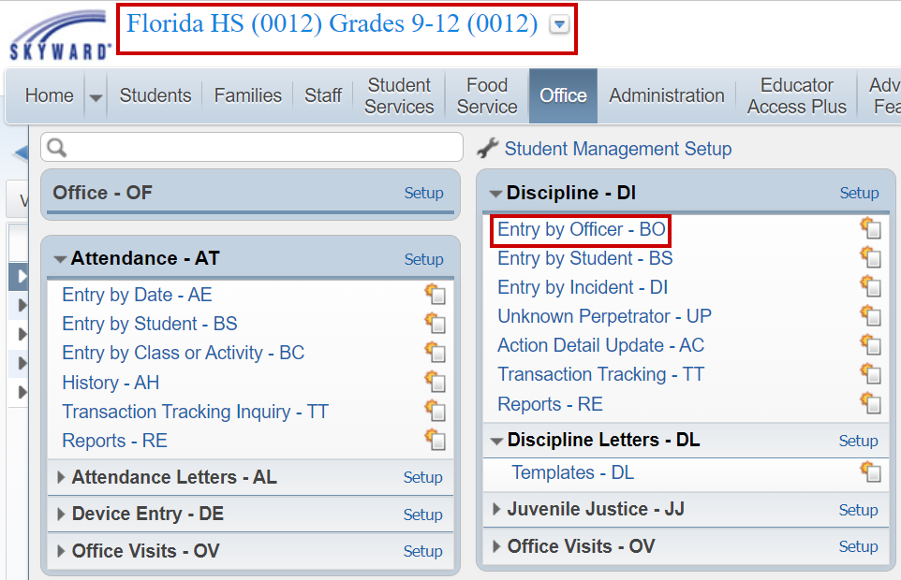
Entry By Officer – Tips and Tricks
WEB STUDENT MANAGEMENT > OFFICE > DISCIPLINE > ENTRY BY OFFICER
Notes:
This is entity specific. Using different view, filters and functions, this area is used by an individual that is identified as a Discipline Officer in Skyward to view, maintain and enter in discipline offenses and actions.

Slide 11
Entry By Officer – Tips and Tricks
WEB STUDENT MANAGEMENT > OFFICE > DISCIPLINE > ENTRY BY OFFICER
Notes:
This is entity specific. Using different view, filters and functions, this area is used by an individual that is identified as a Discipline Officer in Skyward to view, maintain and enter in discipline offenses and actions.

Slide 12
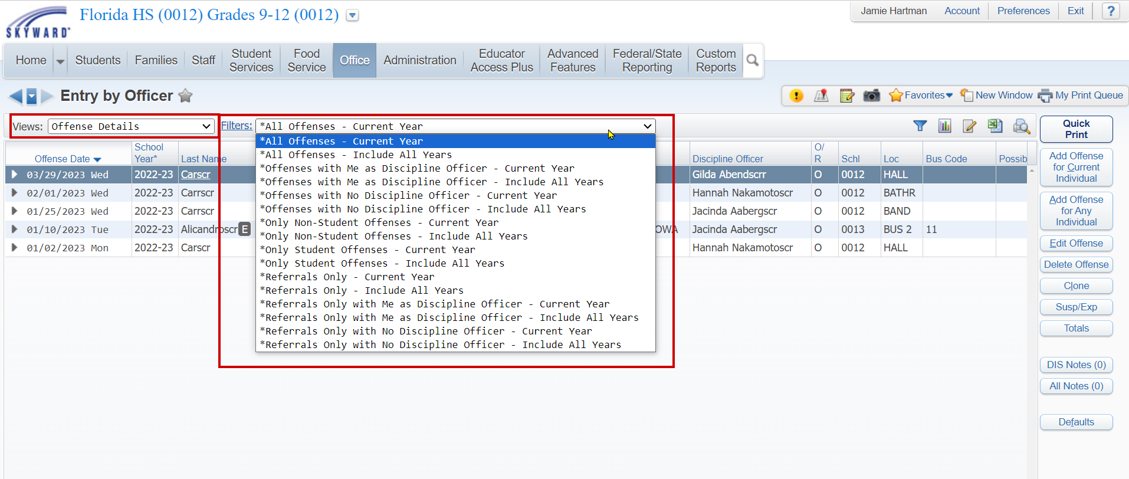
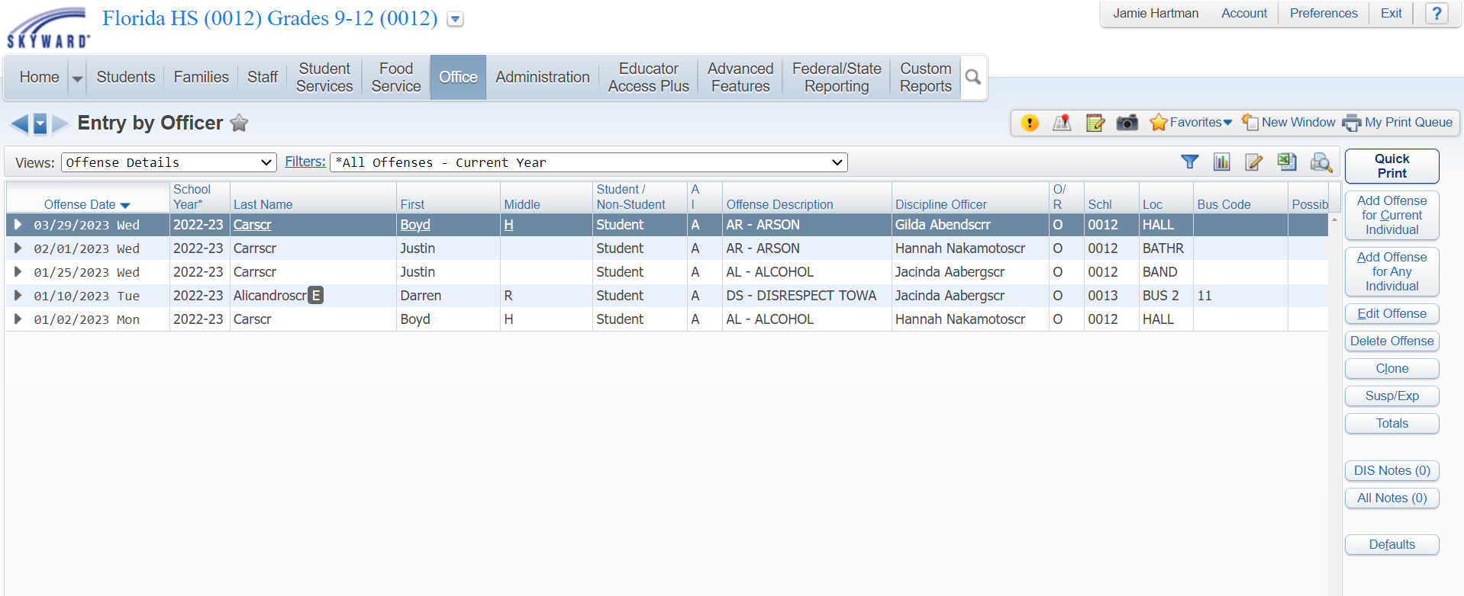
Entry By Officer – Views & Filters
WEB STUDENT MANAGEMENT > OFFICE > DISCIPLINE > ENTRY BY OFFICER
Notes:
Switching the views you have the options to look at offenses, actions and victims. The filters will change based on the view and you can also quick filter, filter dropdown or create your own. Using the views and filters allows you to create “reports” on screen and either, print, export or create processing lists to use with other reports in the system.

Slide 13
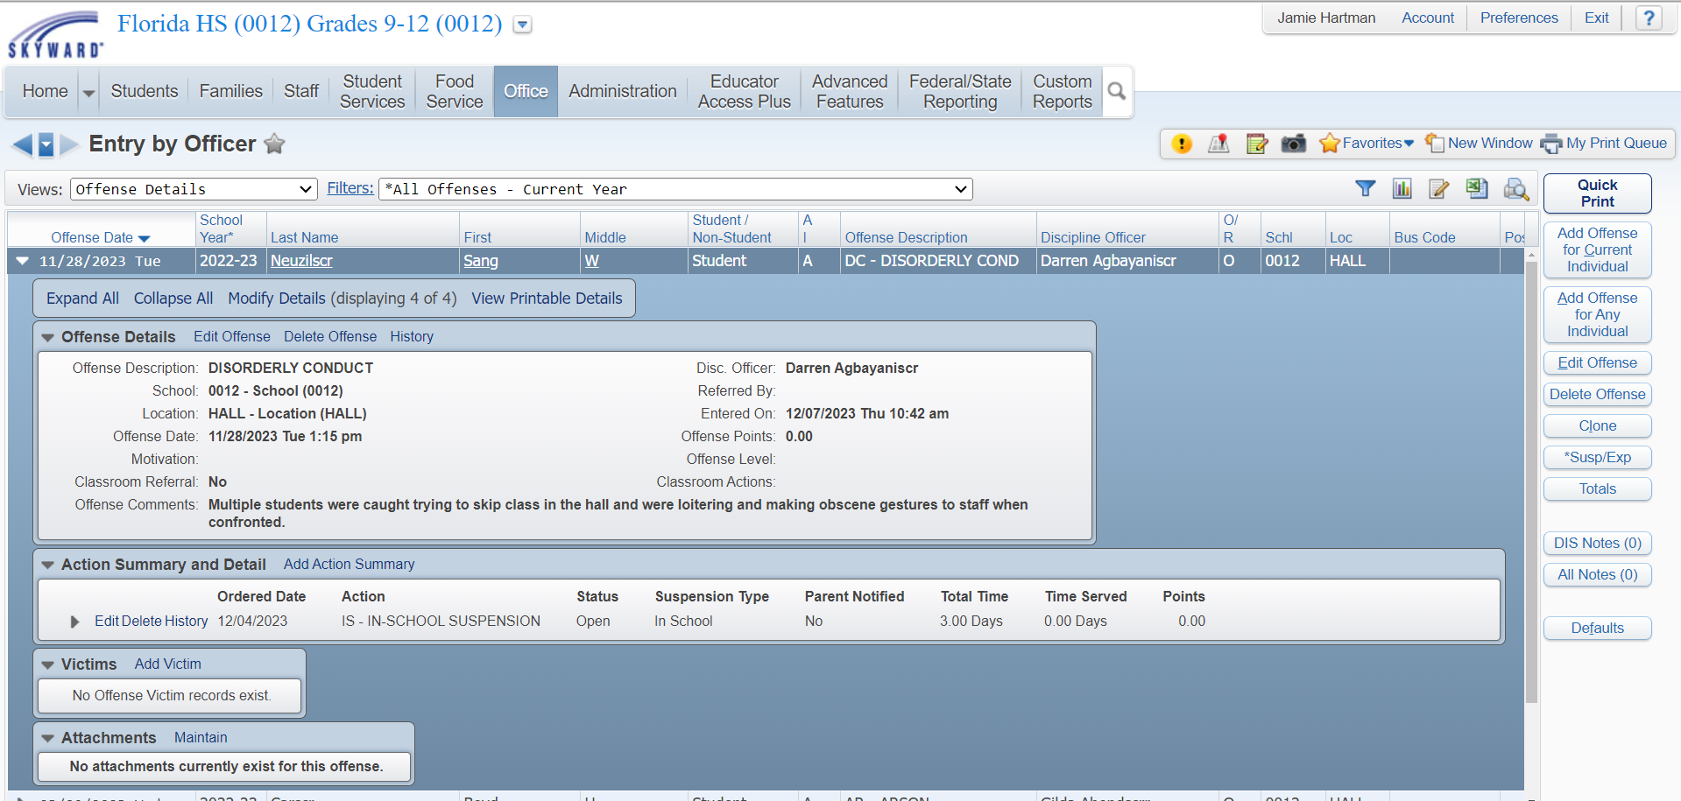
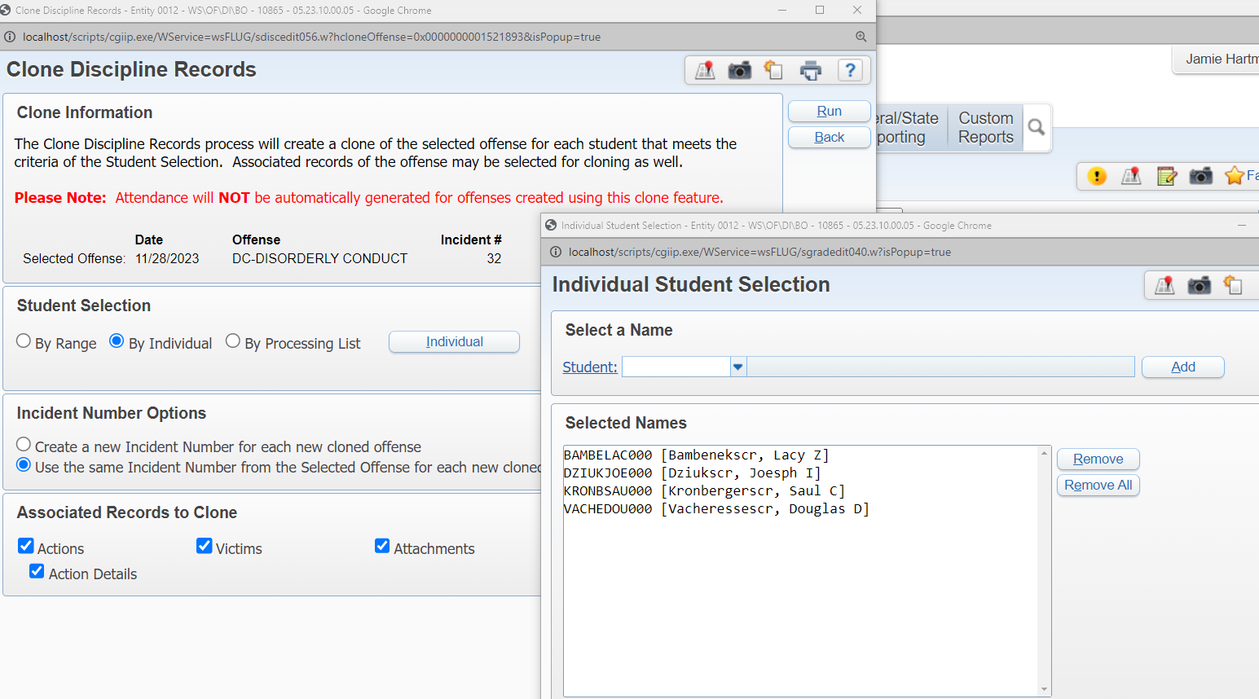
Entry By Officer – Clone
WEB STUDENT MANAGEMENT > OFFICE > DISCIPLINE > ENTRY BY OFFICER

Slide 14
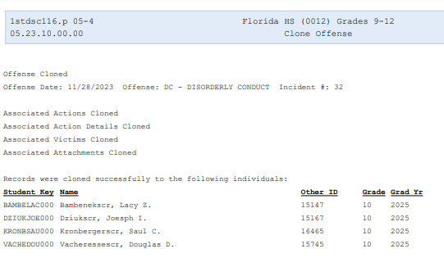
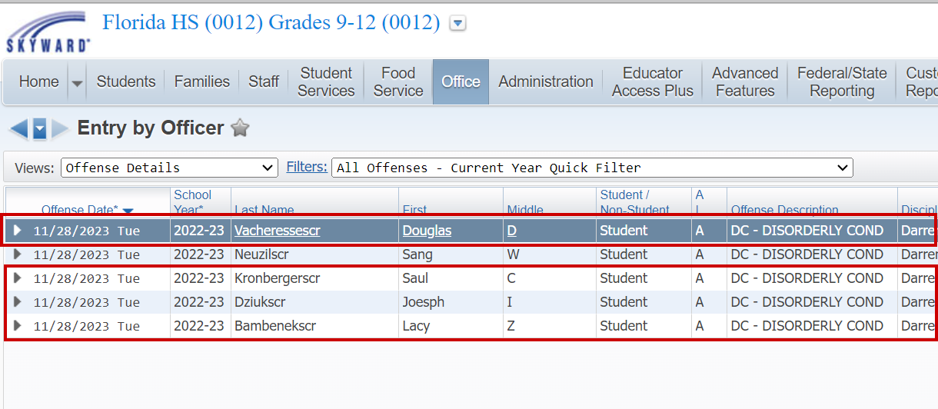
Entry By Officer – Clone
WEB STUDENT MANAGEMENT > OFFICE > DISCIPLINE > ENTRY BY OFFICER

Slide 15
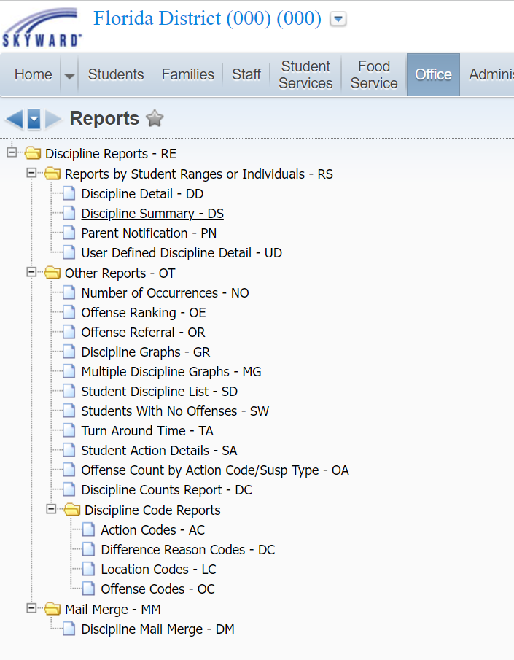
Reports
Most Used Reports
Discipline Detail, Summary & User Defined
Number of Occurrences Report
Discipline Counts
WEB STUDENT MANAGEMENT > OFFICE > DISCIPLINE > REPORTS

Slide 16
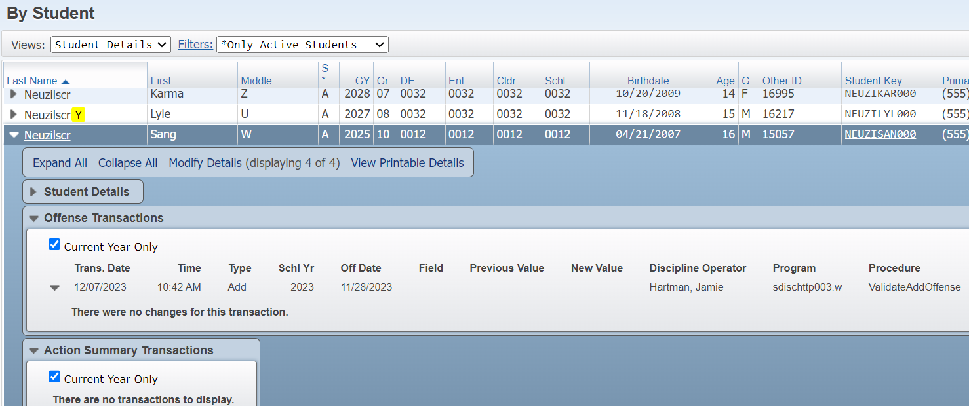
Transaction Tracking-By Student\By Effective Date
WEB STUDENT MANAGEMENT > OFFICE > DISCIPLINE > Transaction Tracking
Notes:
Explain the difference and the IMPORTANCE of Effective Date and how that actually looks at data(timing)

Slide 17
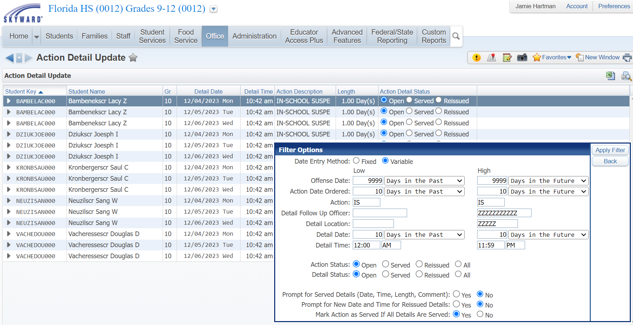
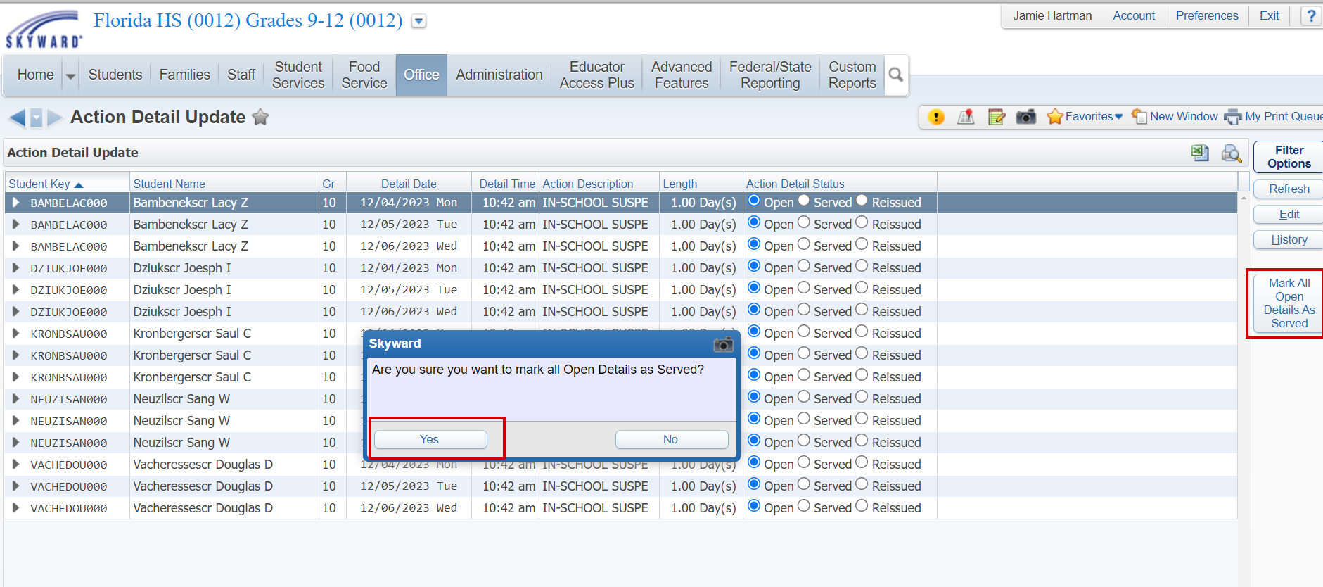
Action Detail Update
WEB STUDENT MANAGEMENT > OFFICE > DISCIPLINE > ACTION DETAIL UPDATE
Notes:
Entity Specific. Filters, Mass Marking Served

Slide 18
Questions

