Slide 1
Gradebooks: From an IT/ Troubleshooting Perspective
Session 3
Liz Kelley – Senior Consultant – Customer Success

Slide 2
Gradebooks: From an IT/
Troubleshooting Perspective
This session will offer troubleshooting strategies that apply specifically to the secondary gradebook. This will include how to resolve situations where grades aren’t calculating as intended as well as how to troubleshoot sync issues with the passback API.
Calculated Grades
Troubleshooting from the gradebook
Reports
Possible Causes
Passback API
Where to look
Possible Solutions

Slide 3
Gradebooks
Calculated Grades – In the Gradebook
Grade Calculation Setup (from within grade bucket column heading)
Weighted Term Grades?
Cumulated Assignment Scores?
Categories
Total Points or Category Weighting?
Weights assigned to categories
Grade Marks
Review the relevant grading scale/grade marks
Posted Grades
Does the student have grade overrides?

Slide 4
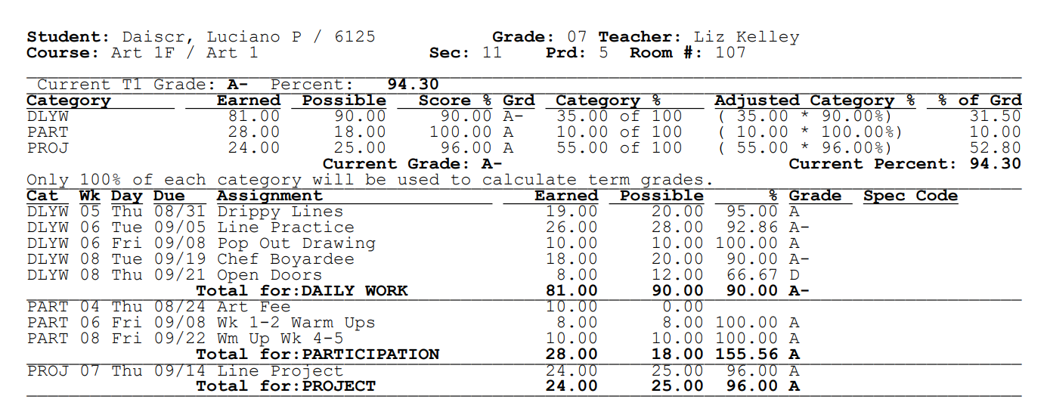
Gradebooks
Calculated Grades – Reports
Progress Detail Report

Slide 5
Gradebooks
Calculated Grades – Possible Causes
For a single student:
Grade Overrides
NEW button

Slide 6
Gradebooks
Calculated Grades – Possible Causes
At the gradebook level:
Category Weighting vs Total Points
Categories not weighted as intended
Or set up differently for each grading period
Categories without assignments > redistributed weighting
Assignment(s) weighted incorrectly
Grade period start date override for gradebook/term
Semester/Final Formulas
Grade differences in gradebook vs Family/Student Access?

Slide 7
Gradebooks
Calculated Grades – Possible Causes
At the entity level:
Category Weighting vs Total Points
Categories not weighted as intended
Or set up differently for each grading period
Limiting categories or terms to 100% when calculating grades
Using rounded percentages when calculating grades
Semester/Final Default Formulas
Minimum Failing Percent
Minimum Failing Grade Override

Slide 8
Gradebooks
Calculated Grades – Solutions
Still an open grading period?
Have grades been posted?

Slide 9
Gradebooks
Passback API – What is it?
Sync assignments and assignment scores from third-party gradebooks back to the corresponding Skyward gradebooks.
Terminology:
LMS API
OneRoster API
Read-Only API vs Passback API
LMS API uses:
Assignments
Assignment Scores
OneRoster API uses:
Line Items
Results

Slide 10
Gradebooks
Passback API – What can it do?
Assignment records can sync:
Title
Description
Due date
Points possible
Category
Assignment Score records can sync:
Points earned
Missing flag
No Count flag
Comment
Special code

Slide 11
Gradebooks
Passback API – Best Practices
Teachers should maintain grades in a single gradebook, not both at once
Values in the Skyward gradebook will be overwritten with subsequent syncs
1:1 setup between Skyward gradebook and third-party gradebook
Skyward should always be the official record
Set up the gradebook the exact same way (categories vs points, etc.)
If you can’t edit the assignment/score in Skyward, you won’t be able to sync to it via the API
Hide calculated grades in third party gradebook to avoid discrepancies

Slide 12
Gradebooks
Passback API – Troubleshooting
Configurations
Overall API Log
API Log from the teacher gradebook (log in as a teacher)
Assignment/Score History

Slide 13
Gradebooks
Passback API – Possible Sync Errors
Assignment due date outside current grading period
Assignment due date outside class start/stop dates
An assignment for this gradebook, title, and due date already exists
Assignment deleted in Skyward gradebook
Assignment category does not exist in Skyward gradebook
Student not enrolled in class on assignment due date
Assignment score is not valid (must be 0-999)

Slide 14
Gradebooks
Passback API – Most Common Issues
Usually caused by differing settings between Skyward gradebook and third-party gradebook
Category Weighting
Semester/Final Formulas
Categories on individual assignments
Less Common:
Gradebooks not connected properly
Teacher has deleted assignments from one program and not the other
Teacher is overwriting their own work

Slide 15
Gradebooks
Questions?

